Slide 2
Goals of the GHTC Program
Proven Technology
Demonstrable
Sustainable
Disaster Resilient
Cost Effective
Fast Construction Process
High Quality of Construction
Suitability to the Diverse Geo Climatic Conditions of India
Meets Stringent Environmental, Societal, Quality and Economic Standards
Building Platforms for Knowledge Sharing
Development of Domestic Technology Research

Slide 3
RCM Group
RCM Prefabs Pvt Ltd, India
Dufabco, Dubai
Dream Trust, India

Slide 4
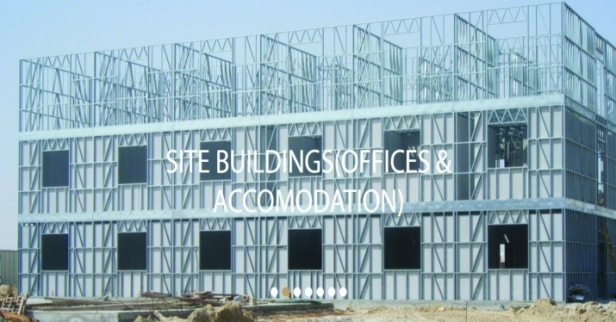
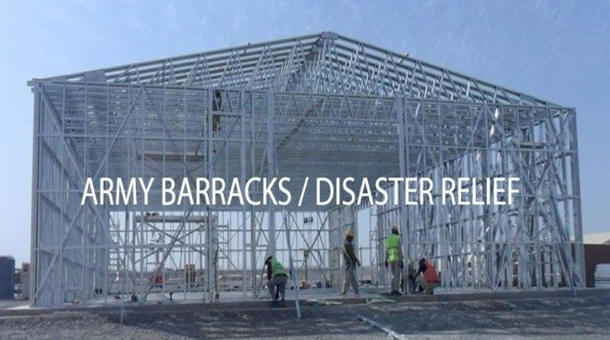
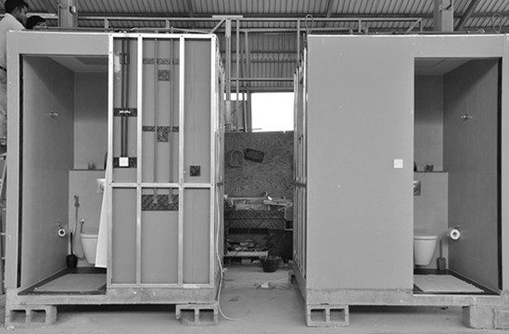
RCM Prefabs
Over 40 Years of Experience in LGSF Prefab Constructions
Pioneered Prefab Constructions in the Middle East (Dufabco)
Finished 500 Prefab units within 6 months in 1984.
Leading Supplier for the Royal Family of Dubai
Peak Productions of 1500 Prefab Units in 1 year – AED 36 Million

Slide 5
RCM - Technology Support
RCM Prefabs Pvt Ltd, India
– Manage India Operations
Framecad Ltd, New Zealand
– LGS Technology
Cavite Form Modules Inc, Philippines
– Formtile Concrete Panels

Slide 6
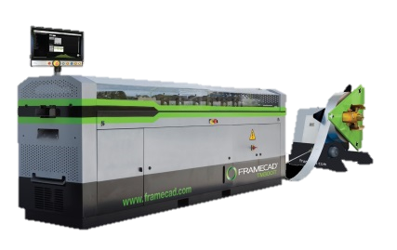
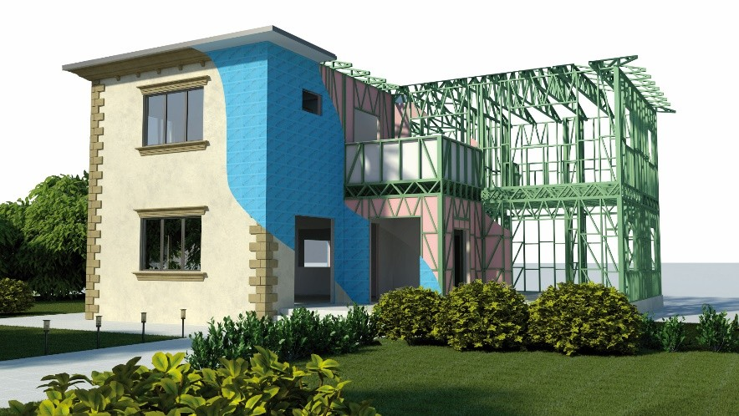
Framecad – Technology Support for LGS
Global No.1 in LGS Framing Systems
Proven Technology in 128 Countries
Fastest Production of Steel Frames
Precise and Accurate Punching operations.
High Volume Production Machines – Produces Steel for 350sqft in just 1 hour.
Advanced Structural Engineering Analysis and Detailing Software with Struct. Reports
Optimized Steel Consumption
End to End Support – from Design, Production, Building Materials, Training and Complete LGS Knowledge Transfer

Slide 7
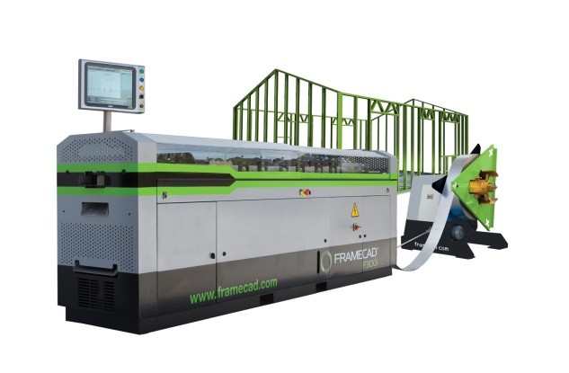
LGS Construction Technology - Benefits
Faster Construction Process
Steel is 100% Recyclable
Steel is Environmentaly Friendly
Steel has the Best Strength to Weight Ratio
GI Steel used in LGS is protected from Corrosion
LGS Steel Structures are best suited for Earthquake Prone Zones.
Efficient Constructions – No Wastages
Green - Guaranteed LEED POINTS
Ease of Handling and Transportation
Ease of Fabrication and Mass Production
Flexibility in Design
Smaller Wall Footprint – Gain 7 to 8% Carpet Area

Slide 8
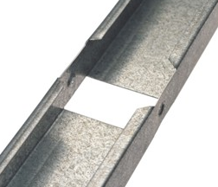
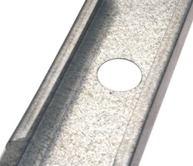
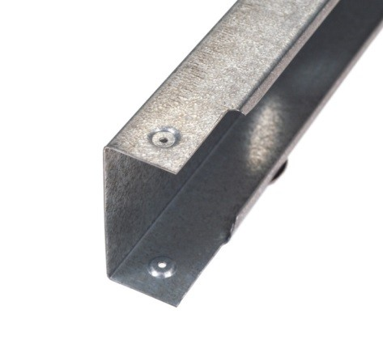
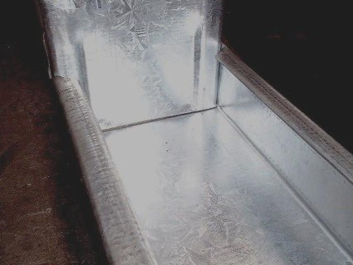
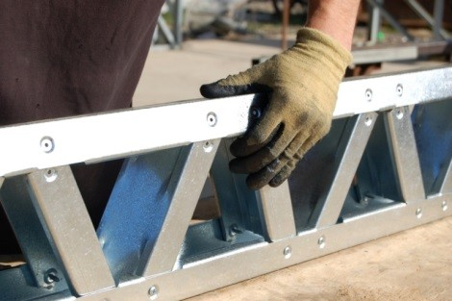
Fast and Automated Punching Operations

Slide 9
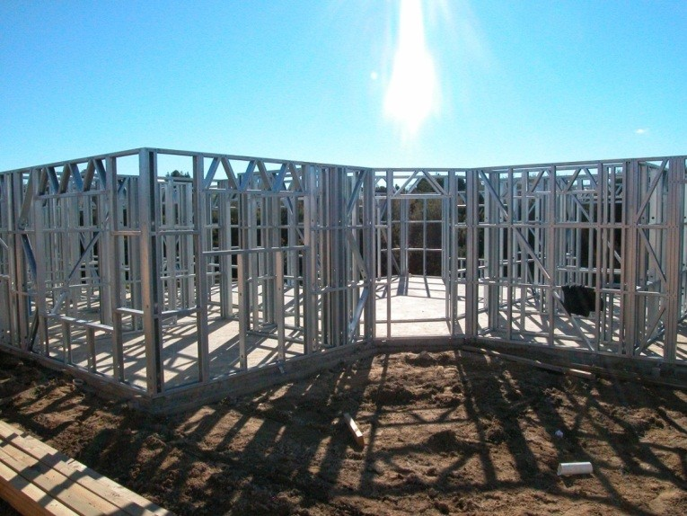
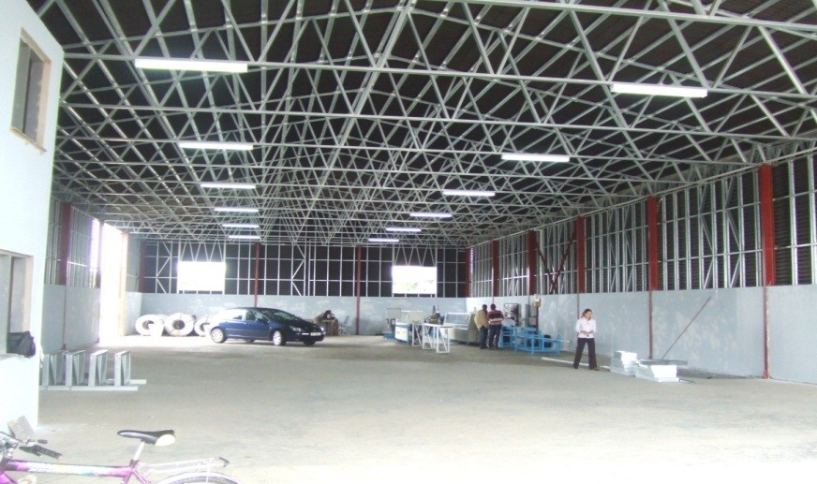
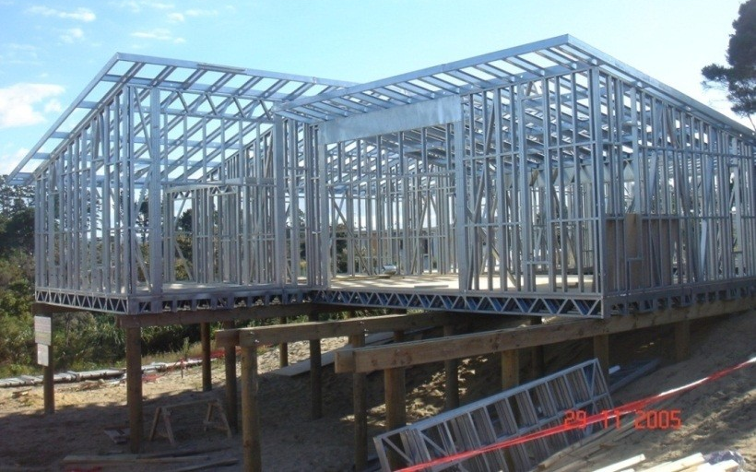
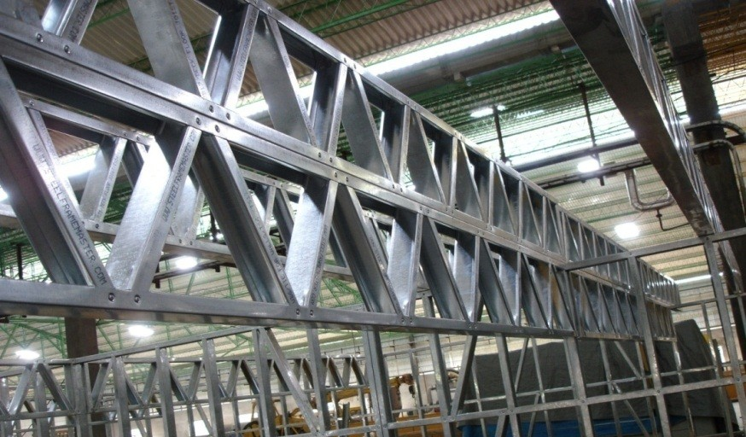
LGS Framing - Applications
Wall Panels
Roof Trusses
Webbed Floor Joists
Roof Panels

Slide 10
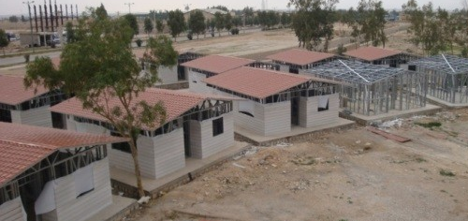
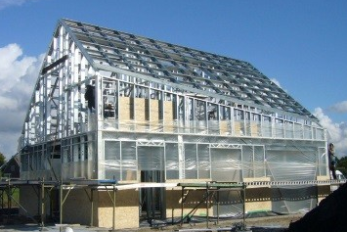
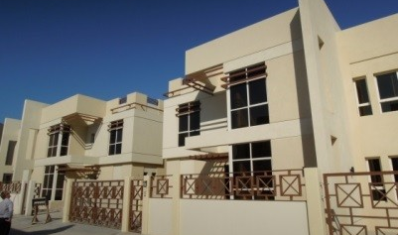
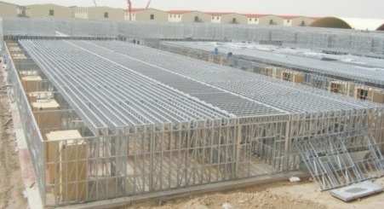
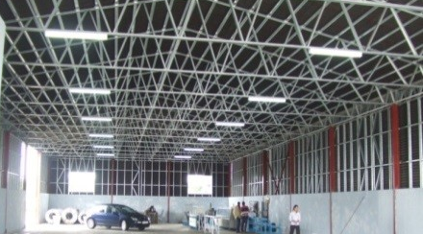
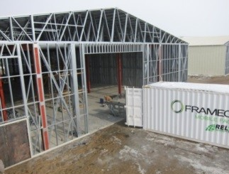
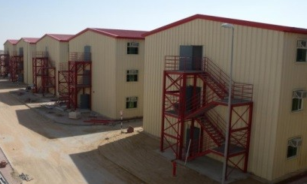
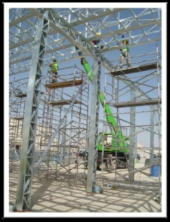
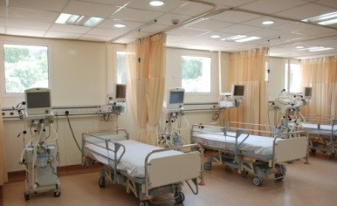
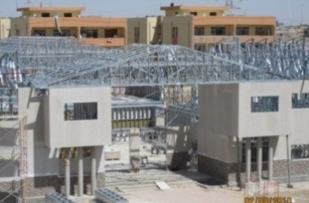
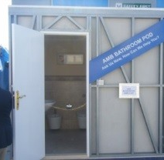
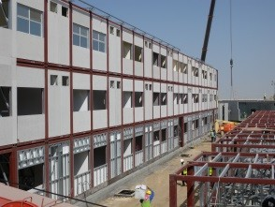
FRAMECAD® - LGS Construction Applications
Residential
Commercial
Institutional
Off Site
Notes:
Fade in Animation Order & Expanded Discussion Points
1. Residential… Villas I Social Housing I Low-Mid Rise I Disaster Relief I Roofing
2. Commercial & Industrial…. Worker Accommodation I Hotels I Offices I Storage I Retail
3. Institutional… Schools I Hospitals I Military
4. Offsite… Portables I Transportable I Pods

Slide 11
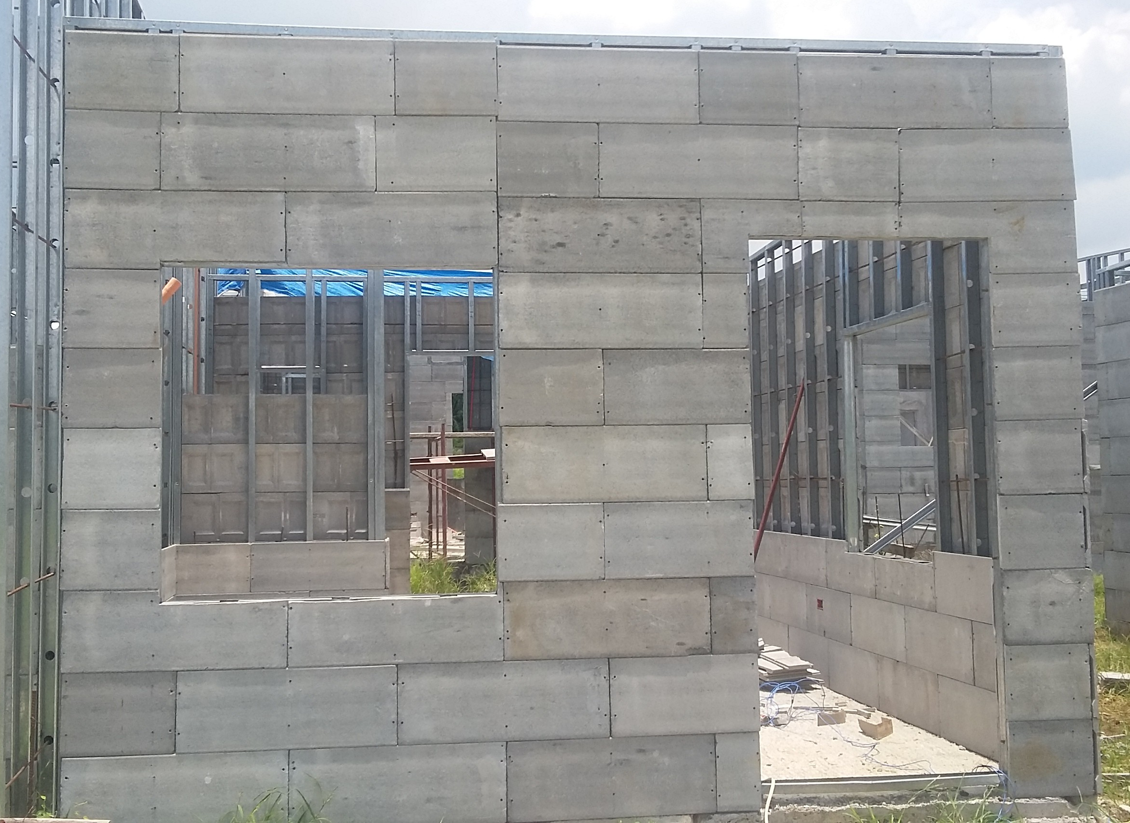
Form Tile Systems

Slide 12
How Formtile System improve LGSF Constructions
Stronger Walls and Floors using Concrete Boards
Infill with Lightweight Concrete/Regular Concrete
Convinces the Indian Customers expectation of “Solid Walls”
Passes the “Knock Test” on the walls – No Hollow Sound!
Any kind of Nailing, Drilling, Hanging Loads are possible.
Sustainable - All Materials Namely, Steel, Cement and Sand are easily available locally.
Easy Acceptance: The Finished building looks and feels exactly like a Concrete Building
Better Thermal, Acoustic properties and Fire Ratings
No Problems with Pests and Rats

Slide 13
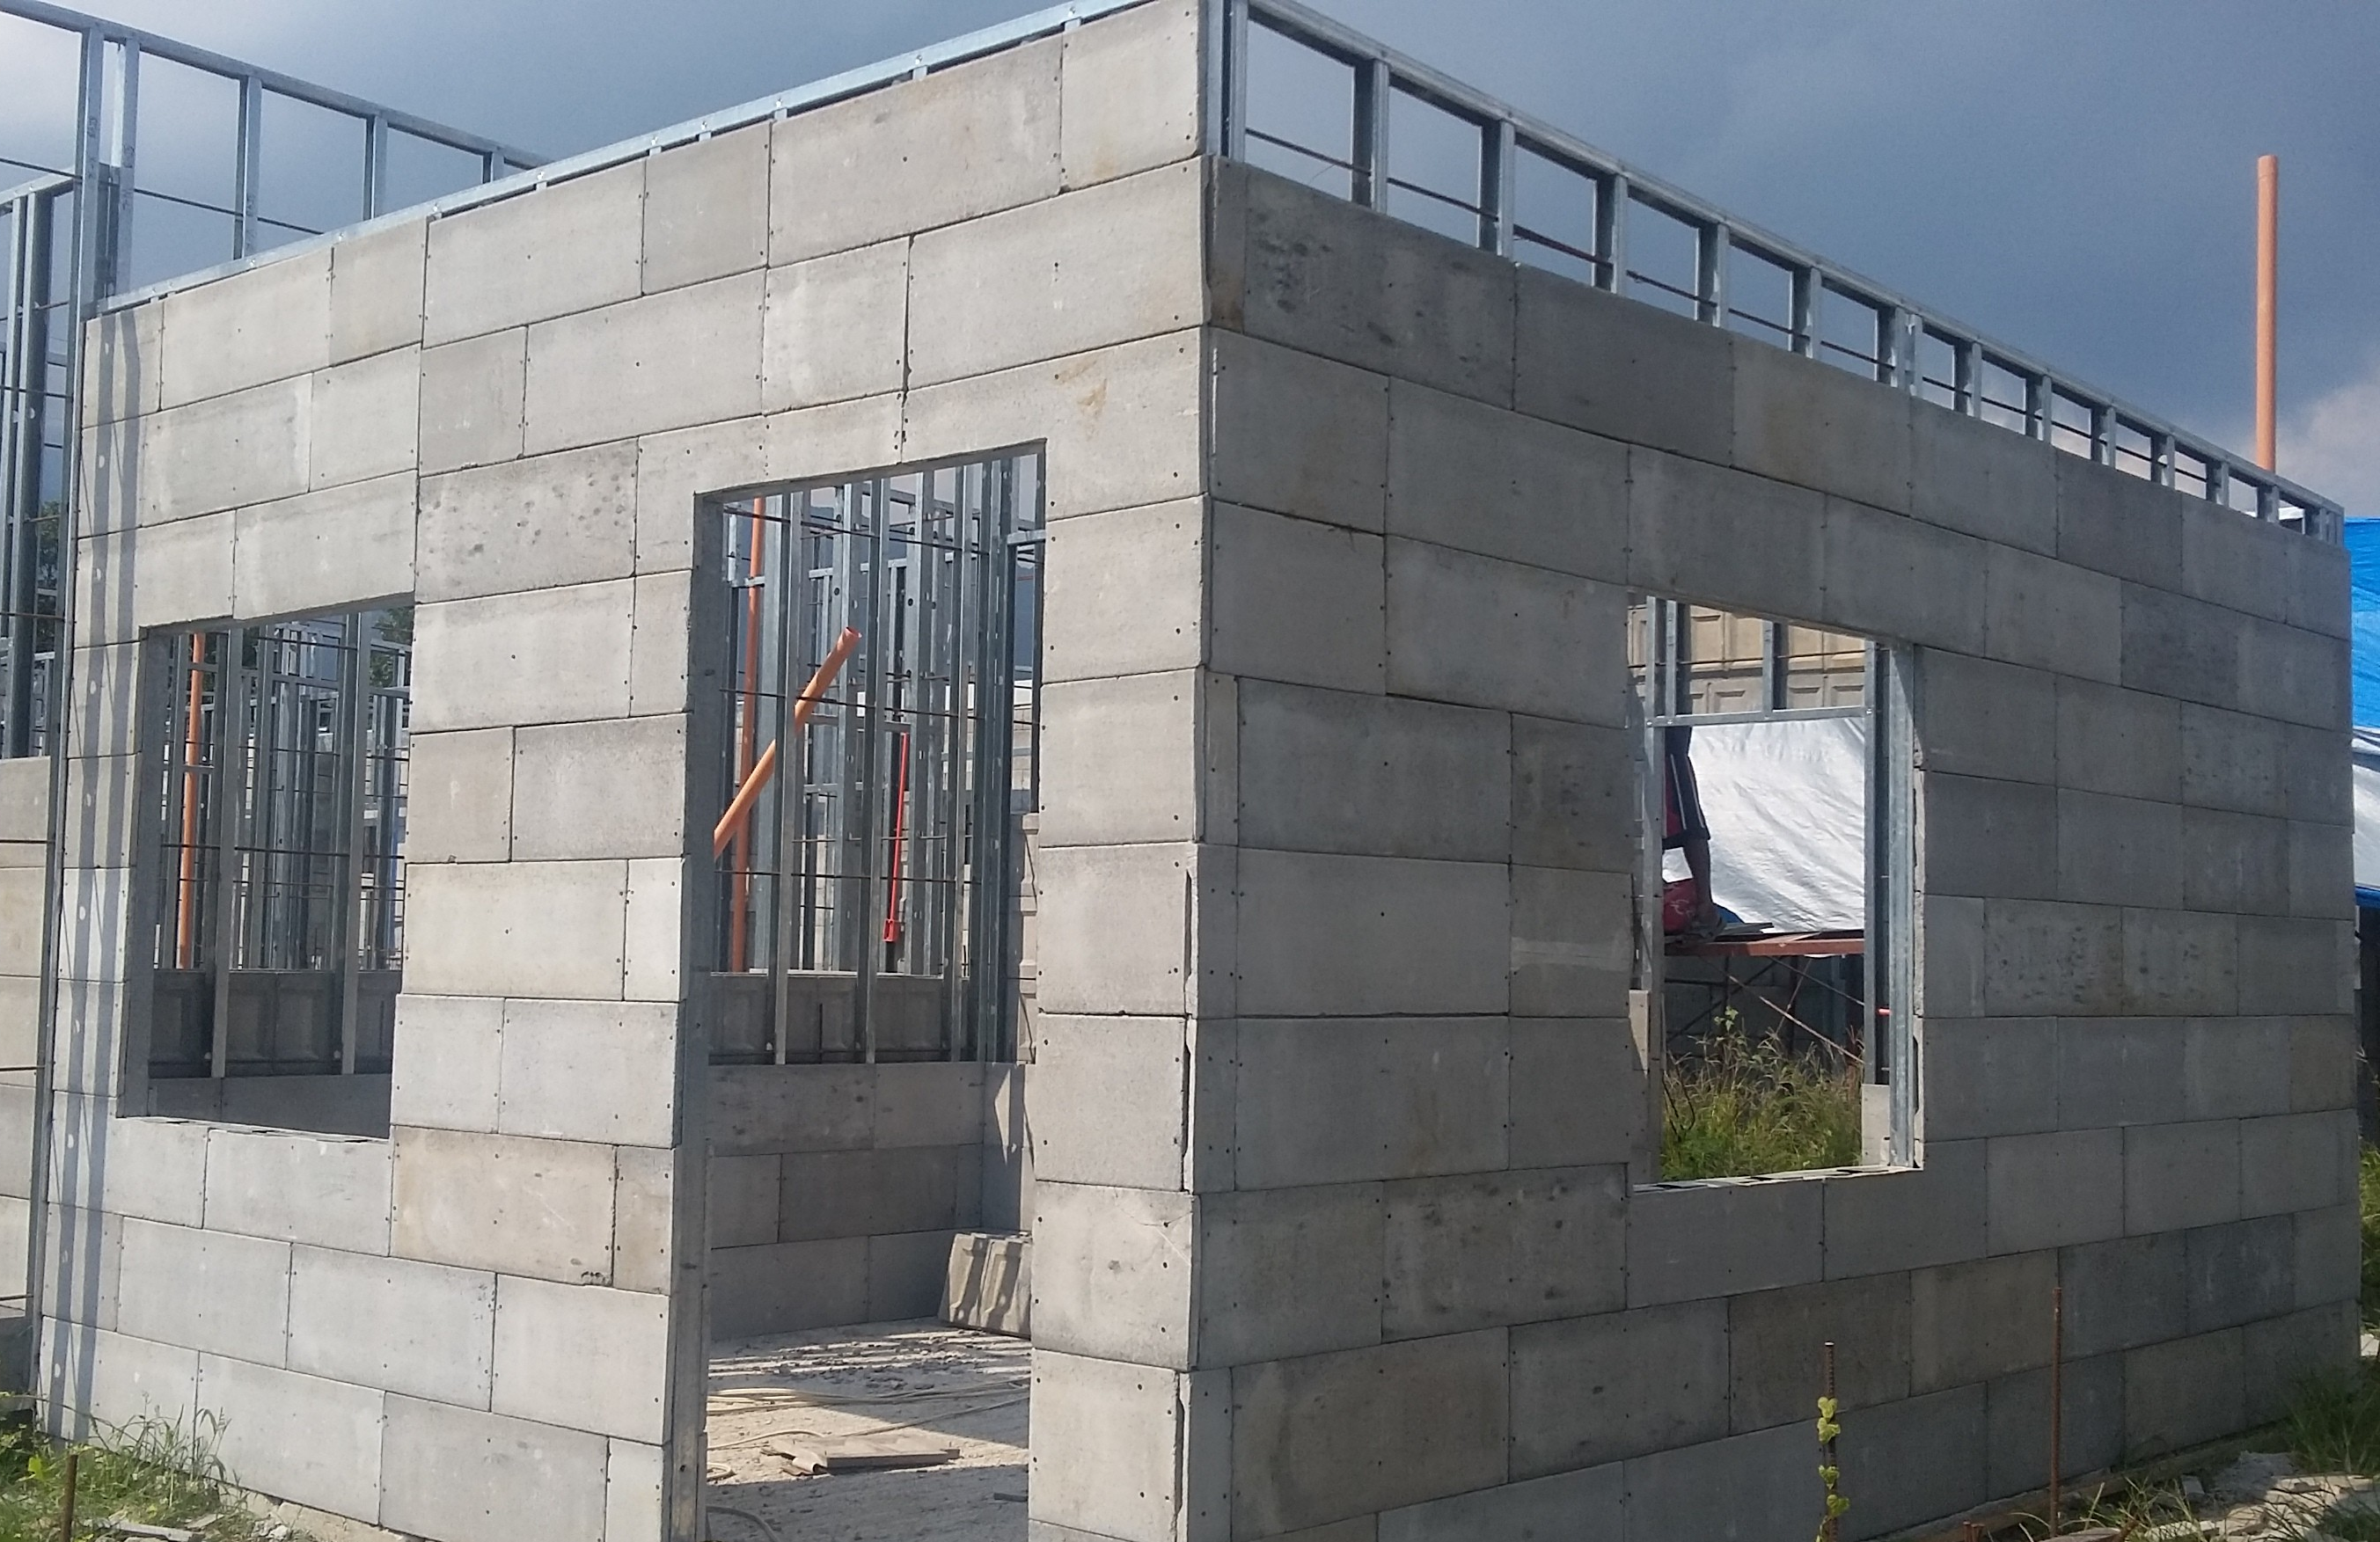
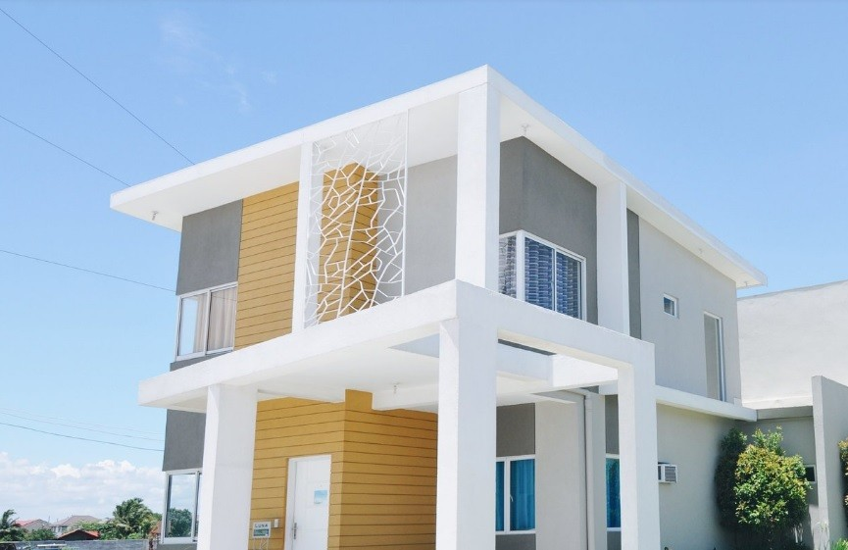
CFMI – Formtile Construction Technology
Technology Originated from Philippines
Used in Philippines, Africa, Nepal, Bangladesh, Israel and USA.
Successfully implemented various Low cost housing projects, Mid Segment and Premier Segment Projects with Form Tile Constructions
More than 20,000 Houses built with Form tiles in Philippines.
Fast Automated Production of Form Tiles
One Machine can produce 10,000 Boards/day
With Double side Cladding, this is equivalent to 12,000 Sqft of Wall Area per day
Easily available Raw Materials – Cement and Sand
Scalable with Multiple machines

Slide 14
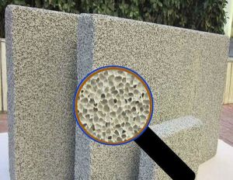
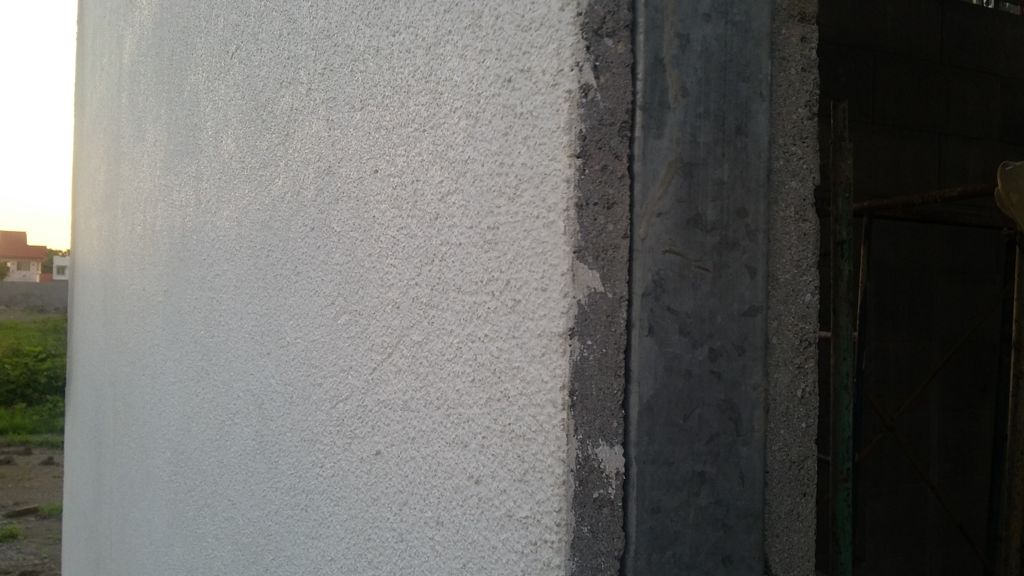
Concrete Formtile Constructions
New Innovations in Cladding Panels and Infill Insulation
For Light Gauge Steel Constructions
Form Tile Panel
Cladding System
Lightweight Concrete Infill Insulation
Stucco Finishing

Slide 15
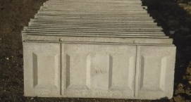
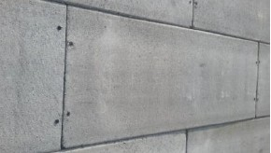
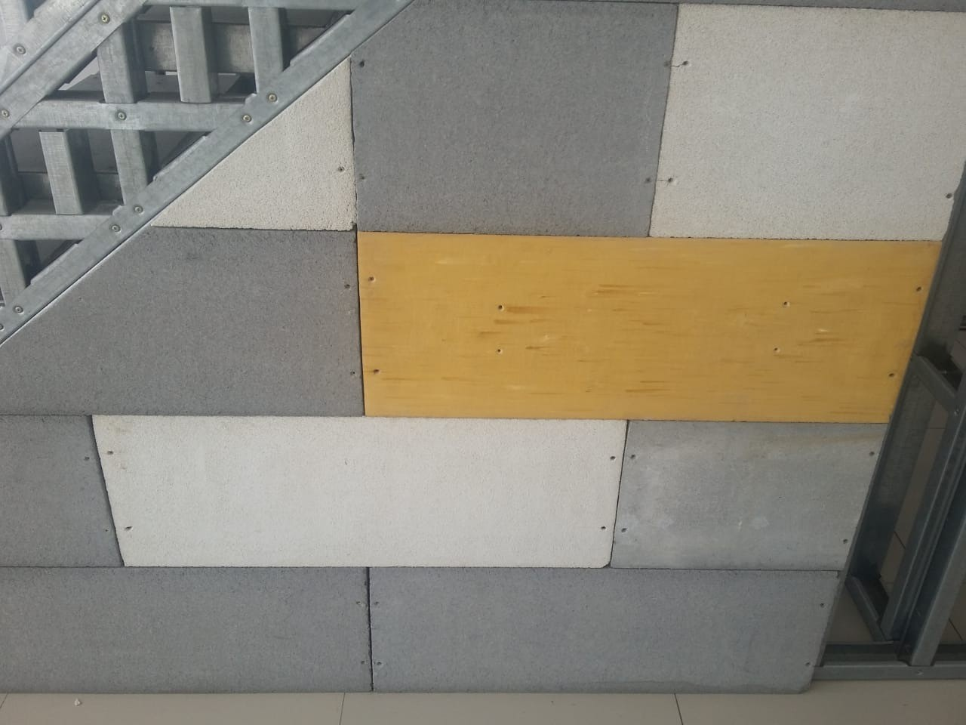
Formtile Panels for Wall Cladding
Very Strong Concrete Wall Cladding
Dimensions: 300mm x 800mm x 25mm
Weight of Each Board: Approx 9.5Kg
Density: 2400kg/m3
Board Thickness: 25mm
1500/2000 PSI Impact Strength
Fastened to Frames with Self Drilling Screws
Staggered Assembly of Boards
Cheap and Easily available Raw Materials:
- Just Cement, Sand and Water
Coloured Boards also can be produced

Slide 16
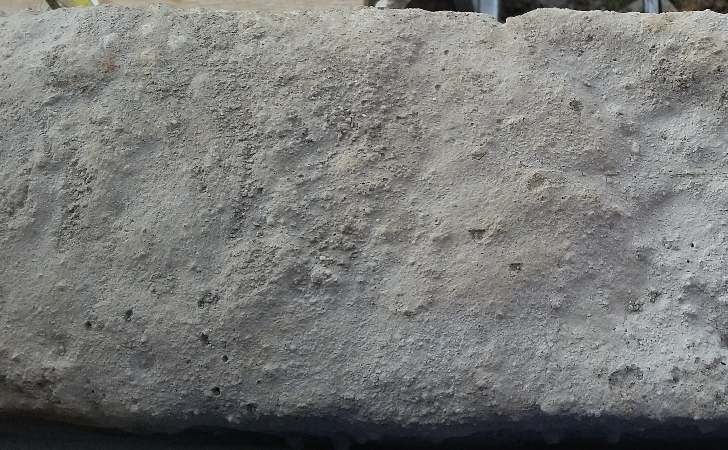
Light weight Concrete Insulation
Light Weight Concrete System
Ingredients – Cement, Sand,
Water and Foaming Agent
400kg/m3 to 600kg/m3 Densities
500% Better thermal insulation
4 Hour Fire Rating
Superior Acoustic Performance
Solid walls – No Hollow sound!
Light weight Concrete Reduces
the LGS Steel Consumption

Slide 17
Mid Segment Residential Projects

Slide 18
Low Cost Row Housing Projects

Slide 19
Low Cost Row Housing Projects

Slide 20
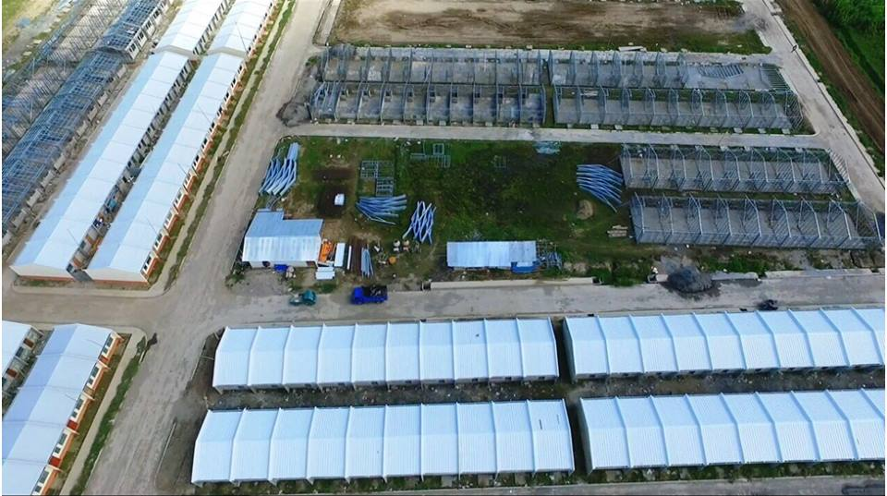
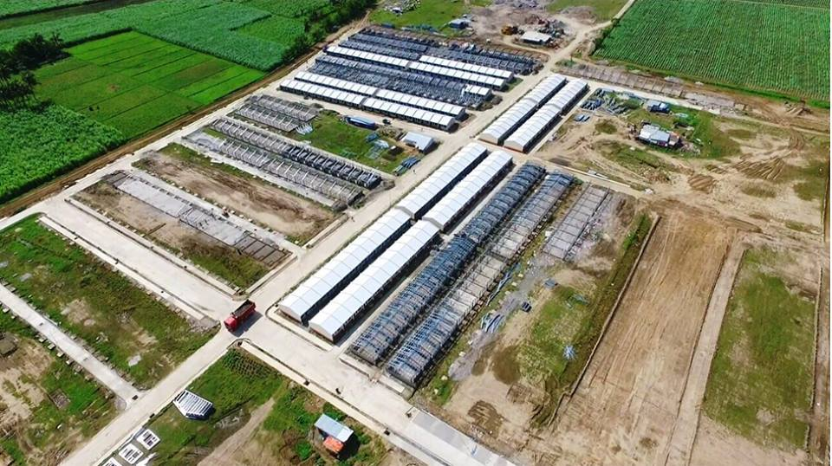
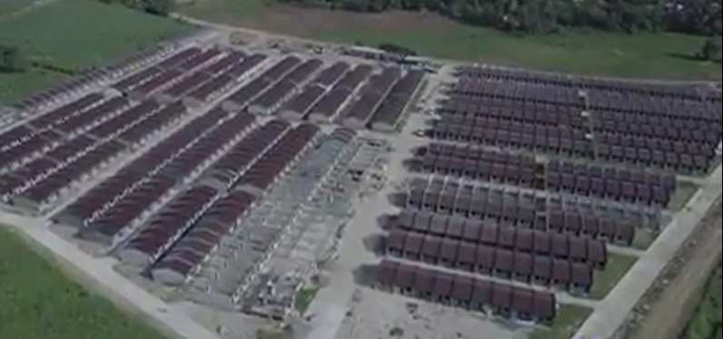
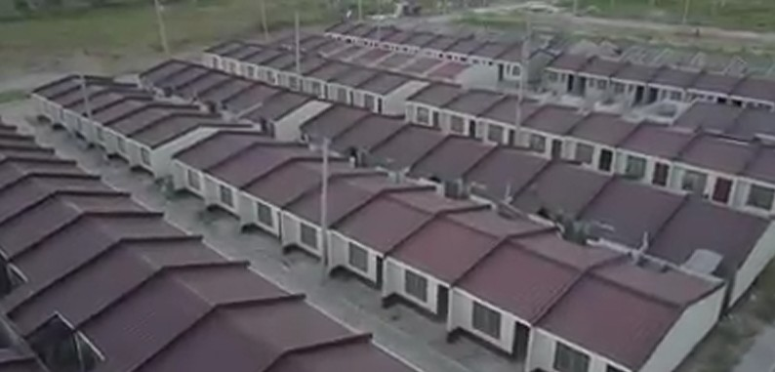
Mass Housing Projects

Slide 21
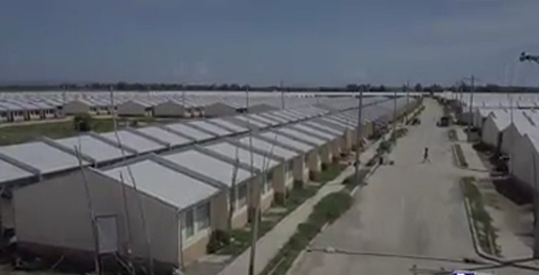
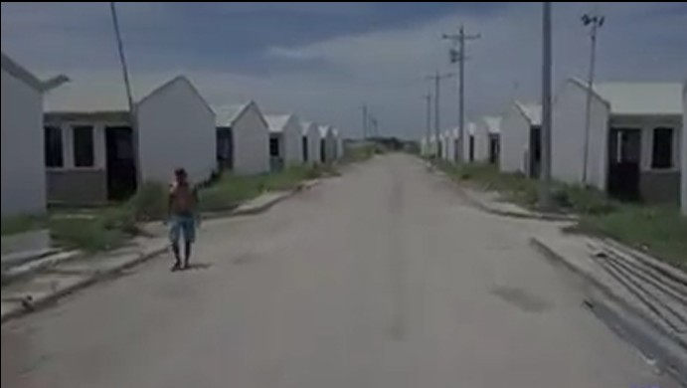
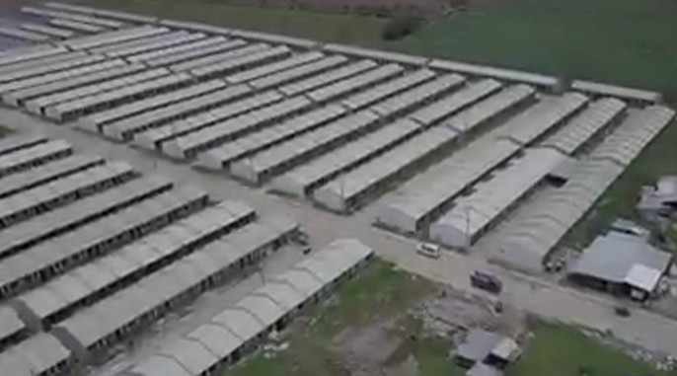
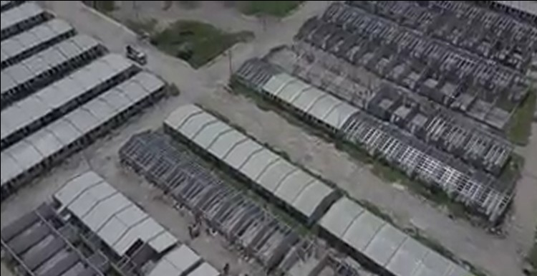
Mass Housing Projects

Slide 22
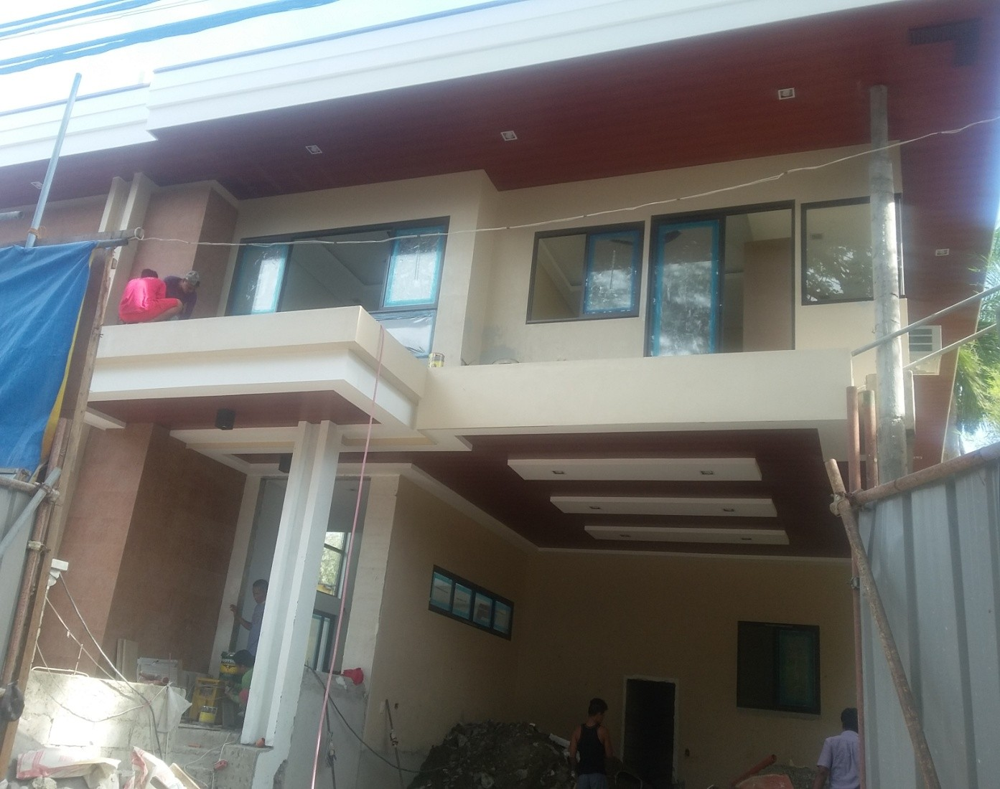
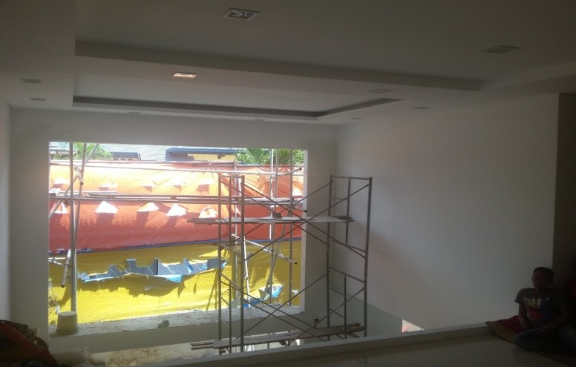
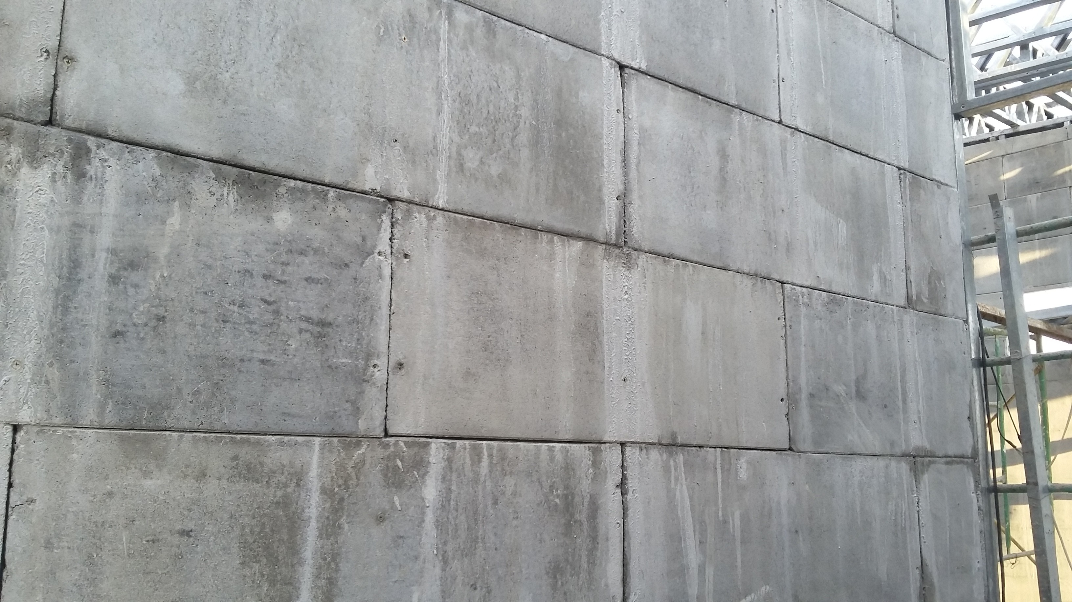
Premium Segment Houses

Slide 23
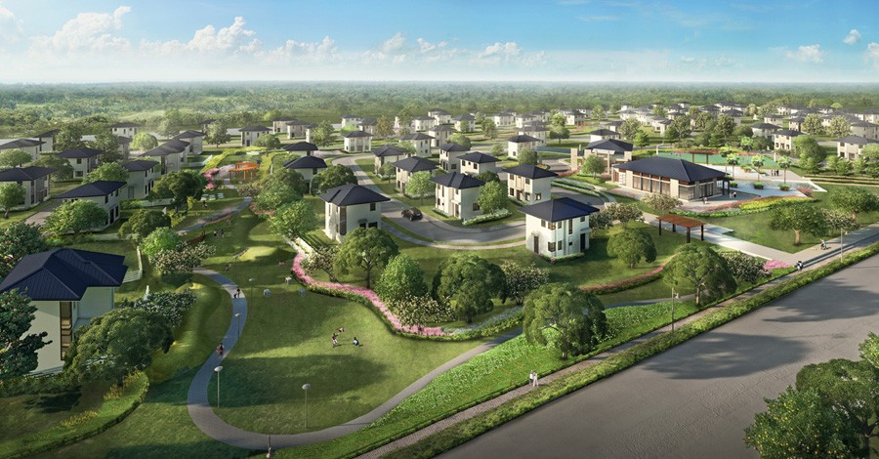
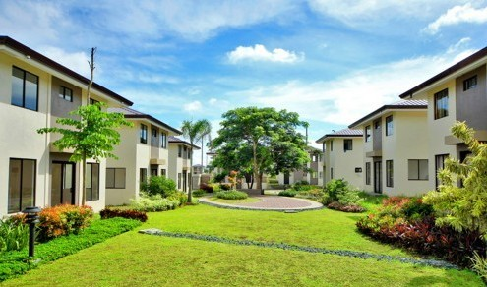
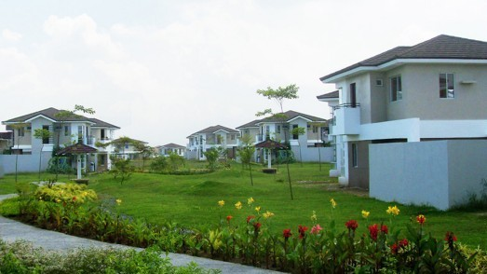
Gated Community Projects

Slide 24
Residential Buildings

Slide 25
Commercial Buildings

Slide 26
Certifications
The Formtile Systems are approved by the National Housing Authority (NHA) of Philippines
CFMI Form Tiles Construction Systems are selected by AITECH in the list of Accredited Construction Technologies (Similar to GHTC in India)
Fire Testing reports available
Acoustic Testing reports available
Formtile Constructions is a Patented Technology

Slide 27
How Formtile Systems is Best suitable for India
Indians want a Strong Wall with no Hollow Sound
Nailing Drilling, Loads on Walls should not be a problem
Can be suitable for various Geo-Climatic Conditions
– Hot, Cold, Rain, Earthquake, Snow, Coastal, Hilly regions.
Safe from Burglary/Theft issues due to Concrete Walls
High Speed of construction for Mass housing projects are possible with Formtile-LGS Combination – Highly Efficient

Slide 28
Frequently asked Questions
How many floors can be built with this Technology?
Number of floors depend on the Gauge thickness of the LGS Steel used.
1.2mm Gauge - 1 to 3 storeyed buildings. 1.6mm Gauge – 1 to 5 storeyed buildings.
2mm – 1 to 8 storied buildings.
If you use Hot rolled steel in conjunction with LGS and build a Hybrid structure,
you can go even higher.
In which places/locations the Formtile Constructions have been built?
Formtiles Construction have been built in Philippines, Denmark, Ivory Coast, Nepal, Africa and Israel.

Slide 29
Frequently asked Questions
What kind of Projects were built with Formtile Technology?
Government Mass Housing Projects
Row Housing Projects
Individual Villas
Low Cost Community Housing
Commercial Projects
Warehouses
Private Gated Communities
Premium Segment Houses
Floating Houses

Slide 30
Frequently asked Questions
How do you help to develop the Skill and knowledge about your Construction technology in India?
For Need based Skill Enhancement, Development and Employment, RCM proposes to tie up with National Skill Development Council of India GOI and NGOS to train
Master Trainers and
Skilled and Semi Skilled Human Resource
Will also train female workers at various levels to improve Women Empowerment in this Industry.

Slide 31
Frequently asked Questions
What is the Time taken for Formtile Constructions?
A 1000 Sqft House can be completed – From Design,
Foundation Stage to Complete Turnkey Completion stage in
less than 30 days.
Maintenance Requirement?
The Structure is very similar to Concrete Constructions and
are very strong. No need of any specific Maintenance.
The Structures life is the same as conventional constructions
How many days it will take to build 1000 houses.
One Framecad LGS machine can produce Steel to build upto
4000 Sqft Built up area in one day.
One Formtile Machine can produce Boards required to build
4000 Sqft Built up area in One day.

Slide 32
Frequently asked Questions
Is this Construction Process Scalable?
The Entire process easily scalable with multiple machines and usage of more number of labourers. The Raw Materials are easily available – Steel, Cement and Sand.
Is this technology suitable for the Diverse Geo climatic conditions of India?
Yes, This Technology is successfull in Philippines, Nepal, Europe and Africa
Philippines – High Wind Loads (350km/hr), Continuous Rains, Hot and Humid
Nepal – High Altitude Region, Earth Quake Zone 5 Region, Very Cold climate
Africa – Very Hot Climate, Dusty Atmosphere
So it will be suitable for the Diverse Geo Cliatic conditions in India.
Is this technology economical for Mass Housing?
Yes, This is Best suitable, with Speed and Cost for Mass Housing Projects.

Slide 33
Frequently asked Questions
How this technology is safe in Earthquake Prone Regions?
The Steel used is High Tensile, with High Yield Strength. Due to the Interconnection of all Studs, Joists and Trusses, The Loads are evenly distributed throughout the Structure. The Form tiles are also fixed on Staggered pattern with 6 screws per board and the board sizes are small enough so that it is best suited for High Earthquake Prone Zones.
How does you help develop the Domestic Technology Research?
We are keen to pass on this knowhow about Formtile and LGS constructions, We will be training the local people in the region of construction and use them for constructions so that the local population (including Women workers) gets employment and also gets valuable knowledge and skills to build such kind of projects in the future. This will help allieviate the unemployment and generate more and more skilled workers.

Slide 34
Limitations of Formtile LGS Constructions
When you go for High rise Structures (>10 Stories), you cannot use 100% LGS. You need to Build such structures as Hybrid ones with combination of Hot rolled Steel and LGS.
The Form tiles Buildings are relatively heavier than regular LGS constructions and the Steel consumption is about marginally more than conventional LGS Buildings, But it adds more strength to the Building.
Post Construction, changes in the design is a bit difficult.

Slide 35
Goals of the GHTC Program
Proven Technology √
Demonstrable √
Sustainable √
Disaster Resilient √
Cost Effective √
Fast Construction Process √
High Quality of Construction √
Suitability to the Diverse Geo Climatic Conditions of India √
Meets Stringent Environmental, Societal, Quality and Economic Standards √
Building Platforms for Knowledge Sharing √
Development of Domestic Technology Research √

Slide 36
Questions?

Slide 37
Thank You!

