Slide 1
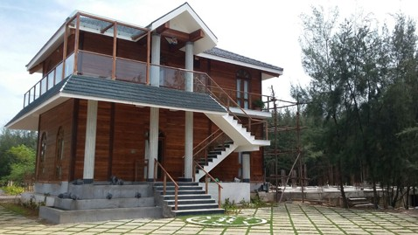
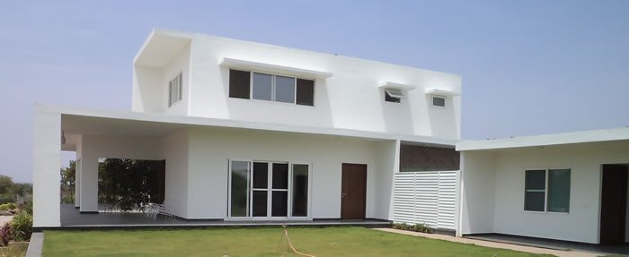
QUIKBUILD
BEARDSELL LIMITED
TECHNOLOGY FOR SPEED, THERMAL COMFORT, STRENGTH, DURABILITY AND SUBSTAINABILITY.

Slide 2
BEARDSELL LIMITED
QUIKBUILD CONSTRUCTION SYSTEM WITH EXPANDED POLYSTYRENE CORE PANEL
Year of Establishment | 1898 (Publically listed at NSE and BSE)
Head Office | Chennai
Branches | Delhi, Mumbai, Bangalore, Hyderabad, Chennai, Kochi, Vizag, Ahmedabad, Coimbatore
Business and product | It is a Green Building Products company engaged in manufacturing and sales of pre-fabricated construction products for Clean Rooms, Cold Storages, Warehouses, Factories, Villas, Multi-storey residential & Commercial Buildings etc. The Company is Pioneer in developing 3D panels with expanded polystyrene core.
Financials | With Revenue of 2.5Billions(2017-2018), company is expected to grow at 50% in next two years
About us | Beardsell Ltd has built a reputation of reliability, and trust with its customers and other stakeholders over several decades. It is managed by a highly accomplished Board of Directors and a professional & competent management team.
Contact Details Website: www.quikbuild.com | Mr. Mukesh Kejriwal , Contact No: 93501 09685 Mr. Girish Dabral – 93122 23098, Mr. Gourav Rishi – 9999 2594 35 E-Mail ID: delhi@quikbuild.com, mukesh@beardsell.co.in

Slide 4
Today’s need for new Construction Technology
Today’s construction industry is facing severe challenges in various aspect. These challenges are:
Need for Green rated / energy efficient buildings.
Fast track construction.
Efficient Utilization of constructible area.
Shortage of labour / construction materials.
Sustainability and Durability.
Need for stronger and light weight construction materials.
Technology need for todays Architectural designs.
QUIKBUILD – A SOLUTION TO THE ABOVE NEEDS.

Slide 6
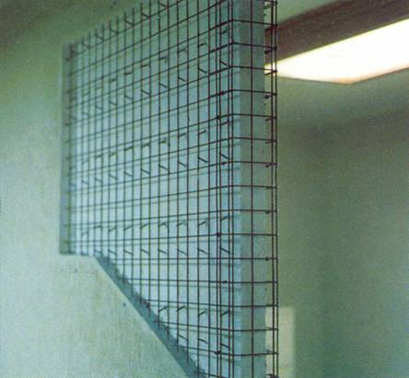
Lightweight
50 % weight of 230 mm Brick-Work
Quik Build Wall = 250 Kg/ m2
Brick-Work =500 Kg/ m2
Reduced costs for foundation, beams, columns etc.

Slide 7
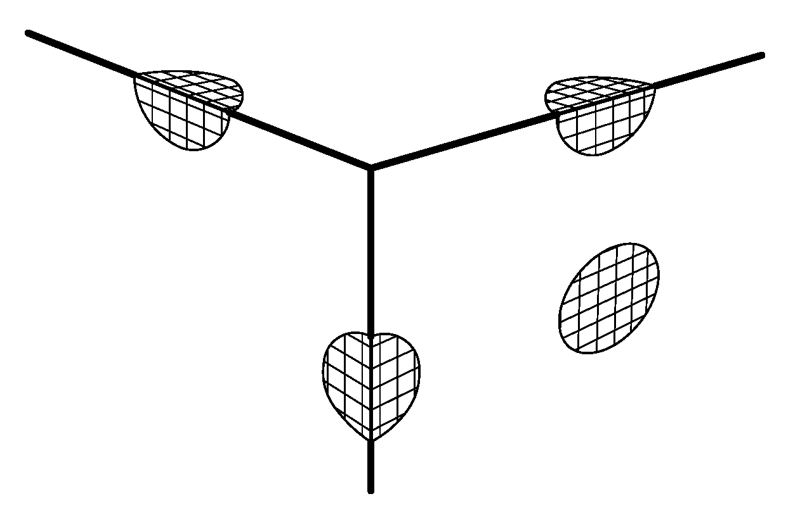
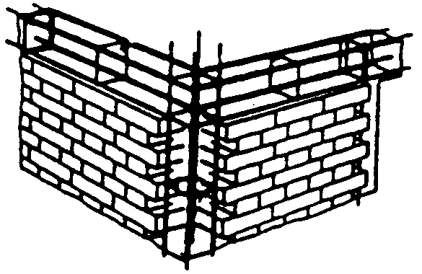
Safe Connections of Non-structural Elements
No danger due to non-structural elements (such as collapsing brick walls)
continuous mesh
reinforcement
no connection
brick-column or beam

Slide 8
Box-like Structures
The box-like structure guarantees maximum resistance against earthquake forces .
held by the slab
immovable slab
(diaphragm effect)
LATERAL LOADS
cross wall
(shear wall)
anchored in the foundation
possibly boundary elements
compression force
tension force
shear forces in the
foundation anchors

Slide 9
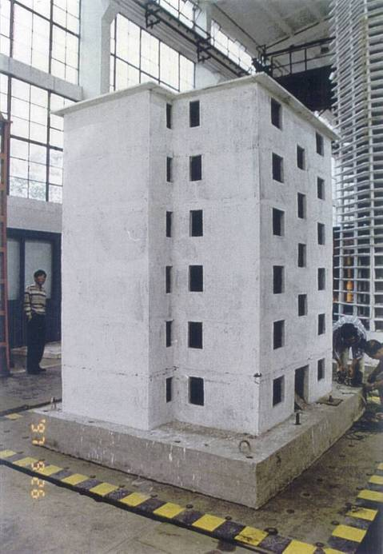
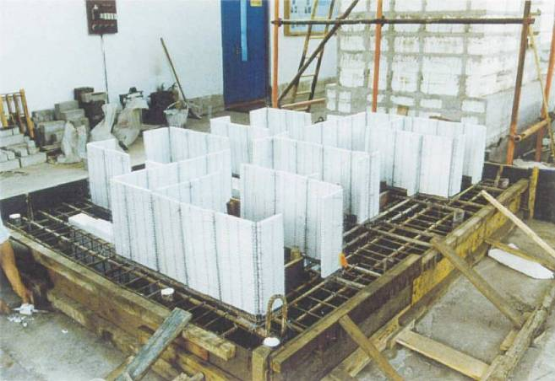
Earthquake Resistance
Model of a 6-storey building
Tongji-University, Shanghai
link folder\V16e - Earthquake Test, Model 1 to 6.pdf
link folder\MPEG Earthquake Kazakhstan,1_21.mpg

Slide 10
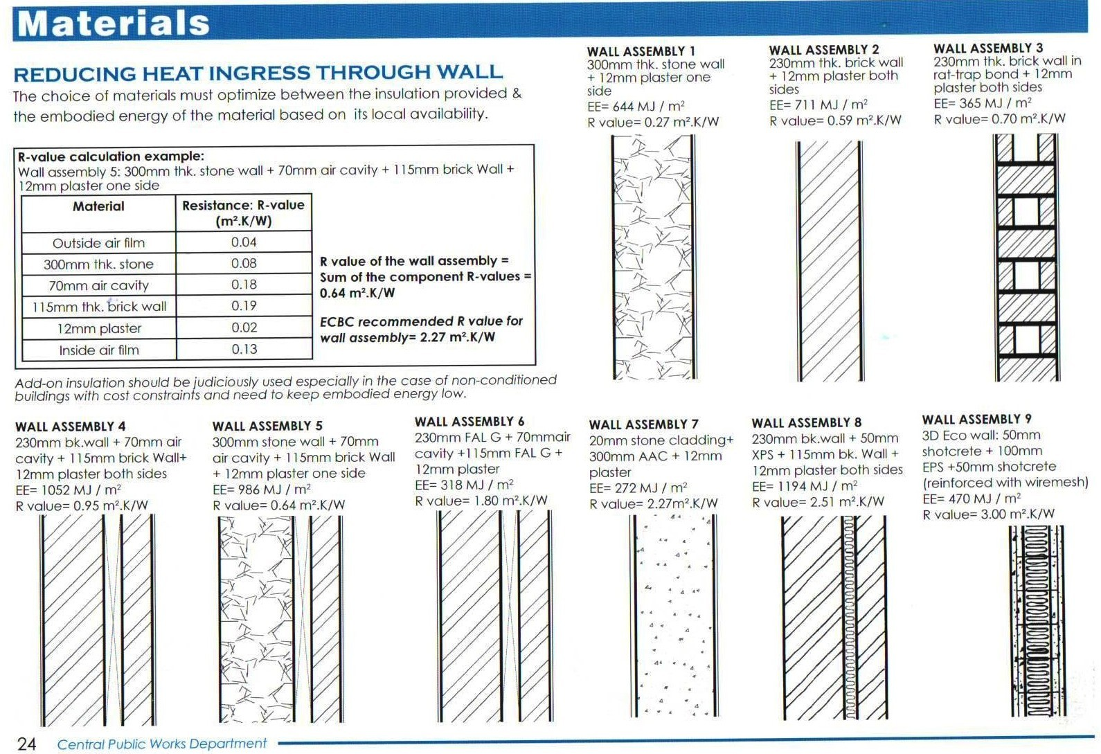
Thermal Insulation
Reduced costs for A/C systems
Reduced Operating Costs
More Carpet Area.

Slide 11
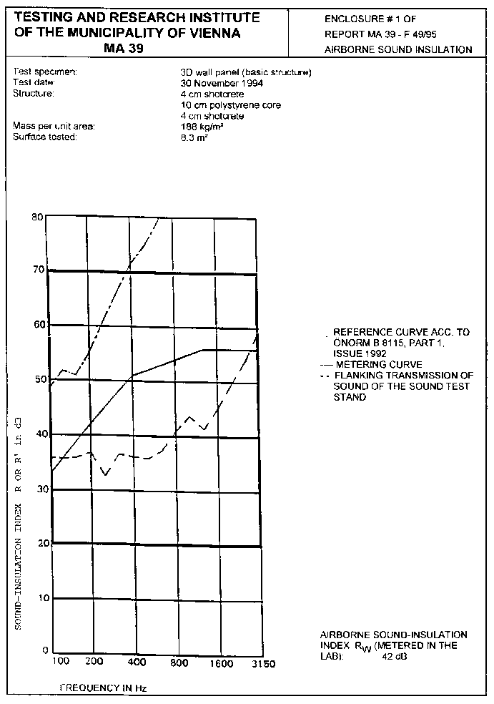

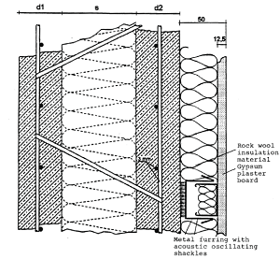
Sound Insulation
Average sound reduction:
R = 46-50 dB
combined with dry walls:
R = 58-61 dB

Slide 12
Other Advantages
Less Water Absorption
Termite Resistance
Structurally Stable Construction
Use Of Prefabricated Elements Produced On An Industrial Scale (Thus, Low Cost & Better Quality)
Minimum Equipments Are Required For Installation (No Cranes)

Slide 13
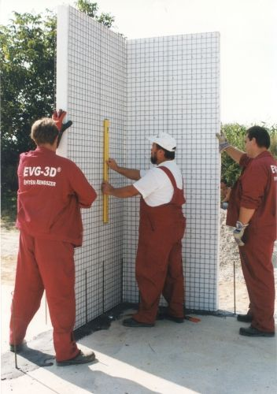
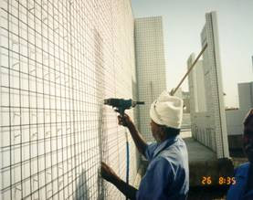
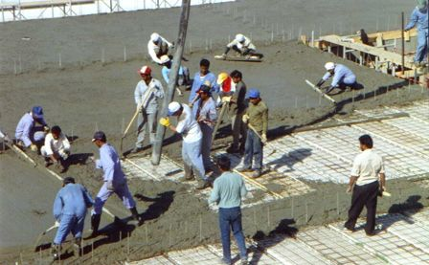
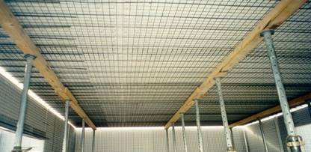
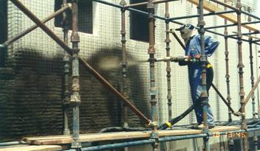
Simple Installation Process
No Special Tools Required
Simple Step-by-Step Procedure
Panel Connection
Concrete
Wall Panels
Shotcrete
Slab Panels

Slide 14

3D EPS PANEL MAJOR. PROJECTS
 | List of Govt. Projects where EPS 3D Panel - used/specified
Sl. No. | Name of Project | Name of Contractor | Name of Executing Agency | Application | Area ( Sft) | Supplier
1 | IIT - Jammu Transit Campus, Jammu | Kalsi Brothers | CPWD | External Wall & Internal Wall | 2 Lac Sq. Ft. | Beardsell
2 | 3 Nos. Const. Barrack at Shri Nitish Kumar Residence, CM of Bihar | P S Insfrastructure | BPBCC- Govt. of Bihar | Complete Building Wall, Roof | 70 K Sq. Ft. | Beardsell
3 | G+2 Building (1200 Sq. Ft. ) at Tamil Nadu Police Housing in Chennai | TNPH - Chennai | TNPH, Govt. of Tamil Nadu | Complete Building Wall, Roof | 1200 Sq. Ft | Beardsell
4 | Indian Railway Staff Qtr. G+3 Building at Jajpur, Odisha | SS Construction | Indian Railway | External Wall, Internal Wall & Stairs | 25 K Sq. Ft. | Beardsell
5 | Indian Railway Staff Qtr. G+2 Building at Jajpur, Odisha | Priya Ranjan Nanda | Indian Railway | External Wall, Internal Wall & Stairs | 15 K Sq. Ft. | Beardsell
6 | CRPF Barracks, at Padareu, Vizag 10 Barracks | AP police housing | CRPF | External and Internal walls with for bullet proof application | 60 K Sq. Ft. | Beardsell
7 | Casa Romana- Dharuhera G+15, 11 Towers. | Exotic Buildcon Pvt. Ltd. | PVT | External Wall & Internal Wall | 10 Lac Sq. Ft. | Beardsell

Slide 15
Cost effectiveness of QUIKBUILD Construction System
QUIKBUILD PANEL
QUIKBUILD PANEL consists of two components mainly Expanded Polystyrene sheet and Galvanised steel mesh. These components makes the panel versatile in durability, energy efficiency and speed in construction use.
EXPANDED POLYSTYRENE
GALVANISED STEEL MESH
1. NON DEGRADABLE
2. LIGHT WEIGHT ( 16Kgs/Cu.mtr)
3. GOOD THERMAL INSULATION
4. GOOD SOUND INSULATION
5. RESISTANT TO WATER ABSORBTION
6. RESISTANT TO TERMITE
7. RESISTANT TO FUNGUS GROWTH
8. FIRE RETARDANT GRADE
9. CELLULAR STRUCTURE WITH SHOCK ABSORBING PROPERTIES.
HIGH TENSILE STEEL(>75Kg/mm2)
GALVANISED ( Hot dipped Zn >60gsm )
RESISTANT TO RUSTING
HIGH STRENGHT/ LOW WEIGHT
UNIFORM LOAD BEARING PROPERTIES
DOUBLE MESH WITH TRUSS WELDS MAKES IT RESISTANT TO BUCKLING.
DIRECT SAVINGS
INDIRECT SAVINGS
ECONOMICAL IN CONSTRUCTION
30 % SAVING IN FINANCIAL COST(INTEREST) DUE TO FASTER CONSTRUCTION TIME.
>20 % SAVING IN CONSTRUCTION OF DOMES, ARCH ROOFS, UG SUMPS AND ELEVATION DESIGNS.
10% MORE CARPET AREA. VERY EFFECTIVE AND HUGE SAVINGS IN CITIES.
40% SAVINGS IN POWER BILL IN AIRCONDTIONED HOUSE.

Slide 16
QUIKBUILD Construction System and Environment.
COMMONLY USED CONSTRUCTION MATERIALS AND ITS DISADVANTAGES.
RED BRICKS :High environmental issues
Deforestation
Depletion of Top fertile soil leading to barren lands and later to high soil Erosion during rain.
Baking of bricks leads Air pollution . There is a substantial increase in SOX, NOX etc. content .
Use of good quality agriculture soil in large quantities for brick making is also a grave area of concern. In geographical regions having thin topsoil, this result in reduction in the productivity of land and in extreme cases the land does not remain fit for agriculture use.
A BRICK CONSTRUCTION IS SUBJECTED TO FAILURES IN A HIGH SESIMIC ZONE
QUIKBUILD CONSTRUCTION SYSTEM COMPLETELY REPLACES AND ELIMINATES THE REQUIREMENT OF BRICKS. QUIKBUILD BEING A MONOLITHIC & LIGHTWEIGHT IS HIGHLY RESISTANT TO EARTHQUAKE.

Slide 17
Benefits of Quikbuild product
Time saving
50% time is saved as compared to conventional method. Example, G+2 conventional will take at least four and half to five months to complete the shell. Whereas, with Quikbuild, it will take only about two and half months to complete the shell work from foundation.
Increased Carpet Area
Because of our thin walls as compared to conventional, you will be able to save about 4-5% of the carpet area. Hence, for every Rs. 10lakhs you spend, you will get a benefit of Rs. 40,000
Money saving
Nearly 50% reduction in both labour and water requirement. Also when the rooms are large, you will be able to save more as the number of panels required will be less because of lesser number of partition walls
Stronger and Lighter
Quikbuild structure will be stronger and lighter as compared to RCC. The panels are easy to handle because of light weight. And our product is the only suitable material in India for add on structures
Innovative Technology
This is a modern foreign technology. We brought it to India. It is being used in countries like Austria, US, China, Gulf etc. from many years, mostly for premium projects, villas etc.

Slide 18
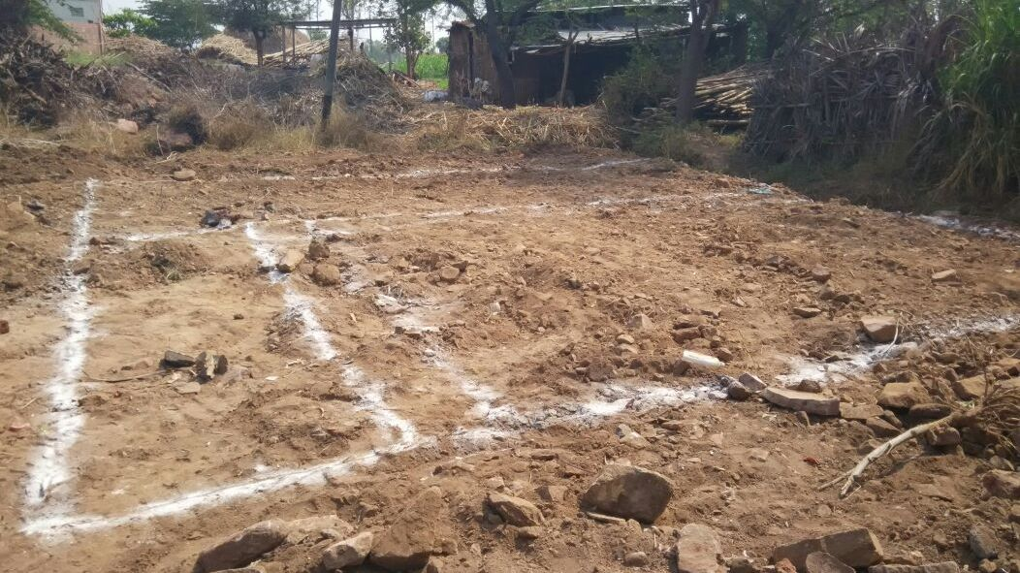
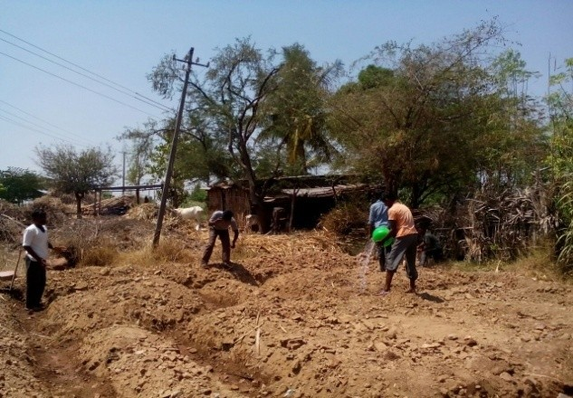
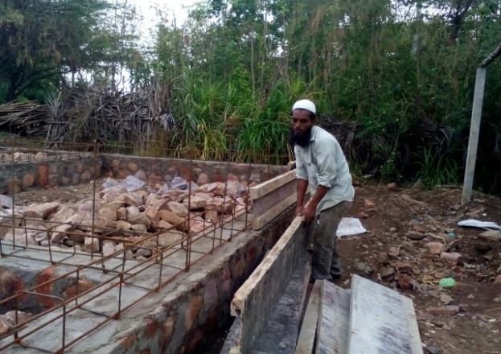
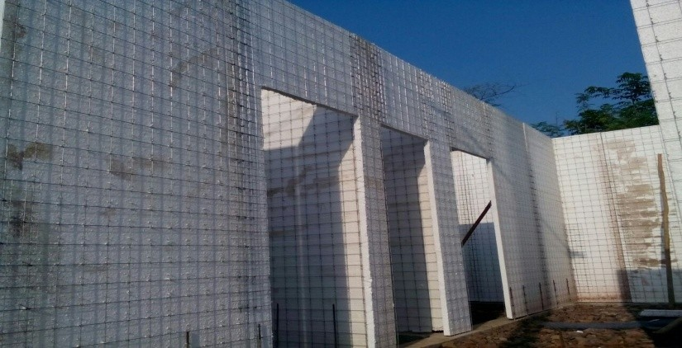
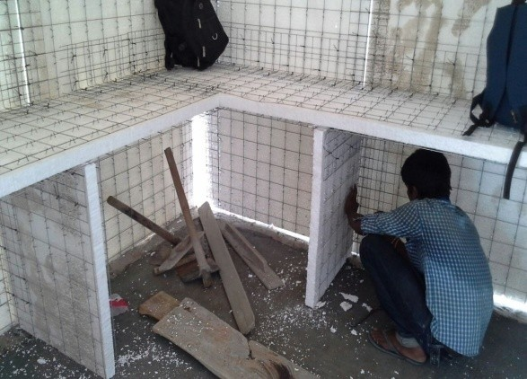
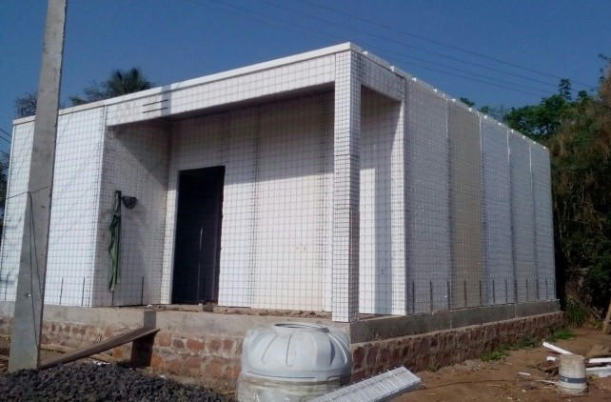
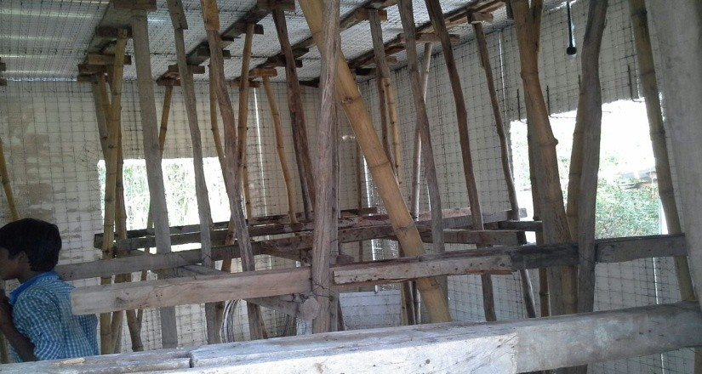
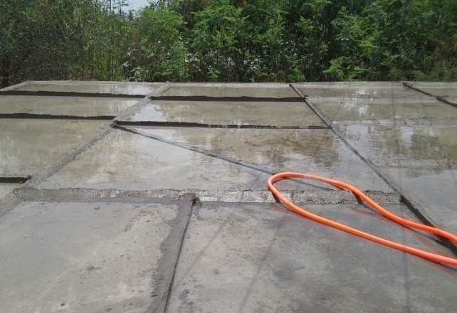
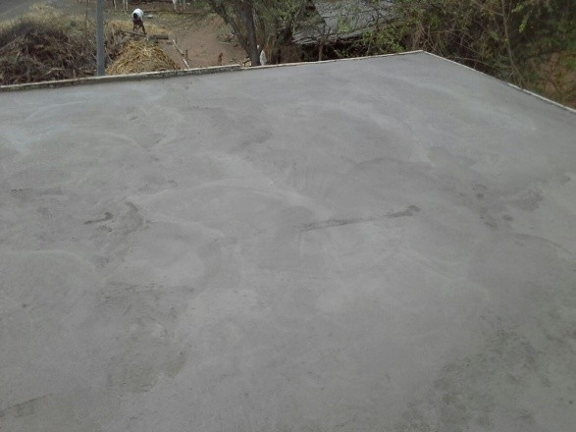
STAGES OF CONSTRUCTION
LAYOUT MARKING
EXCAVATION WORK
PLINTH BEAM
WALL PANEL ERECTION
ROOF PANEL ERECTION
ROOF CENTERING
ROOF CONCRETING

Slide 19
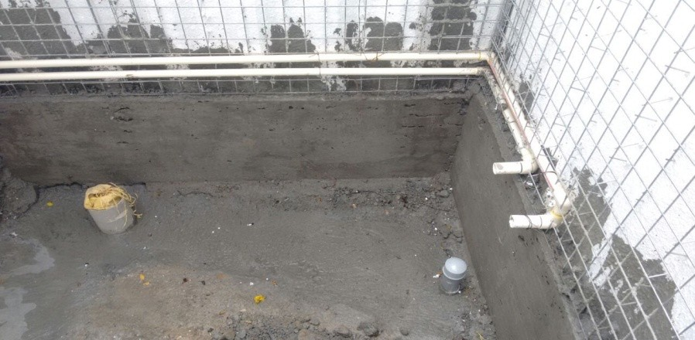
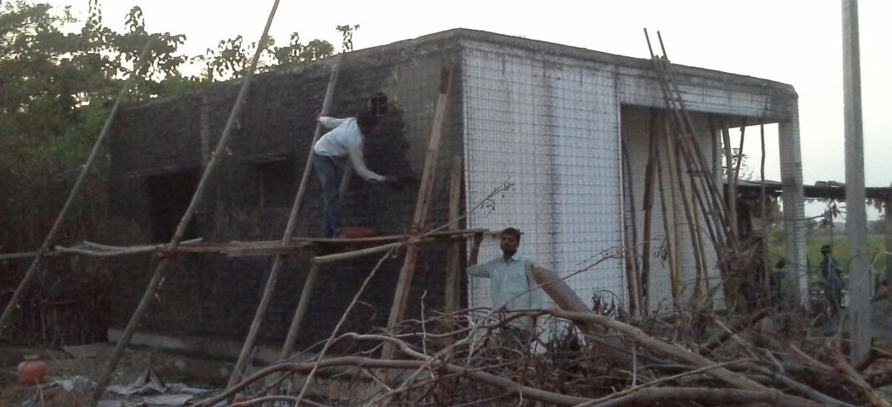
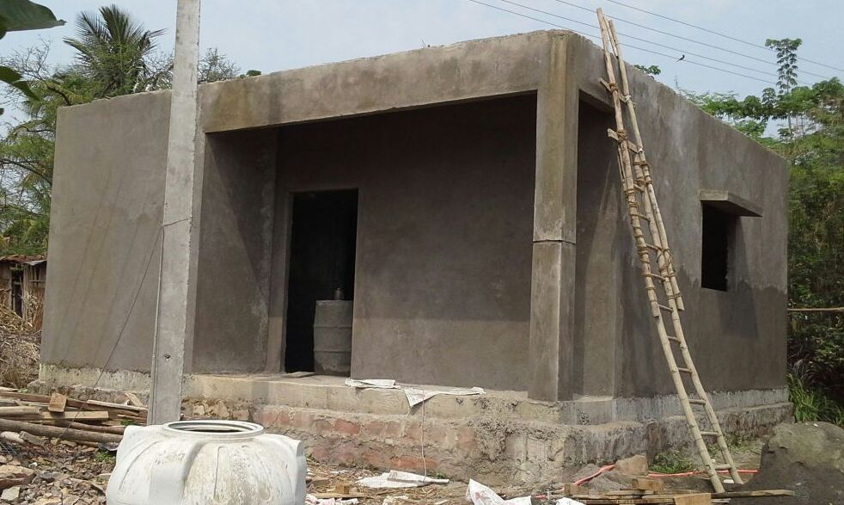
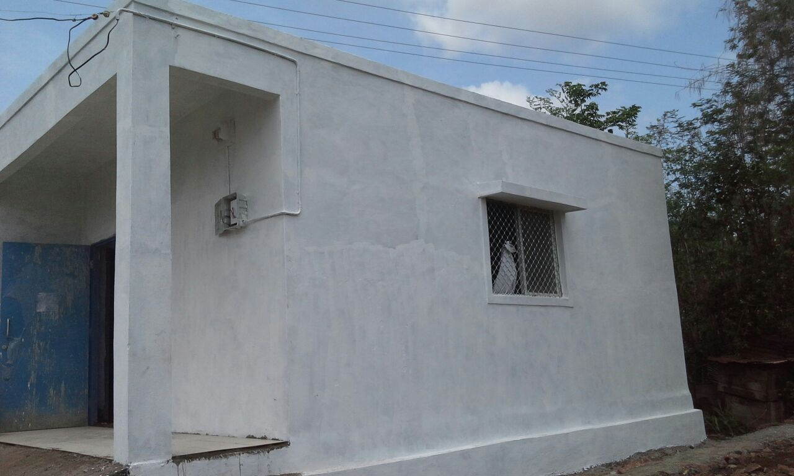
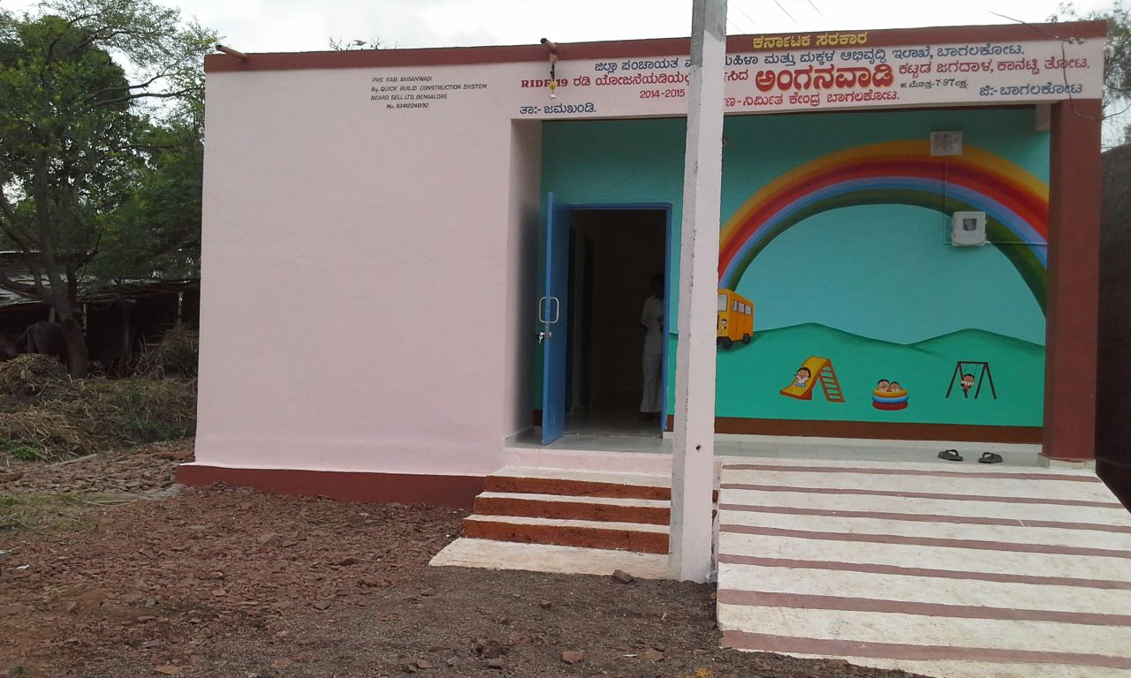
INSIDE & OUTSIDE PLASTERING
FINISHING WORKS - PAINTING

Slide 20
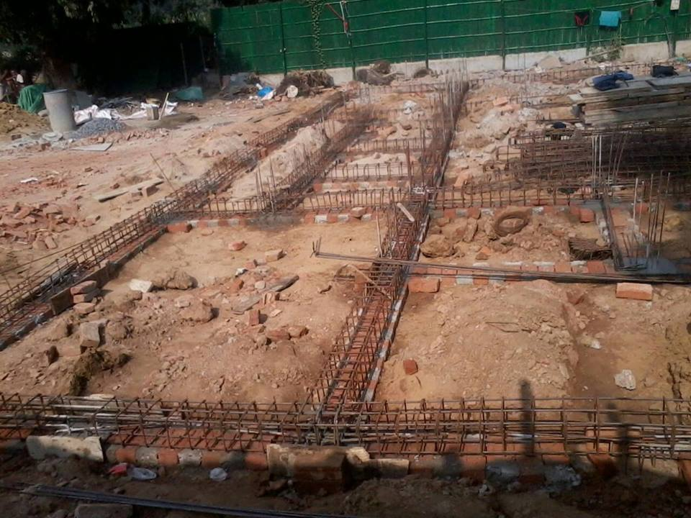

Slide 21
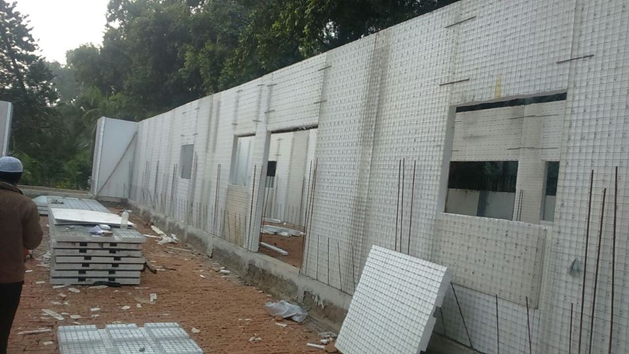

Slide 22
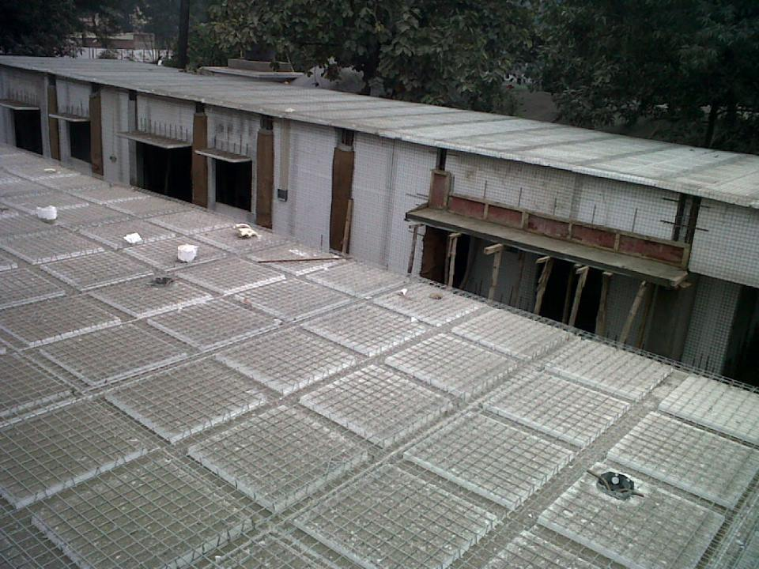

Slide 23
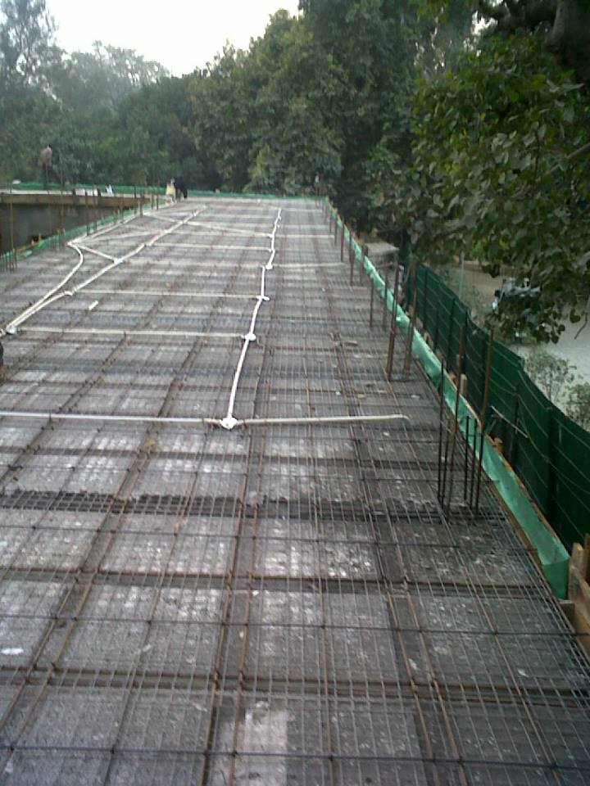

Slide 24
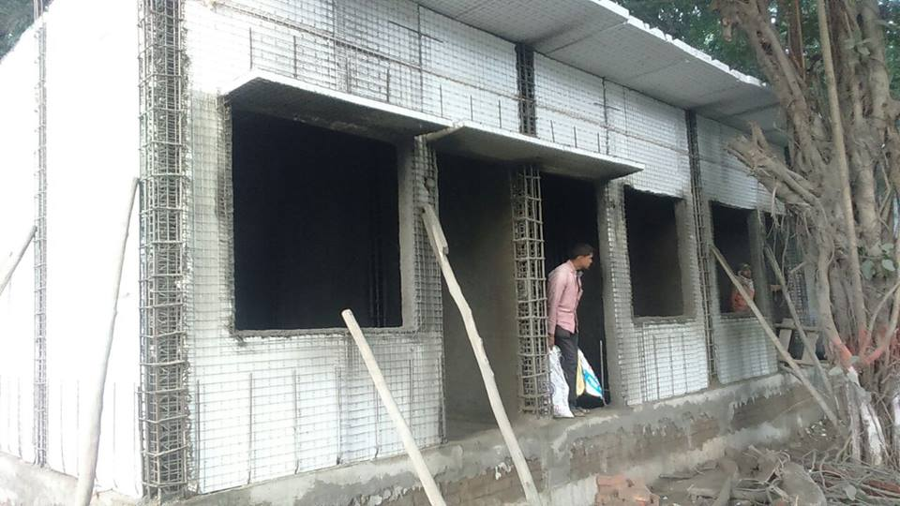

Slide 25
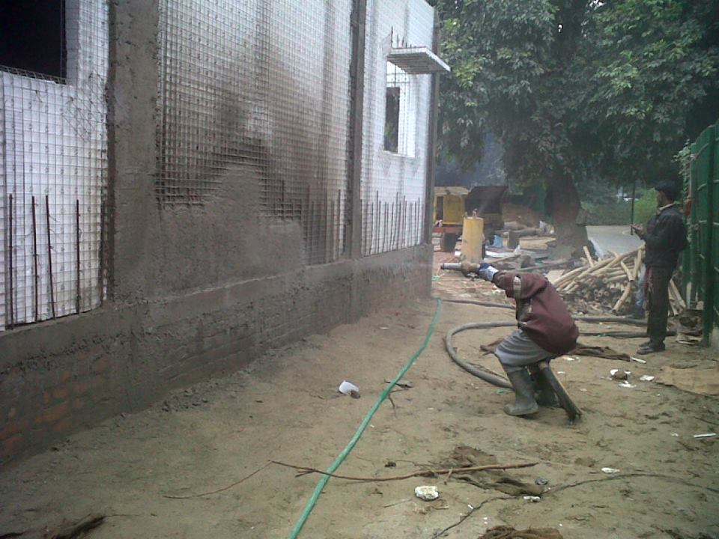

Slide 26
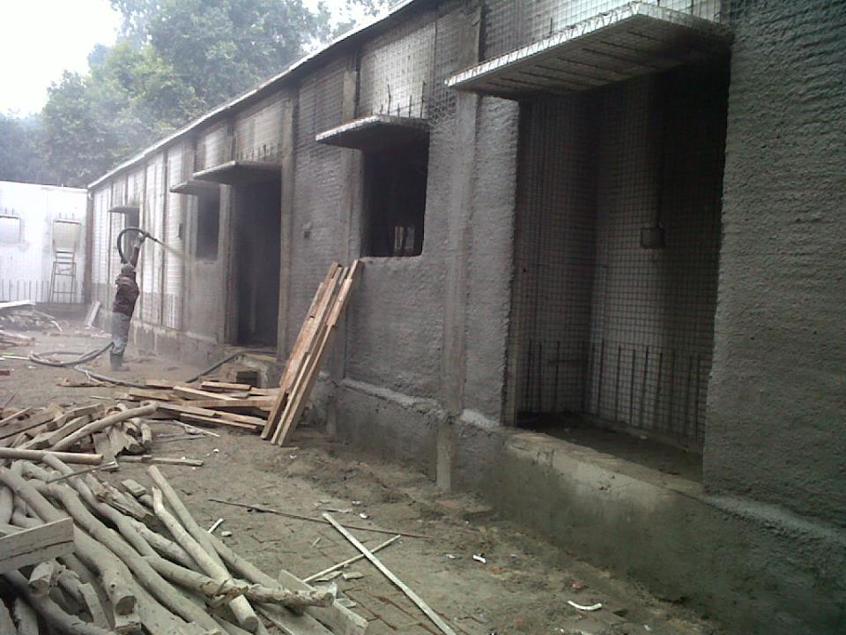

Slide 27
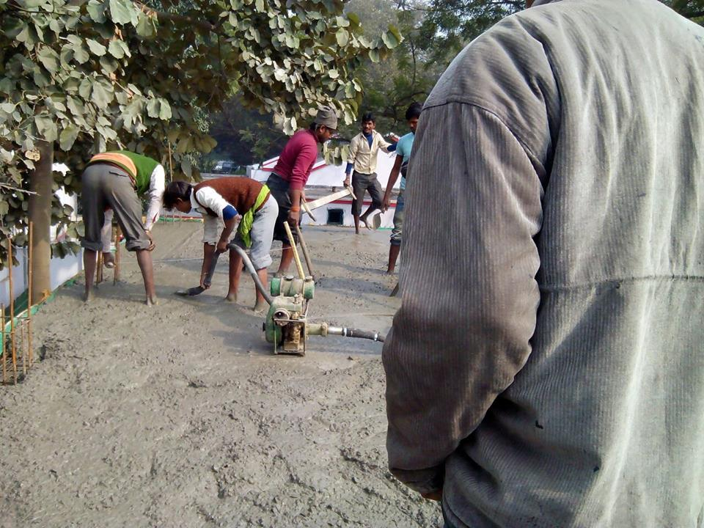

Slide 28
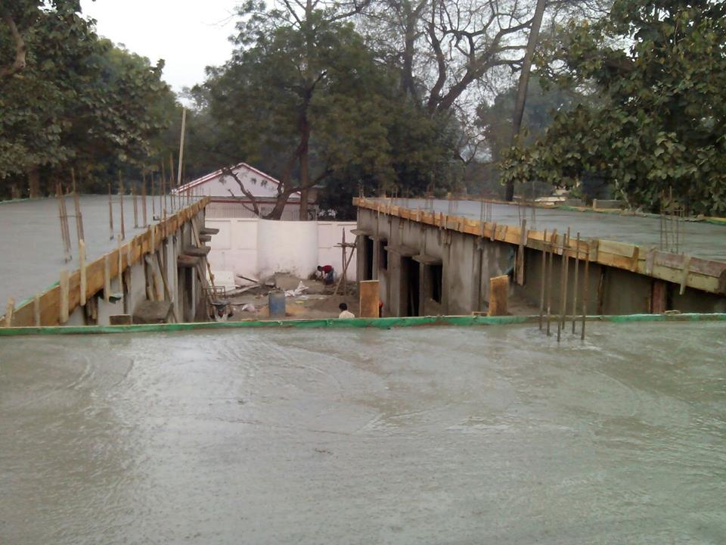

Slide 29
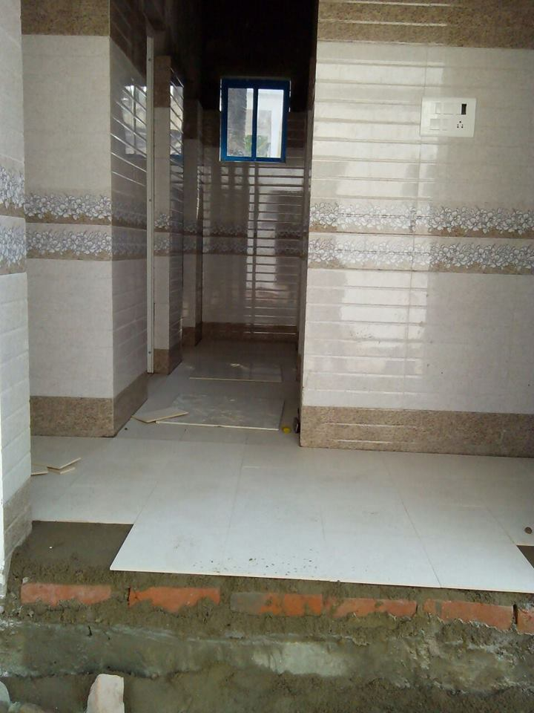

Slide 30
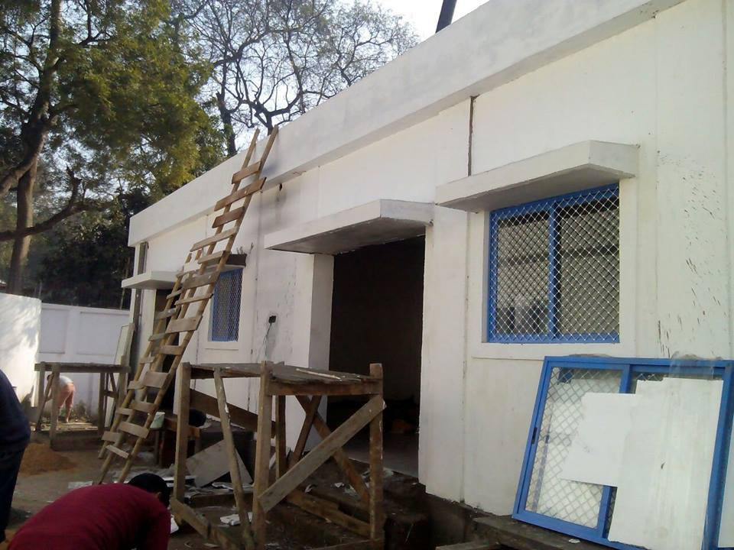

Slide 31
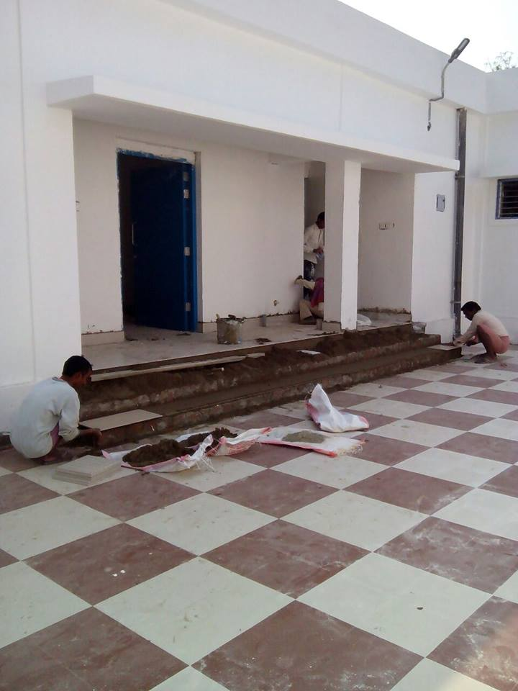

Slide 32
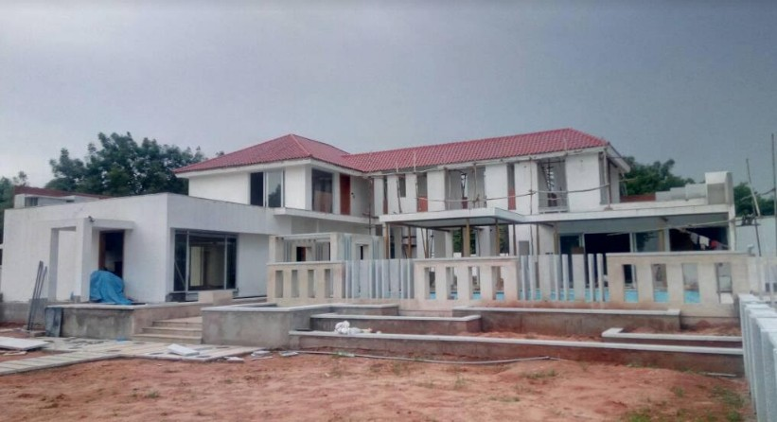
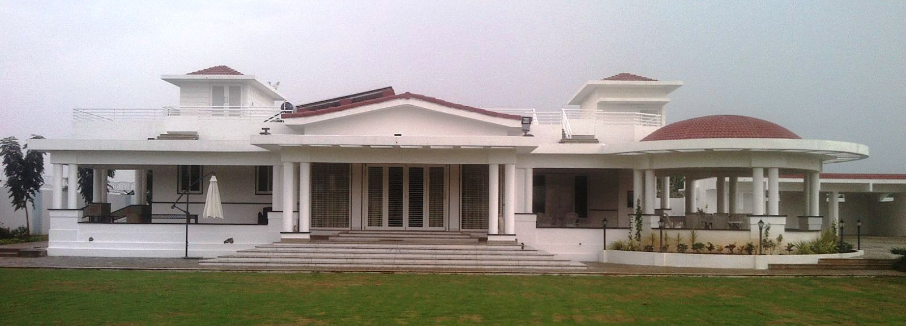
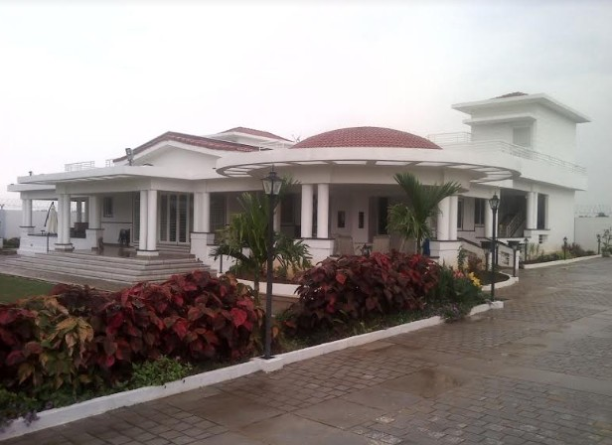
LUXURY FARM HOUSES

Slide 33
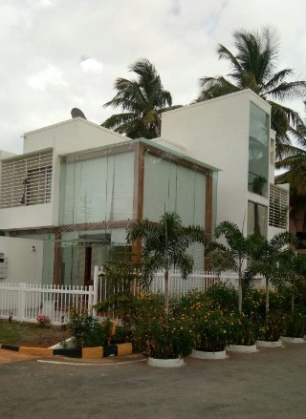
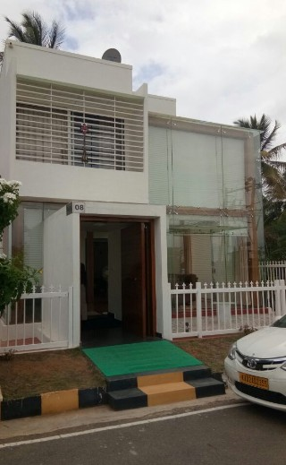
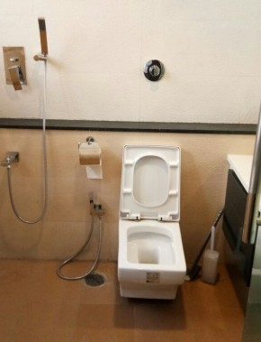
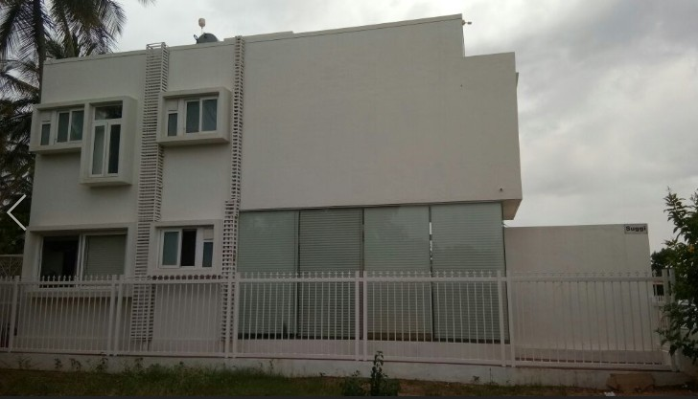
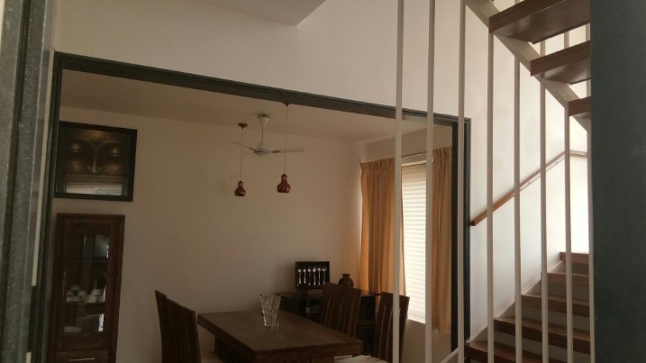
MYSORE FARM HOUSE

Slide 34
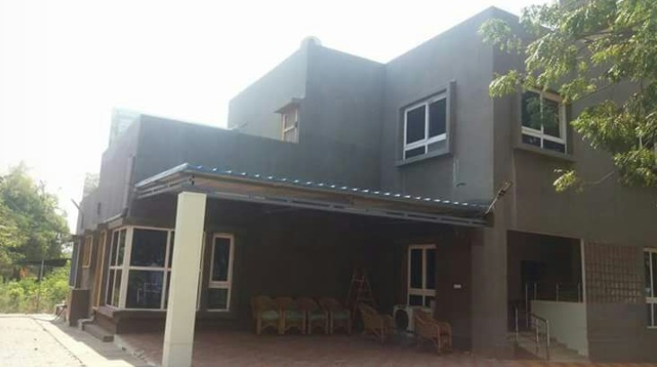



LUXURY FARM HOUSES
WAYNAD FARM HOUSE

Slide 35






VEMBAR CHURCH - CHENNAI
JEEVODAYA HOSPITAL
JP NAGAR, ABOVE EXISTING BUILDING

Slide 36




IIT JAMMU

Slide 37



QUIKBUILD PROJECTS – RAILWAY QUARTERS ORRISA

Slide 38








HIMALAYA DRUGS – BANGALORE
CONSTRUCTION OF THEIR VARIOUS FACILITIES WITH QUIKBUILD SYSTEM
CANTEEN CUM STORE G+1 BUILDING
STAIRCASE
MEZZANINE OFFICE – COLUMNS,BEAMS,ROOF PANEL& WALL PANELS
BABY CRECHE

Slide 39




PREFAB WAREHOUSE/ PRODUCTION UNIT –DEVANAHALLI, BANGALORE
MARRIAGE HALL - NASHIK
VEGA AUTO STEEL - RUDRAPUR

Slide 40






QB SHIMLA WORKERS QUARTERS
UNDER GROUND SUMP 35000LTRS CAPACITY, LOCATION: KODAIKANNAL

Slide 41






QUIKBUILD RESIDENTIAL COMPLETED PROJECTS
GUEST HOUSE AT KRISHNAPATNAM PORT
OLD AGE HOMES AT COIMBATORE
G+2 HOUSE AT PERMBALUR IN TN
G+1 QB HOUSE AT HYDERABAD
G+2 HOUSE AT MUMBAI
HOUSE AT CHENNAI

Slide 42





QUIKBUILD RESIDENTIAL COMPLETED PROJECTS

Slide 43




VILLA PROJECTS

Slide 44




G+2 RAILWAY QUARTERS AT ORISSA
TAMILNADU POLICE HOUSING – G + 2
MASS HOUSING PROJECTS

Slide 45





ANGANWADIS IN KARNATAKA
QB HOUSE IN WEST AFRICA

Slide 46






QUIKBUILD FOR DOMES / ARCH CONSTRUCTION

Slide 47
IIT TEST CERTIFICATES

Slide 48

IIT TEST CERTIFICATES
MSME LAB TEST CERTIFIES QUIKBUILD PANELS

Slide 49
NDT TEST REPORT

Slide 50

IGBC CERTIFICATE
BMTPC CERTIFICATE

Slide 51

AWARDS SPEAKS A MESSAGE
"Construction Industry Awards 2016“
21st May 2017
At
The Music Academy, Chennai.
Dear Sir,
Warm Greetings
We are pleased to inform you that your organization has been selected for the Construction Industry Award 2016. The Award ceremony will be held at The Music Academy, Chennai at 5:30PM on 21st May 2017.
Our award selection committee has approved your nomination under the Award Category of
“Excellence in Innovative, Green & Cost Effective Technology”.

Slide 52


COMPLETION CERTIFICATES

Slide 53



Slide 54


CSIR-CBRI RECOMMENDED THE TECHNOLOGY

Slide 55



CSIR-CBRI RECOMMENDED THE TECHNOLOGY

Slide 57



























Our Client base includes:
and many more…

Slide 58
Thank You
Business Development Team
BeardSell Ltd

