Slide 1
PMAY(U) Journey &
Light House Projects
Joint Secretary & Mission Director (Housing for All) 2nd March 2019

Slide 2
PMAY(U) Launched
0.7 Million Houses Approved
Hon’ble President’s vision - ‘Housing for All by 2022’
CLSS for MIG
4.3 Million Houses Approved
DHPs 1.7 Million
Houses Approved
Planning Area Inclusion
7.0 Million Houses Approved
2014
GHTC India Launched 7.9 Million Houses Approved
2015
2016
2018
2017
2019
PMAY(U)
Road to Success

Slide 3
Houses sanctioned under PMAY(U)
No. of Houses in Lakhs
Urban Housing Demand
100 Lakh
Houses Sanctioned 79 Lakh
Financial Year

Slide 4
PMAY(U) – Progress till 01.03.19
Demand Assessed
10 Million
Houses Sanctioned
7.9 Million
Central Assistance
US$ 17 billion (Rs 1.22 Lakh Cr)
Total Investment
US$ 63 billion (Rs 4.48 Lakh Cr)
Cities included
4,331
4.2 Million
1.6 Million
1.5 Million
Houses Grounded
Houses Completed
Houses Occupied

Slide 5
PMAY(U) Progress in Verticals
ISSR In-Situ Slum Redevelopment
CLSS Credit Linked Subsidy Scheme
AHP Affordable Housing in Partnership
BLC Beneficiary-Led Construction
GoI grant @ Rs. 1 Lakh per house
4.5 Lakh ISSR houses approved
Benefit of
2.67 Lakh
through interest subsidy of 3 to 6.5%
4.4 Lakh CLSS Beneficiaries
GoI grant @ Rs. 1.5 Lakh per house
26 Lakh AHP houses approved
GoI grant @ Rs. 1.5 Lakh per house
44 Lakh BLC houses approved

Slide 6
States Evolving under PMAY(U)
Maharashtra
Madhya Pradesh
Gujarat
Uttar Pradesh
Tripura
Demand:
Demand:
Demand:
Demand:
Demand:
1.0 Lakh
Sanction:
15.0 Lakh
Sanction:
11.4 Lakh
11.5 Lakh
Sanction:
6.8 Lakh
7.7 Lakh
Sanction:
4.7 Lakh
17.8 Lakh
Sanction:
9.1 Lakh
Tamil Nadu
Demand:
13.9 Lakh
Sanction:
6.2 Lakh
Andhra Pradesh
Demand:
13.8 Lakh
Sanction:
12.4 Lakh
0.8 Lakh

Slide 7
Leap-frogging under CLSS
Share of Primary Lending Institutions

Slide 8
Web-enabled
Demand capture Process
Process approach
Demand validation by ULB
PMAY(U) Accountability Systems
Digitization
Beneficiary database with bank account
Aadhaar seeding
of beneficiaries
DBT / PFMS
Electronic Funds Transfer
SLTC, TPQMA, Social Audit
for field level verification

Slide 9
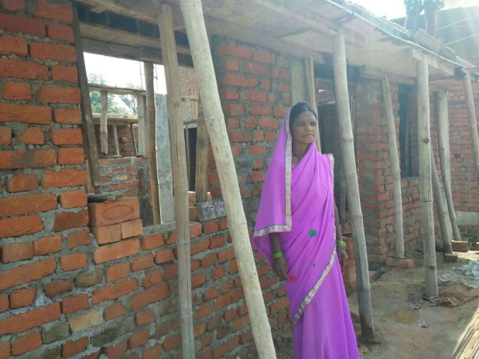
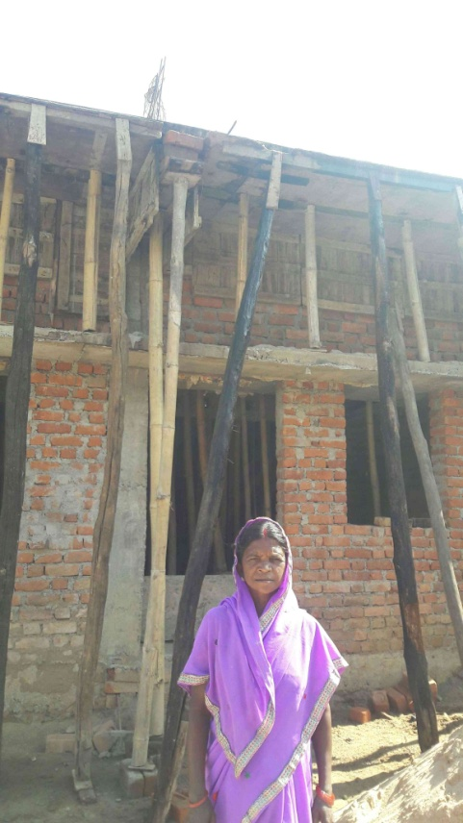
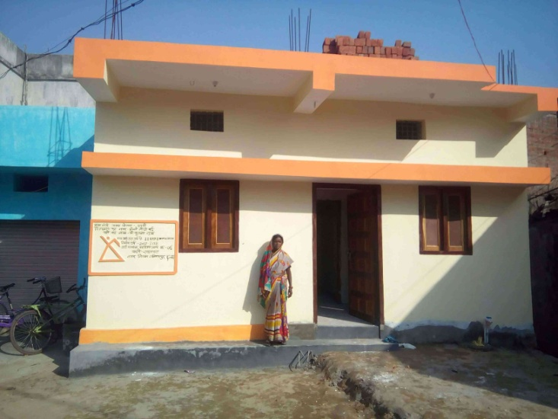
Geo-Tagging
Bhuvan Mobile App
For Geo-referenced photographs of construction stages under BLC Component of PMAY(U)
1.8 Million houses geo-tagged
NIC Mobile App For Geo-referenced photographs of AHP/ ISSR projects under PMAY(U) on Bharat Maps
900 projects geo-tagged
Mobile app for Beneficiaries Mobile app for Geo-referenced photographs to be taken by BLC beneficiaries
1
Grounding Stage
2
Foundation Stage
3
Lintel Stage
4
Roof Stage
5
Completion Stage
Geo-Tagging of BLC house in Ambikapur, Chhattisgarh

Slide 10
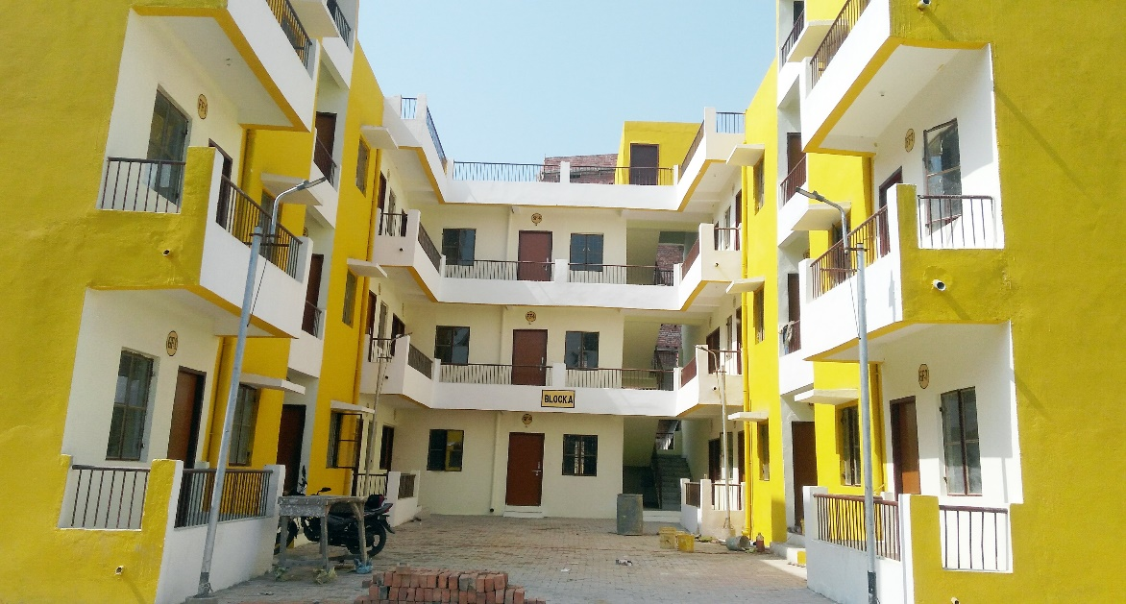
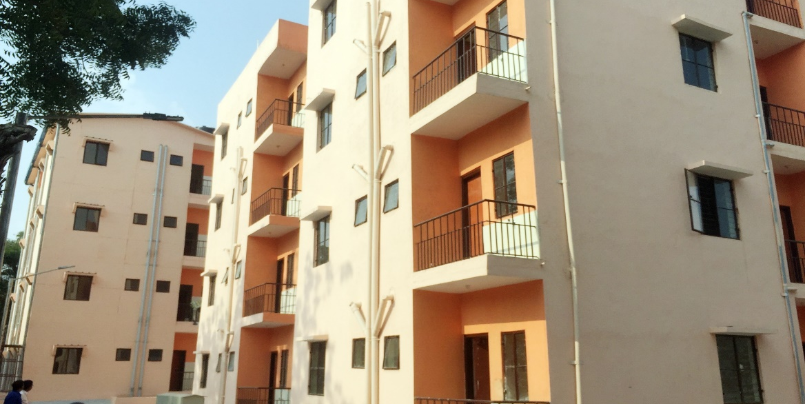
Demonstration Housing Projects
A model housing project built with new/ alternate technology
Providing on-site orientation to practitioners in the housing sector with knowledge on the application and use of alternate technology
Each DHP contains up to 40 Houses with sustainable, cost and time effective emerging alternate housing construction technologies suitable to the geo-climatic and hazardous conditions of the region
Biharshariff, Bihar
Hyderabad, Telangana

Slide 11
PMAY(U) Light House Projects
Proven Technologies that are innovative and established will be identified and mainstreamed from around the world for use in the Indian context
6 technologies to be applied to build Lighthouse Projects at six PMAY(U) regions under GHTC-India
These projects will comprise approx. 1,000 housing units each
The projects will demonstrate the merits of the selected technologies and serve as live laboratories for research, testing, technology transfer, increasing mass awareness and for mainstreaming them in the country.
JAMMU AND
KASHMIR
HIMACHAL
PRADESH
PUNJAB
UTTARAKHAND
ARUNACHAL
PRADESH
HARYANA
SIKKIM
NAGALAND
RAJASTHAN
Lucknow Uttar Pradesh
ASSAM
BIHAR
MEGHALAYA
MANIPUR
Indore Madhya Pradesh
WEST
BENGAL
MIZORAM
Rajkot Gujarat
Ranchi Jharkhand
Agartala Tripura
DAMAN AND DIU
MAHARASHTRA
DADRA AND
NAGAR HAVELI
TELANGANA
GOA
ANDHRA
PRADESH
KARNATAKA
Chennai Tamil Nadu
KERALA

Slide 12
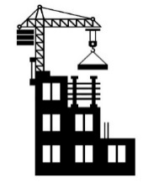
Average cost of Rs. 8.00 Lakh per DU has been assessed as per the existing DHPs guidelines formulated under TSM of PMAY (U).
Rs. 2.00 Lakh or 20% of the estimated cost (including internal infrastructure), whichever is lesser will be released by MoHUA to the implementing agency as Technology Innovation Grant (TIG)
Break up of funding of Rs 8 Lakh per dwelling Unit
Central Share (MoHUA) 1.5 Lakh
Technology Innovation Grant (TIG) 2.0 Lakh (max)
State Share (Avg.) 1.0 Lakh
Beneficiary Share 3.5 Lakh
Technology Innovation Grant TIG

Slide 13
PMAY(U) awards for Implementation and Innovation institutionalised to identify and reward the “Top Performers” and to encourage others to compete and attain the goal of ‘Housing for All’ in a sustained manner
Beneficiary Awards for each State/UT for most aesthetic and innovative houses built under the Beneficiary-Led Construction
Special Category awards for Community Mobilisation, Slum Redevelopment, Policy initiatives, Project monitoring etc have also been instituted.
PMAY(U)
Awards

Slide 14
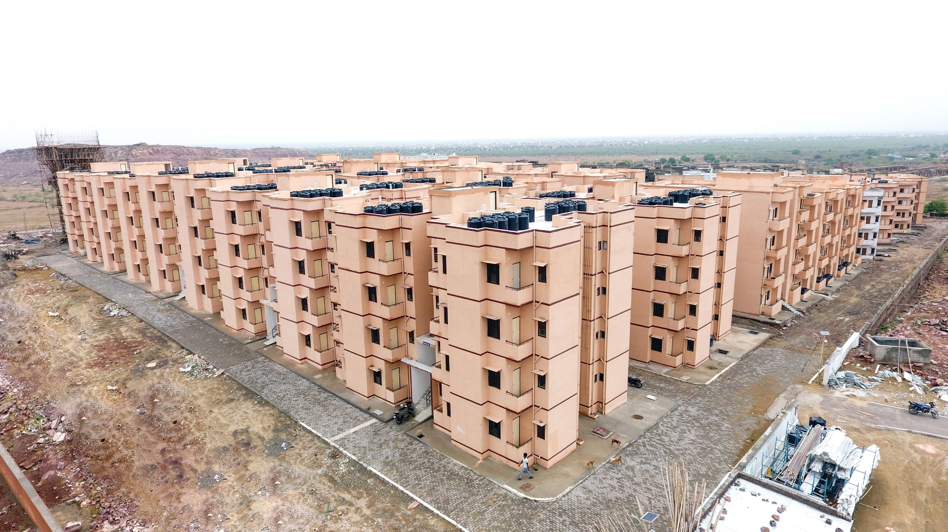
AHP - Jodpur, Rajasthan

Slide 15
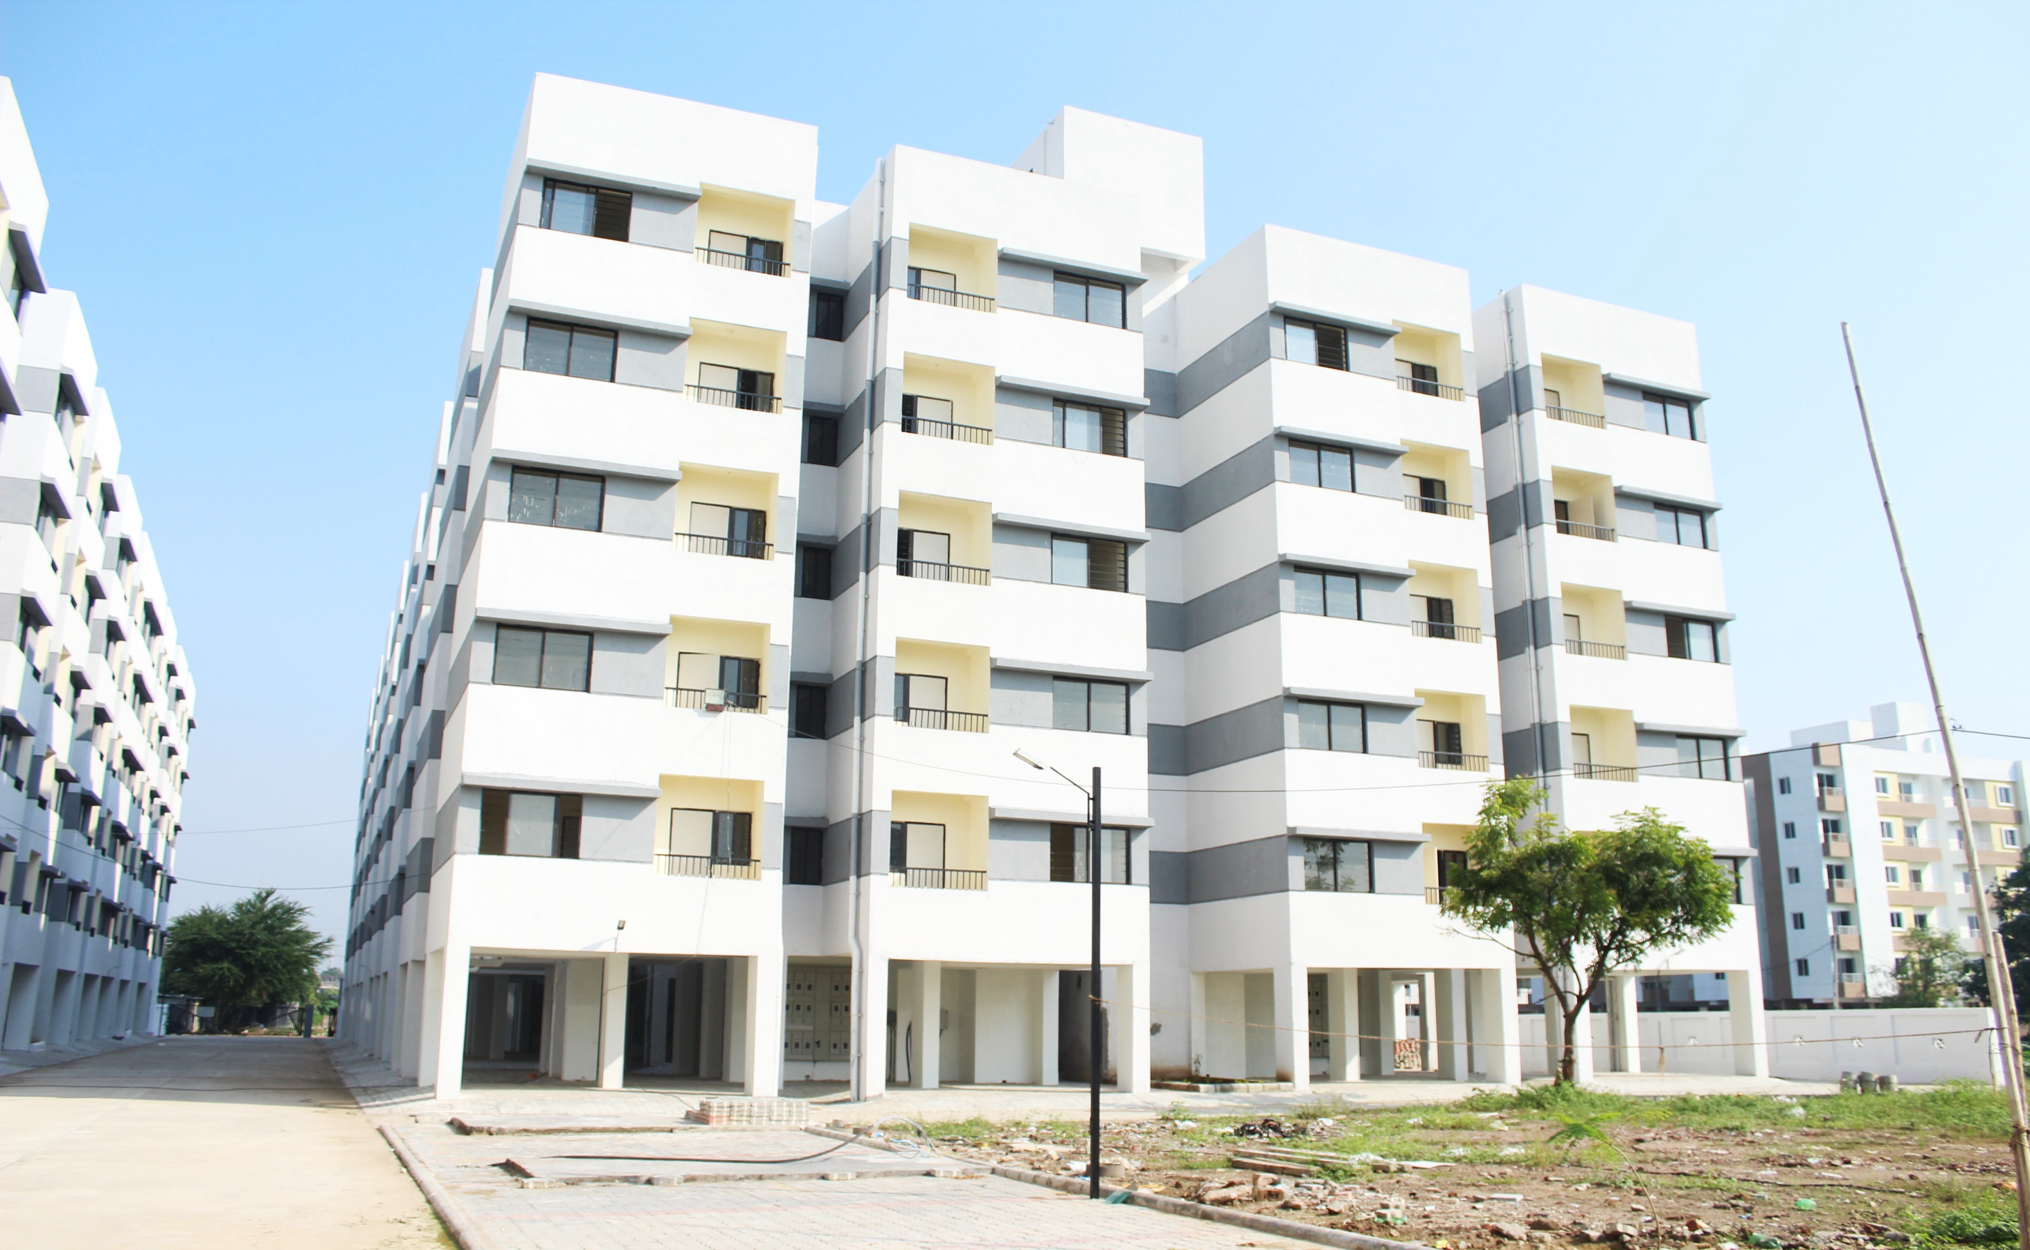
AHP - Vadodra, Gujarat

Slide 16
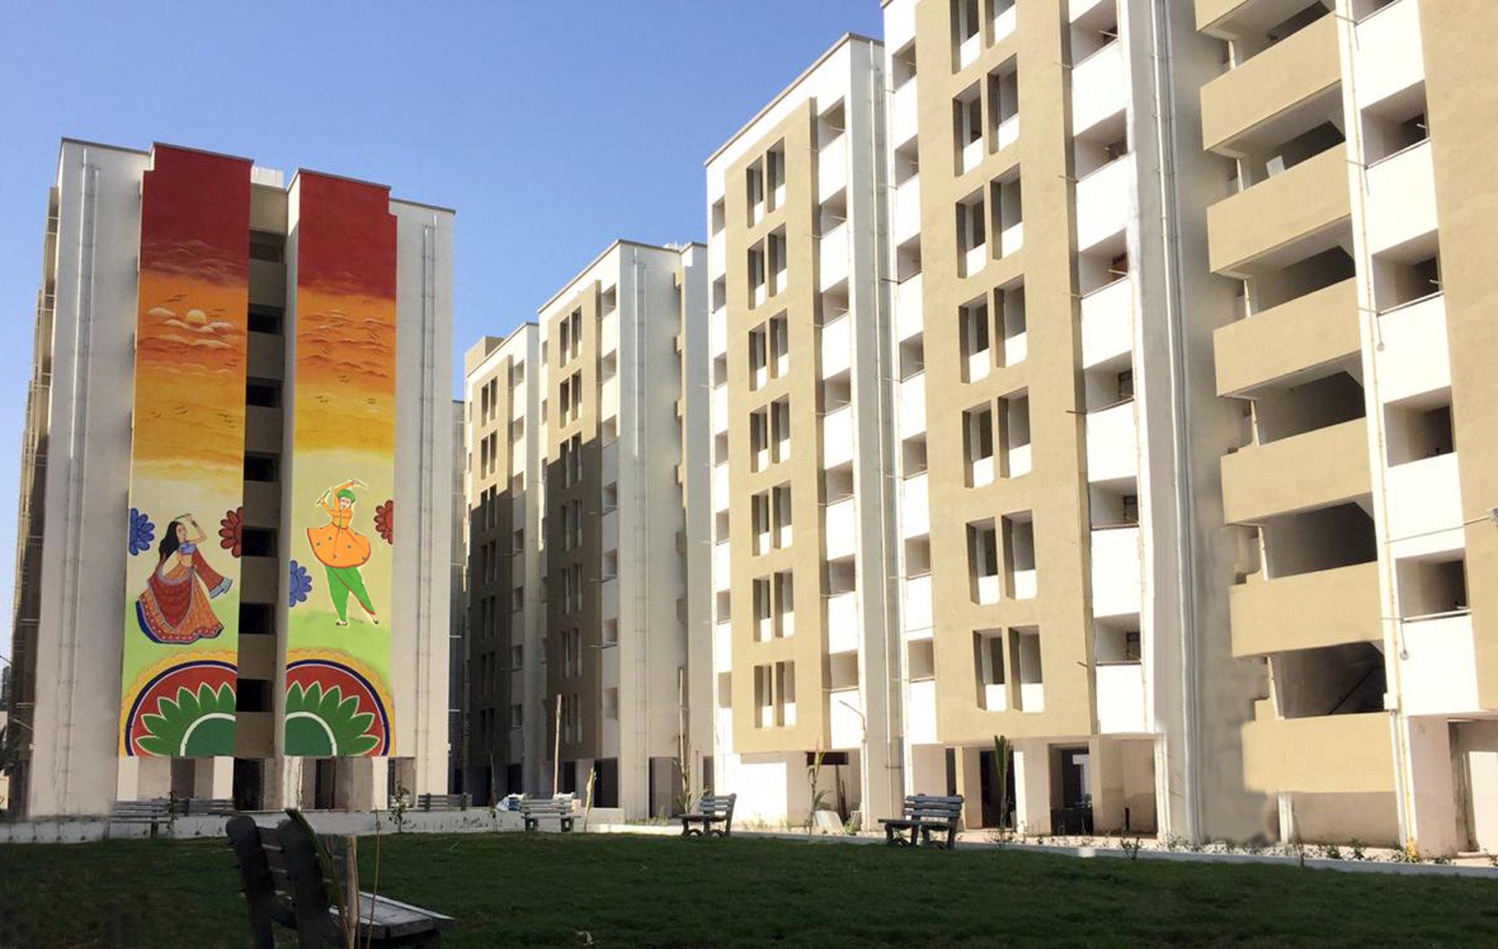
AHP - Rajkot, Gujarat

Slide 17
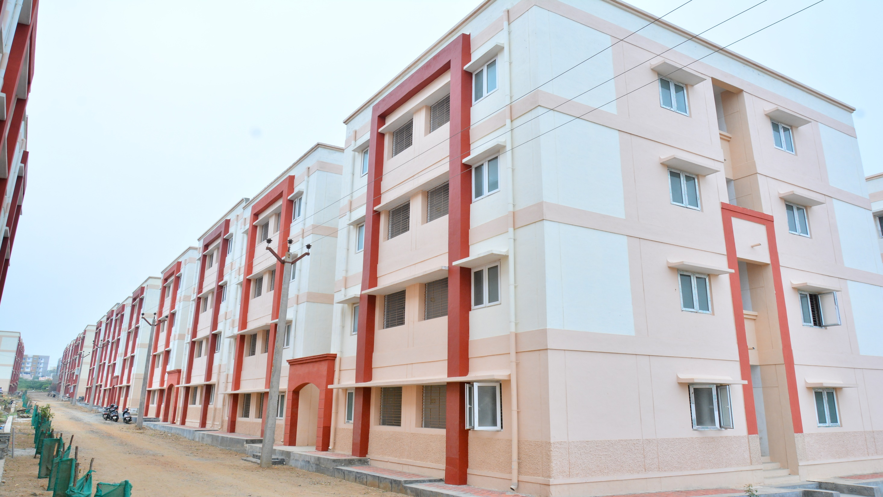
AHP - Coimbatore, Tamil Nadu

Slide 18
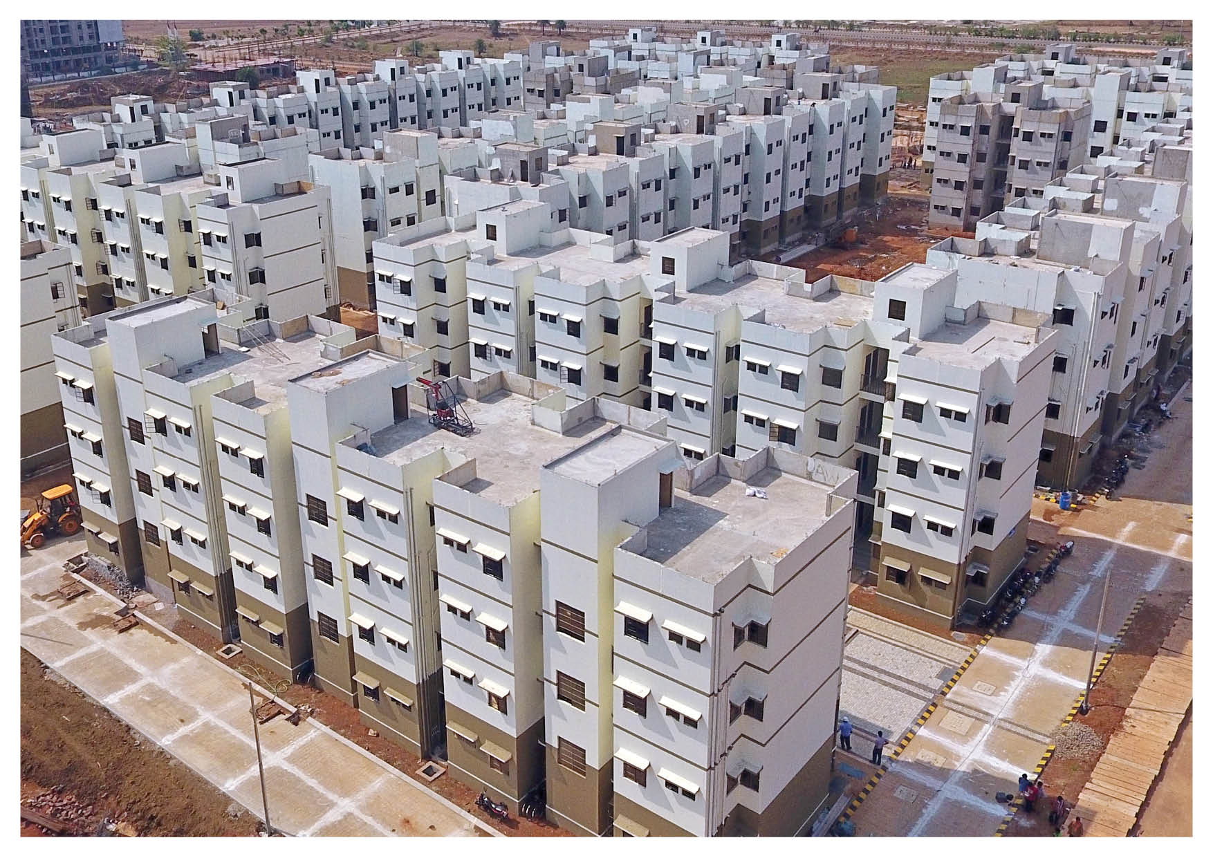
AHP – Atal Nagar, Chhattisgarh

Slide 19
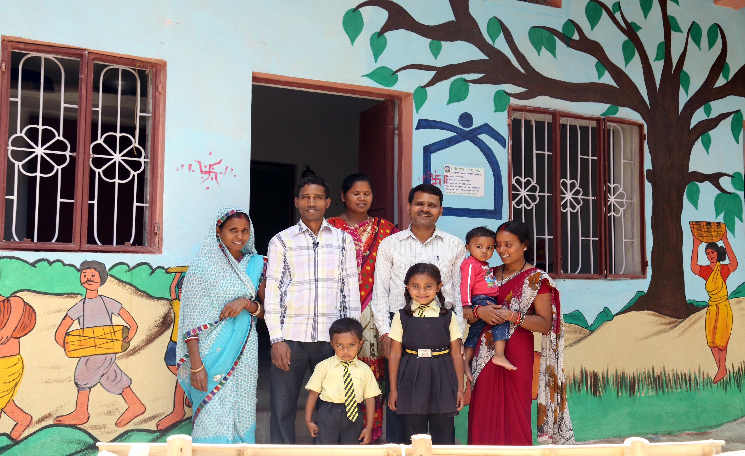
BLC - Ranchi, Jharkhand

Slide 20
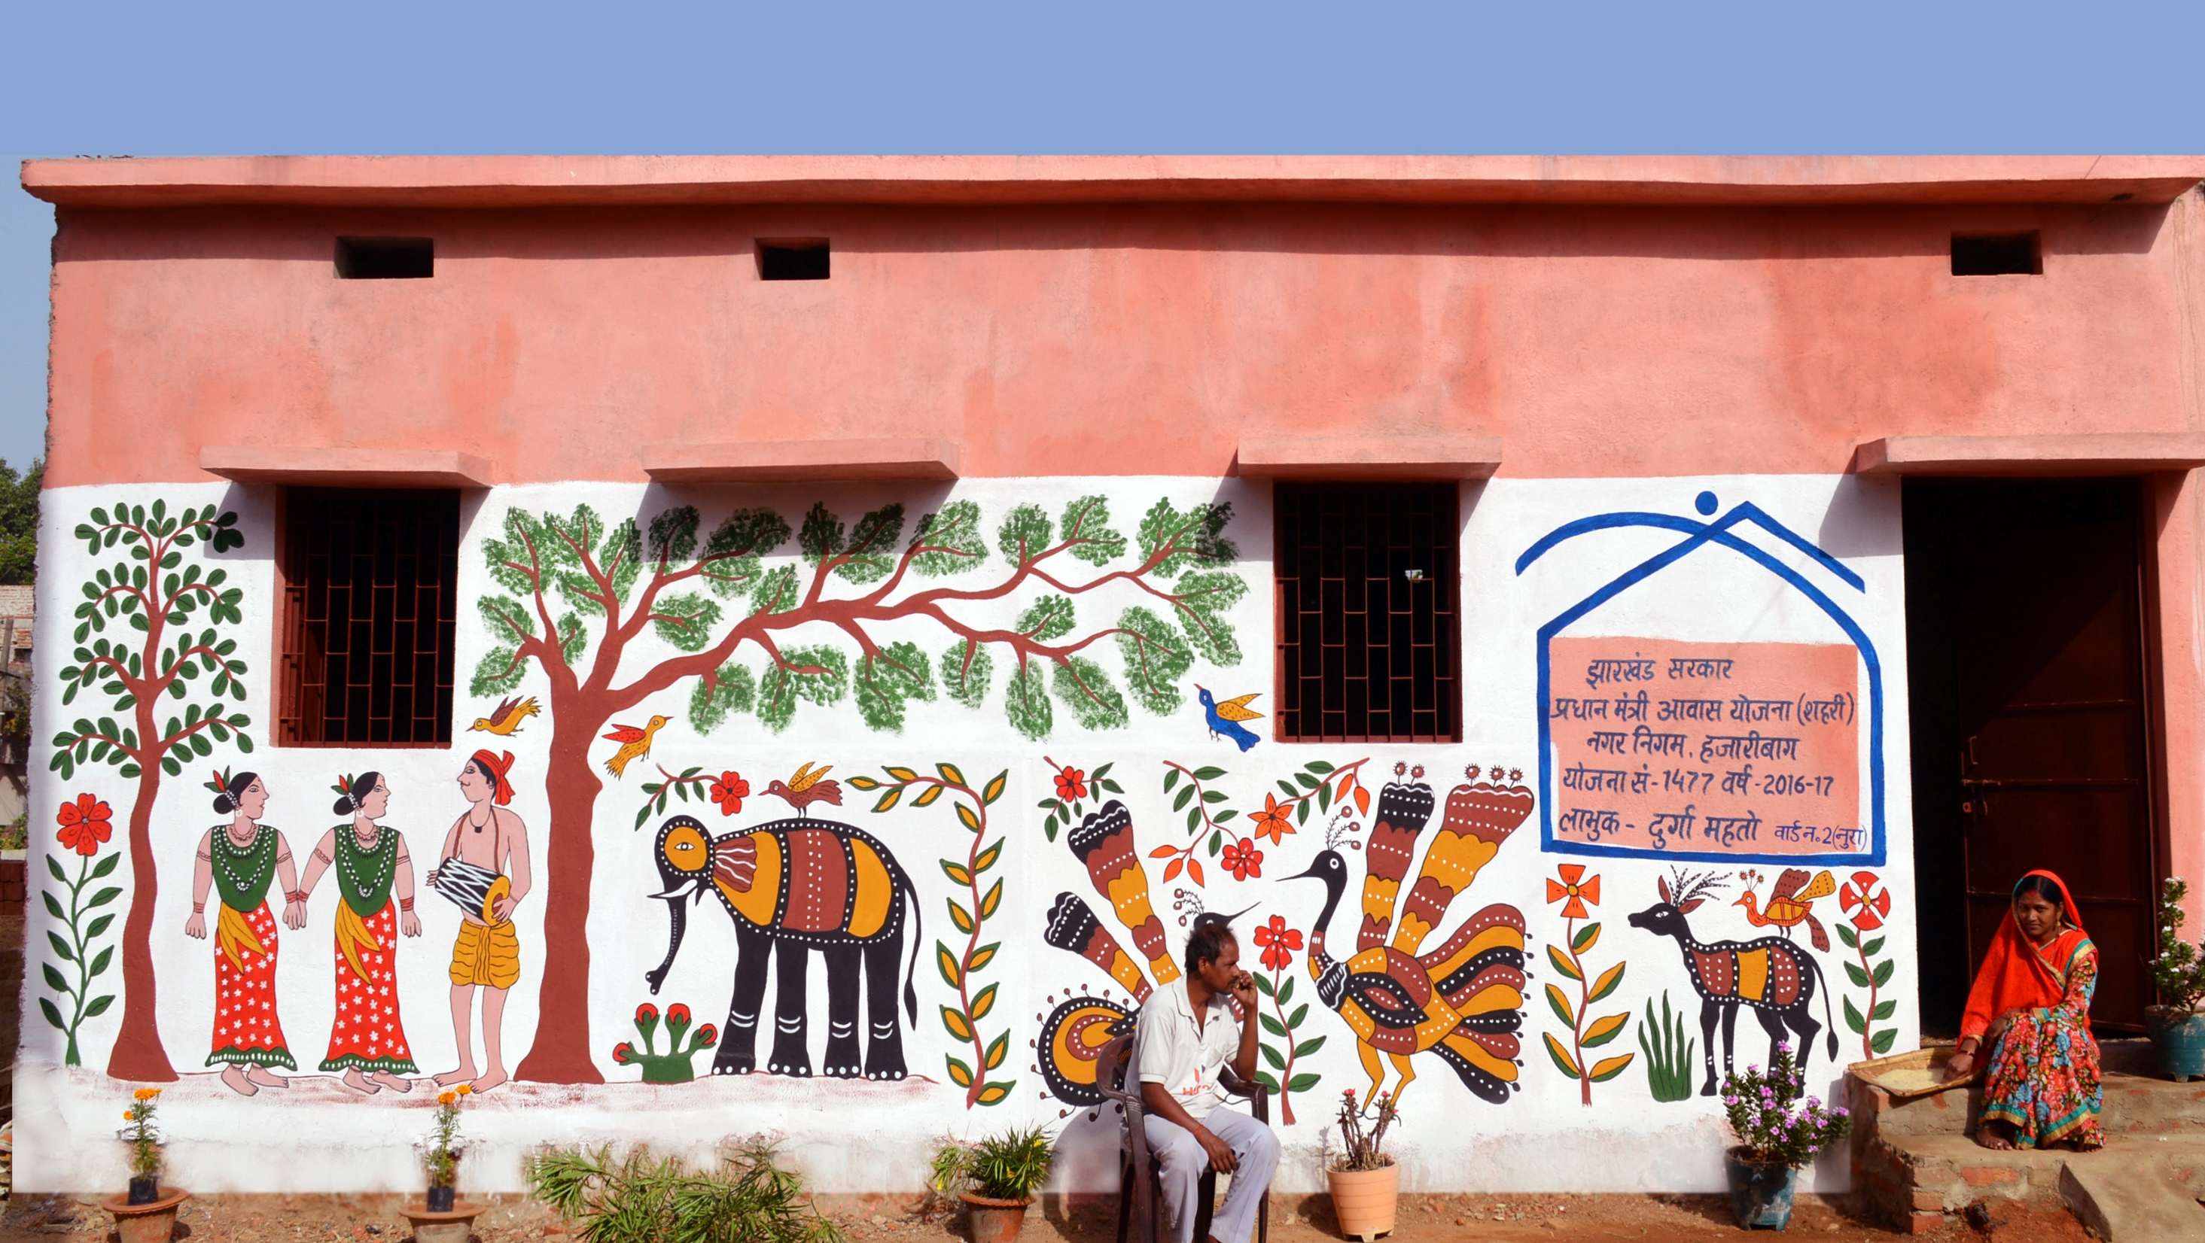
BLC - Hazaribagh, Jharkhand

Slide 21
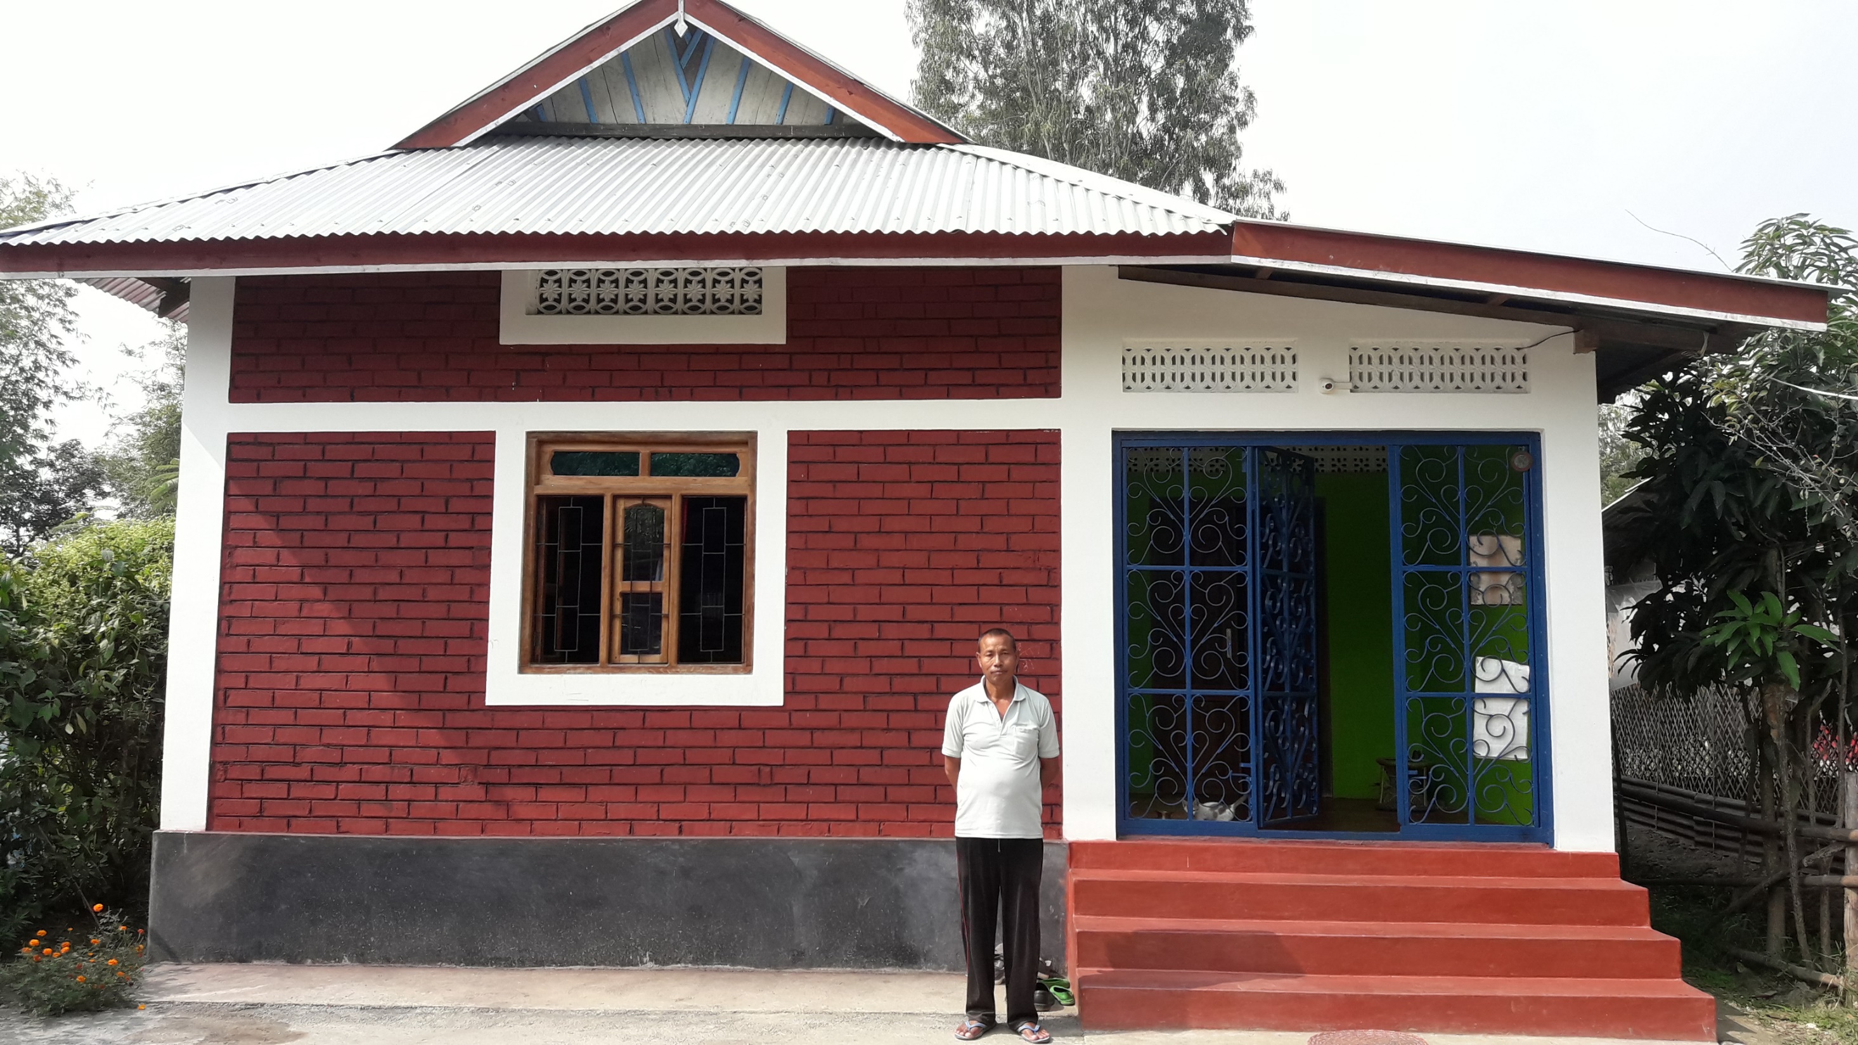
BLC - Nambol, Manipur

Slide 22
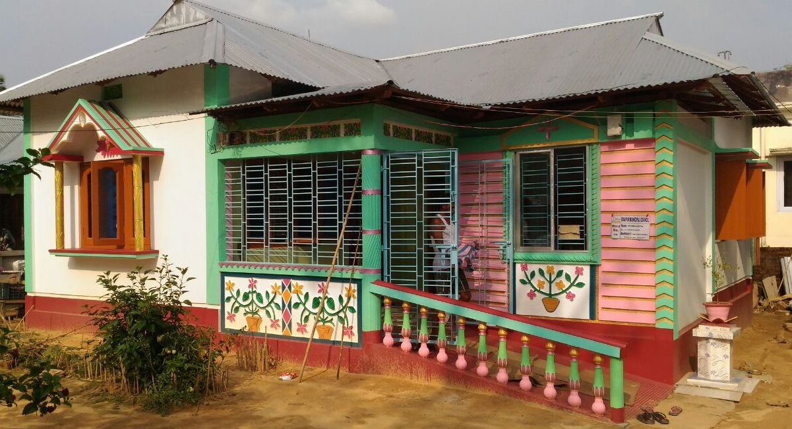
BLC - Udaipur, Tripura

Slide 23
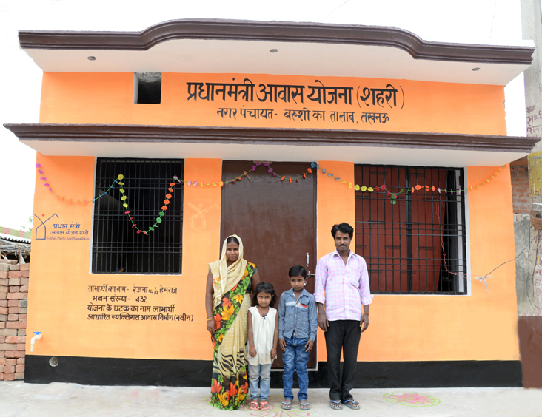
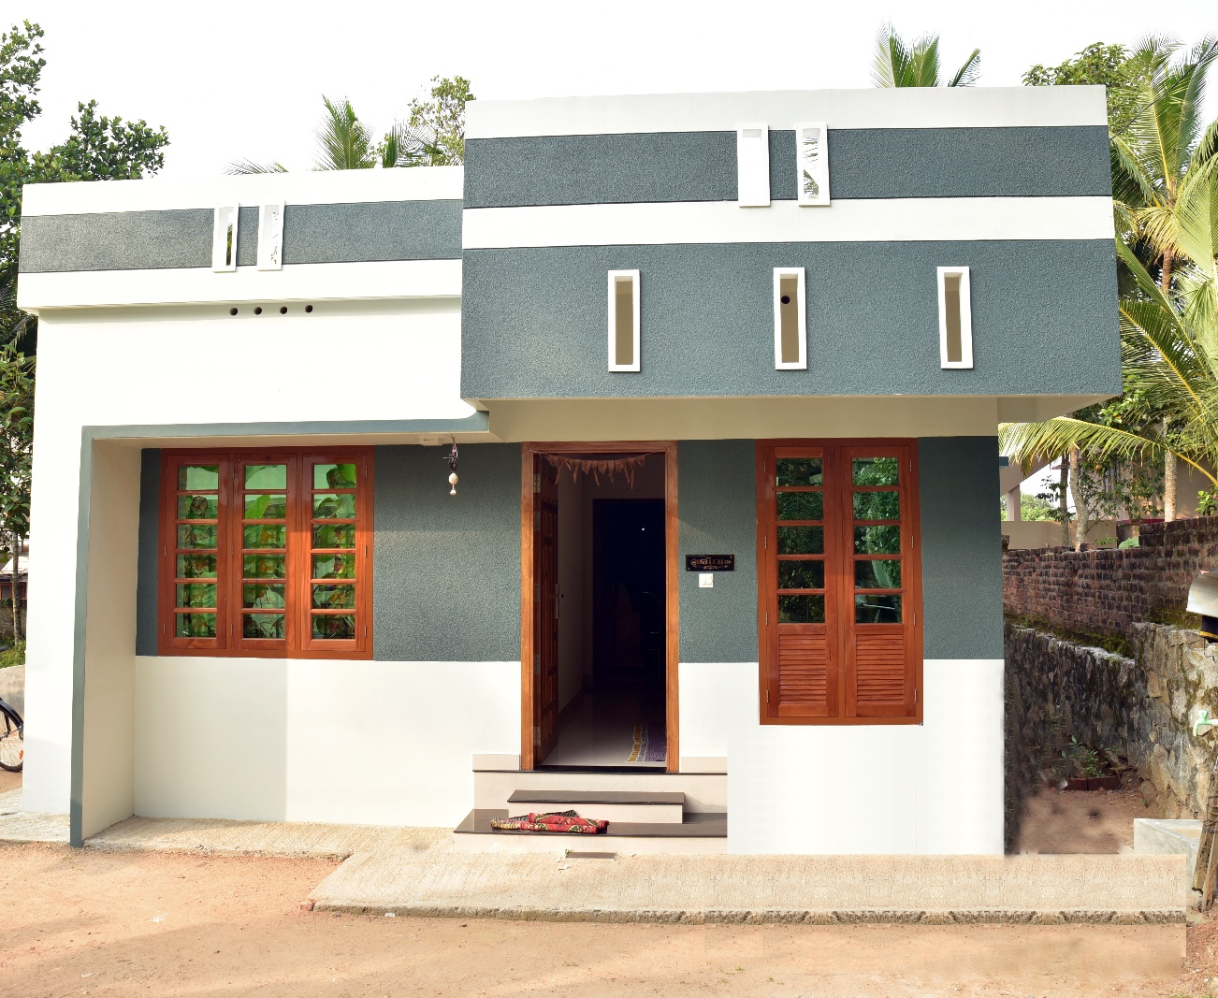
BLC - Lucknow, Uttar Pradesh
BLC - Kochi, Kerala

Slide 24
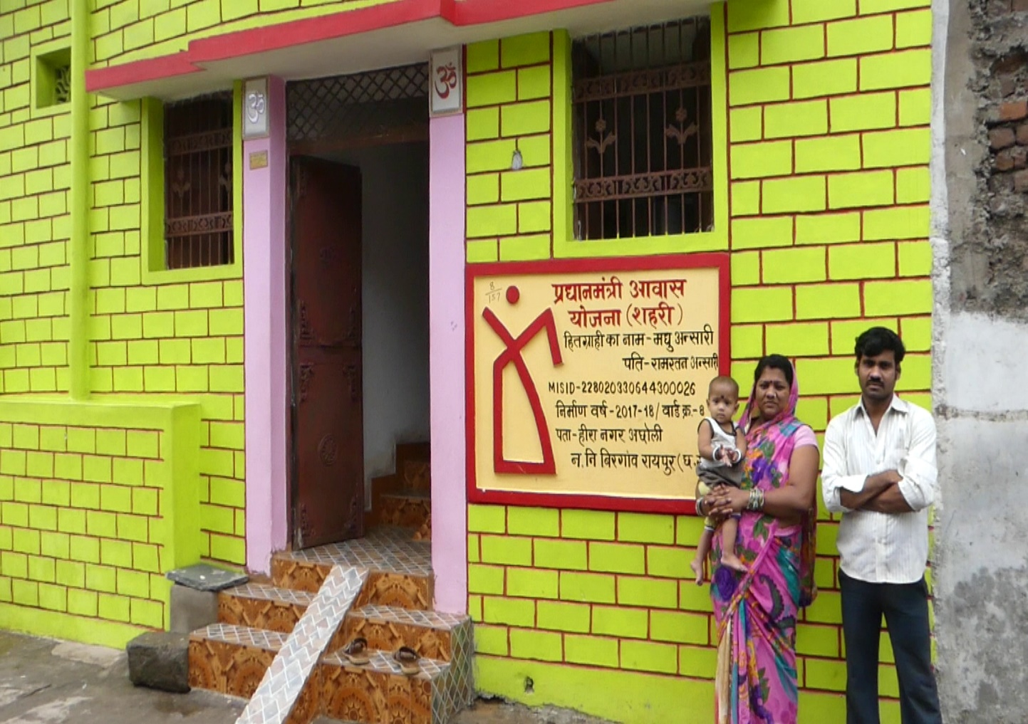
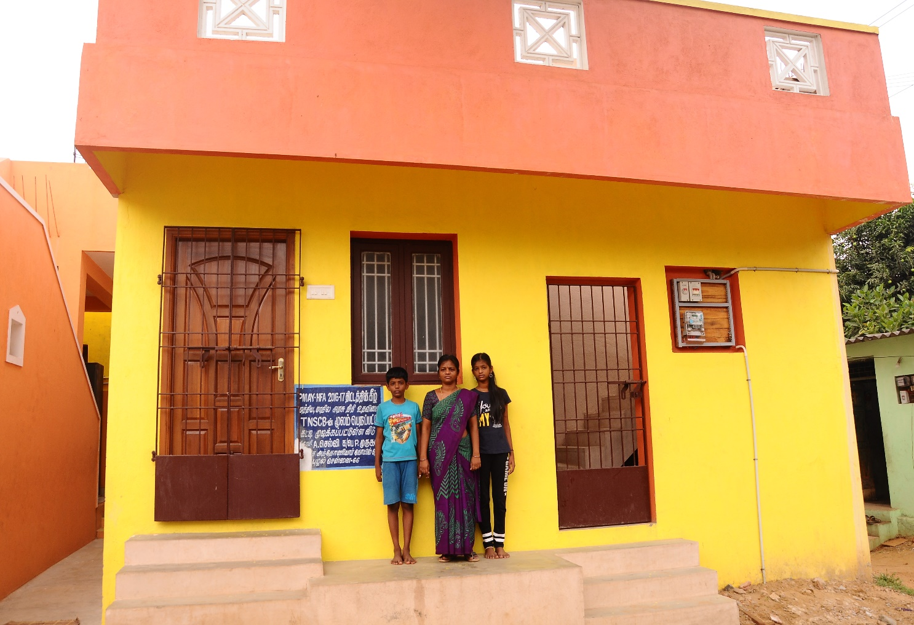
BLC - Raipur, Chhattisgarh
BLC – Chennai, Tamil Nadu

Slide 25
Thank you

