Slide 1
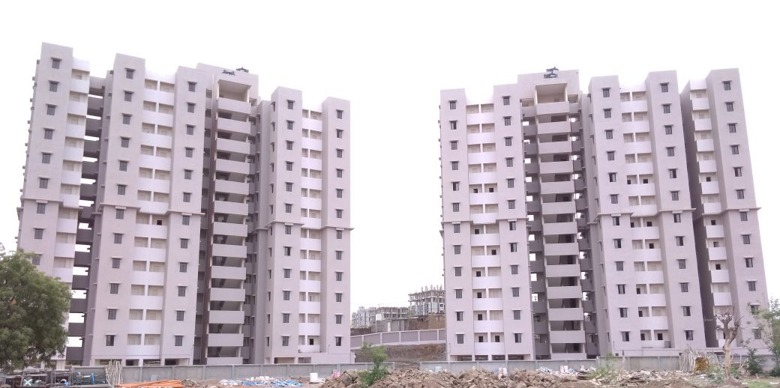
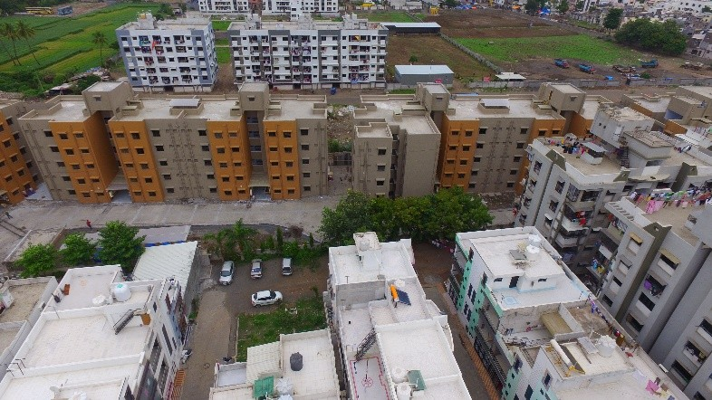

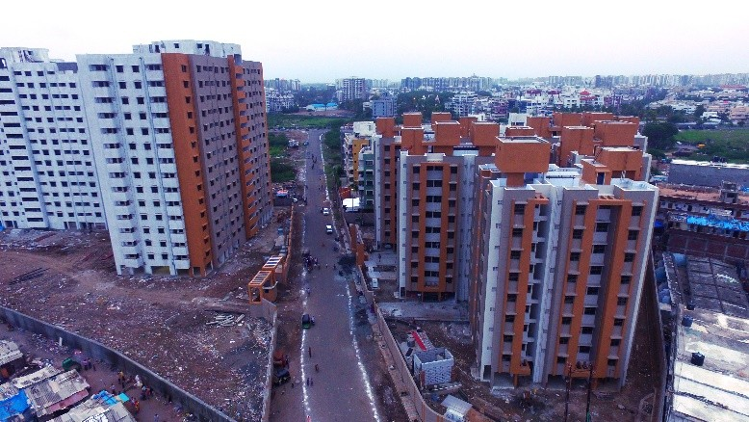
PROPOSAL FOR LIGHT HOUSE PROJECT OF GUJARAT
Gujarat
Affordable Housing Mission
Urban Development & Urban Housing Department
Government of Gujarat

Slide 2
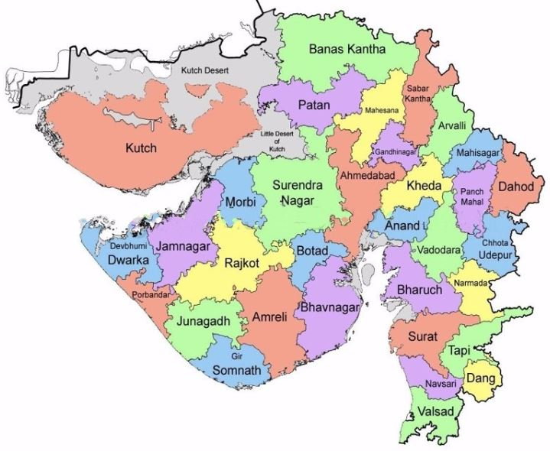
Gujarat
OVERVIEW OF URBAN AREAS
Population Gujarat 6.04 Cr
Urban Population of Gujarat 2.57 Cr (42.5%) (As per Census 2011)
170 ULBs | 8 Municipal Corporations | 162 Municipalities |  |  |  | 1 notified area (Saputara)
 |  | 22 Class-A (Population >1,00,000) | 34 Class B (Population 50,001-1,00,000) | 62 Class C (Population 25,001- 50,000) | 44 Class D (less than 25,000)

Slide 3
Gujarat
STATE ASSISTANCE ACCORDANCE WITH PMAY (U)
Component | Carpet Area | Cost of the house | GoI Grant | State Grant | ULB Grant | Beneficiaries Contribution
In-situ Slum Redevelopment (ISSR) | 30 Sq.M. | 5.50 lakh | 1 lakh | 1 lakh | - | Free of Cost
Affordable Housing in Partnership (AHP) Greenfield | 30 Sq.M. | 6.00 lakh | 1.50 lakh | 1.50 lakh | Physical & Social Infra. + Land | EWS-I 3 lakh
 | 40 Sq.M. | 8.50 lakh |  |  |  | EWS-II 5.50 lakh
Affordable Housing in Partnership (AHP) Untenable | 30 Sq.M. | 6.00 lakh | 1.50 lakh | 4 lakh | Physical & Social Infra. + Land | Up to 1 lakh
Beneficiaries Led Construction (BLC) (New Construction) | 30 Sq.M. | 4.00 lakh | 1.50 lakh | 2 lakh | - | 0.50 to 0.75 lakh

Slide 4
Gujarat
STATE VISION FOR HOUSING
Demand Survey has been carried out in all Urban areas in 2016
Indicative City wise Survey data of required houses
Status of Demand Survey Work |  | AHP | BLC | CLSS | Total
Municipal Corporations | Ahmedabad | 63487 | 7454 | 158145 | 229086
 | Bhavnagar | 57910 | 2490 | 16830 | 77230
 | Gandhinagar | 57800 | 790 | 884 | 59474
 | Jamnagar | 10258 | 14515 | 47839 | 72612
 | Junagadh | 17570 | 1915 | 5418 | 24903
 | Rajkot | 3730 | 418 | 119 | 4267
 | Surat | 1604 | 707 | 1799 | 4110
 | Vadodara | 10152 | 2184 | 7923 | 20259
Total- MC |  | 222511 | 30473 | 238957 | 491941
Nagarpalikas (NP) | All Class Nagarpalikas | 118927 | 93854 | 71311 | 284092
Total- NP |  | 118927 | 93854 | 71311 | 284092
Grand Total |  | 341438 | 124327 | 310268 | 776033

Slide 5
Gujarat
STATE VISION FOR HOUSING
Gujarat State’s envisaged target of around 7.64 lakhs dwelling units (housing) to be achieved by 2022
Indicative Dwelling Units to be started year wise
Total | 74,632 | 1,79,752 | 3,05,417 | 456127 | 6,55,770 | 7,64,926

Slide 6
Gujarat
OVERALL ACHIEVEMENTS
4.17 Lakh houses approved against 7.64 lakhs houses to be approved by 2022 (approx. 55%)
Sr. No. | Year | AHP | ISSR | BLC | CLSS | Total
1 | 2015-16 | 14,763 | 17,580 | 0 | 0 | 32,343
2 | 2016-17 | 46,926 | 19,971 | 3,177 | 9,330 | 79,404
3 | 2017-18 | 34,066 | 18,175 | 18,947 | 33,454 | 1,04,642
4 | 2018-19 | 73,259 | 400 | 28,408 | 72,863 | 1,74,930
 |  | Considered in CSMC meeting on 25.02.2019
 |  | 14,578 | 0 | 11,283 | 0 | 25,861
Grand Total |  | 1,83,592 | 56,126 | 61,815 | 1,15,647 | 4,17,180

Slide 7
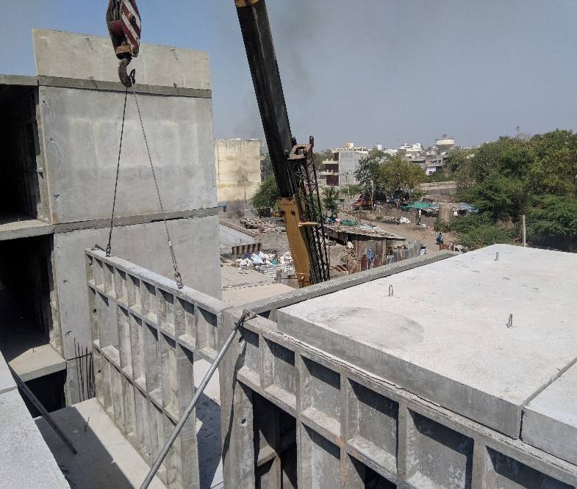
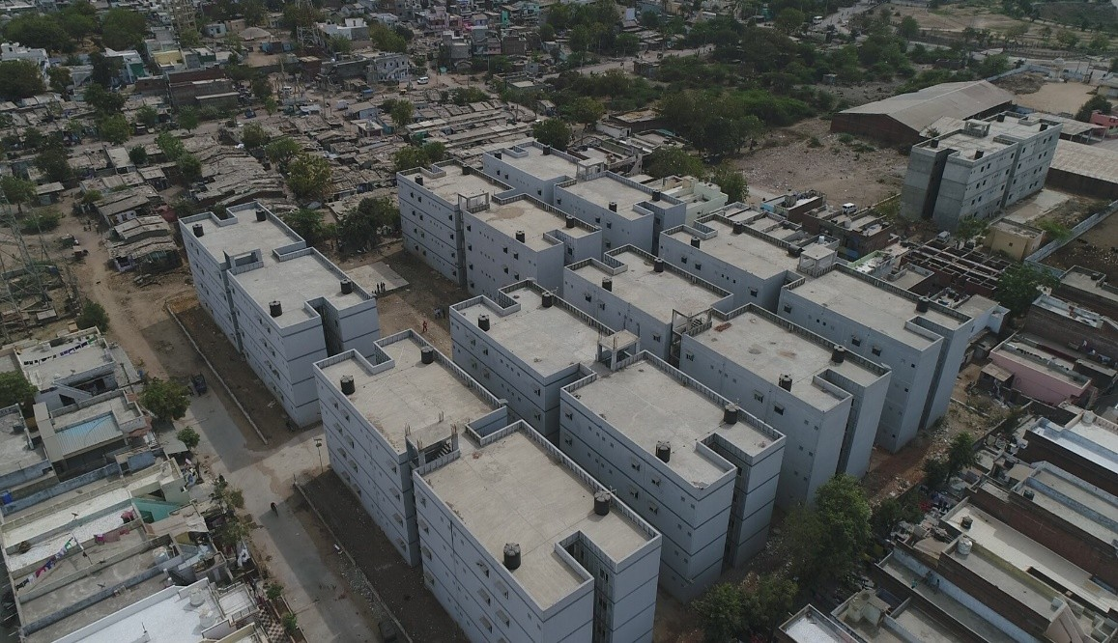
Gujarat
TECHNOLOGY USED
The Conventional Technologies is not adequate to construct the houses against the demand of housing in a time bound manner. Thus Government of Gujarat starts to adopting new innovative and emerging technologies for construction and give them priority
More than 55,000 houses have already been built for using innovative technologies.
Waffel Crete Technology - Kalaol

Slide 8
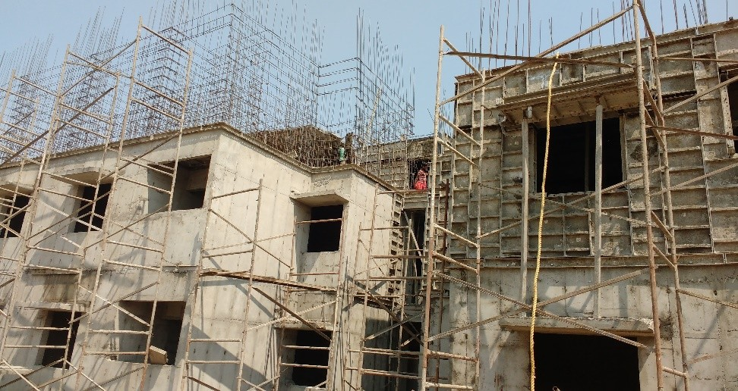
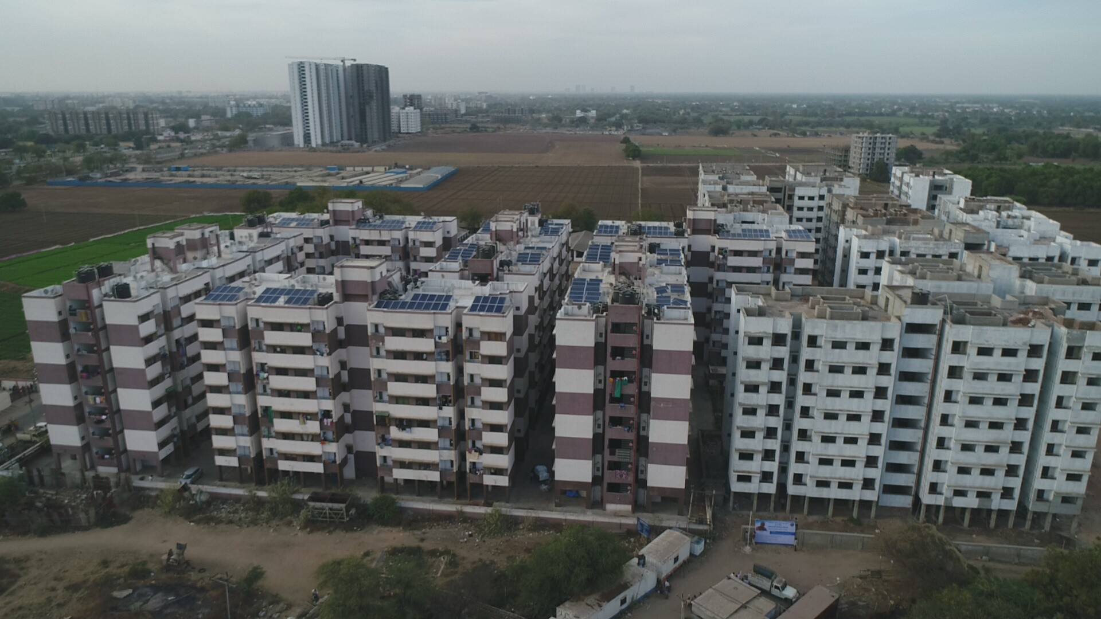
Gujarat
TECHNOLOGY USED
Mascon Technology – Ahmedabad

Slide 9
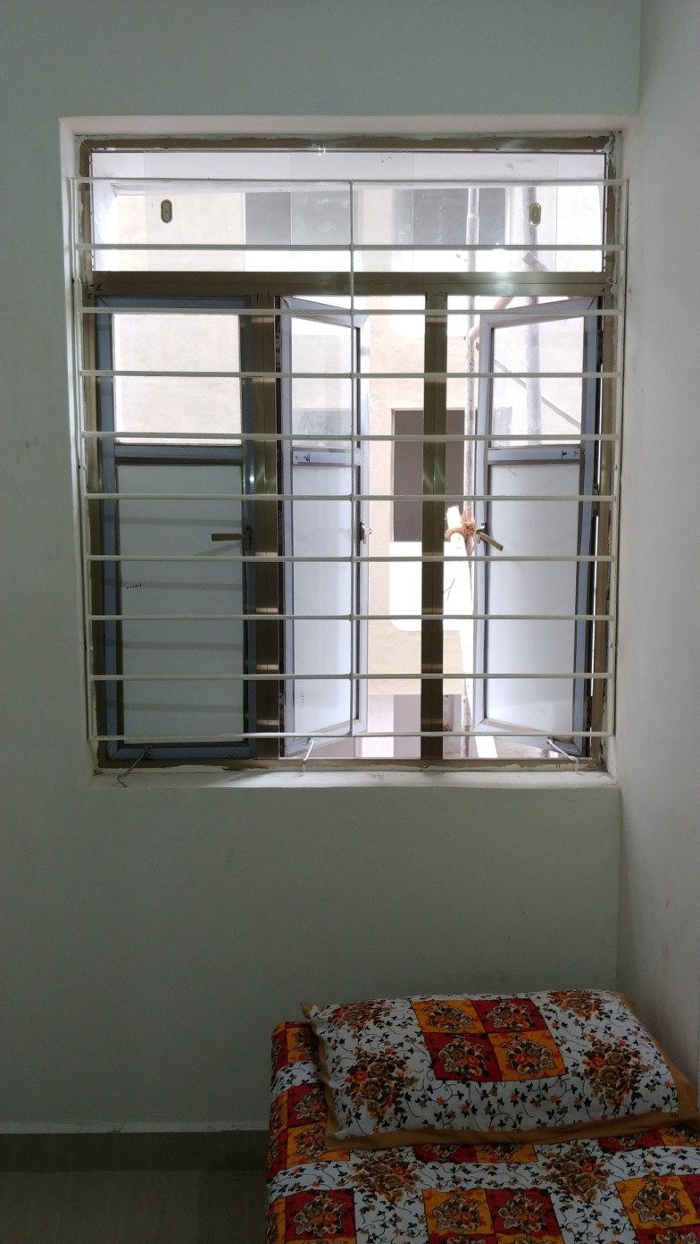
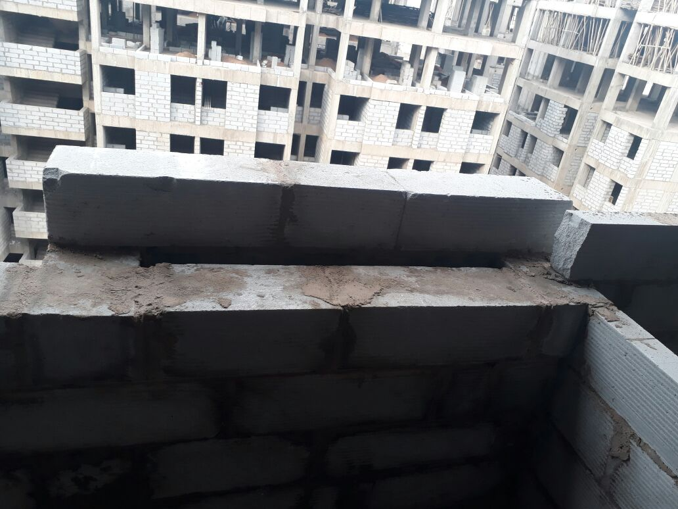
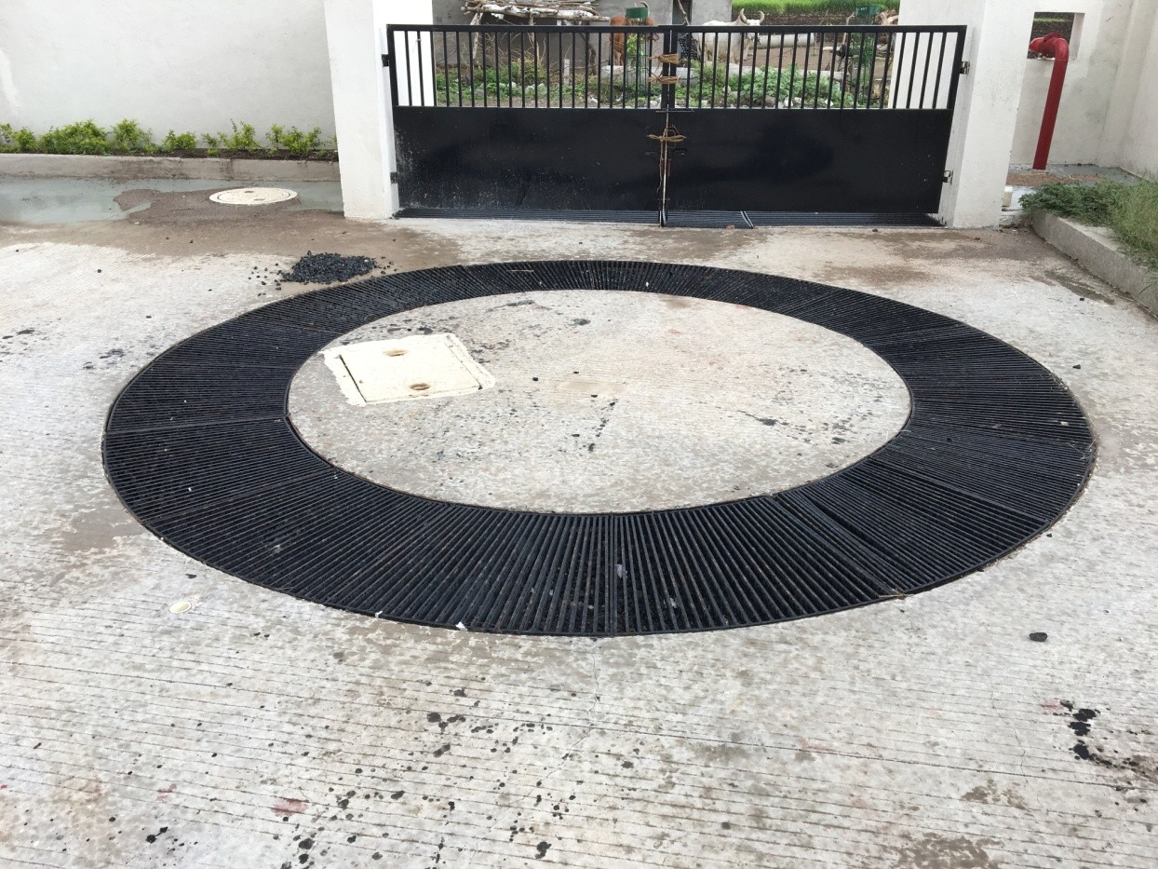
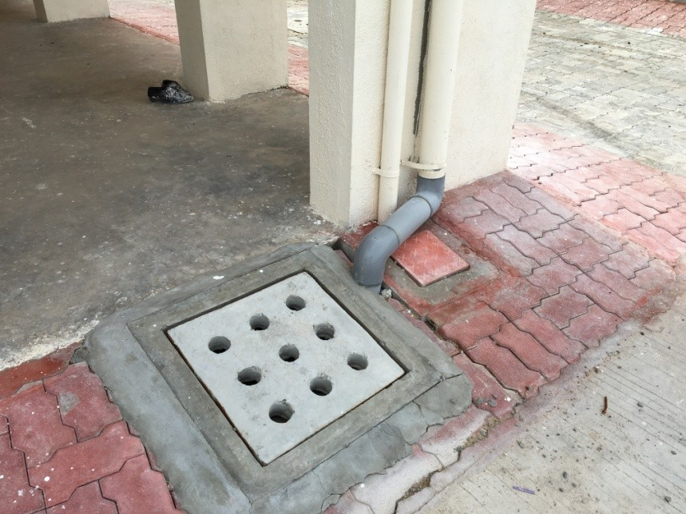
Gujarat
GREEN BUILDING CONCEPT
Green Building Concept Base Window
Cavity walls for reduce heat
Rain water Harvesting

Slide 10
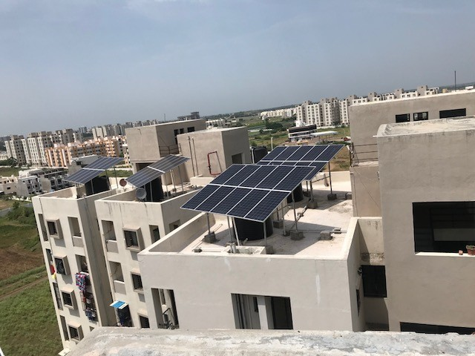
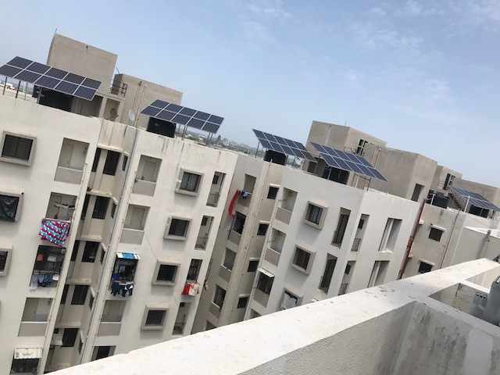
Gujarat
GREEN BUILDING CONCEPT
Green Building Concept - Rajkot
Solar panel installed in affordable housing to generate electricity which is using in Lift, Common lights etc. So that zero maintenance cost of the beneficiaries

Slide 11
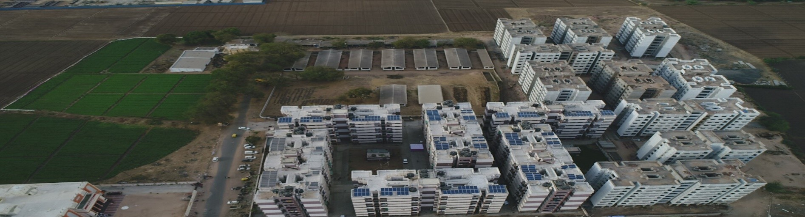
Gujarat
EXTRA FACILITES WITHOUT ANY EXTRA COST
AUDA - Ahmedabad
Dual Plumbing System
Solar Panel
PNG Gas pipeline

Slide 12
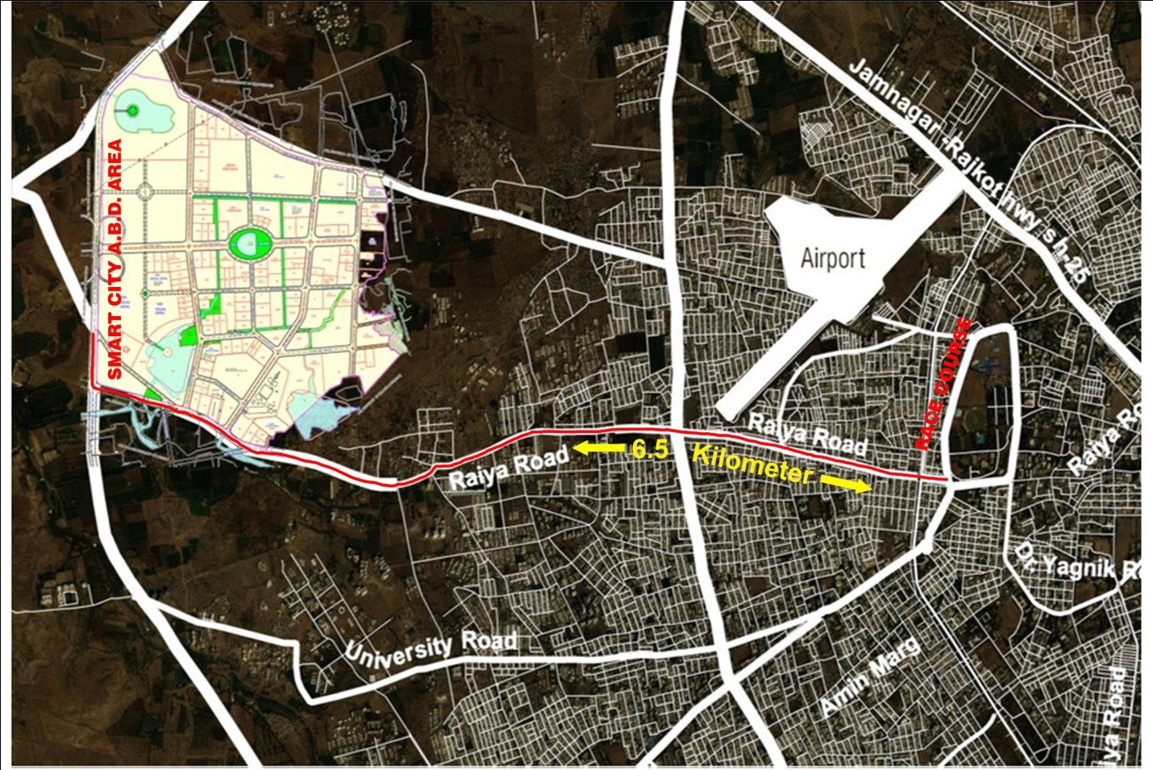
Gujarat
LOCATION MAP
Rajkot City proposed site for Light House Project under GHTC

Slide 13
Gujarat
SALIENT DETAILS
Rajkot City proposed site for Light House Project under GHTC
No | TP | Remarks
1 | Implementing Agency | Rajkot Municipal Corporation
2 | Ownership of the land | Rajkot Municipal Corporation
3 | Size of Proposed land | 2.43 hectors
4 | Buildable Dwelling Units | Approx. 1488 houses of 40 sq.m. carpet area
5 | Availability of basic amenities | Yes, available Power Distribution Network, Municipal Water Supply Network, Municipal Sewerage System, Public Transport Facilities etc.,
6 | Distance from the city centre | 6.5 km
7 | Site Development Status of the project | Green field land available with all amenities in the city area for execution of the project
8 | Availability of facilities for factory setup | 1.25 hector of land made available in the vicinity
9 | Details of transport linkage of the project | Yes, available

Slide 14
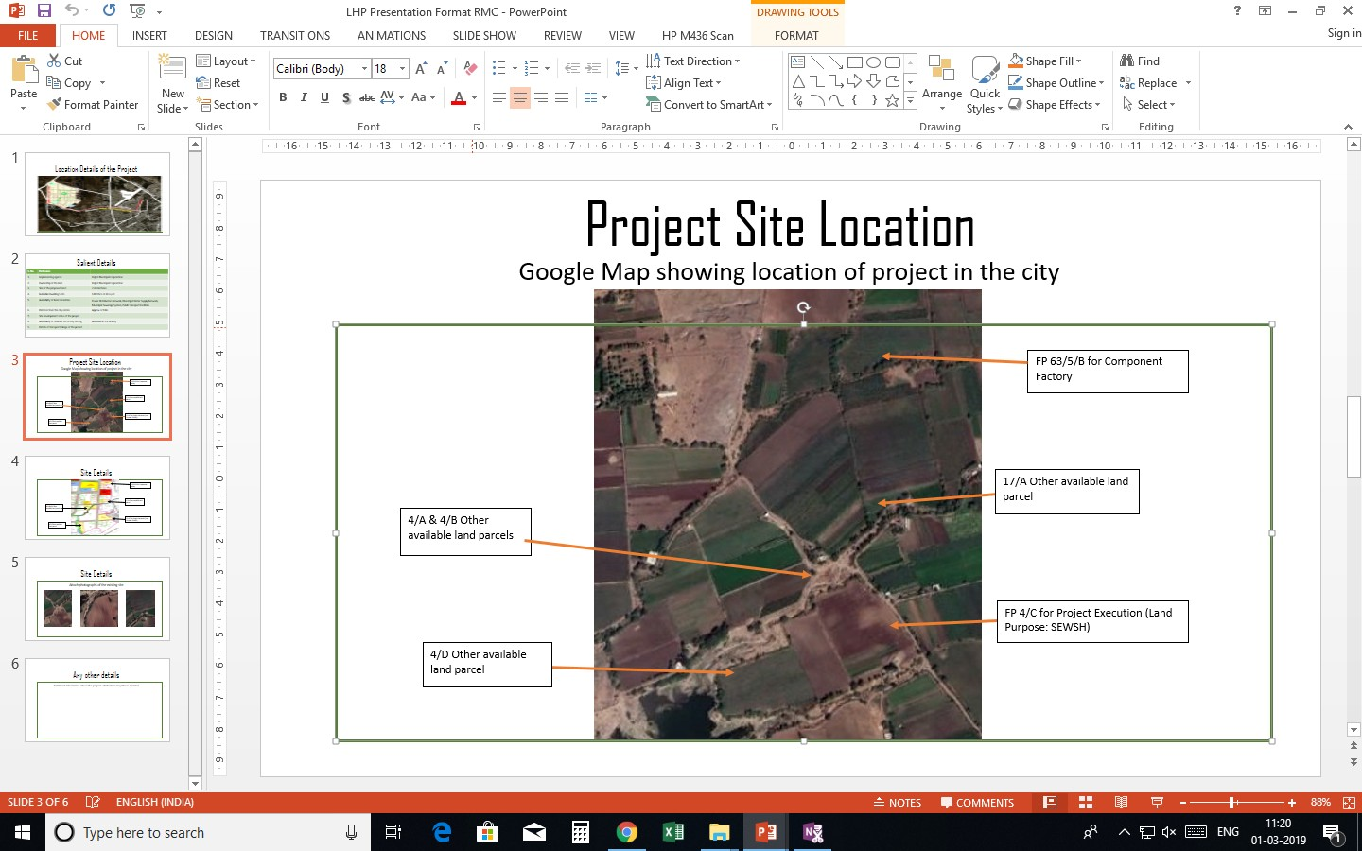
Gujarat
PROJECT SITE LOCATION
Rajkot City proposed site for Light House Project under GHTC

Slide 15
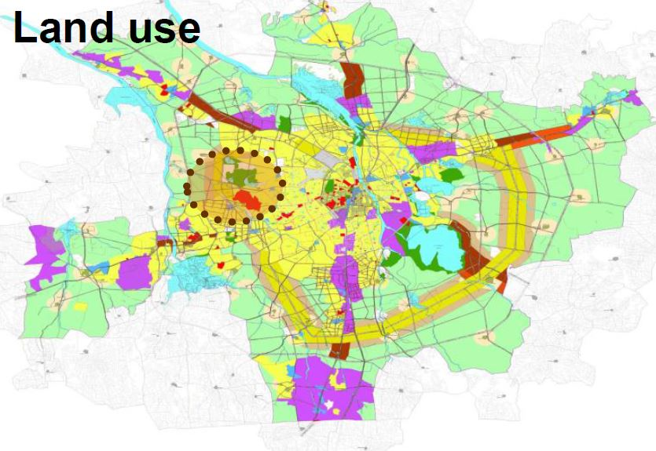
Gujarat
LAND USE FOR LHP
Rajkot City proposed site for Light House Project under GHTC

Slide 16
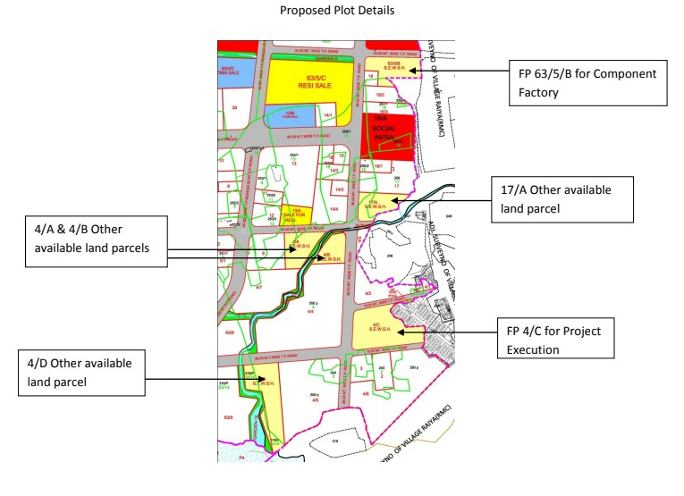
Gujarat
SITE DETAILS
Rajkot City proposed site for Light House Project under GHTC
No | TP | FP | FP area Sq.m. | Remarks
1 | 32 | 4/C | 24333.95 | Site for Execution of the light house project
2 | 32 | 63/5/B | 12583.00 | Site for component factory for Machinery and equipment
3 | 32 | 17/A | 10398.05 | Alternate site for execution of the project
4 | 32 | 4/A | 10759.00
5 | 32 | 4/B | 7580.50
6 | 32 | 4/D | 21267.65
Total |  |  | 86922.15
Project proposal has already been
submitted to MoHUA, New Delhi
vide letter no. AHM/PMAY (U)/
GHTC/2796 dated 12th Feb 2019
along with approval of State
vide circular note No. AHM/Projects/PMAY/SLSMC/2790 dated 11th Feb. 2019.32

Slide 17
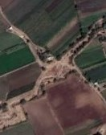
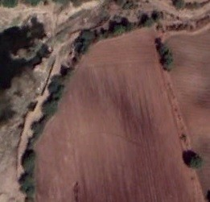

Gujarat
SITE PHOTOGRAPHS
Rajkot City proposed site for Light House Project under GHTC

Slide 18
Gujarat
OTHER INFORMATION
Rajkot City proposed site for Light House Project under GHTC
Site is located within the city area of Rajkot city and around 6.5 KM from the city centre
Available Infrastructure facilities on the proposed site :
RCC Roads
Municipal Water Supply Network
Power distribution network
Municipal Sewerage System
Transport Facilities
Provision of other land also made available in the vicinity for component factory set-up as required

Slide 19
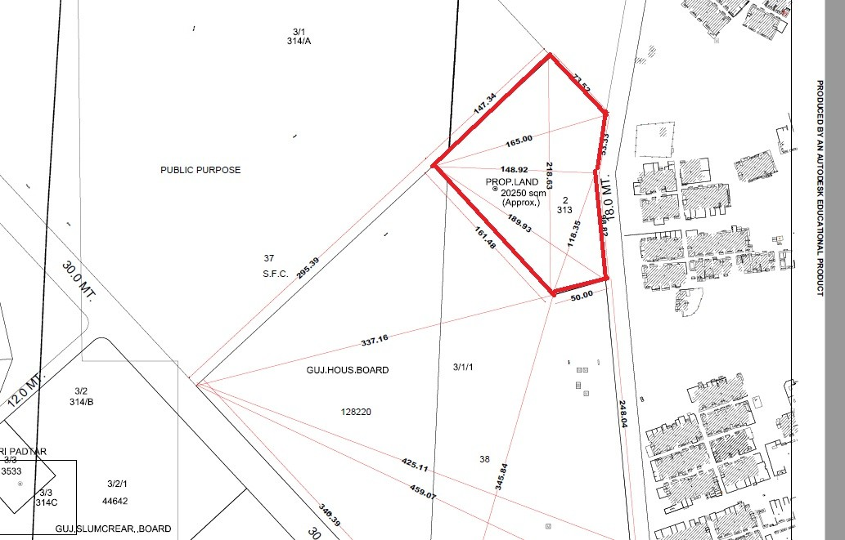
Gujarat
Demonstration Housing Project
Ahmedabad City (GHB) proposed site for execution of DHPs
No | TP | FP | FP Area (Sq.m)
1 | 94 | 3/1/1 | 20000 sq.m.
Proposed Land Area
State also planned for execution of Demonstration Housing Project as per guideline of the Ministry

Slide 20
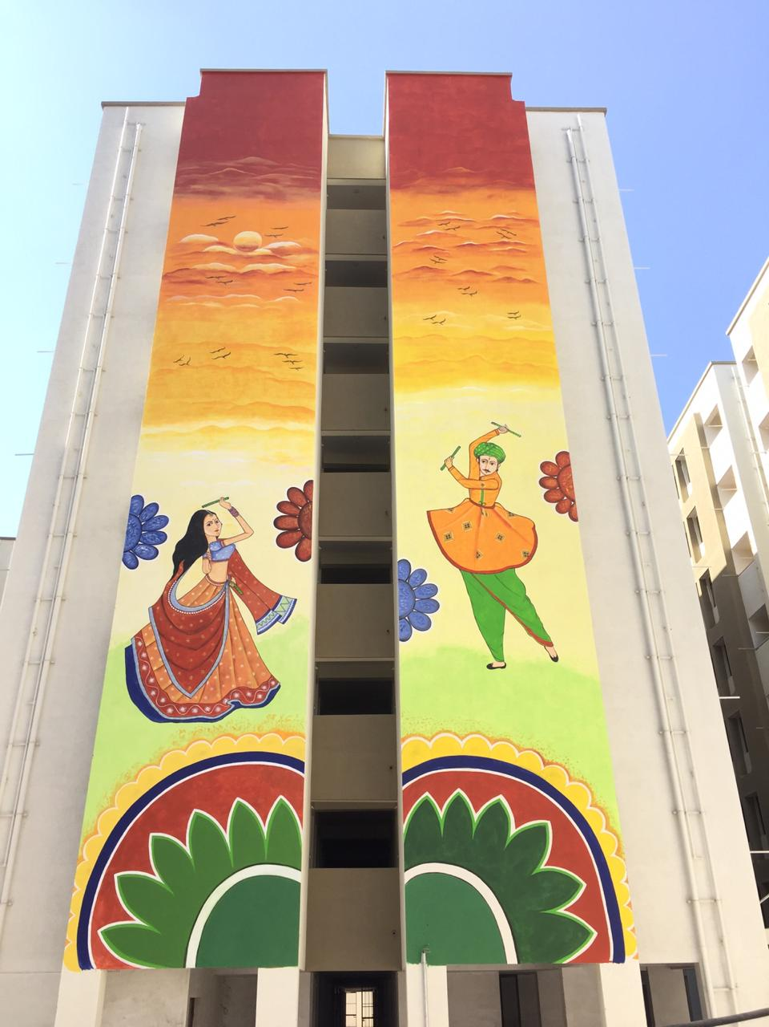
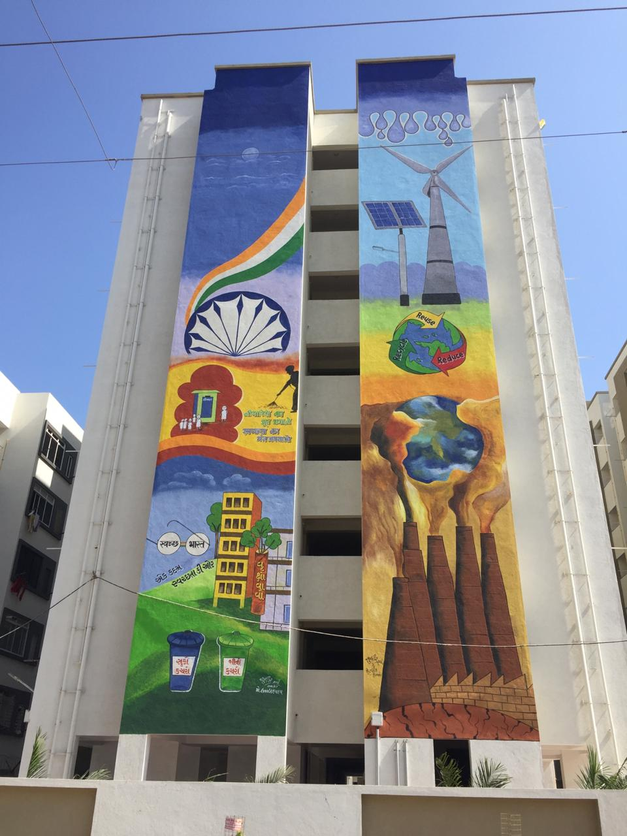
Location : Mavdi Rajkot
Plot Detail : TPS 28, FP 12/A
No. of DU’s : 1176
Gujarat
PMAY(U) – AHP PROJECT
RAJKOT, GUJARAT

Slide 21
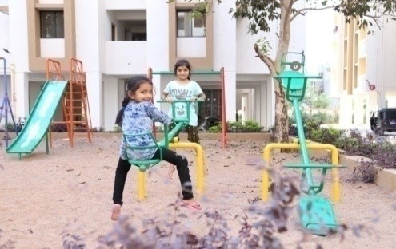
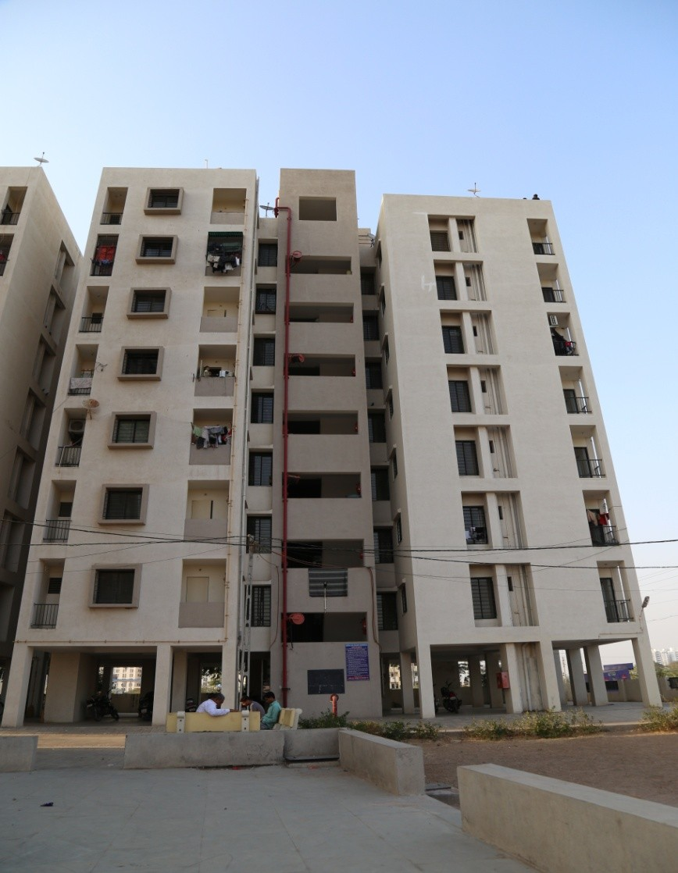
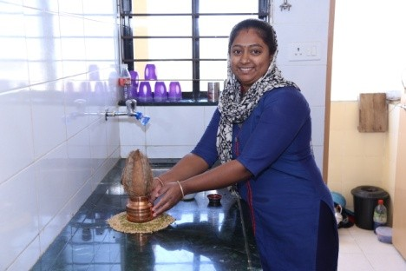
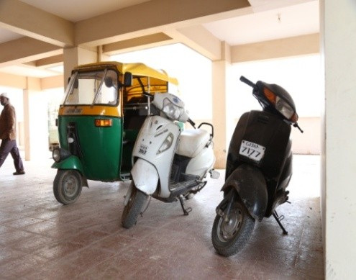

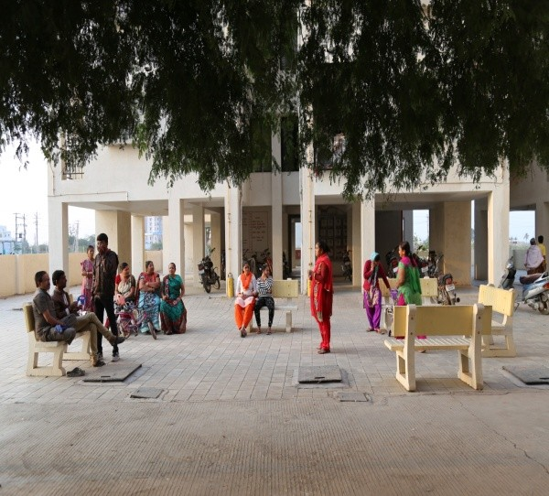
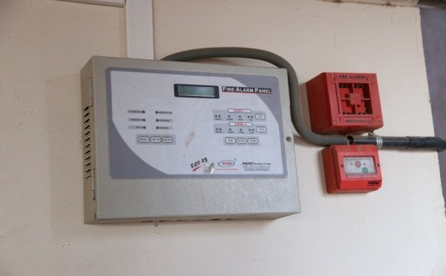
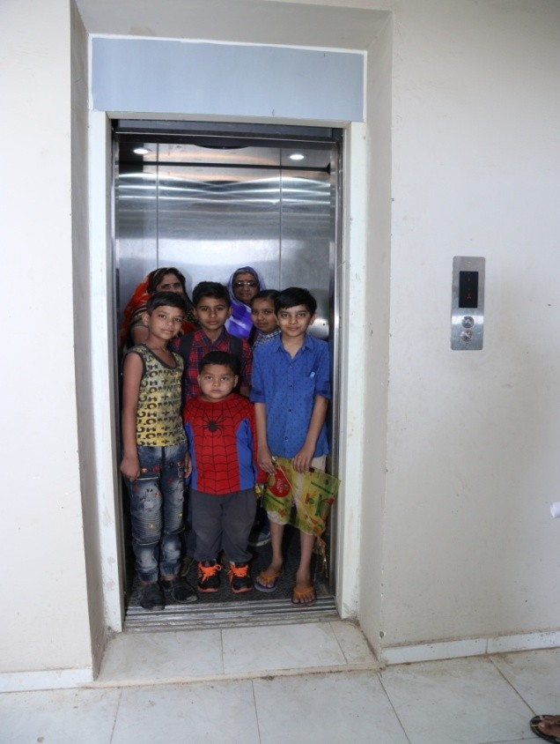
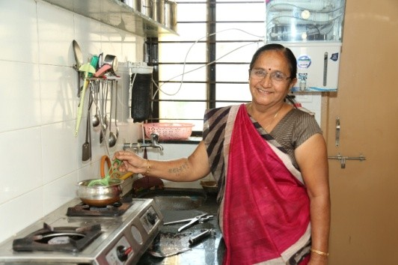
Location : Mavdi Rajkot
Plot Detail : TPS 28, FP 12/A
No. of DU’s : 1176
Gujarat
PMAY(U) – AHP PROJECT
RAJKOT, GUJARAT

Slide 22
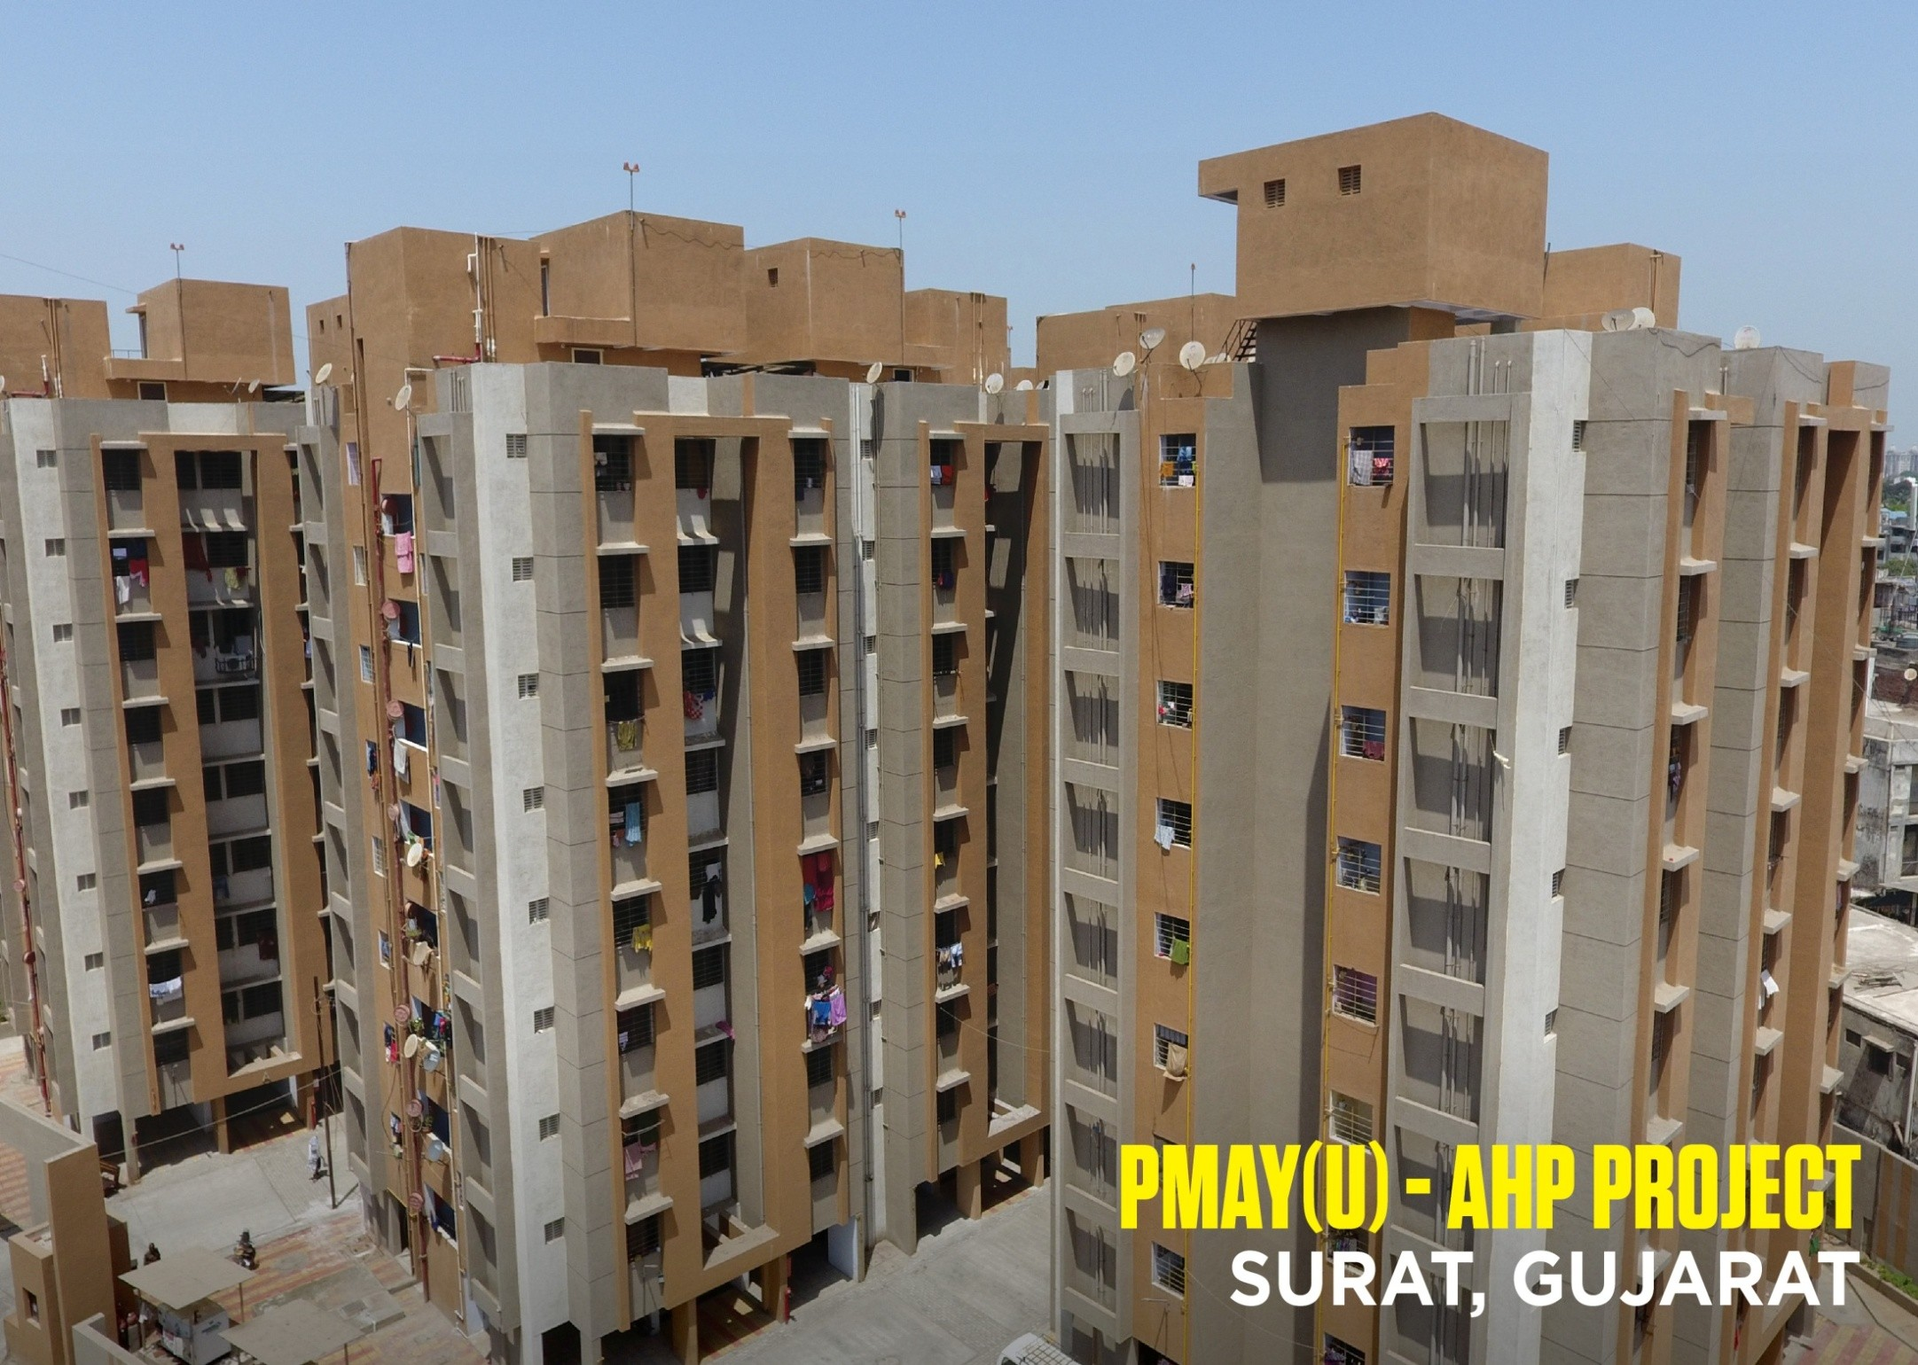
Location : Althan-Bhatar
Plot Detail : T.P.28, F.P.152
No. of DU’s : 272
Gujarat

Slide 23
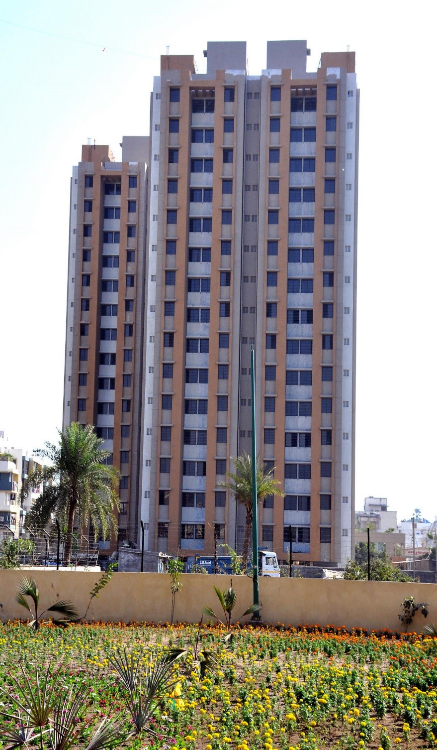
Gujarat
THANK YOU

