Slide 1


Slide 2
INTRODUCTION of NIIPL
Nipani
Infra &
Industries
Private
Limited

Slide 3
INTRODUCTION
Established in the year 1996,
NIIPL has vast experience of over 20 years
A turnkey structural steel construction solutions provider,
Experience in working difficult terrains.
Successfully Completed over 500000 Sq Ft using LGSF.
Strength over 500 worker and 30 Engineers
100% OTIF rate.
One of the Pioneer’s in LGSF technology in India
Your priority is our business.

Slide 4

OUR BUSINESSES
Academic Institutes
Staff Housing
Watch Towers
Barracks
Colf formed steel construction
Conventional Construction
NIPANI INFRA & INDUSTRIES PVT.LTD.

Slide 5
Our Presence
Corporate Office – Jabalpur Madhya Pradesh
Head Office Jabalpur
Factory – Jabalpur Madhya Pradesh
Design Office Pune
Design Office – Pune, Maharashtra
+91 761 4022215, 9300626212
www.nipaniindustries.com

Slide 6

OUR PRESENCE

Slide 7
GSTIN – Of Various States
City / State | GSTIN
Jabalpur - 482 001. Madhya Pradesh | 23AAGCN0704R1ZY
Rishikesh, Uttarakhand | 05AAGCN0704R1ZW
Kamrup- 781017, Assam | 18AAGCN0704R1ZP
Bhubneshwar, Odisha | 21AAGCN0704R1Z2
Jaipur-302013, Rajasthan | 08AAGCN0704R1ZQ
Narayan Manzil, New Delhi | 07AAGCN0704R1ZS
Palakkad, Kerala | 32AAGCN0704R1ZZ
Vijayawada, Andhra Pradesh | 37AAGCN0704R1ZP
Mandi, Himachal Pradesh | 02AAGCN0704R1Z2
Head Office Jabalpur
Design Office Pune

Slide 8

Notes:
As an Engineer we always question on existing things, because this developed in our neurons to ask WHYYYYY?
Why We are Here, Why is there need for Brain Storming the existing System ???
Of course for Improvement !!!
And We know It has to Change!!!
Because Change is the only thing which is permanent!
And Also the Biggest room in this world is the Room of Improvement!!!

Slide 9
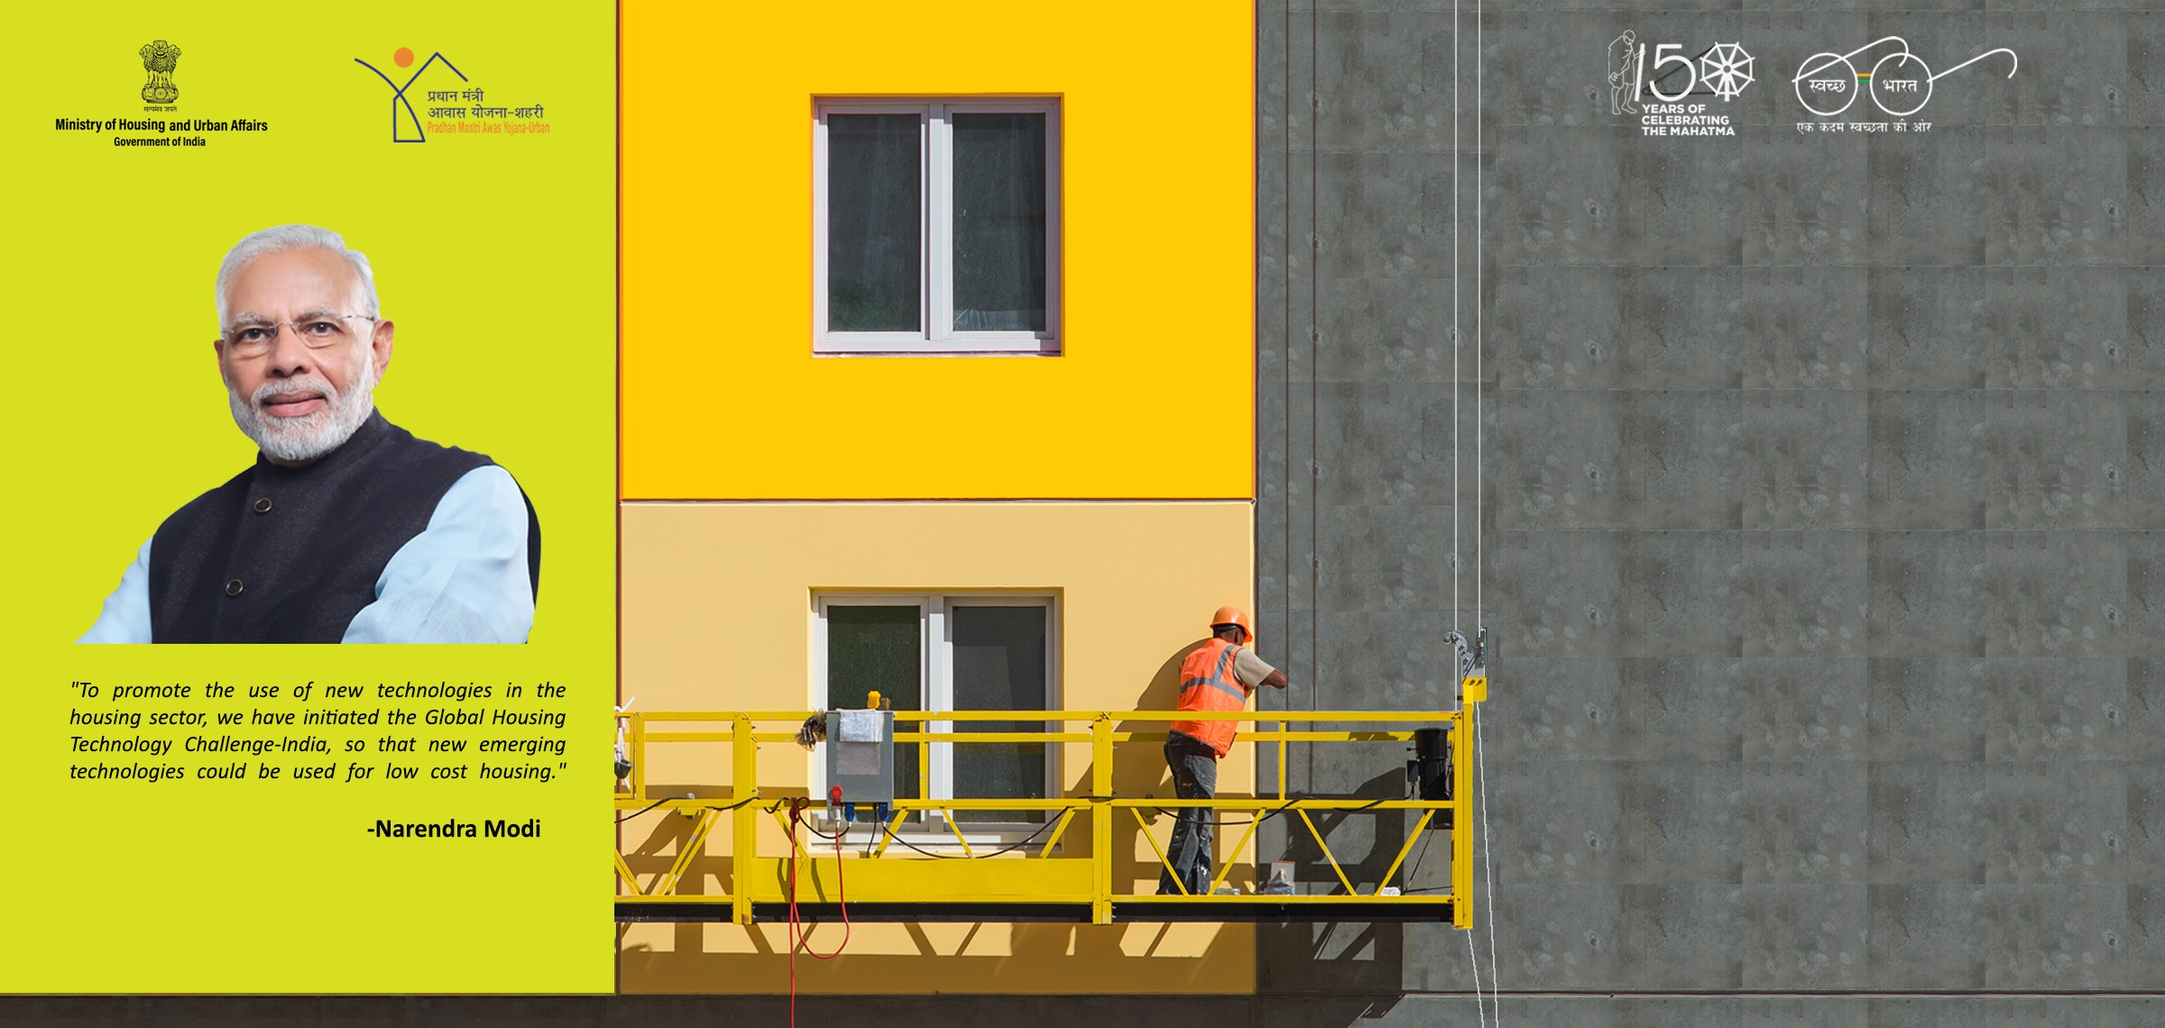

GHTC INDIA Challenge
Notes:
As per commitment of our Honable PM Shri Narendra Modi Ji, Housing for all will be there by 2022.
Moving with Promie & Policy of Existing Govt Ministry of Housing and Urban Affairs organized thi Expo cum Challenge. Our Main Challnge today is to complete a Time Bound project with a Sustainable , Faster and Eco Friendly Solution.

Slide 10
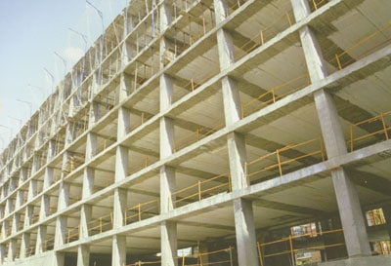

Our Aim –
Is to replace RCC with Innovative Construction Technology.
Notes:
What I get from this word “Replace” is to change the existing system with a Robust one…..
We all had a ride on “Tanga” yes The Horse Cart ,
In order for faster movement of cart, we can reduce the dead weight of Cart , putting efficient bearing on wheels ….. No No Not at all because these are short term solution..
What is desired to change the Horse as a source … Because for faster movement Source is the Bottle neck…
Similarly ….When we think of replacing RCC, we must think of a solution which has a different source that is other than Sand Aggregate, Cement and Water..
So we need to adopt a solution which has Least dependency on Sand Cement Aggregate and Water? … Something like a Dry system..

Slide 11

Need to Replace The RCC with a Proven Technology Which is……
Notes:
So we need to wisely adopt a technology ,,,, A technology which is…

Slide 12
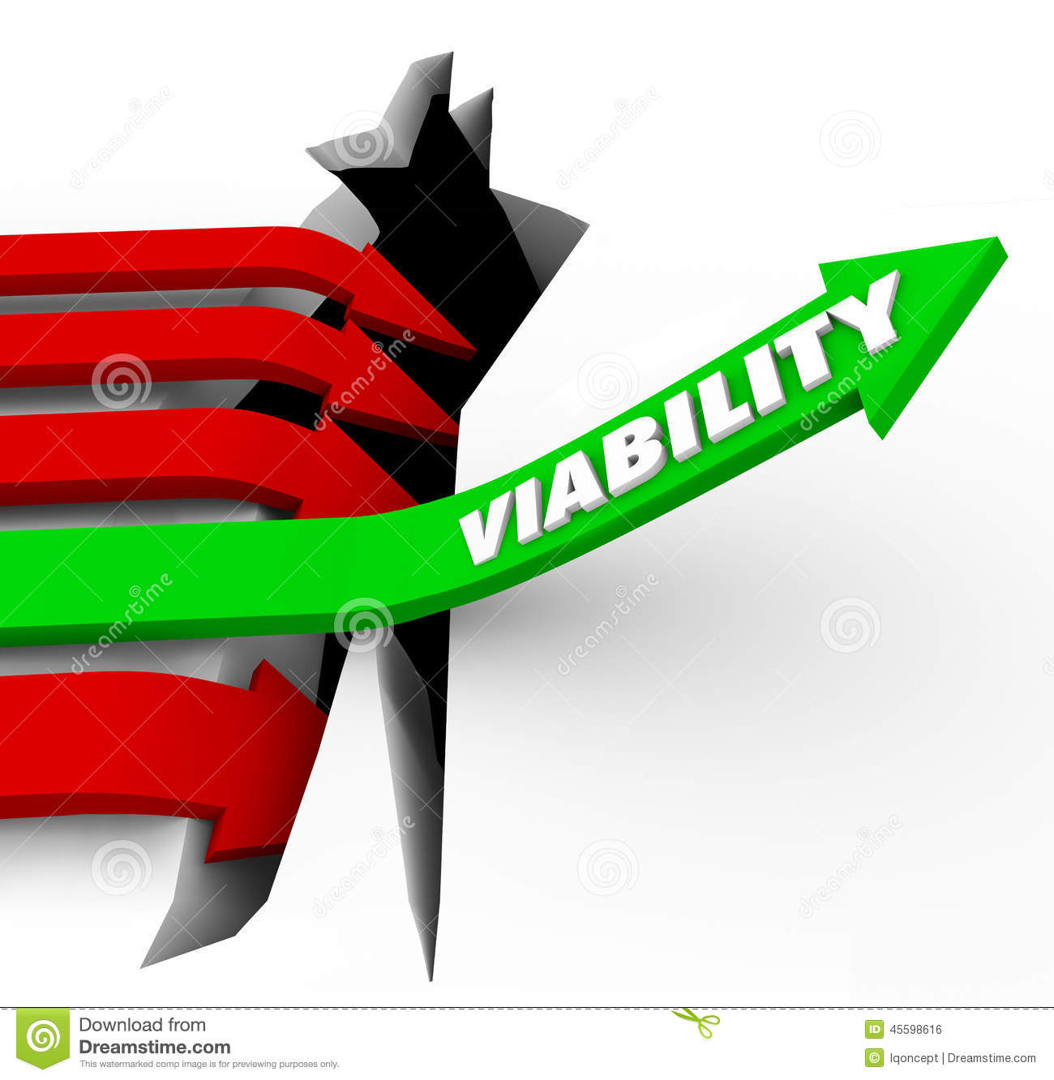
A technology …..
Which is Viable !!!!!!
Viable with respect to Project Size…
Notes:
Viable with respect to project size, that is from 10 thousand sq ft to 100 thousand of sq ft.
Such as there is a Product in which plant has to be set at Site may not be Viable for a smaller project of say 10000 SQFT…
Or
A product being centrally manfactured but due to its huge size and weight may not be viable for Mega Project at Difficiult terrain.
So we must choose a Proven Technology which is viable for all sizes of Projects irrespect of the Terrain or Transportation Constraints.

Slide 13
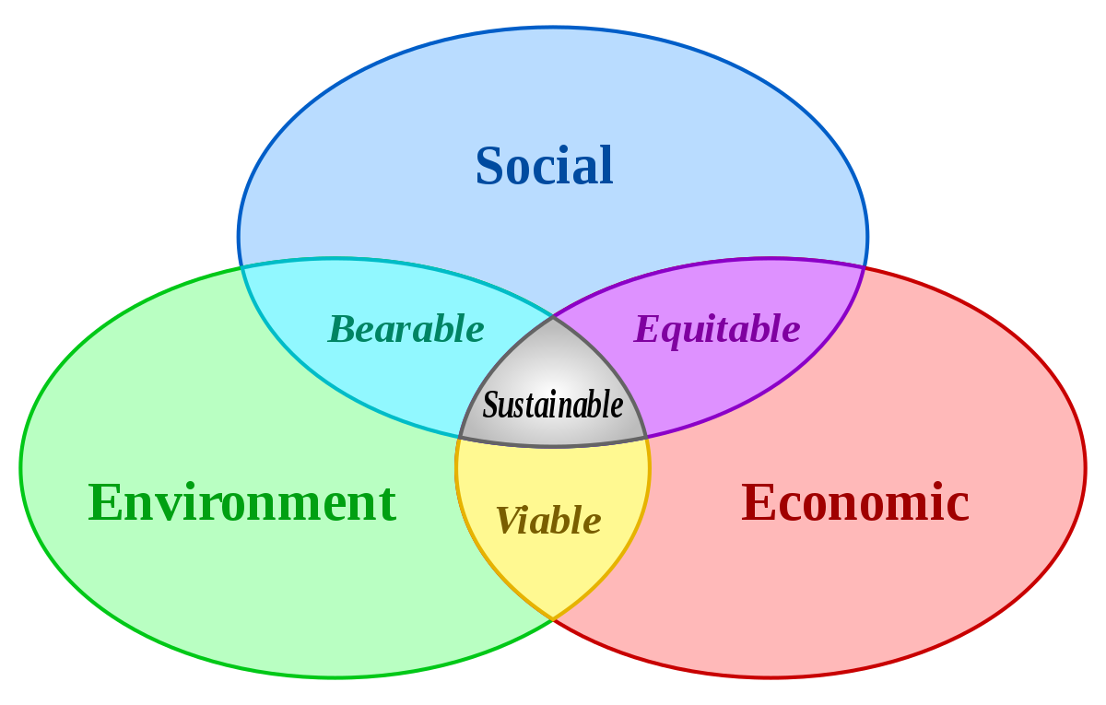
A technology …..
Which is Sustainable !!!!!
with respect to various Geographical location, seismic zone, or disturbed Areas.
Notes:
Yes Sir Its is Sustainability ,, Be it Temperature, Earthquake prone areas, Socio – Demoghraphic conditions, Disturbed areas, Difficult Terrain. The Product must be Sustainable.

Slide 14

A technology …..
Which is Faster !!!!!
to complete time bound projects.
Notes:
As per commitment of Our Honrable Prime Minister, we need to finish this project by 2022 , So for a Time Bound project a Technology must be a Rapid Construction Technology.

Slide 15
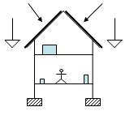
A technology …..
Which is Lighter !!!!!
so that dead weight of the building is least, with requisite strength.
Notes:
Dead Weight of a building plays a Vital Role in many aspects …
Like In Earthquake… Loss of Life happens due to heavy weight of Structures collapsing on the people inside the building.

Slide 16

Last But not at all the Least
A technology …..
Which is Eco Friendly !!!!!
for safeguard of environment and our next generations.
Notes:
Urbanization is on the Full pace,,,, We are talking to keep the open space for healthy , We are bound to go for Mass Construction, so we must not overlook the point of Construction & Demolition Debris. In order to Fulfill the Commitment PMAY 2022 , we must not sideline the future disatourus outsome for out next generation due to this Construction and Demolition Debris. So choose the Eco Friendly Product.

Slide 17

Solution
to
all Problems
Notes:
We must adopt a Proven Technology which is Solution to all the problems.

Slide 18
So here we presenting a Answer to all Problems
A proven Technology
Promoted by BMTPC
Approved by MES
Incorporated in CPWD SOR
Used by Various Premiere Govt Department Such as IIT Guwahati, IIT Mandi, UPRNN, Northern Railways, Bihar State Power Holding, TTD, PIU and many more.
Notes:
Many Proven technologies have many rates based on their sizes But LGSF has only one that is 174.10 Rs/KG in CPWD SOR.

Slide 19
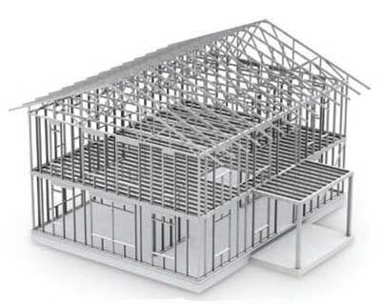
Light
Gauge
Steel
Frame

Slide 20
Introduction to
Light
Gauge
Steel
Frame
Notes:
As LGSF is a quite familiar and A proven Technology…. I will Skip This part and move my presentation to show how it’s the solution to all problems.

Slide 21
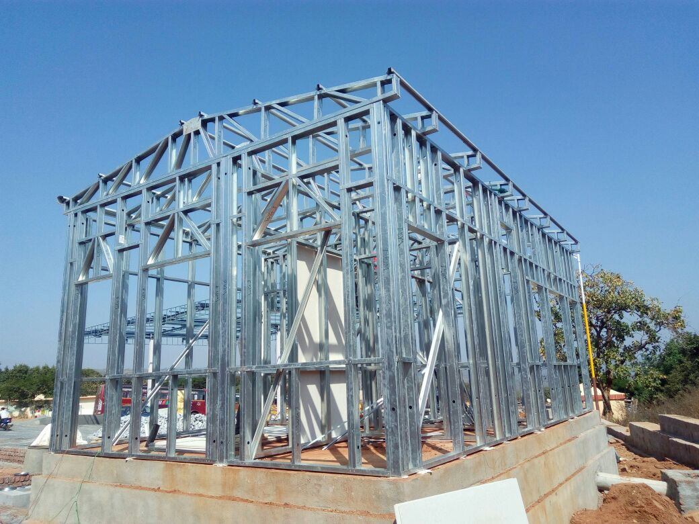
Viability
As No Heavy Machinery Required to Handle it on the Site it is Viable.
No Huge set up or Plant is required at site it is Viable.
Due to its Light Weight Its can be transported and erected wherever a Man can reach on foot.
So It is viable for all size of projects as it can be shipped --- From A Car or A Cargo

Slide 22
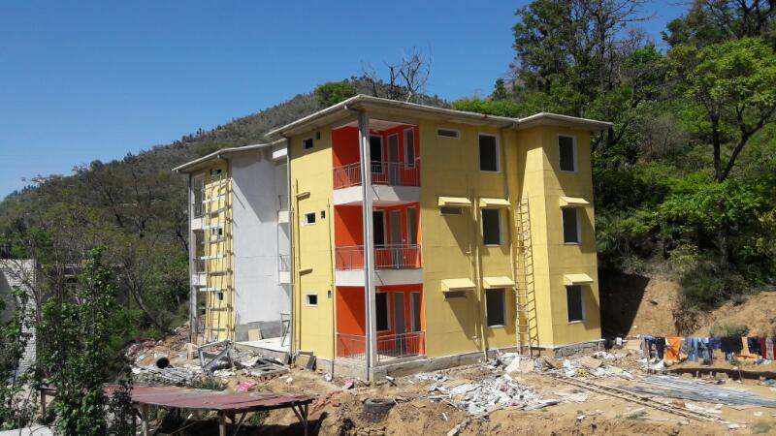
Sustainability
It is the most suitable type of construction technology for various Demographic, Seismic, & Political areas.
LGSF is a Proven technology for Mass housing across the Globe.
Notes:
LGSF is the technology which has proved its sustainibility across various countries in Mass Housing Projects.

Slide 23

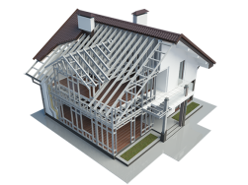
Proven Track Record of LGFS in Mass Housing across the Globe
USA
IRAQ
PAKISTAN
MENA Countries
ETHIOPIA
INDIA
GABON
MOZAMBIQUE
ANGOLA

Slide 24
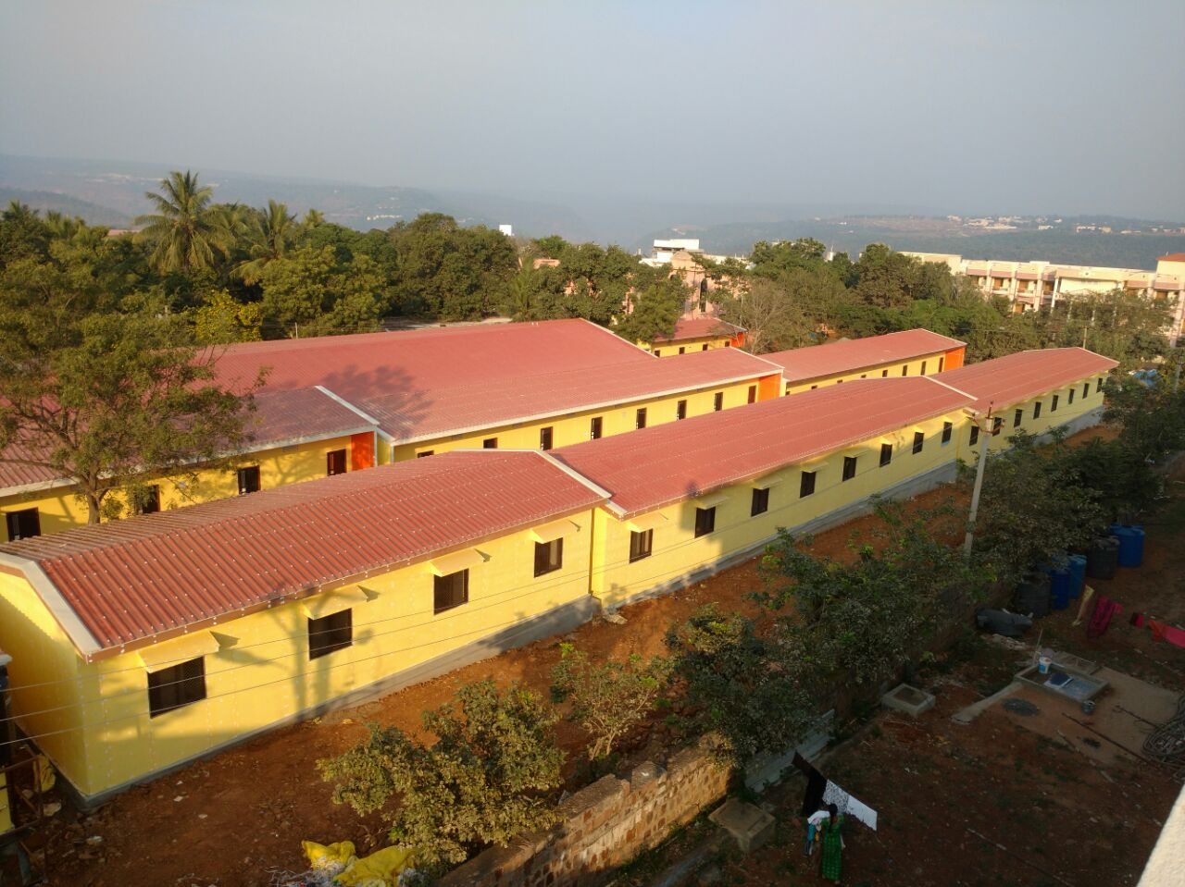
Sustainability
On top of It,
We at NIIPL successfully
constructed
5 Lakh Sqft of Buildings
using LGSF technology Pan
India worth
150 Crore during Last
10 years.

Slide 25
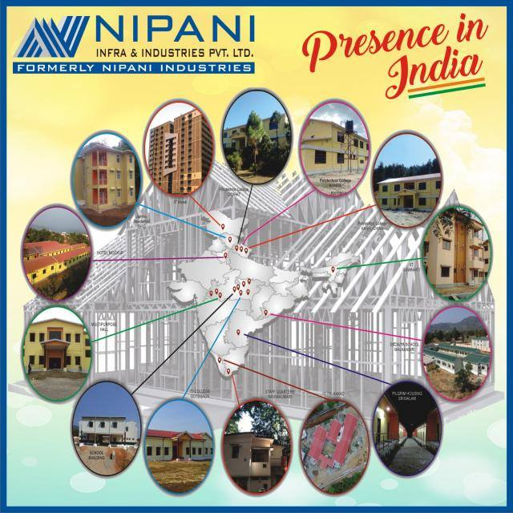
Notes:
We have Covered Almost all Part of India, Right from Jammu to Kanyakumari and Mid West to North East States.

Slide 26
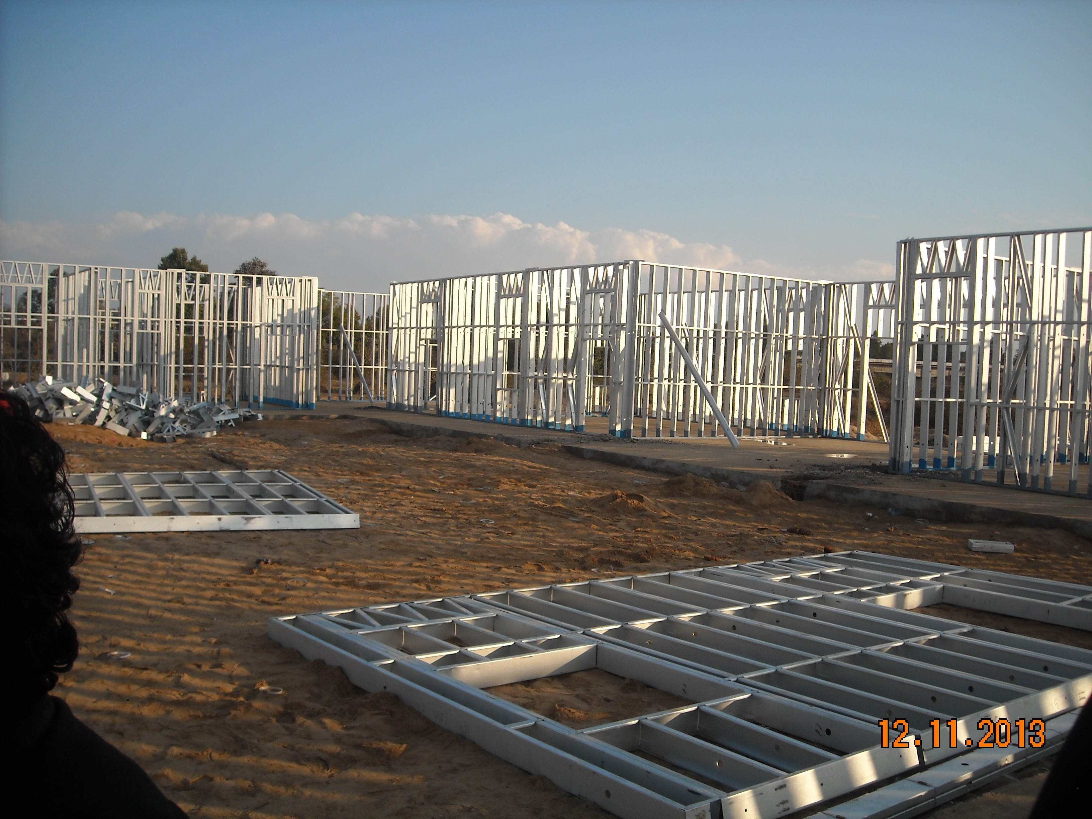
Faster
With our Current Set up at Nipani Infra & Industries Pvt Limited we can approximately manufacture and supply 1500 MT of LGSF which can cater around 300000 SQFT of construction.
For Mass Housing
With our current manufacturing and Erection prowess ,NIPANI can fully construct 1000 Dwelling unit Just in 15 Months.
Construction Time can be reduced
upto 60% with balanced
integration.
Notes:
Taking Higher side 50 Kg/Sqm Consumption , 30000 Sqmtr or roughly 300000 Sqft of area can be constructed with these supplies.

Slide 27
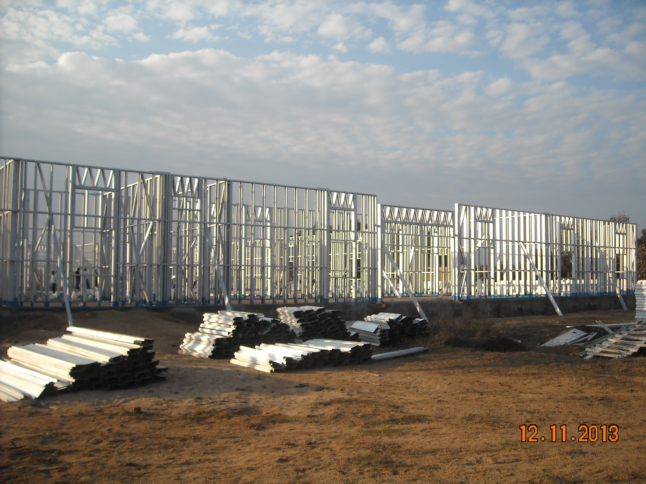
Lighter
As LGSF is made from 0.75 mm to 1.5 mm thick high strength Galvalume Sheets.
Due to its Optimum design for Load bearing walls and its Uniform Distribution load bearing frames makes its Light.
Its dead weight is 1/4 th of the
RCC and many other proven
technologies.
Notes:
Remember Leesser the Dead Weight .. Lesser the Casualties in Earthquake.

Slide 28
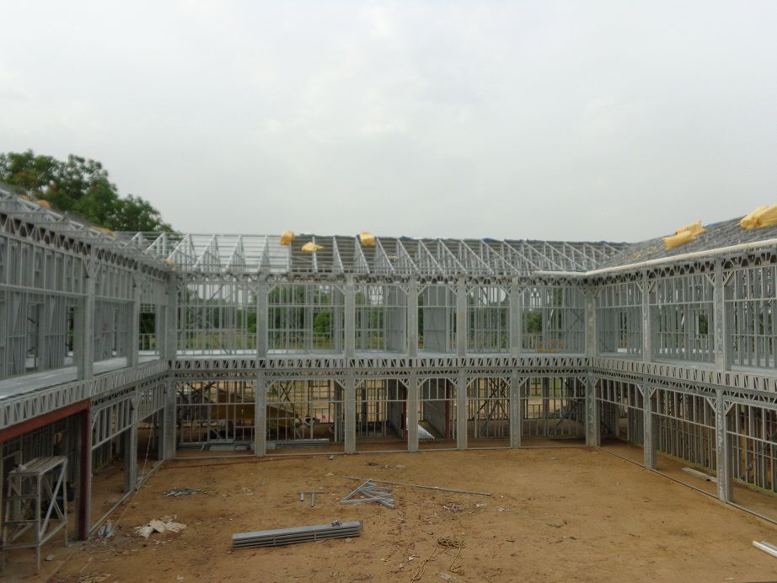
Eco Friendly
As LGSF is Made of Steel , its completely recyclable, which make its most eco-friendly out of all available proven technology.
Since its has low Dead Weight, so lighter foundation is required. Hence Least dependability of natural resources such as Sand And Aggregates.
Water requirement is also very very low as compared to RCC and other Technologies.

Slide 29
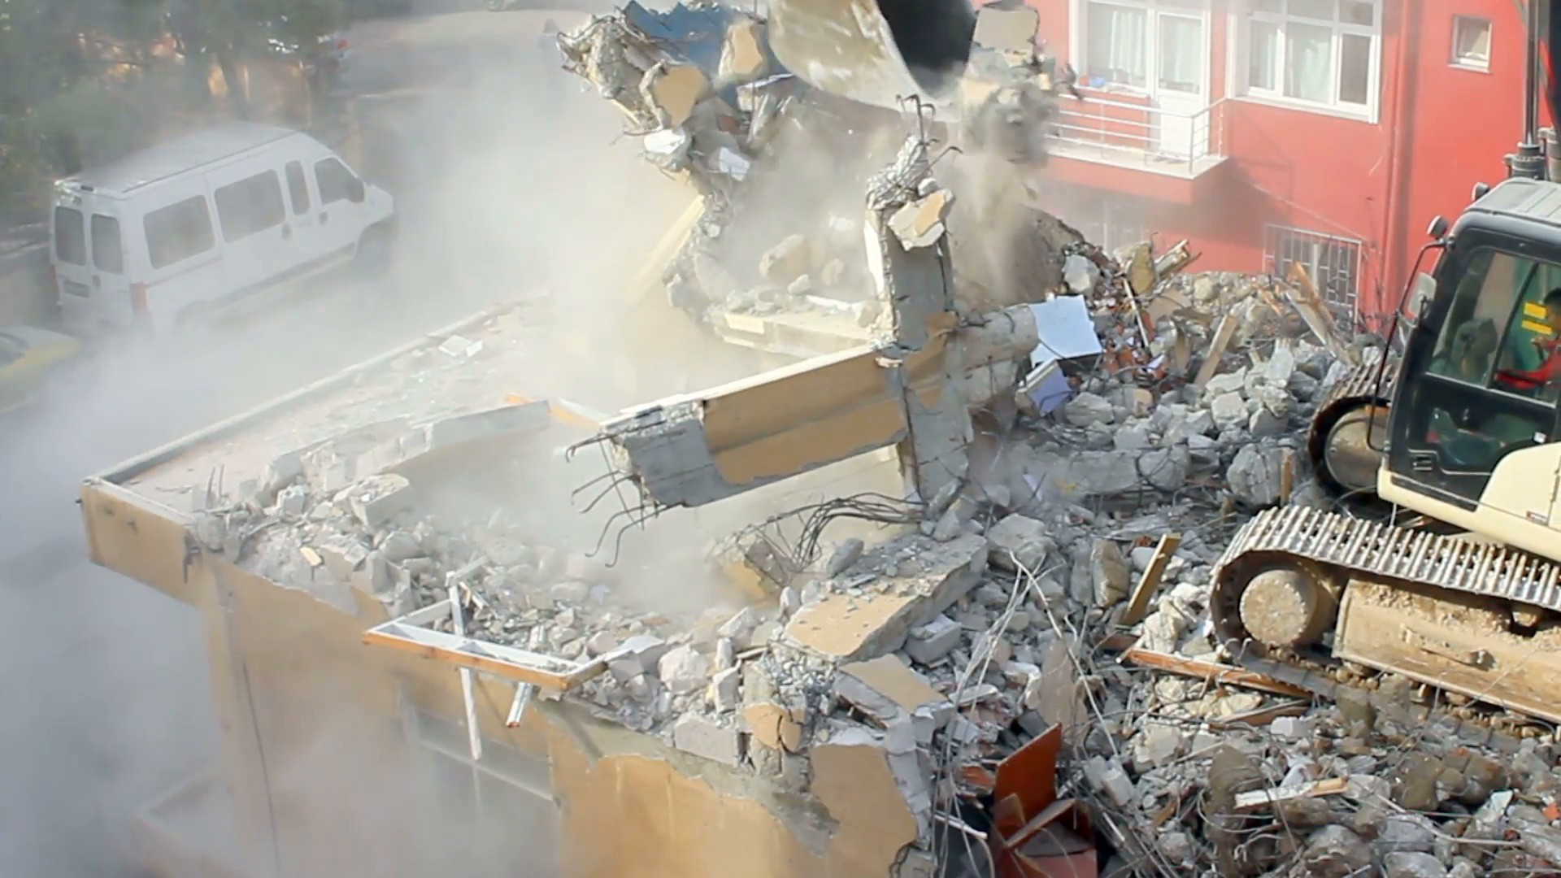
As India is a
Developing Country
It’s a Construction Country too…
LGSF is the technology with minimum
Construction and Demolition Debris
Notes:
As India is a Developing Country It’s a Construction Country too… to Dhool to Udegi.

Slide 30
AS LGSF IS A
BALANCED INTEGRATION of
We at Nipani Infra & Industries pvt Ltd acquire
Full Fledged Design Team,
Fully Equipped Manufacturing Plant and
Nipani Certified erection Teams
is the Ideal Proven Technology to take
up this Noble cause Project of
PMAY 2022 .
Make Construction Faster
Lighter and Easier with LGSF
by NIPANI.
DESIGN
Manufacturing
LGSF Building
Erection
Notes:
Now I will Present One Project complete cycle just to show how our capacity of doing project Faster Lighter and Easier is a Eco Friendly way.

Slide 31
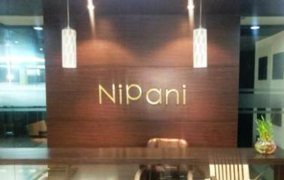
Presenting G+2 Building at Tilak Bridge Project of Northern Railway Pre Engineered Building using Light Guage Steel.
Notes:
We have selected Delhi site , so that you all may visialize , How LGSF is fasetr, viable, sustainable most importantly Eco Friendly, as its very difficuilt to get construction done in delhi due to pollution index.

Slide 32
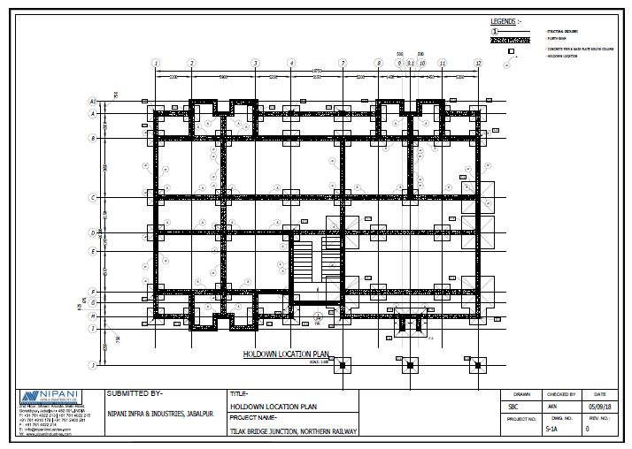
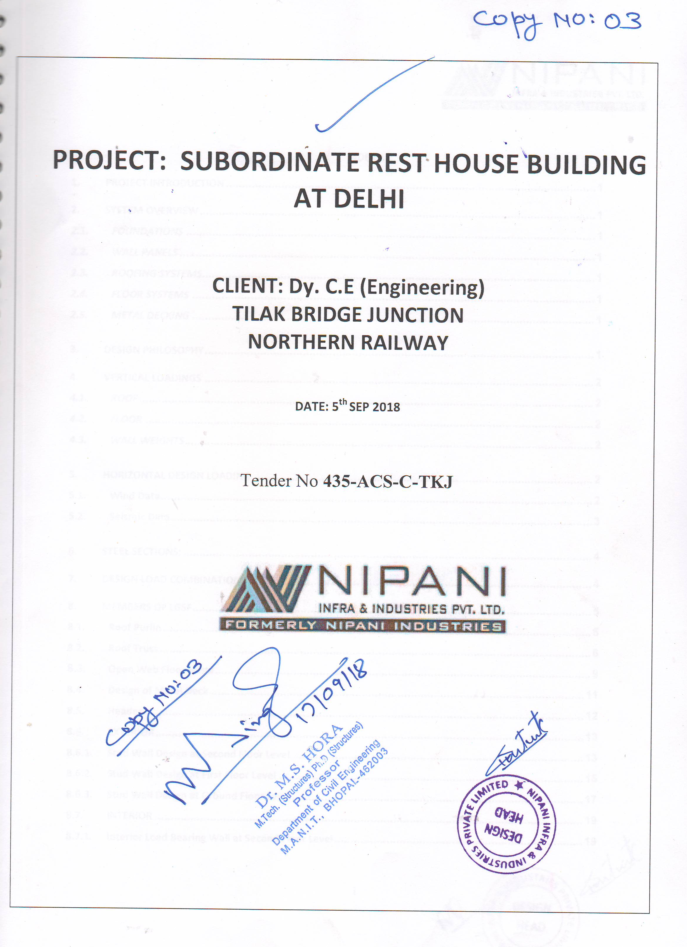
Preparation of Design Documents & Drawings
Project Design Report

Slide 33
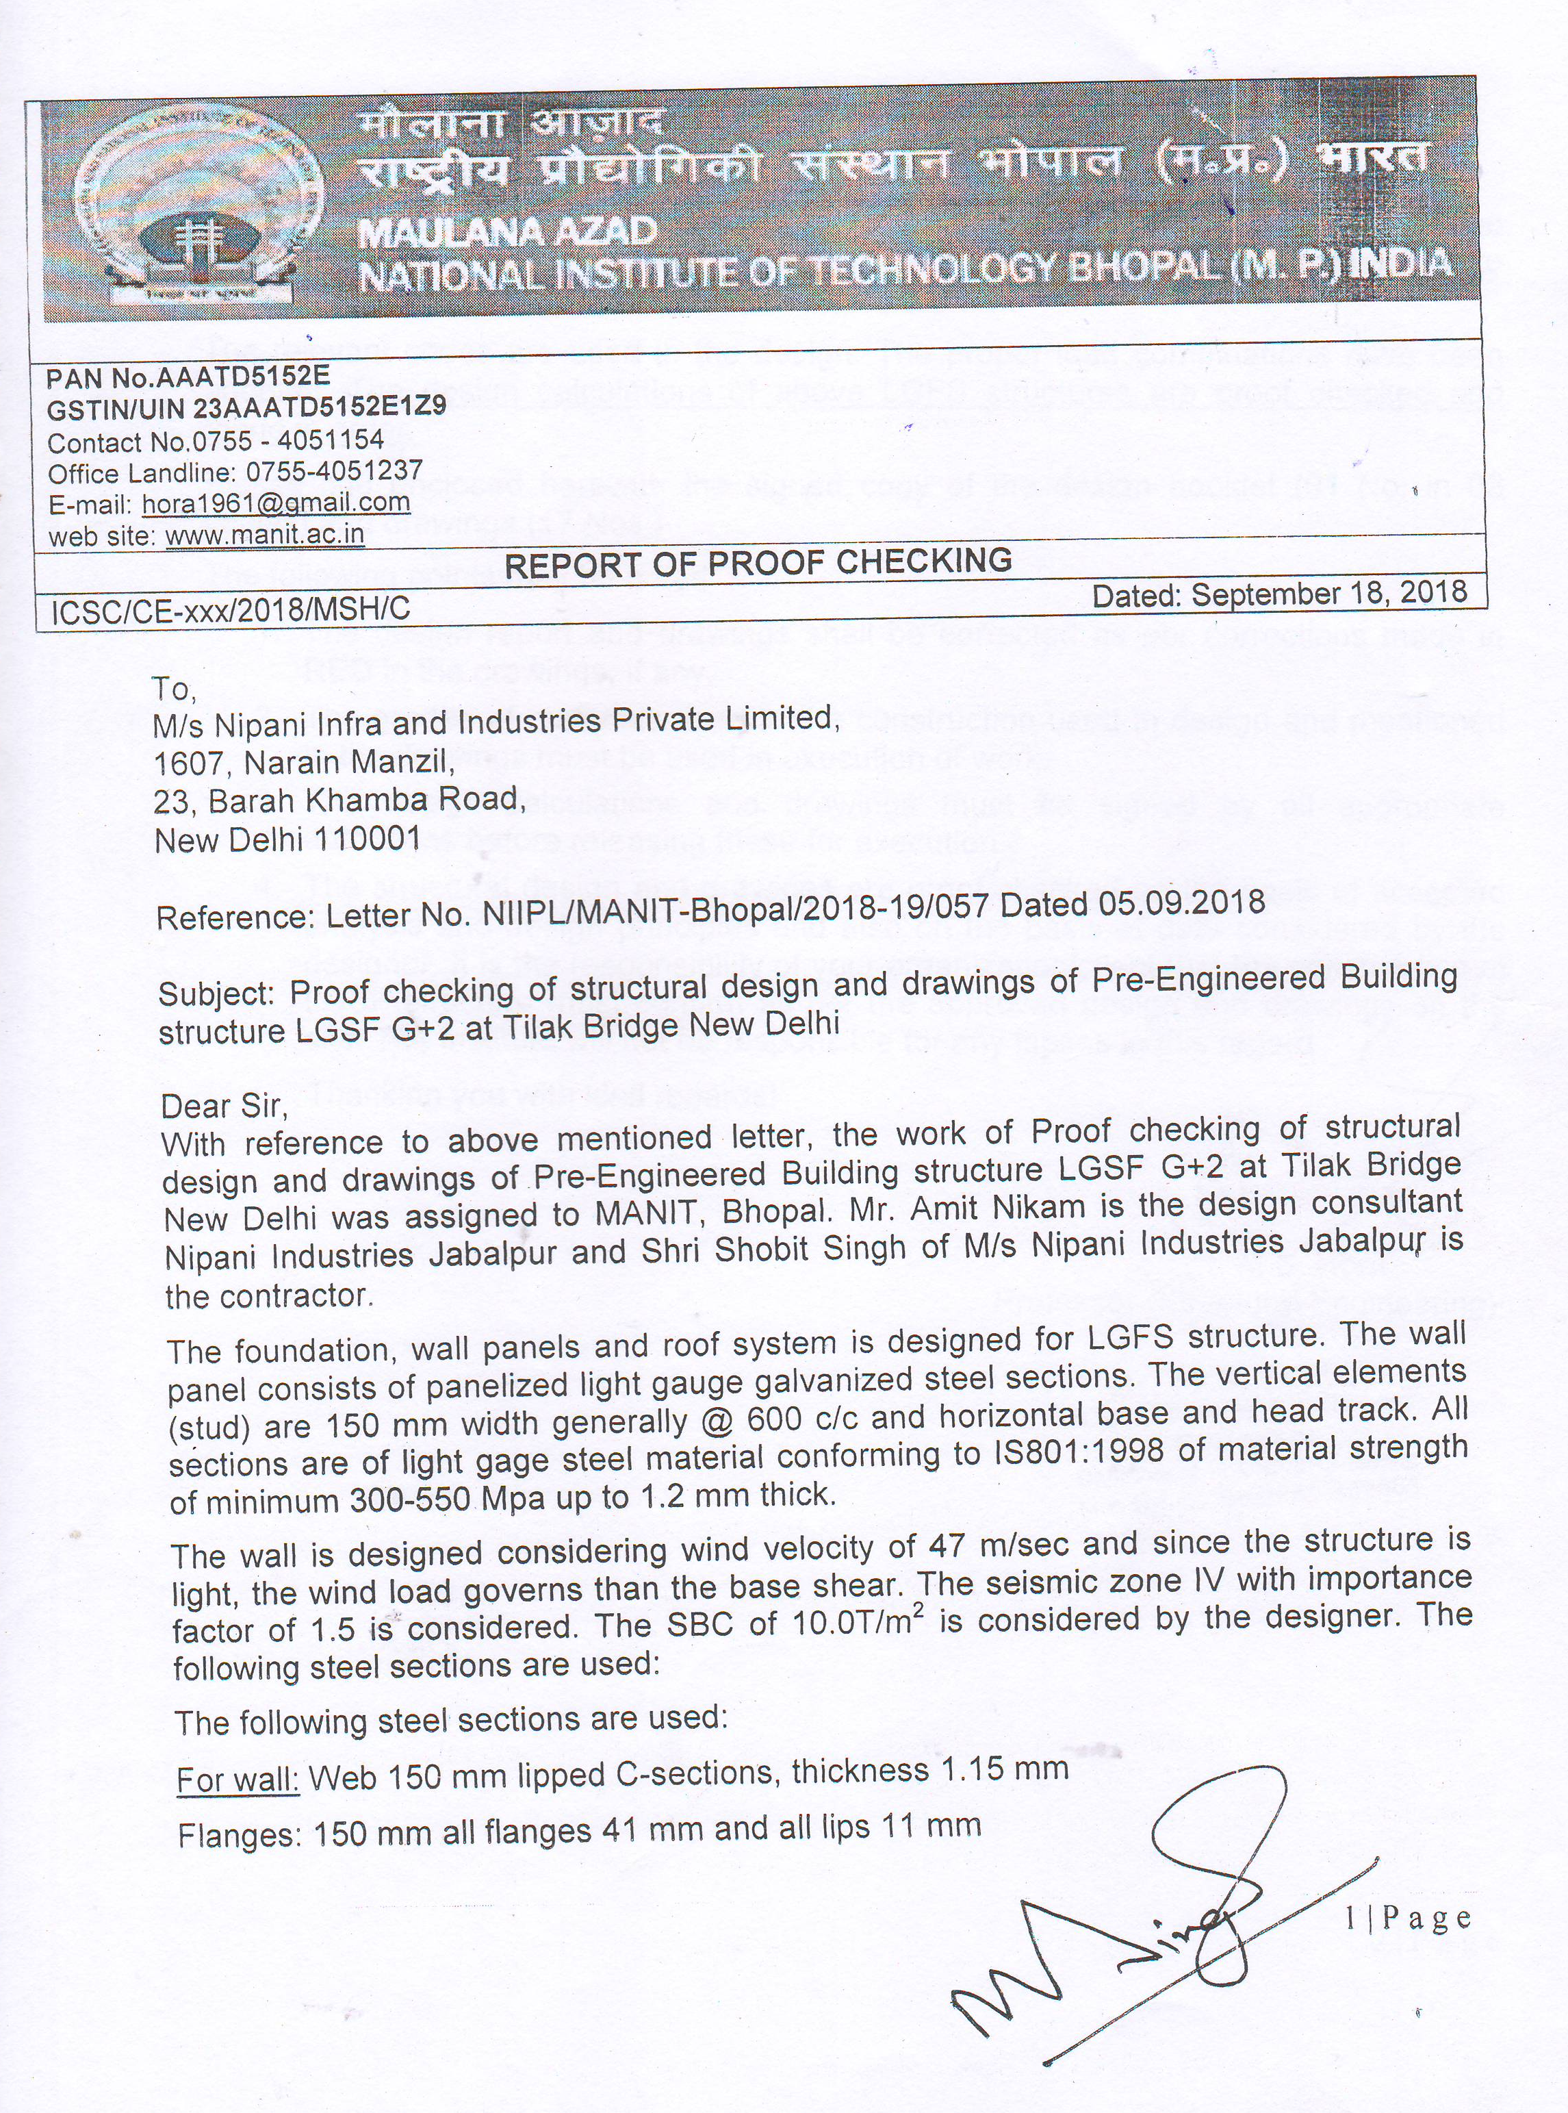
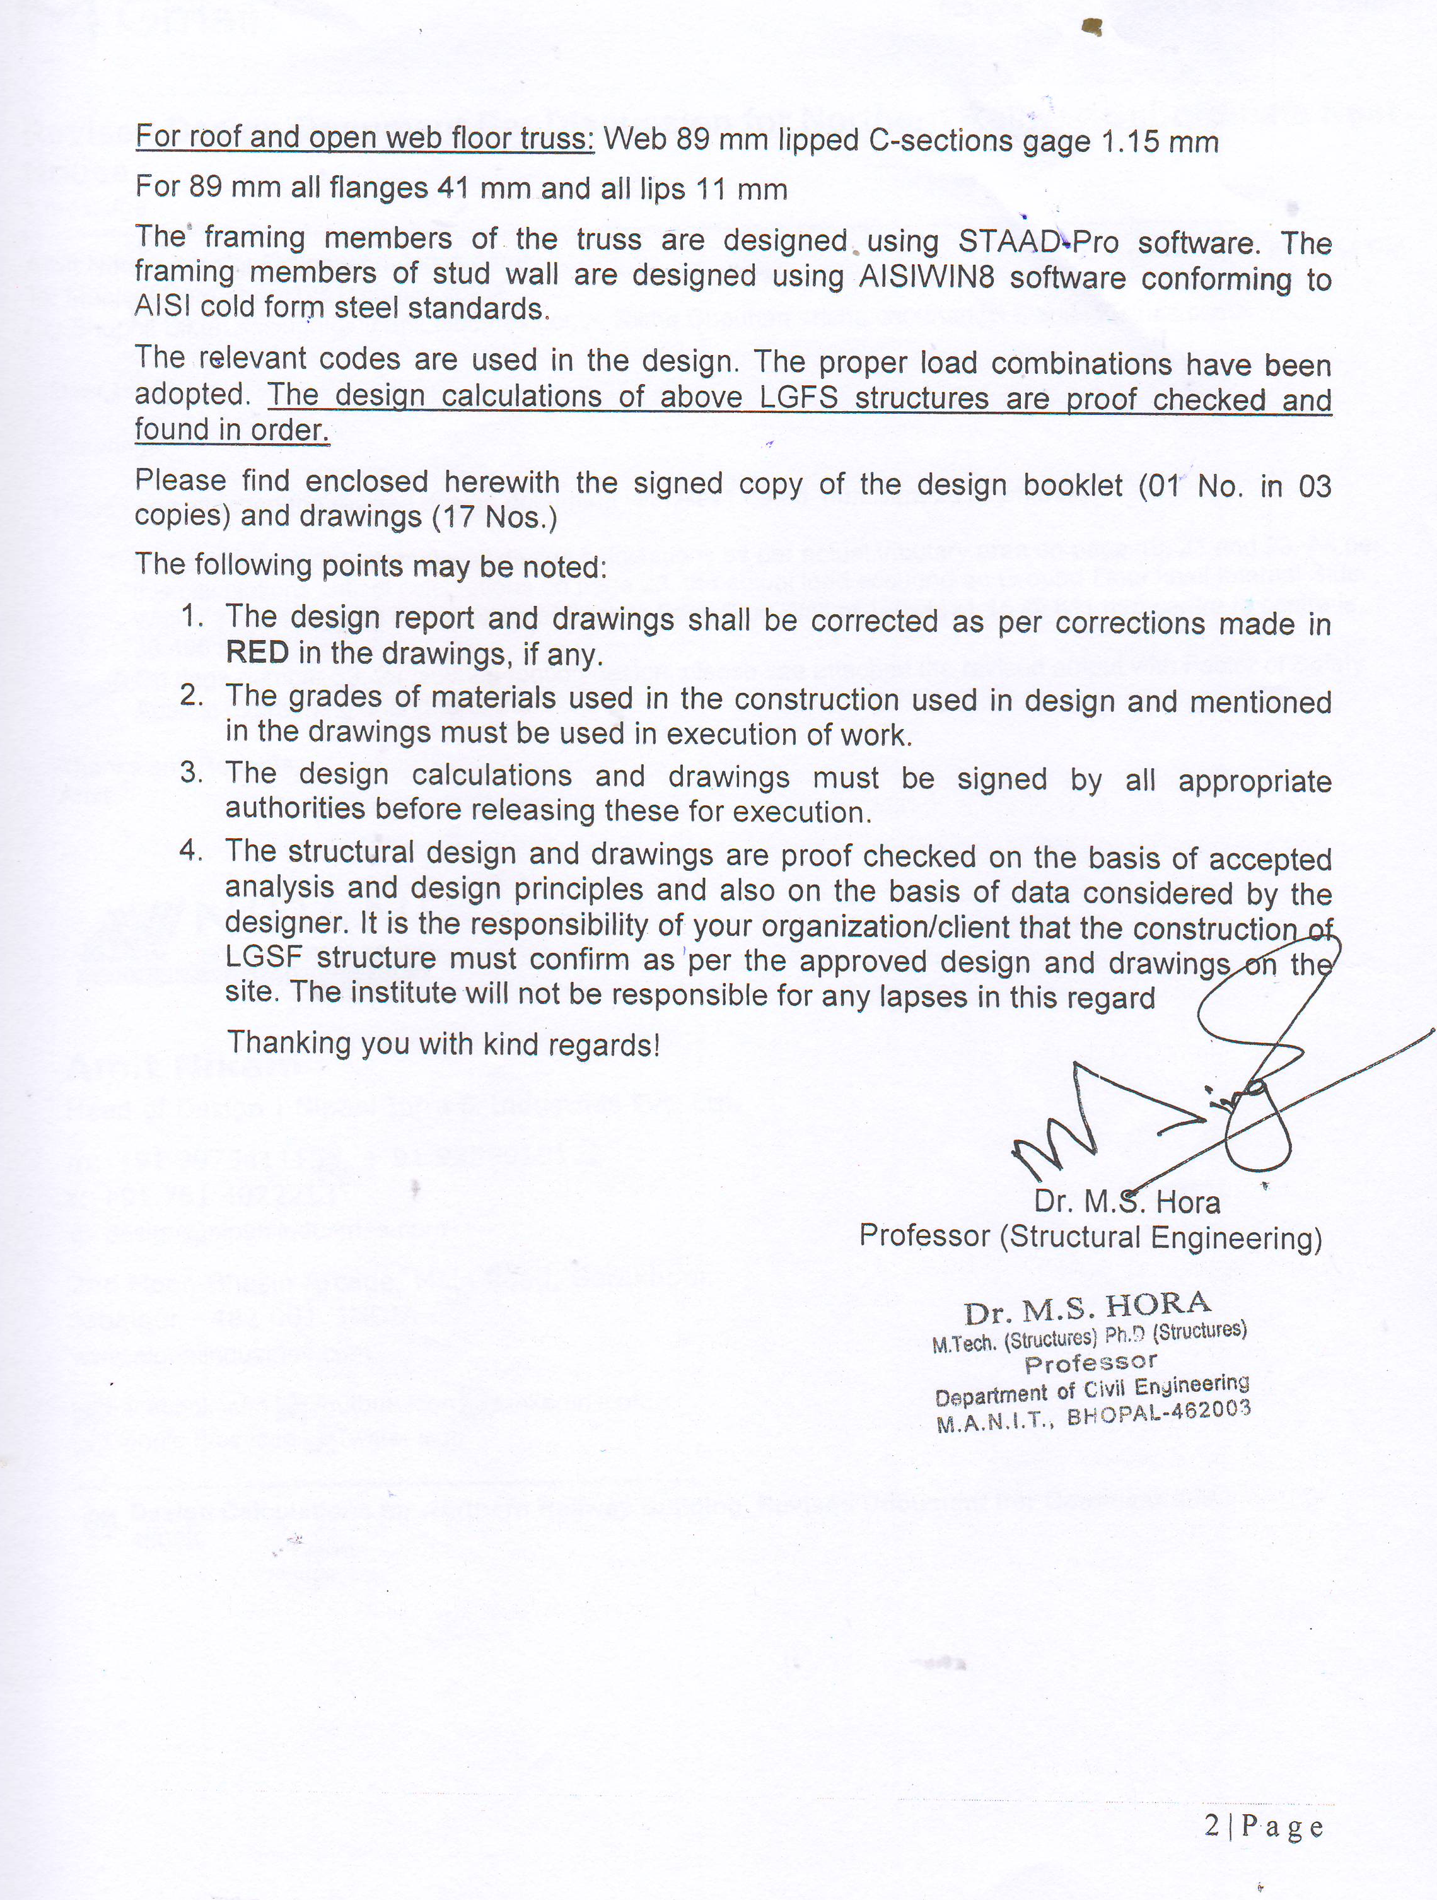
Vetting of Design by Third Party

Slide 34
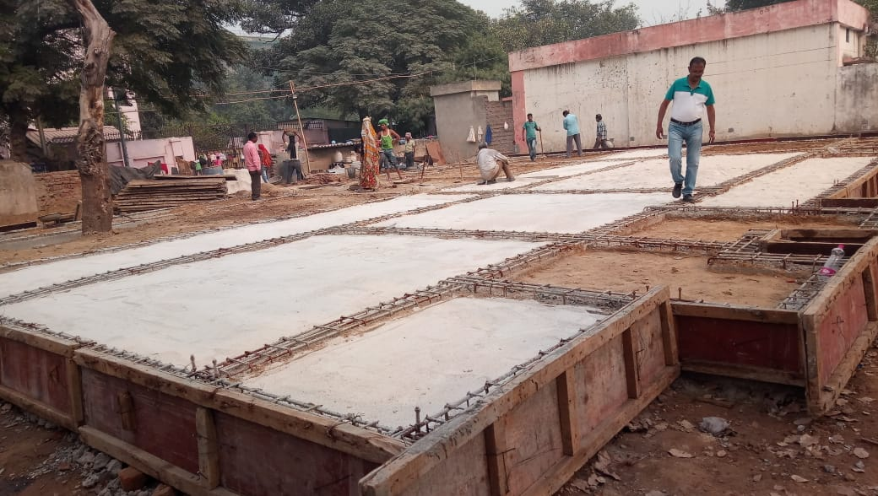
Foundation at Site

Slide 35
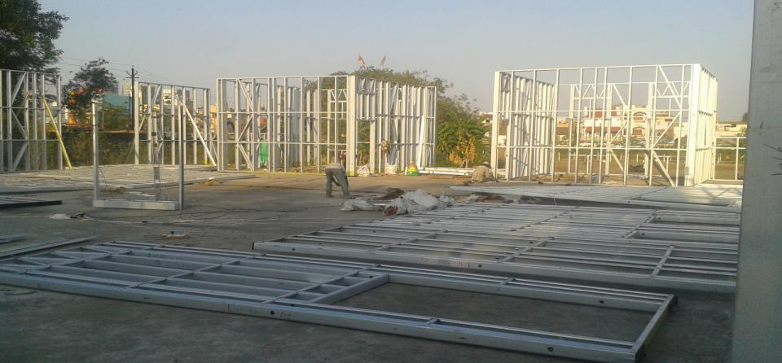

  Wall Assembly and Erection

Slide 36
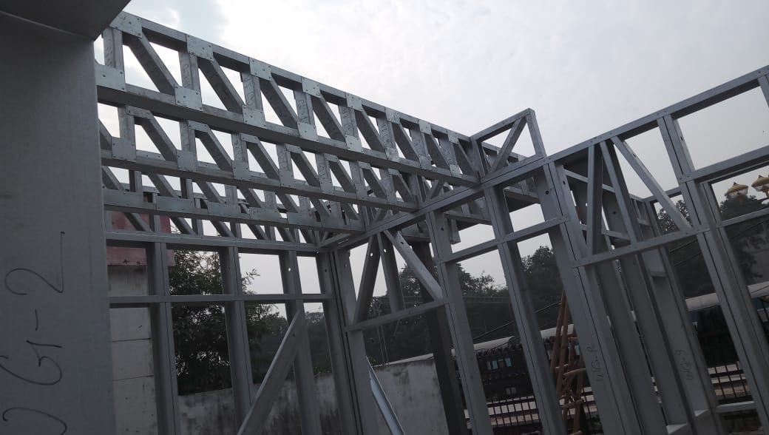

Slide 37
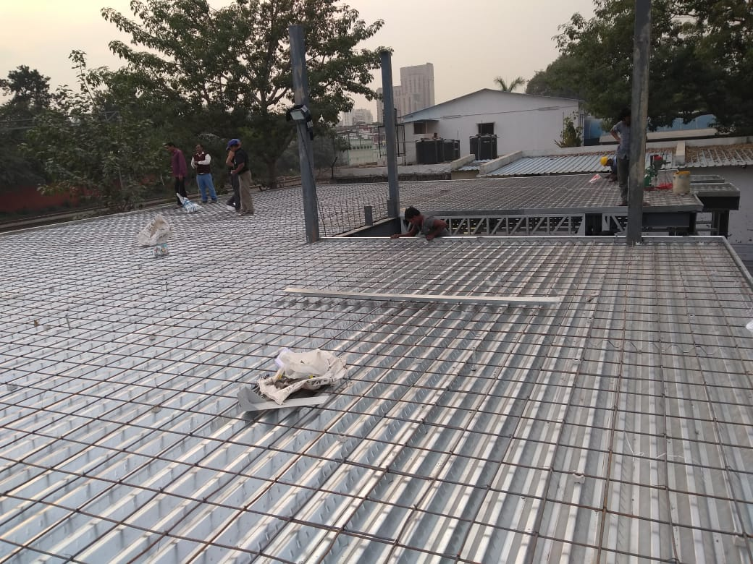
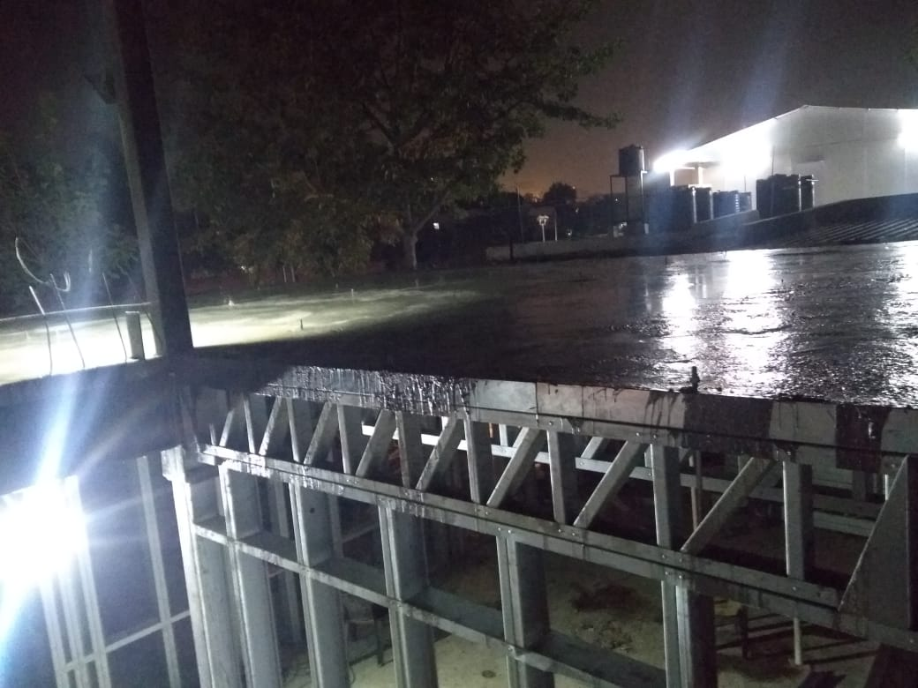
Deck Sheet Fixing and Slab Reinforcement
Slab Casting

Slide 38
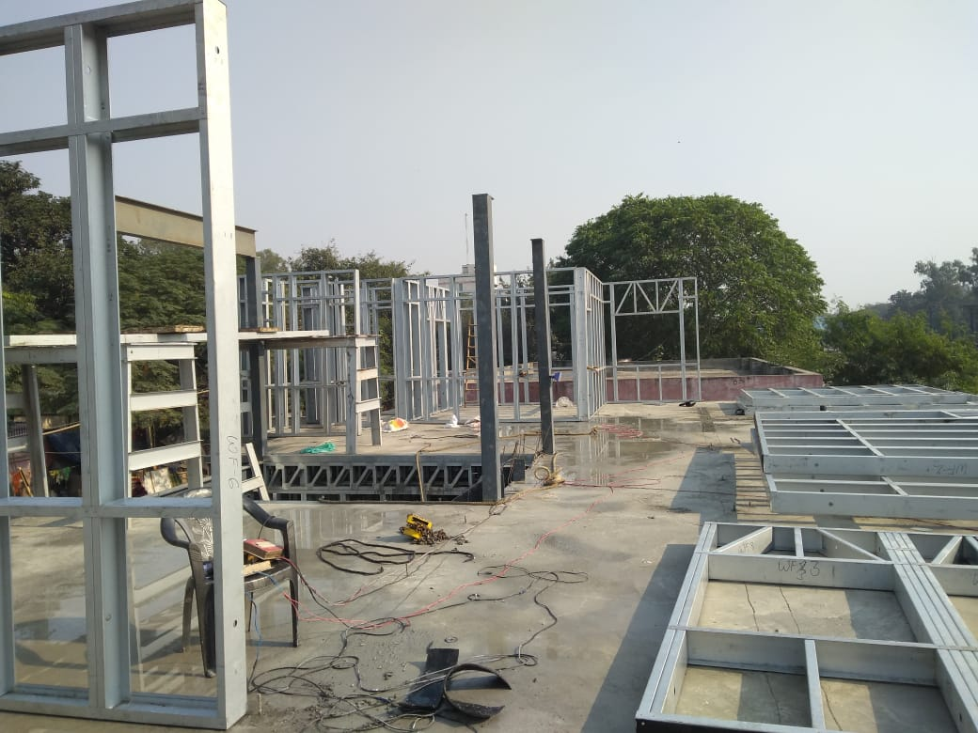
Next Floor Wall Assembly and Erection

Slide 39
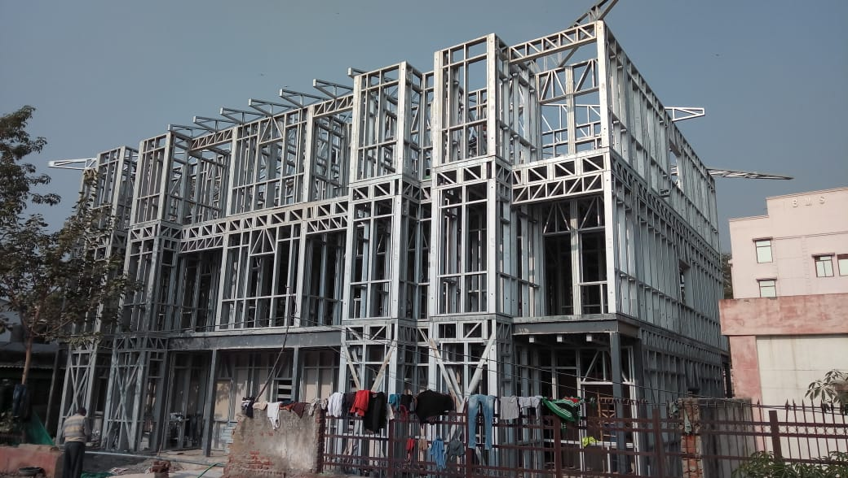
Light Gauge Steel Structure with RCC Intermediate Floors

Slide 40
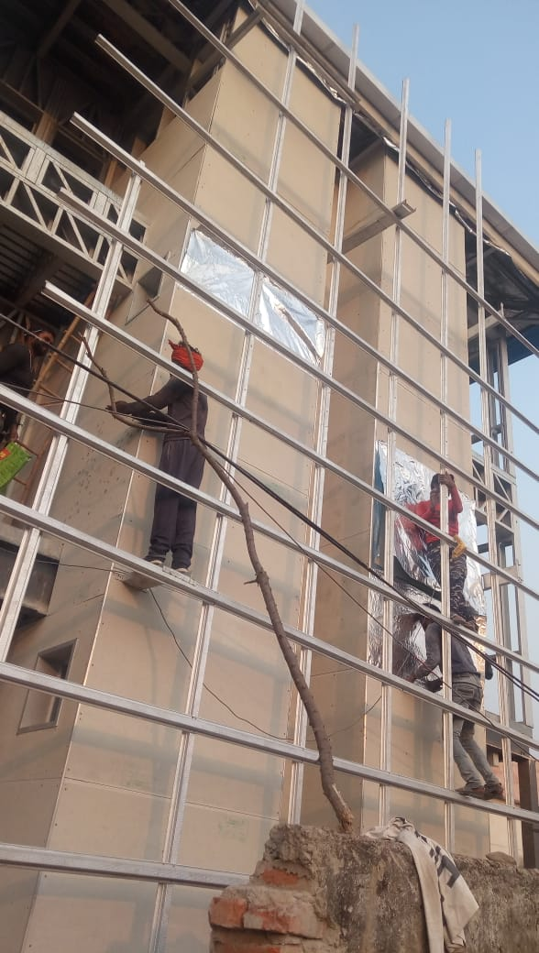
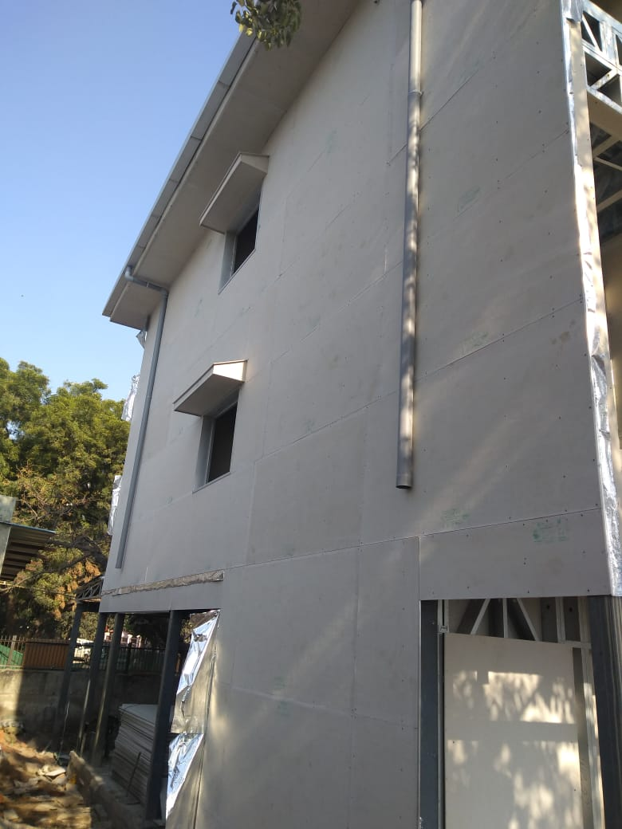
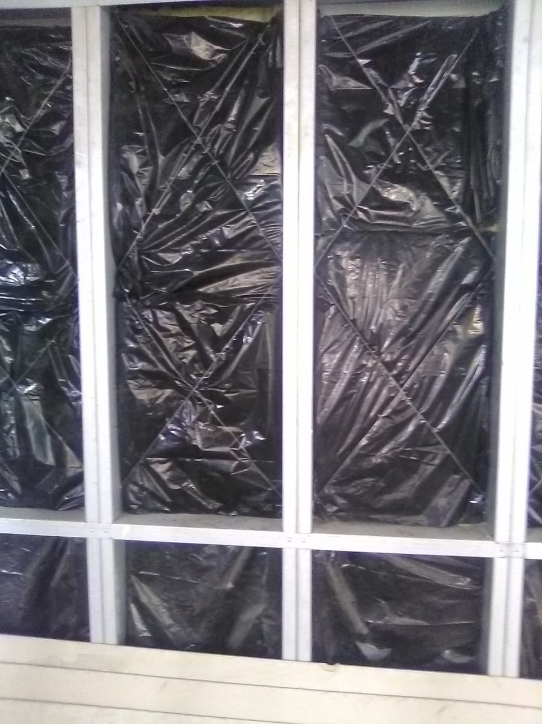
External Face Boarding
Service Pipes Fixing
Insullation Fixing

Slide 41
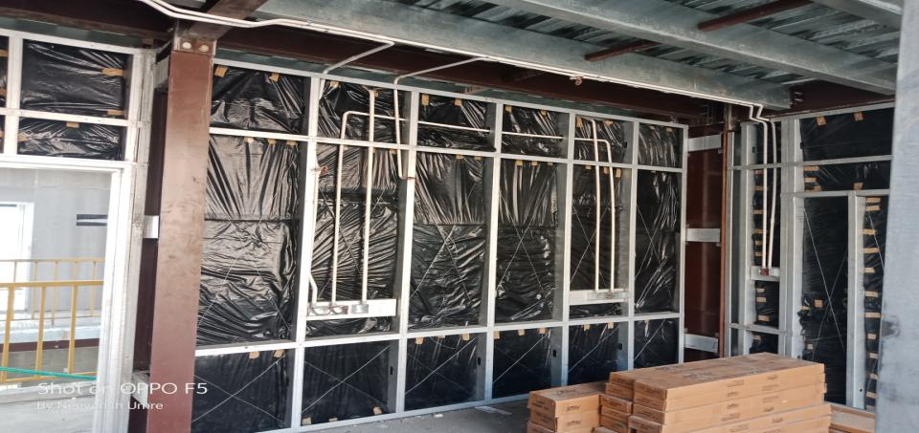
Internal Electrical Pipes Fixed

Slide 42
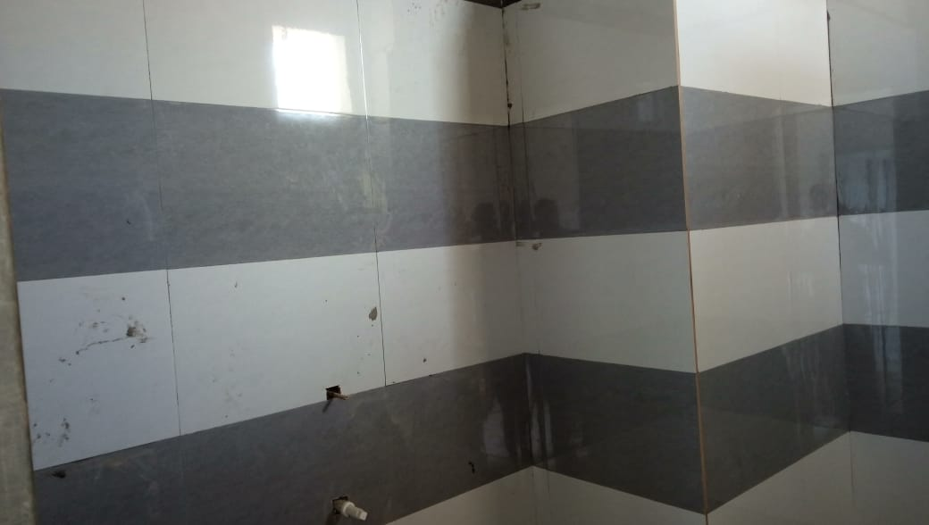
Internal Board and Wall tile fixing

Slide 43
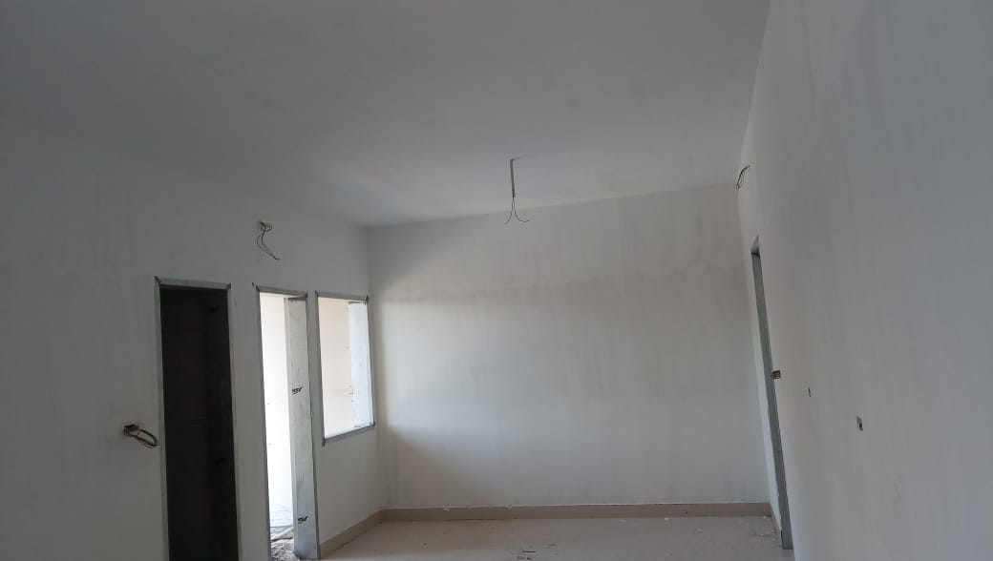
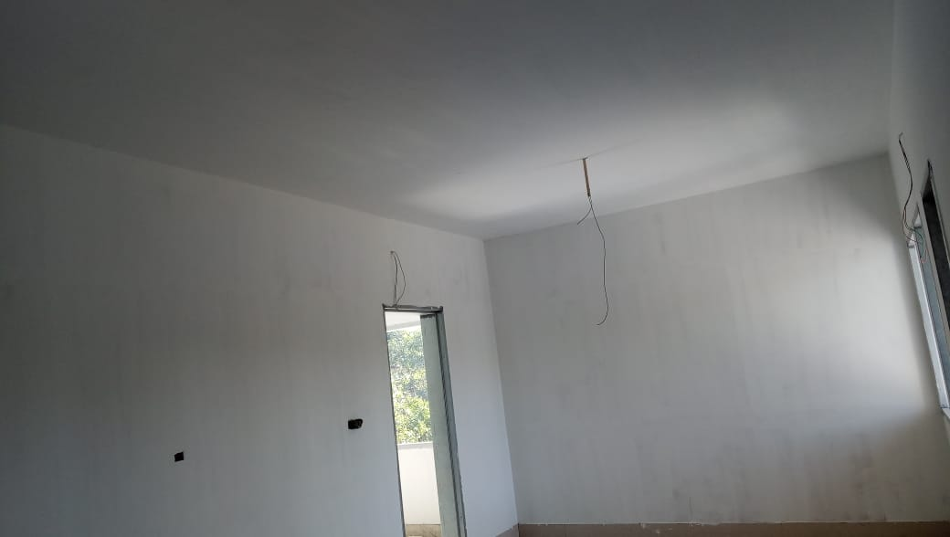
Internal Finishes

Slide 44
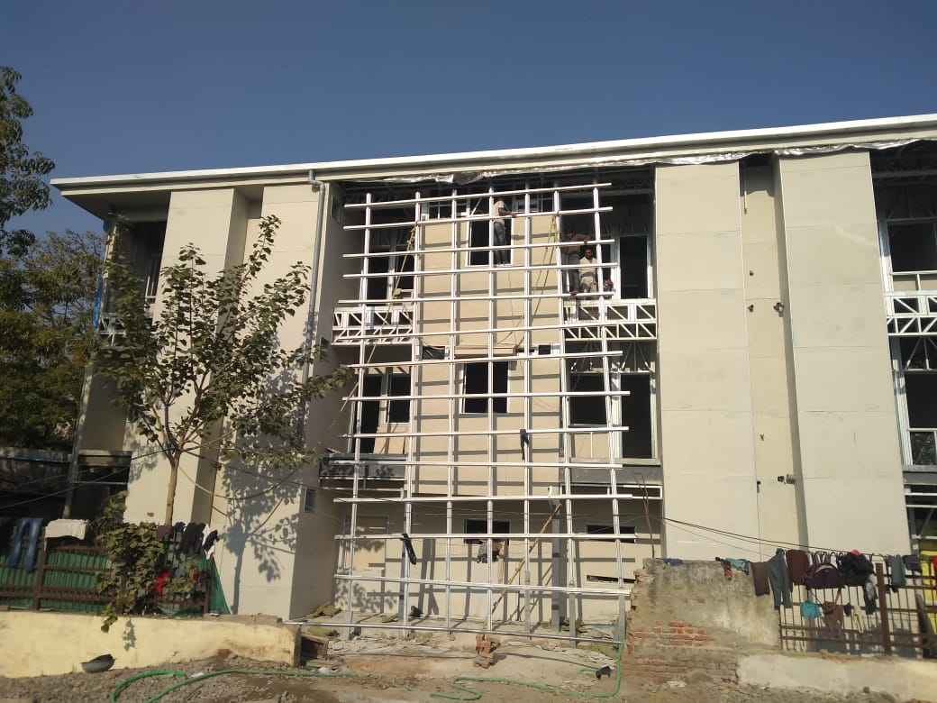
External Finish

Slide 45
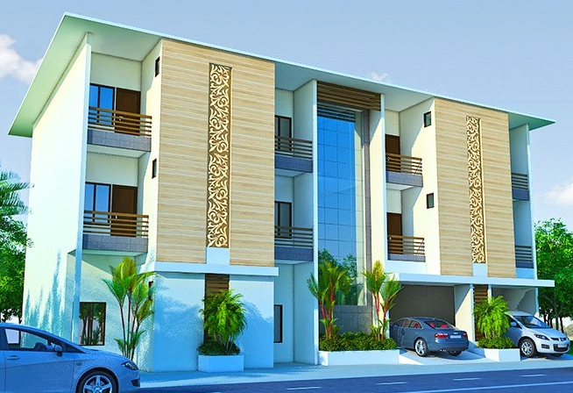
Proposed External Finish

Slide 46
  Our Proven Track Records
Successfully completed over 40 LGSF projects with 100 %OTIF.
Associated in several project in Premier education institutes in India such as IIT Guwahati, IIT Pallakad, IIT Mandi.
Associated with several Government Department such as
MPPWD,
Orissa PWD,
MP Police Housing Corporation,
Orissa Police Housing Corporation,
CPWD,
PIU,
MP State Co-operative Marketing Federation,
UPRNN and many more.

Slide 47
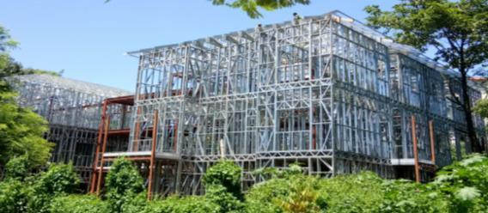
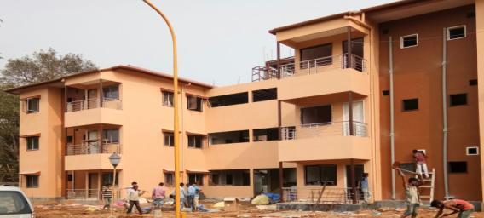
L
G
S
F
Guwahati Assam
F
I
N
I
S
H

Slide 48
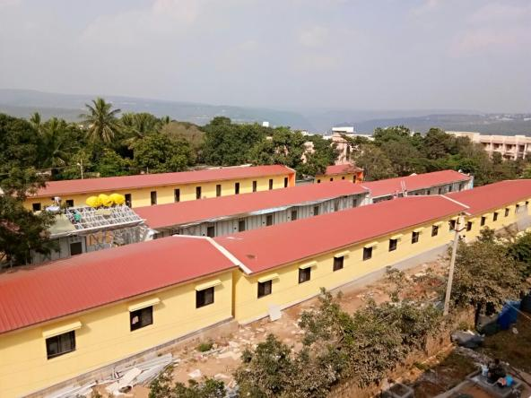
SRISAILAM - AP

Slide 49
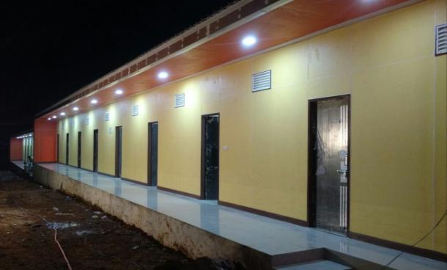
SRISAILAM - AP

Slide 50
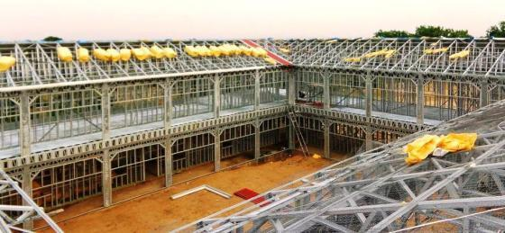
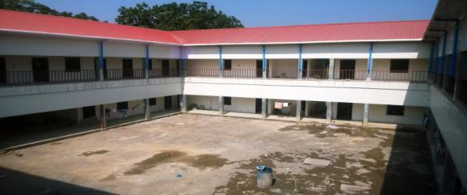
L
G
S
F
Madhya Pradesh
F
I
N
I
S
H

Slide 51
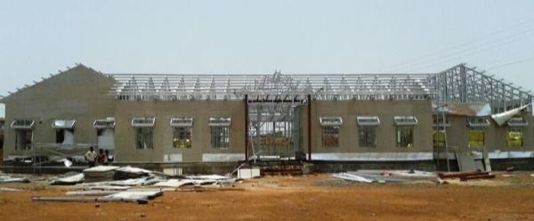
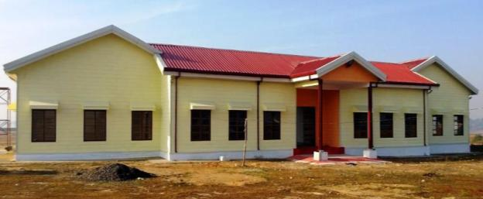
L
G
S
F
Madhya Pradesh
F
I
N
I
S
H

Slide 52
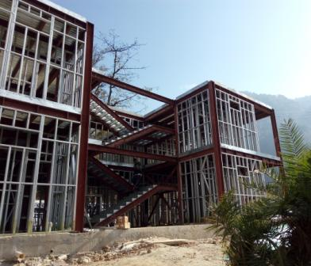
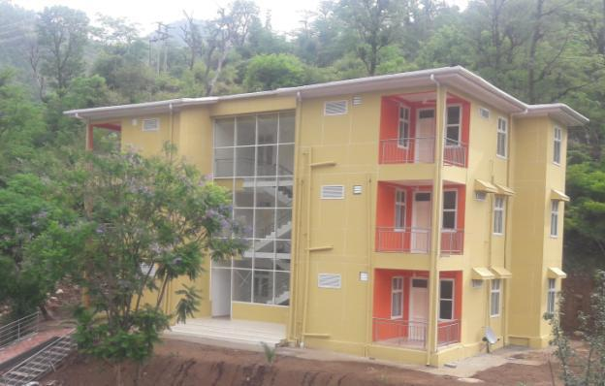
Mandi - HP

Slide 53
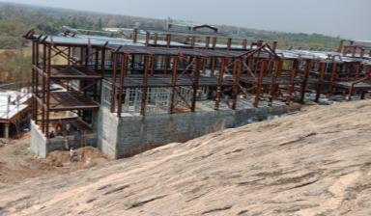
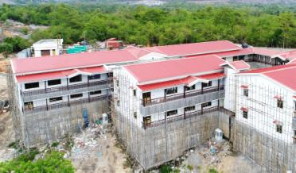
Palakkad - Kerala

Slide 54
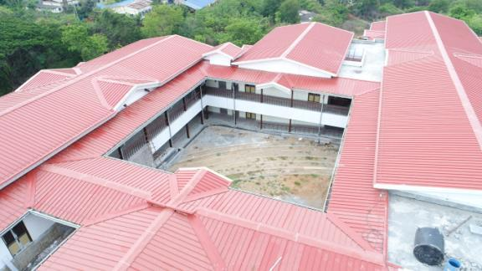
Palakkad - Kerala

Slide 55





For Further Update You may Visit us @
www.nipaniindustries.com
@nipaniindustries
Nipani Industries
Nipani Industries

Slide 56
Thanks
Now Open for Questions.
Notes:
Thanks for Listening me with patience, Hence I rest my Case to Jury. Over to you for any Questions.

Slide 57
SLIDES
FOR QUESTION AND ANSWERS

Slide 58
Merits of Steel Based Building
Dead weight - More than 60% reduction.
Suitability for high seismic zones (Zone IV - V)
Construction Time – reduced up to 60 %
ROI - Early Operations for Hotels, Hospitals, Malls etc.
Flexibility in design – large spans and architecturally pleasing
Savings in Carpet Area is saved due to slender steel sections
Less space required for material storage and preparation
Tidy premises – Safe for workers

Slide 59
Life Cycle Cost

Slide 60
Case Study
Built up Area |  | 21000 | SQFT
Dwelling Unit |  | 81 | Nos
Rent Per Day |  | 300 | Rs
Completion Time in days |  | Value In Rupees |  | REMARKS
 |  | RCC | LGSF
 |  | 365 | 120 | 245 days early Finish
Life 50 Years | Installation Cost | 100 | 125 | Taking LGSF 25% Higher
 | Early Return on Investment | 0 | -25
 | Maintenance of Services every 3 Years @ 7% | 112 | 112 | 16 Times Maintenance in span of 50 years
 | Dismantling | 10 | 7 | 10 % in case of RCC and 7 % incase of LGSF
 | Recycle Value | -5 | -50 | Considering steel salvage value at par after 50 years
 | Total Life Cycle Cost | 217 | 169 | 22%
This make LGSF Nearly 22 % Cheaper in terms of Life Cycle Cost

Slide 61
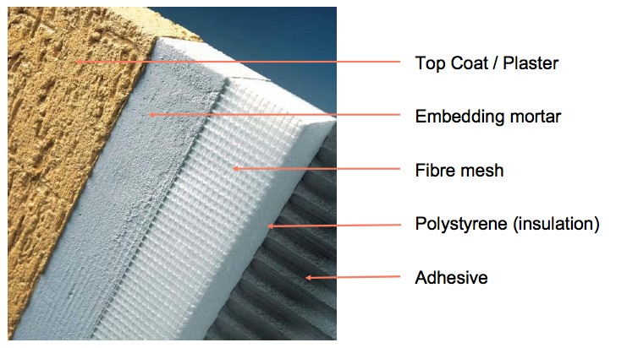
External Insulation Finish System (EIFS)

Slide 62

Cold formed steel Designing elements
Design Criteria
Building Codes
Standard CFS codes
Indian Codes and Standards
Certification
Usage of CFS Framing
  IS 875: Part 1 to 5 – Loads on Structure
  IS 800: 2007 – Design of Steel Structures
  IS 801: 1975 & AS/NZS 4600:2005 – Design of Cold-Formed Steel
  IS 456: 2000 – Design of Concrete
  IS 1893: 2002 – Earthquake Resistant Design

Slide 63



Cold formed steel Certifications
  ICC ES Certification in the US (ESR-2361)
  ATI Certification in the US (CCRR-1030)
  CE Certification in Europe (1224-CPD-0200)
  Certification in Poland (AT-15-8394/2010)
  SASFA Accreditation in South Africa
  NZ and AUS certification
  Approved in Iran
  Approved in Afghanistan

Slide 64
Thanks
Now Open for Questions.

