Slide 1
Mass Housing using Elematic -PRECAST Technology from Finland

Slide 2
Our company

Slide 3
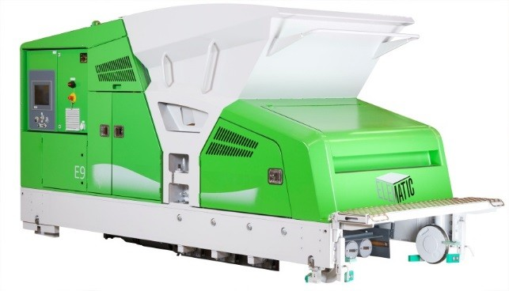
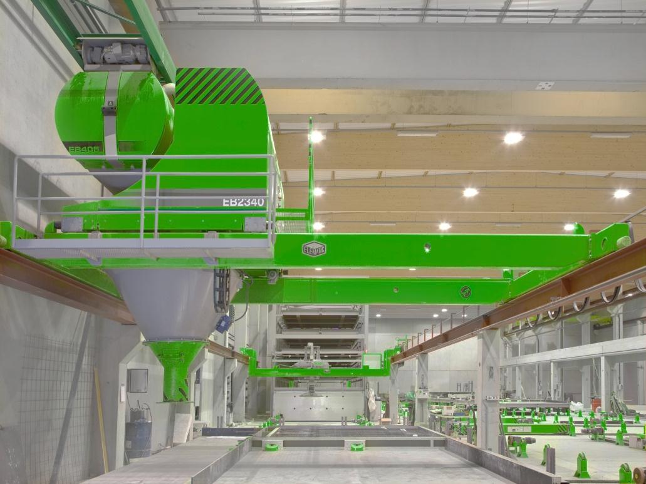
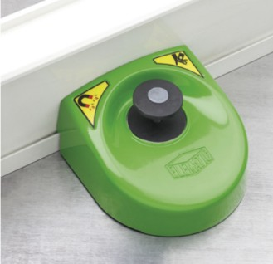
Elematic - World‘s Leading Supplier of
Precast- Proven Technology from Finland
Elematic is the world´s leading supplier of know-how, machinery, equipment, production lines and complete production plants for the precast concrete industry. Elematic´s production technology is already in use in more than 100 countries on five continents with 4000 plant installations.

Slide 4
ELEMATIC FACTS IN BRIEF
Founded 1959
Head office: Akaa, Finland
3 production units: Fnland, India
Customer service centers: UAE (Dubai), Finland and USA.
Subsidiaries and sales offices: UAE (Dubai), USA, Germany, Hong Kong, Russia, India, China.
Representatives: In over 50 countries
Number of Elematic precast technology customers
Over 4000 deliveries worldwide to more than 100 countries

Slide 5
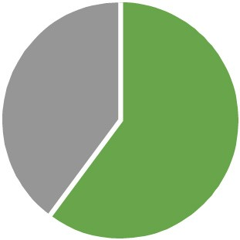
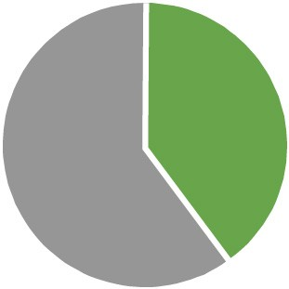
The only one-stop-supplier in the precast concrete industry
Delivering anything from a single machine or production line to a complete plant for any precast product
World-leading technology, knowhow, process excellence and software
The most extensive customer services in the market
Setting up World’s largest precast plant at Iraq for 7500 sq.m. BUA per day.
Global market share
Hollow-core slab technology 60%
Elematic
Others
All precast concrete production technologies 40%
Elematic
Others

Slide 6
STUCK IN TIME ?

Slide 7
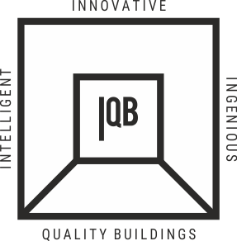
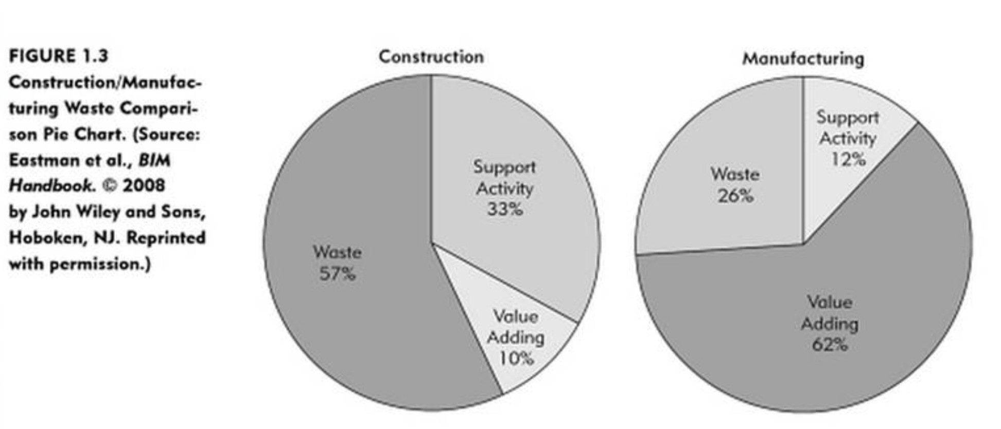
A Stark Reality of Civil Construction
The Real opportunity !!

Slide 8
Precast Share Globally
10% GREATER THAN THE LEVEL OF INDIA

Slide 9
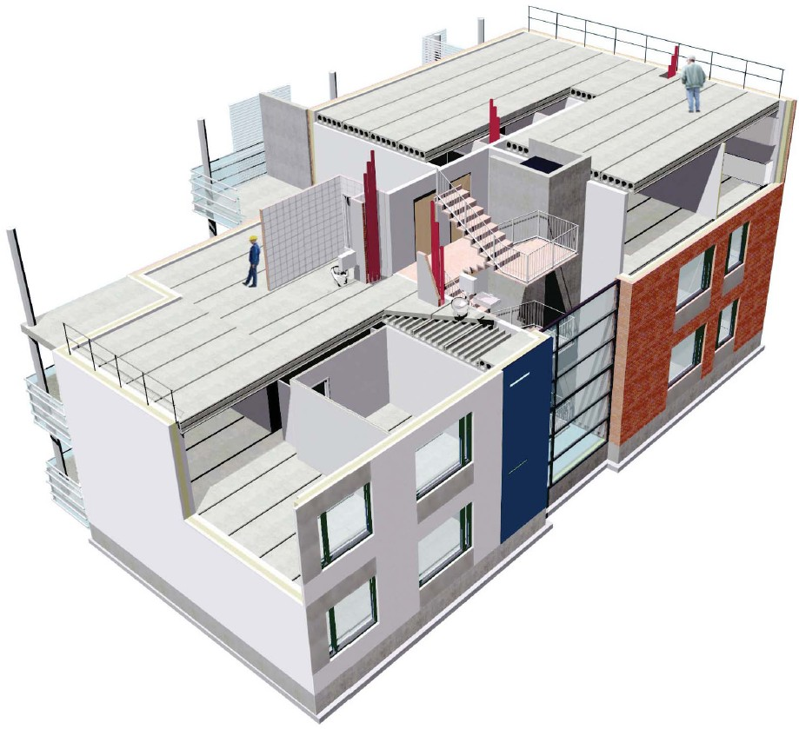
Precast System for Housing
Wall-Frame System :
Hollow-core Slab floor
Exterior façade (Non-load-bearing/ Lateral load resist)
Stairs and Lift Core
Non-load bearing Internal Walls
Gravity + Lateral Load-bearing Wall

Slide 10
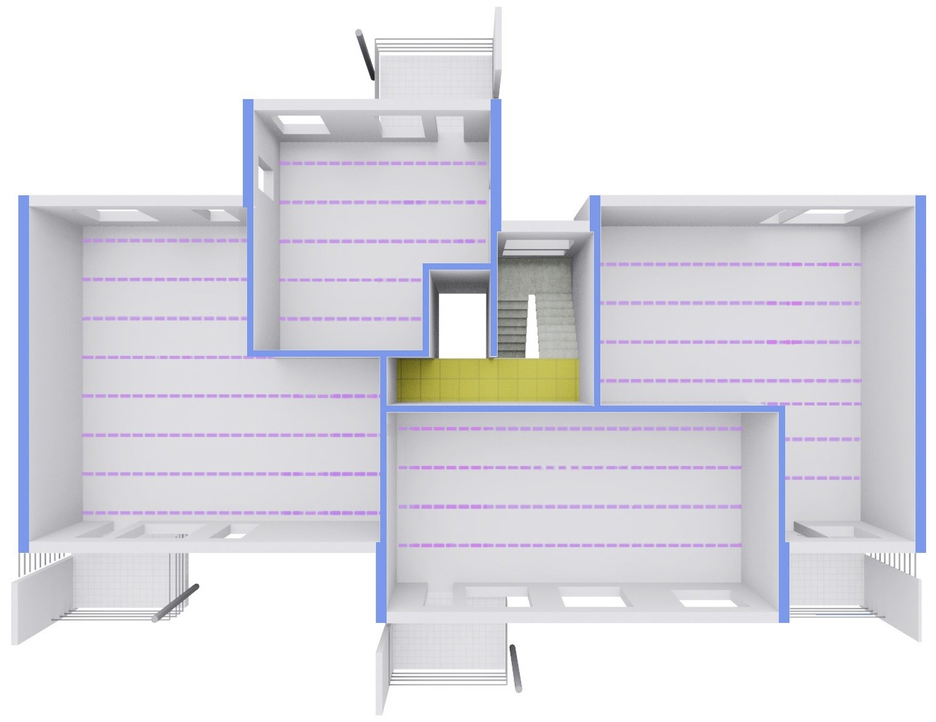
Wall Frame – Flexible Layout- Easy to produce- Easy to Transport – Easy to Install
Construction system:
Load-bearing walls
Non load-bearing walls
Slabs
Fixed structures

Slide 11
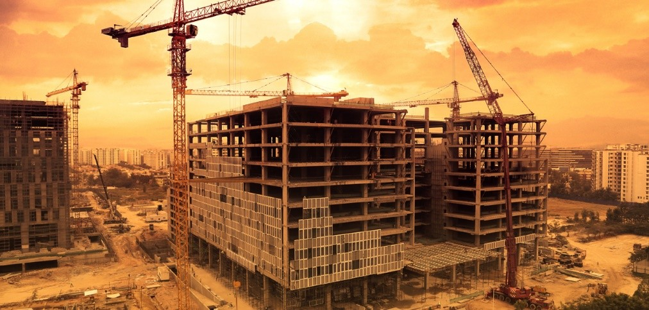
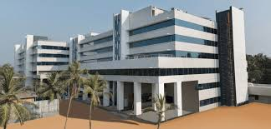
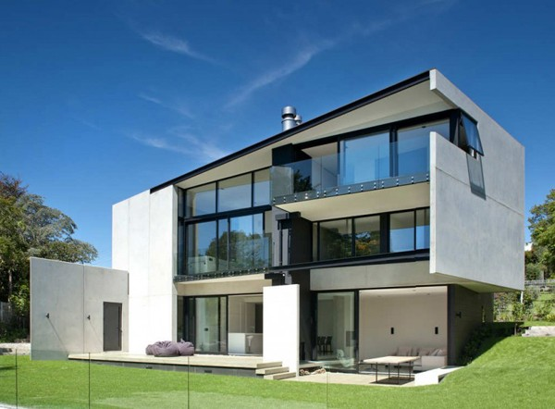
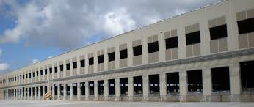
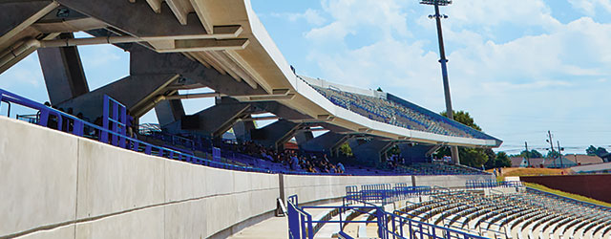
PRECAST : ONE TECHNOLOGY FITS ALL
COMMERCIAL BUILDINGS
HOSPITALS
RESIDENTIAL BUILDINGS
WAREHOUSING
STADIUMS

Slide 12
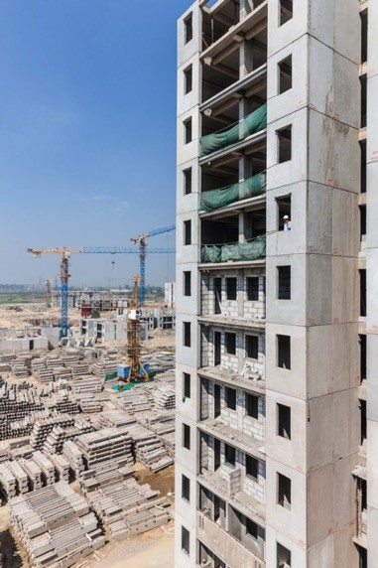
Indian Affordable Housing
A Case Study
BG Shirke - DDA
Precast Success Story

Slide 13
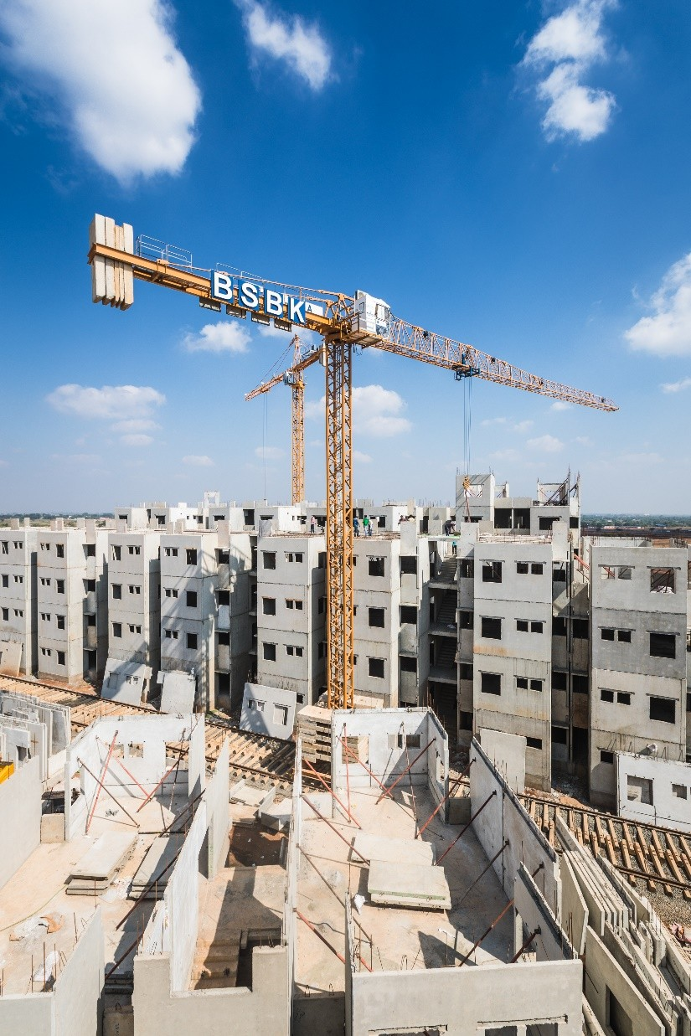
Project: EWS / LIG Housing
Contractor: BSBK Group
Project Details –
~6200 apartments,
Construction time 3 years
G+3, G+8 buildings
Elematic Machines –
KVT Line for walls
Mechanical tilting tables for special elements
Long line for and hollowcore slabs
Other Services –
Installation of precast plant
Annual maintenance contract

Slide 14
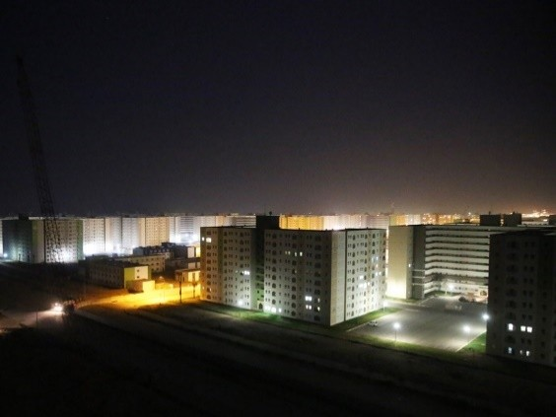
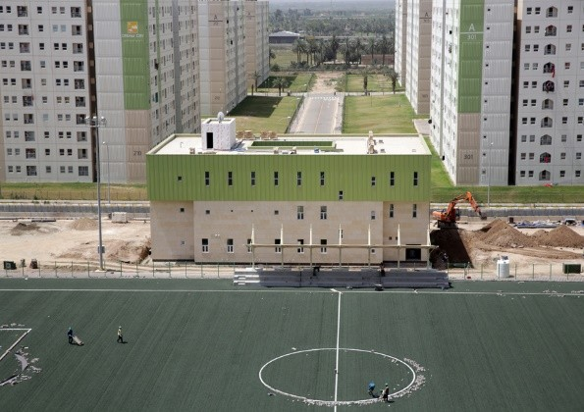
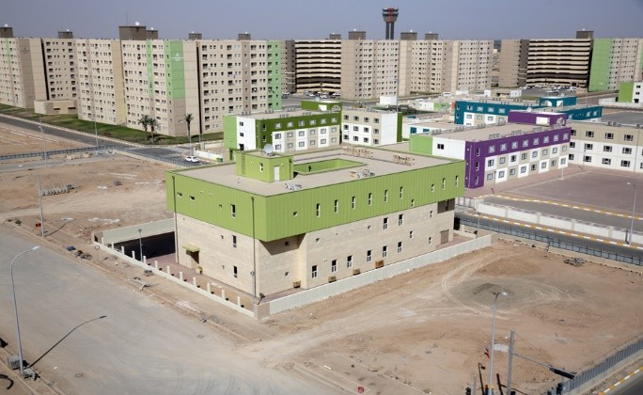
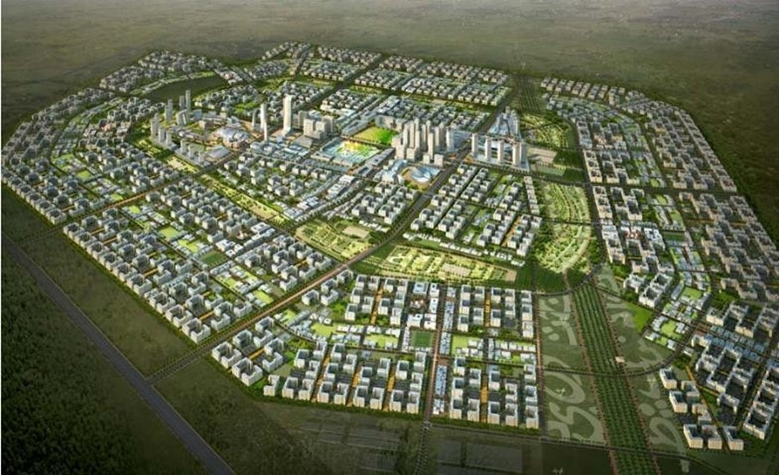
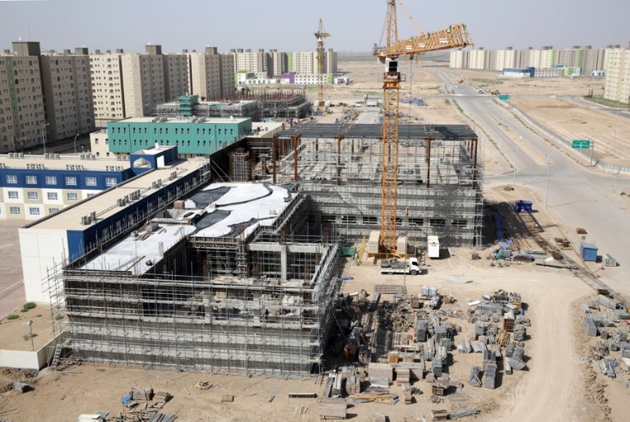
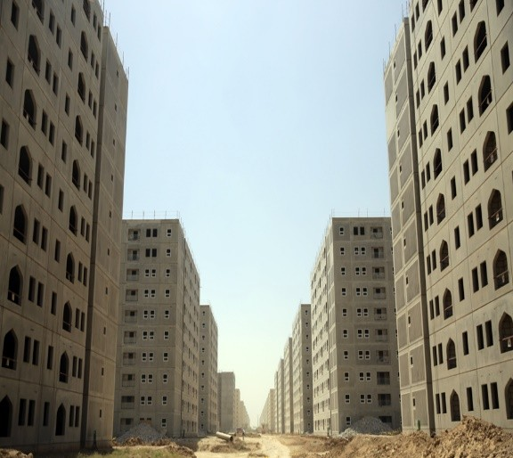
An International - Eye Opener- BISMAYAH CITY – IRAQ-1750 Towers of 10 story Building in 5 Years
Precast At its very best

Slide 15
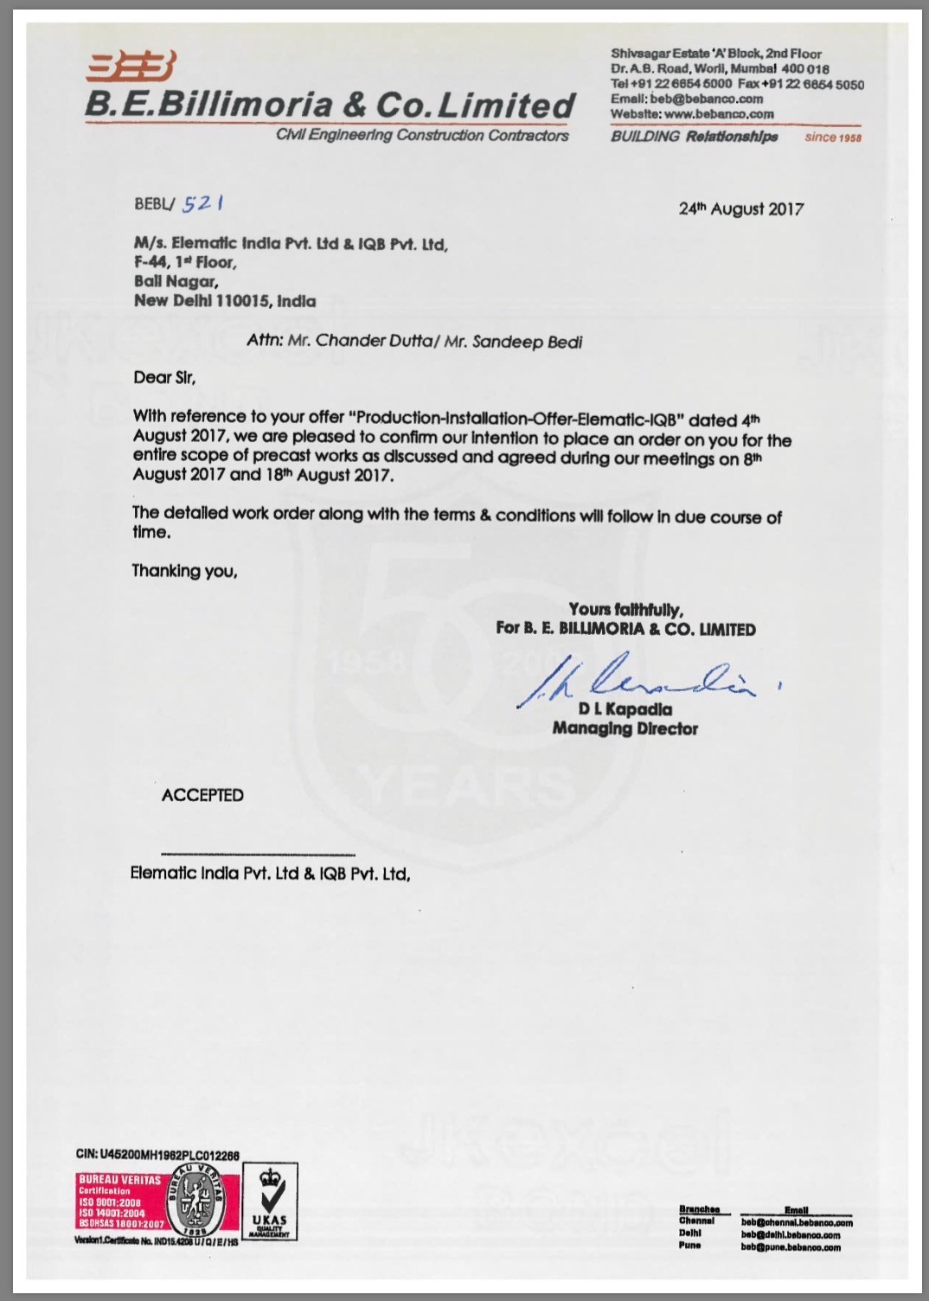
Billimoria (MPMC) Pune
I^{QB’s} precast 1st project
960 Floors in 960 Days!
G + 14 - 60 towers precast construction contract
5 million sq ft - in 40 months
Contract value ~Rs. 80 Crores
Scope:
PMC
Precast element production
Precast element storage & logistics
Precast element erection

Slide 16
Elematic India Services
ELEMATIC SERVICES
Precast Plant Design
Production Training / Supervision
Structural Engineering Services
Architectural / MEP Services*
Concept Design / Project Feasibility Study
Execution Training / Supervision
Supply Precast Machinery
Rebar Automation/ Precast Accessories*
Plant Setup & Maintenance
* Services provided through our partners

Slide 17
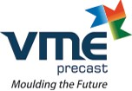
Some of our key customers
Reference of some of the key customers having our machinery setup

Slide 18
Key customers in India and Sri Lanka

Slide 19
Elematic Plant Installations in India
Sr.No | Precast plant | Location | Commissioned in | Capacity -Indicative Mn sqft BUA/Year | Machinery installed by
1 | BG Shirke | Delhi | 2012 | 4 | Elematic
2 | KEF Infra | Tamil Nadu | 2014/2018 | 4 | Elematic
3 | KEF Infra | Lucknow | 2017 | 1.5 | Elematic
4 | VME Precast | Tamil Nadu | 2008 | 2 | Elematic
5 | Amrapali Precast | Delhi | 2011 | 3 | Elematic
6 | L&T | Mumbai/Bangalore | 2011 | 1 | Elematic
7 | Simplex Infra | Mumbai | 2010 | 1 | Elematic
8 | PRECA | Hyderabad | 2014 | 1.5 | Other
9 | Sobha Precast | Bangalore | 2016 | 1 | Other
10 | Precasters India | Bubhaneswar | 2015 | 1 | Elematic
11 | Robomatic | Hyderabad | 2018 | 1 | Elematic
12 | Teemage Precast | Tamil Nadu/ Telangana/AP/Delhi | 2012/2014/2016 | 3 | Elematic
13 | BN. Precast | Ahmedabad | 2014 | 1 | Elematic
14 | Aurobindo Realty | Hyderabad | 2018-19 | 3 | Elematic
15 | Mahesh GRC | Delhi | 2016 | 1 | Elematic
16 | Precasters India | Bhubaneshwar | 2016 | 1 | Elematic
17 | Godrej | Delhi | 2019 | 1 | Elematic
18 | BE Billimoria | Pune | 2018 | 2.5 | Elematic
19 | Jindal Realty | Delhi | 2015 | 1.5 | Elematic
20 | BSBK | Chattisgarh | 2016 | 1.5 | Elematic
21 | Inventaa | Hyderabad/ Vijayawada/ vizag | 2017-18 | 4 | Elematic

Slide 20
THANK YOU

