Slide 2
EPS Wall Panel Technology

Slide 3
1- Fastest Adapting Technology
2- Lower Cost due to reduced labour
3- Faster Implementation
4- Higher structural integrity
5- Uniform Quality

Slide 4
6- Simpler Construction
7- Higher Insulation property
8- Both Thermal and ascoustic
9- better fire proofing
10- Higher moisture resistance

Slide 5
11- Light weight
12- More ecofriendly
13- less polluting manufacturing

Slide 6
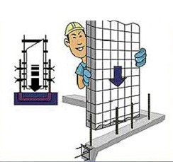
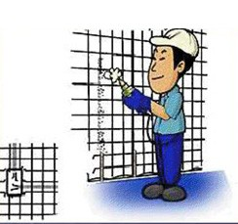
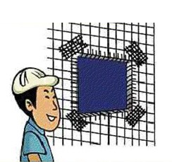
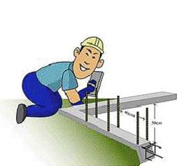
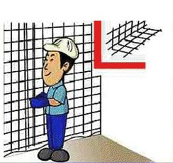
Construction process

Slide 7
Our works

Slide 9
Office: No 666, 47th Street,
9th Sector, K K Nagar
Chennai-600078
9444733310
www.msnconstruction.in
Email: msnconst@icloud.com
msneps@icloud.com

