Slide 1
Global Housing Technology Challenge (GHTC) – India
UTTAR PRADESH

Slide 2
Pradhan Mantri Awas Yojana (Urban)
Physical Progress_Uttar Pradesh
PMAY (U) Progress in UP
Verticals | Houses Approved | Grounding /Work order Issued | Grounded/In Progress |  |  |  | Completed
 |  |  | Foundation | Lintel | Roof Casted | Total
AHP | 1,29,849 | 26,256 | 14,065 | - | 4,559 | 18,624 | 110
BLC | 9,77,057 | 3,16,813 | 1,76,688 | 23,945 | 37,781 | 2,38,414 | 78,399
Total | 11,06,906 | 3,43,069 | 1,90,753 | 23,945 | 42,340 | 2,57,038 | 78,509
CLSS | Till 28.02.2019, upfront subsidy of Rs 483.28 Cr. released to 23,102 beneficiaries.

Slide 3
Pradhan Mantri Awas Yojana (Urban)
Financial Progress_Uttar Pradesh
PMAY (U) Progress in UP
Verticals | Houses Approved | Houses Grounded | Houses Completed | Fund Received (in Lakhs) |  | Fund Disbursed (In Lakhs)
 |  |  |  | Central Share | State Share
AHP | 1,29,849 | 26,256 | 110 | 16,482.00 | 10,988.00 | 25,598.00
BLC | 9,77,057 | 3,16,813 | 78,399 | 3,50,999.00 | 1,28,575.00 | 3,49,330.00
Total | 11,06,906 | 3,43,069 | 78,509 | 3,67,481.00 | 1,39,563.00 | 3,74,928.00

Slide 4
Global Housing Technology Challenge (GHTC) – India
Proposal for Lighthouse Project
Lucknow Nagar Nigam, Lucknow

Slide 5
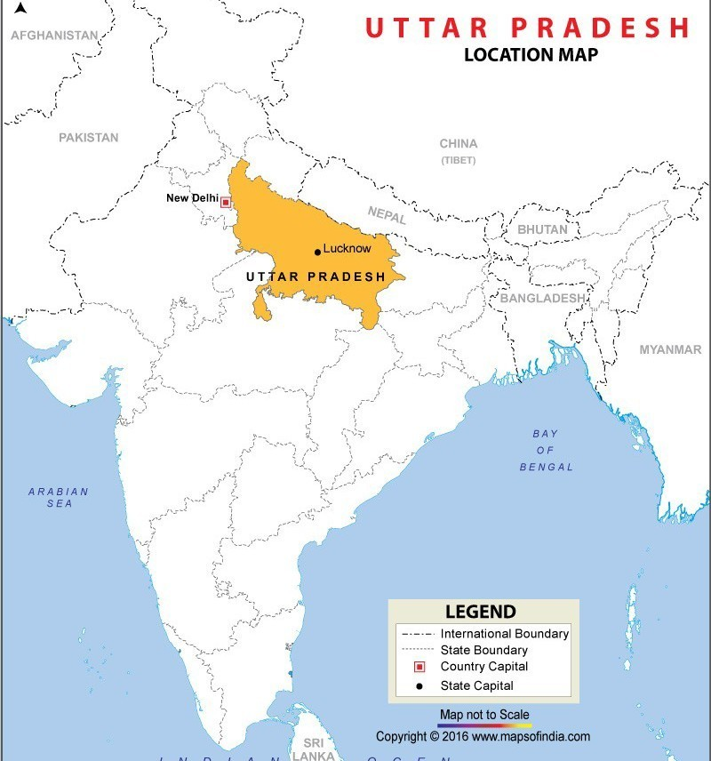
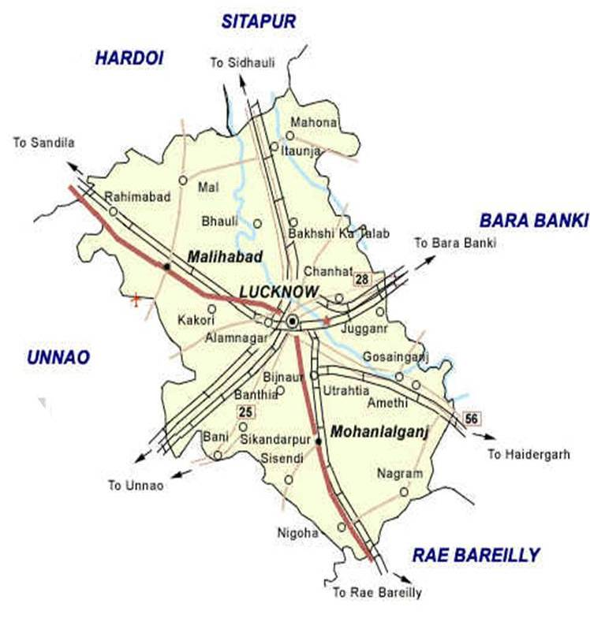
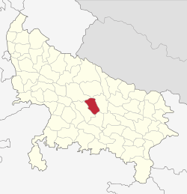
Location Map
Map of India
Lucknow
Proposed Site for
Light House Project
Map of Lucknow
Map of Uttar Pradesh

Slide 6
Details of Light House Project
Site is located in Lucknow Nagar Nigam at Nadarganj, Amausi.
The proposed site is in two parts measuring a total of 2.266 ha.
Site A : 0.37 ha Site B : 1.896 ha
Proposed site is just 3.0 Km from Chaudhary Charan Singh International Airport and 6.9 km from commercial center.
The site is well connected to public transport and electricity distribution network.
Facilities of municipal water supply and sewerage are available in close vicinity.
The land is almost plain and require minimum earthwork do be done.
The site lies in seismic Zone 3 and have humid sub tropical climate.
The land use of the proposed site is residential.

Slide 7
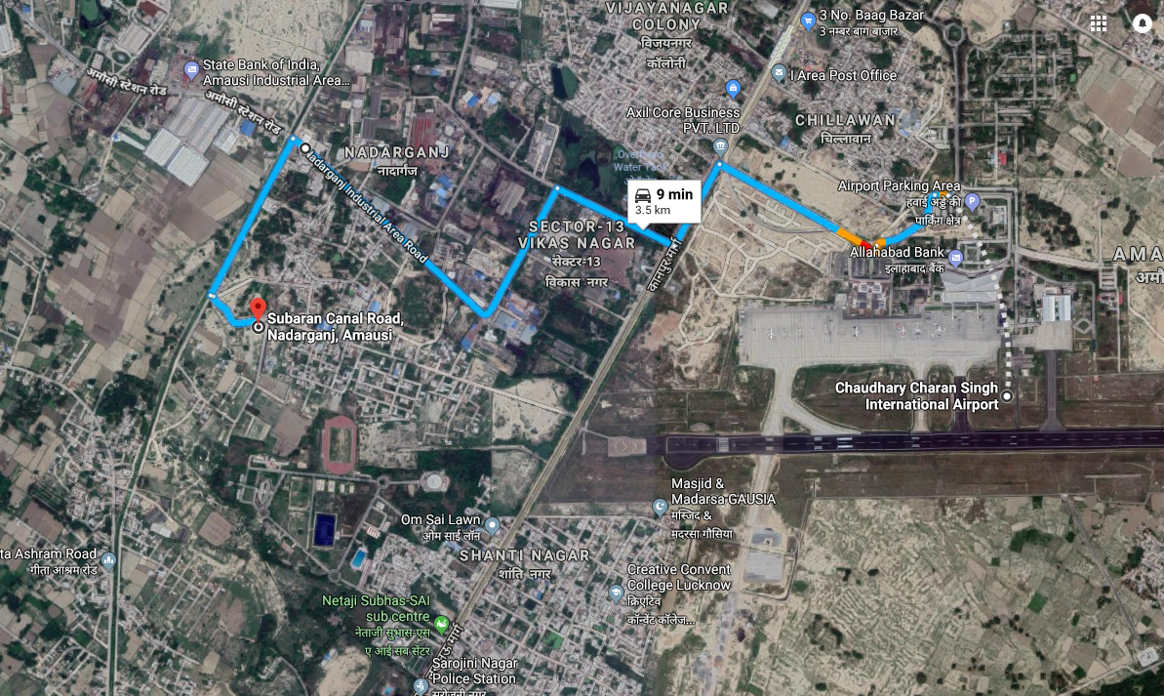
Satellite Image showing Distance of Proposed site from Airport : 3.50 km

Slide 8
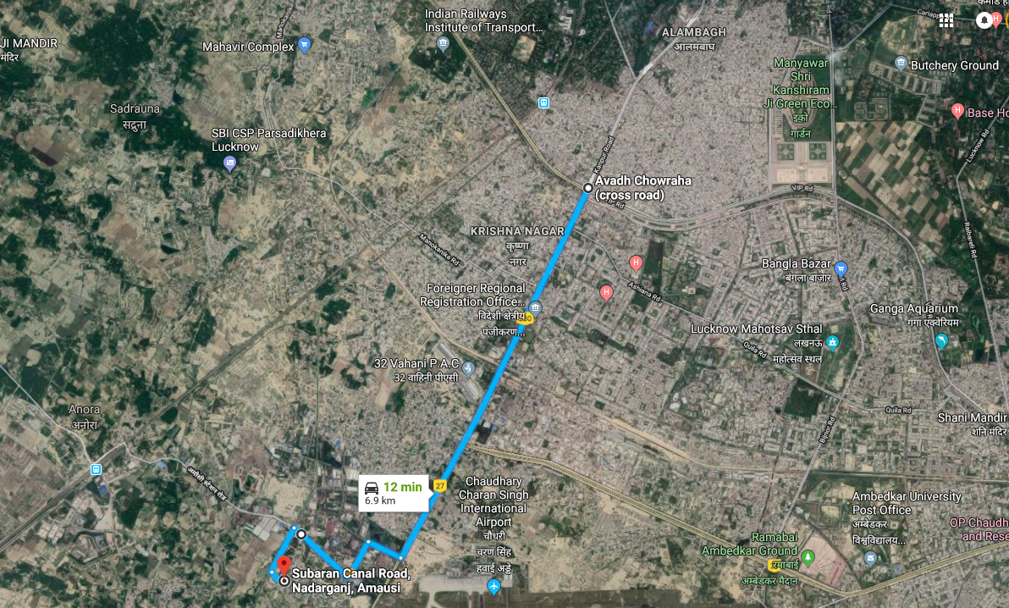
Satellite Image showing Distance of Proposed site from Commercial Centre : 6.90 km

Slide 9
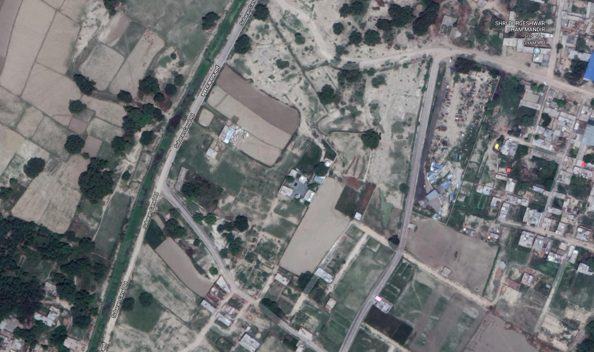
Satellite Image showing
SITE B
SITE A

Slide 10
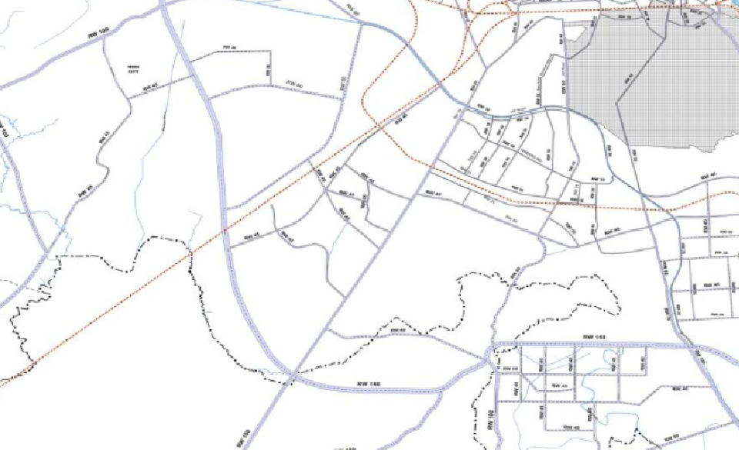
Public transport facilities with respect to the proposed site
CHARBAGH RAILWAY STATION
AMAUSI RAILWAY STATION
AMAUSI STATION ROAD
CHAUDHARY CHARAN SINGH INTERNATIONAL AIRPORT
RAILWAY LINE
LUCKNOW – KANPUR ROAD
Proposed Site for
Light House Project

Slide 11
Survey Map (Site A)
Area : 0.37 ha
N

Slide 12
Survey Map (Site B)
Area : 1.896 ha
Area Site (A) : 0.37 ha
Area Site (B) : 1.896 ha
Total Area : 2.266 ha
N

Slide 13
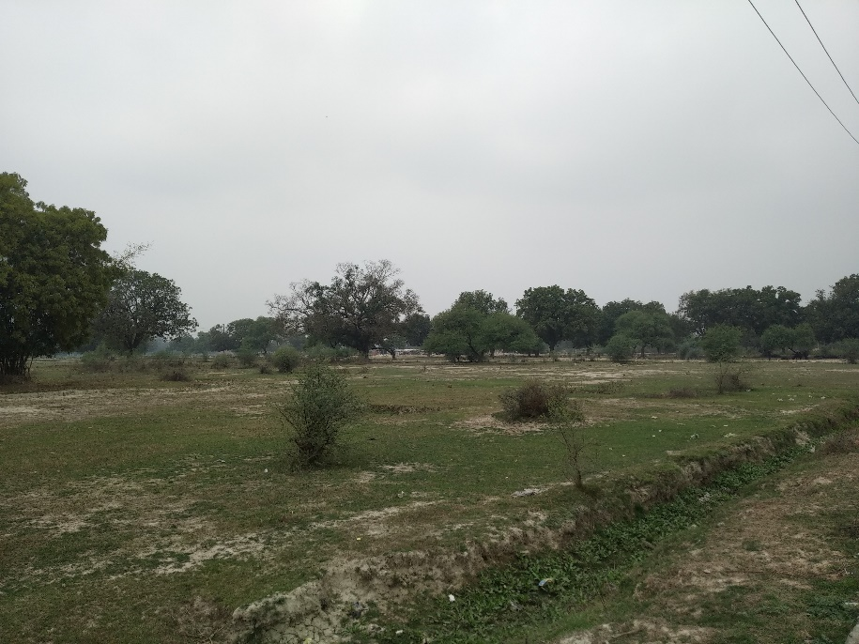
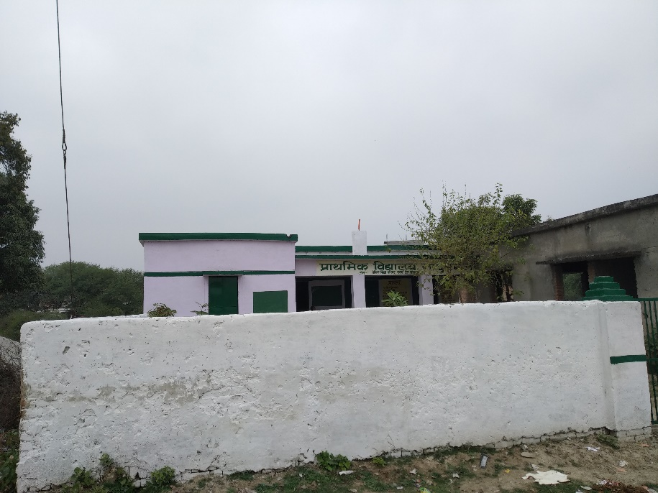
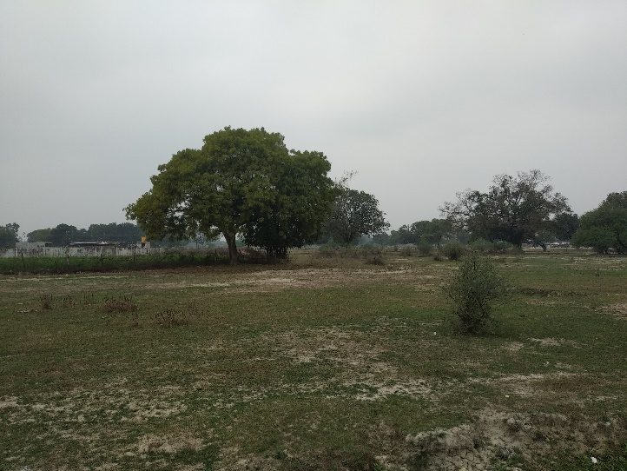
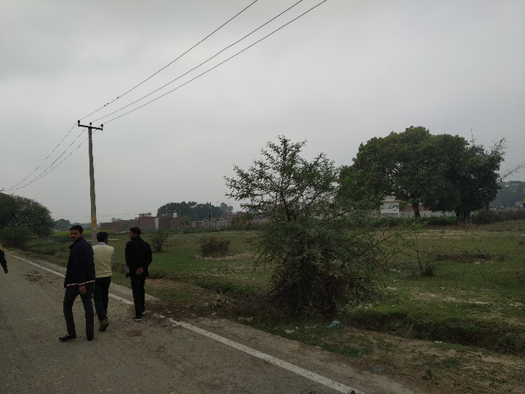
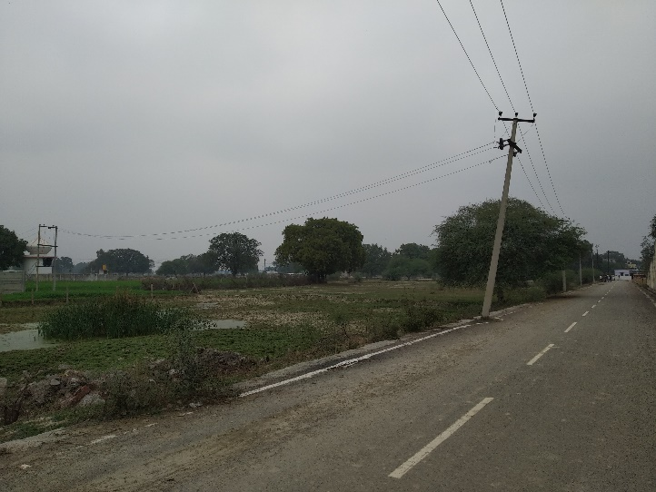
Site Pics

