Slide 1
Light House Project: Global technology Challenge Proposal for construction of 1000 Dwelling Units at Agartala, Tripura

Slide 2
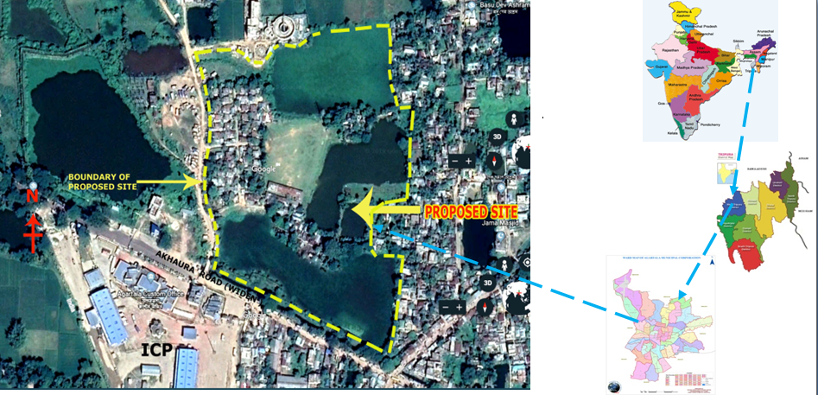
Location Details of the Project
Put the Map here

Slide 3
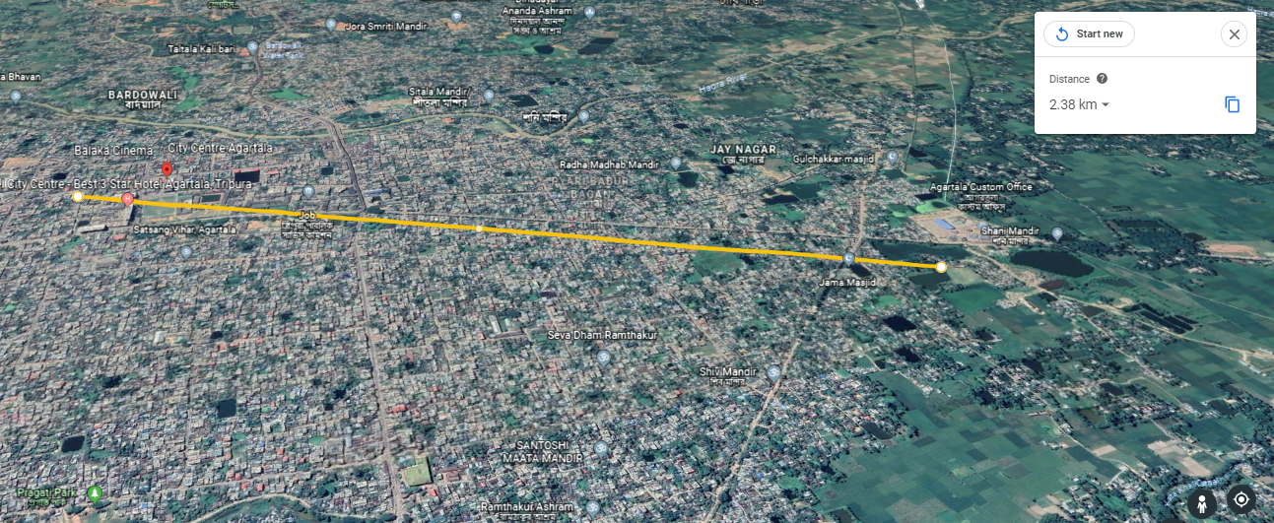
Arial Distance of proposed site from City centre- 2.38 Km

Slide 4
Salient Details
S. No. | Particulars | Details
1. | Implementing agency | Urban Development Department, Tripura
2. | Ownership of the land | Government of Tripura/Agartala Municipal Corporation
3. | Size of the proposed Land | 2.86 Hectare
4. | Buildable Dwelling Units | 1000 Units
5. | Availability of basic amenities | Water, Electricity, Transportation. sewerage/septage facility will be provided.
6. | Distance from the city centre | 2.38 Km
7. | Site development status of the project | Available
8. | Availability of facilities for factory setting | Not such facility available
9. | Details of transport linkage of the project | The proposed site is connected with public transportation by Tripura Urban Transport system and other conveyance.

Slide 5
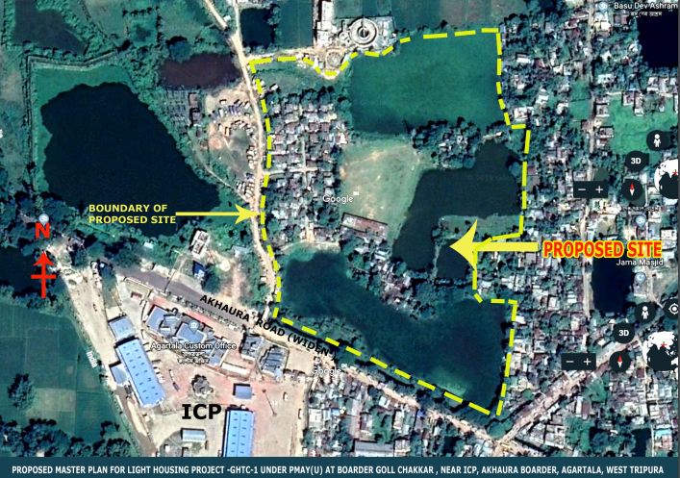
Project Site Location
Google Map showing location of project in the city

Slide 6
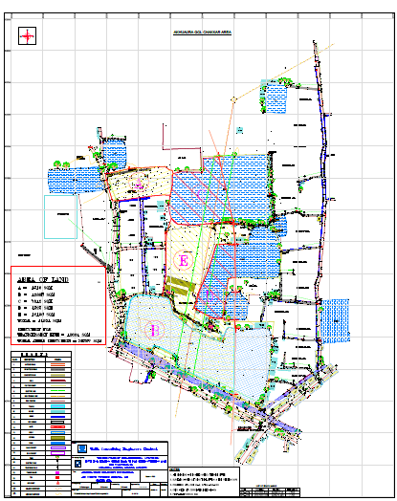
Site Details
Attach photographs of the existing site

Slide 7
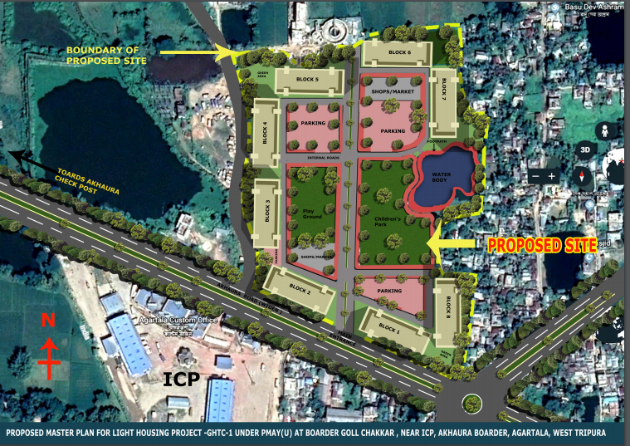
Site Details (2-Dimensional View of the Project)
Lay out Plan/Topographical maps/Land use map

Slide 8
Site Details(3- Dimensional View of the Project)

Slide 9
Other Details
Proposal has been sent to MoHUA, GoI for construction of Light House at Akhaura, Gol-chakkar area, Agartala under PMAY(U).
The project ensure rehabilitation of 1000 slum dwellers on about 2.5 Hectares of Government land .
Funding Pattern:
Central Share- GoI grant will be 3.5 lakh/ unit (30 Sqm.).
State share-Rest amount of Rs 4.00 to 4.50 Lakh per DU will be compensated from HUDCO loan by the State Government.
Land belongs to the State Government. Available free of encumbrances.

Slide 10
THANKS

