Slide 1
Global Housing Technology Challenge Tamil Nadu Slum Clearance Board
TNSCB- A pioneer in urban housing for EWS since 1971
So far constructed 2.12 lakh storeyed tenements / houses with full infrastructure for the slum families
Developed 1.31 lakh plots with clear title and handed over to the urban poor
Invested Rs 7129.74 crore on construction and urban slum improvement
Our houses have a plinth area of 400 Sqft with vitrified tile flooring
Focus on livelihood also

Slide 2
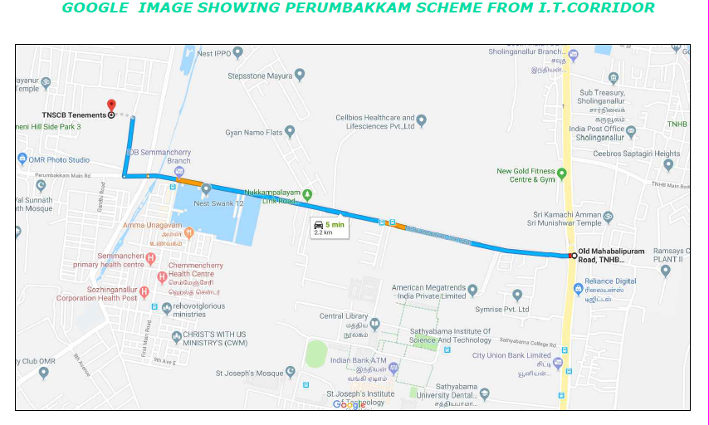
Location Details of the Project

Slide 3
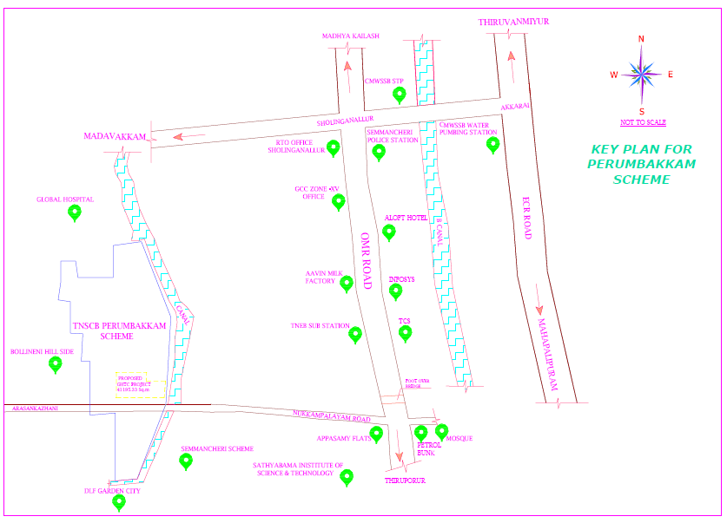
Location Details of the Project

Slide 4
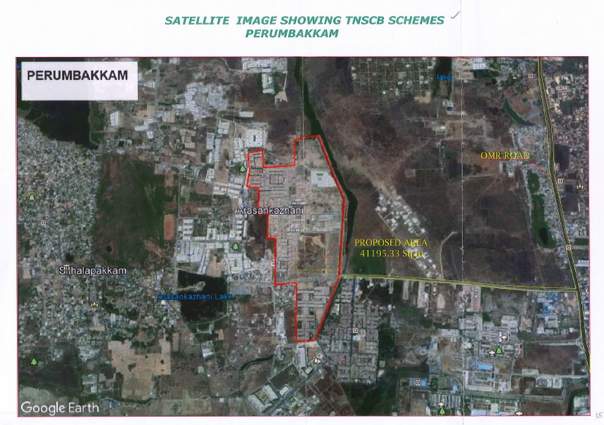
Project Site Location

Slide 5
Salient FEATURES
S. No. | Particulars
1. | Implementing agency | TAMILNADU SLUM CLEARANCE BOARD
2. | Ownership of the land | TAMILNADU SLUM CLEARANCE BOARD
3. | Size of the proposed Land | 4.12 hectares
4. | Buildable Dwelling Units | 2080
5. | Availability of basic amenities | BT Road, RCC Storm water drain, Piped Water supply , Underground sewage system with treatment facilities, Street lights, Schools and a 30 bedded PHC etc A govt arts and scince college was also inaugurated recently
6. | Distance from the city centre | 2.2 km

Slide 6
Salient FEATURES..
S. No. | Particulars
7. | Site development status of the project | Tamilnadu Slum Clearance Board has constructed 20,376 houses at Perumbakkam and 6764 houses at Semmancherry adjoining the project, private flat promoters such as DLF, BSCPL,Nest have constructed thousands of flats around the project. Sathyabama deemed university and many other educational institutions and software companies are existing around the project site.
8. | Availability of facilities for factory setting | Adequate land is available with TNSCB adjoining the project site for facilitating the factory setting
9. | Details of transport linkage of the project | Project site lies very close to OMR withj a connecting road. Further TNSCB has constructed a bus terminus cum depot at Perumbakkam near the project site and public transport is available to connect various destinations in the city.

Slide 7
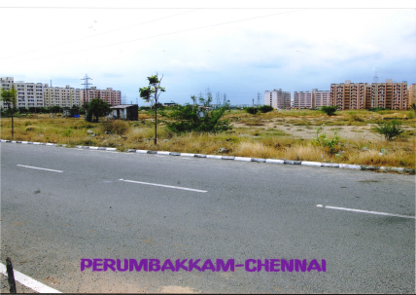
THE SITE

Slide 8
OTHER DETAILS
LOCATED ON THE PRIME AREA CLOSE TO CHENNAI
HAS A PRE EXISITING WELL DEVELOPED INFRASTRUCTURE
WELL SURROUNDED BY RESIDENTIAL AND COMMERCIAL LOCALITY INCLUDING I.T. PARKS
HAS A VERY GOOD CONNECTIVITY TO THE CITY AND OTHE PLACES OF VOCATION
TNSCB IS ALREADY IMPLEMENTING PROJECTS USING THE MODERN TECHNOLOGY IN CONSTRUCTION

Slide 9
THANK YOU

