Slide 1
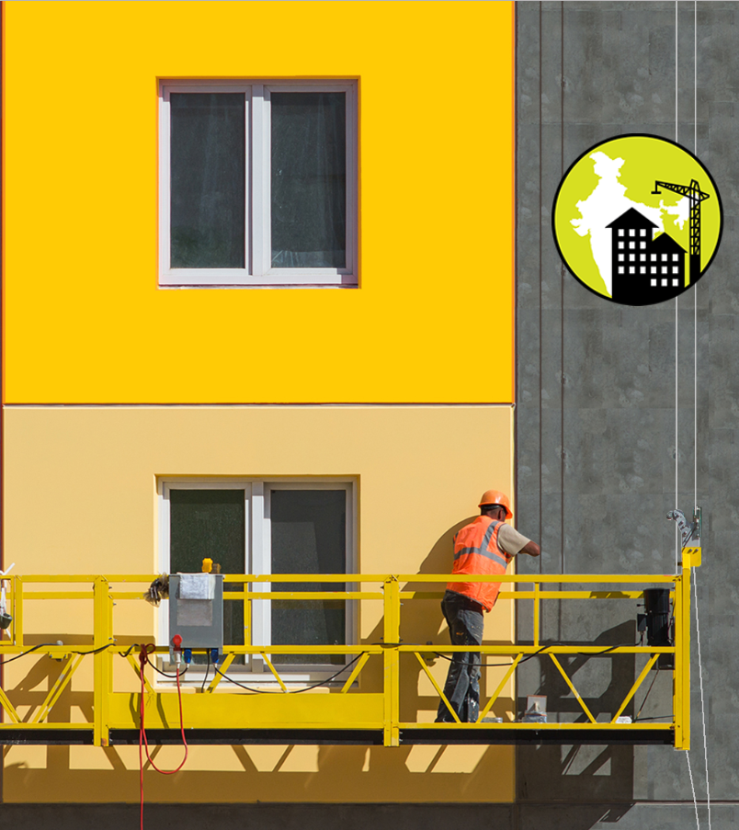
Pradhan Mantri Awas Yojna Urban
Global Housing Technology Challenge India
02 March 2019
URBAN DEVELOPMENT & HOUSING DEPARTMENT GOVERNMENT OF JHARKHAND

Slide 2
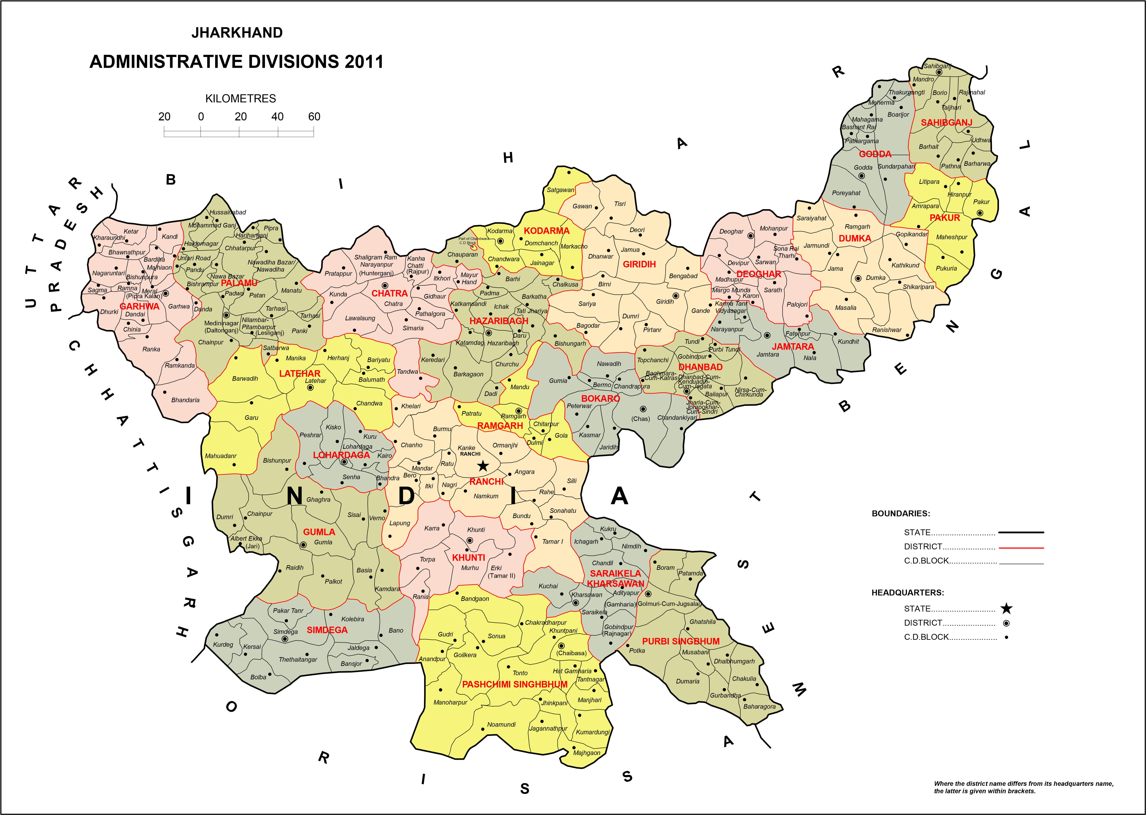
Jharkhand
POTENTIAL
Urban Development & Housing Department, Government of Jharkhand
All the attributes/parameters of GHTC Proposal starting with city brief.
Concluding remark of Why Jharkhand?

Slide 3
Pradhan Mantri Awas Yojna (Urban)
DEMAND VS PROGRESS
Way Forward
Progress till date:
(Grounded/Completed)
ISSR: Nil
AHP: 987 / 80
2015 - 2016
2022
94,010
04
2018 - 2019
To be Achieved:
ISSR: 52,584
AHP: 41,426
Total: 94,010
Demand:
ISSR: 52,584
AHP: 73,950
Total: 1,26,534
Years
To cater the demand in line with the formulated roadmap, there is a need of improvement in speed of construction without compromising on the quality.
Urban Development & Housing Department, Government of Jharkhand

Slide 4
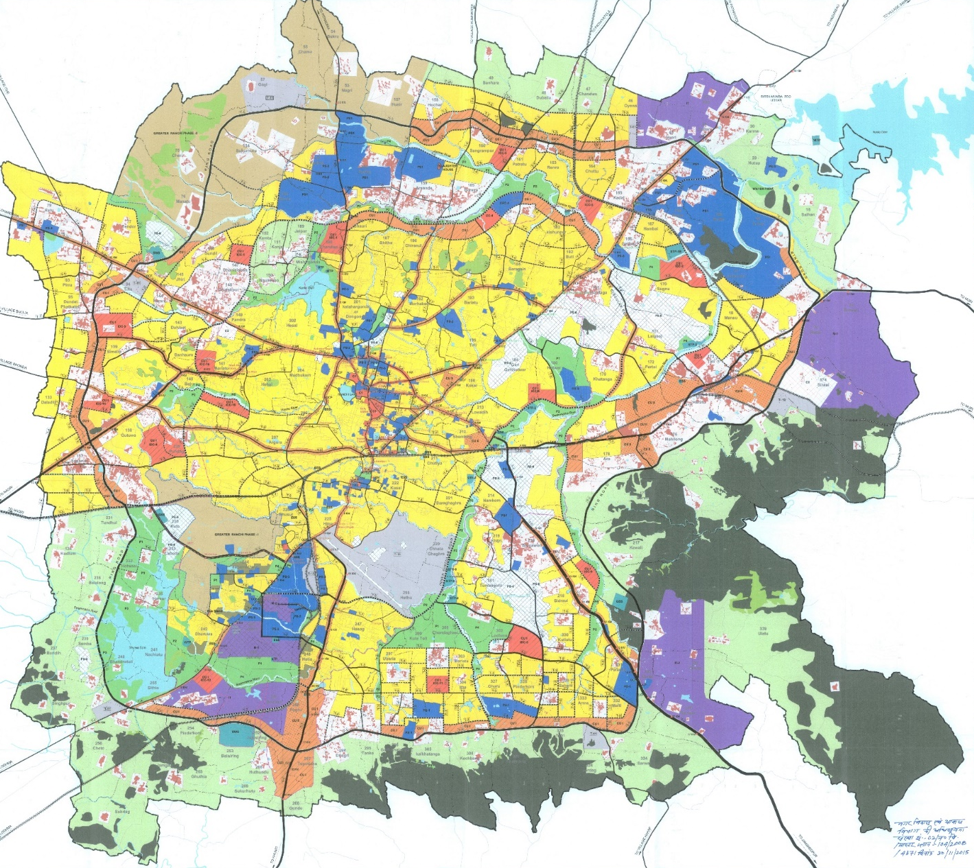
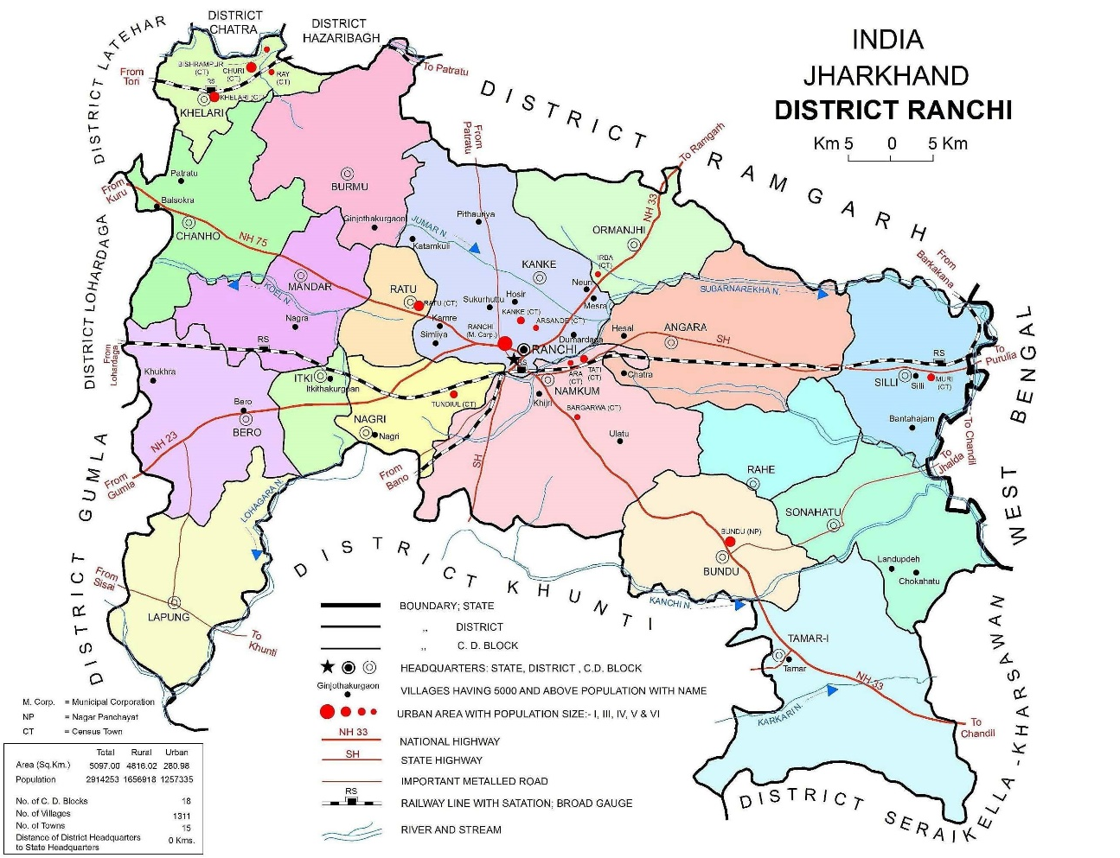
Housing Technology for Jharkhand
INTRODUCTION TO SITE
Ranchi Master Plan 2037
Ring Road
Ring Road
Proposed Site
Ring Road
Albert Ekka Chowk
Argora Chowk
Railway Station
Airport
Landmark | Distance from Site (Kms)
Argora Chowk | 5.5
Abert Ekka Chowk | 9
Railway Station | 9.5
Airport | 12.2
Ring Road
Urban Development & Housing Department, Government of Jharkhand

Slide 5
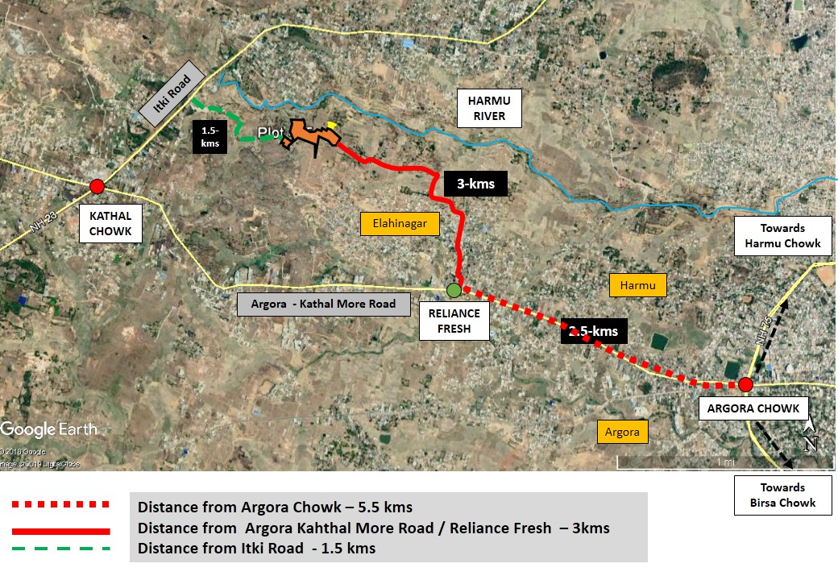
Housing Technology for Jharkhand
INTRODUCTION TO SITE
Parameters | Particulars
Location of the Site | Bajra - Plot 785
Total area of Site (In Hectares): | 2.20
Maximum Permissible FAR /FSI | 3.5
Proposed carpet area of one Dwelling Unit (In Sqm) | 30
Proposed DUs (Nos) | ~1140
Urban Development & Housing Department, Government of Jharkhand

Slide 6
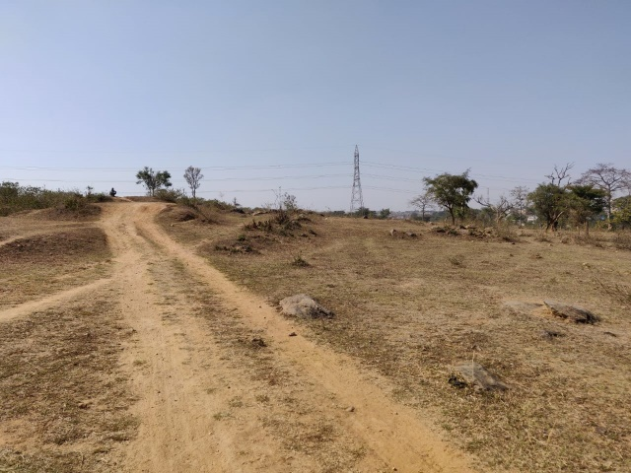
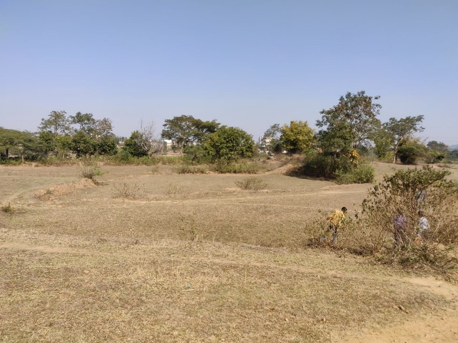
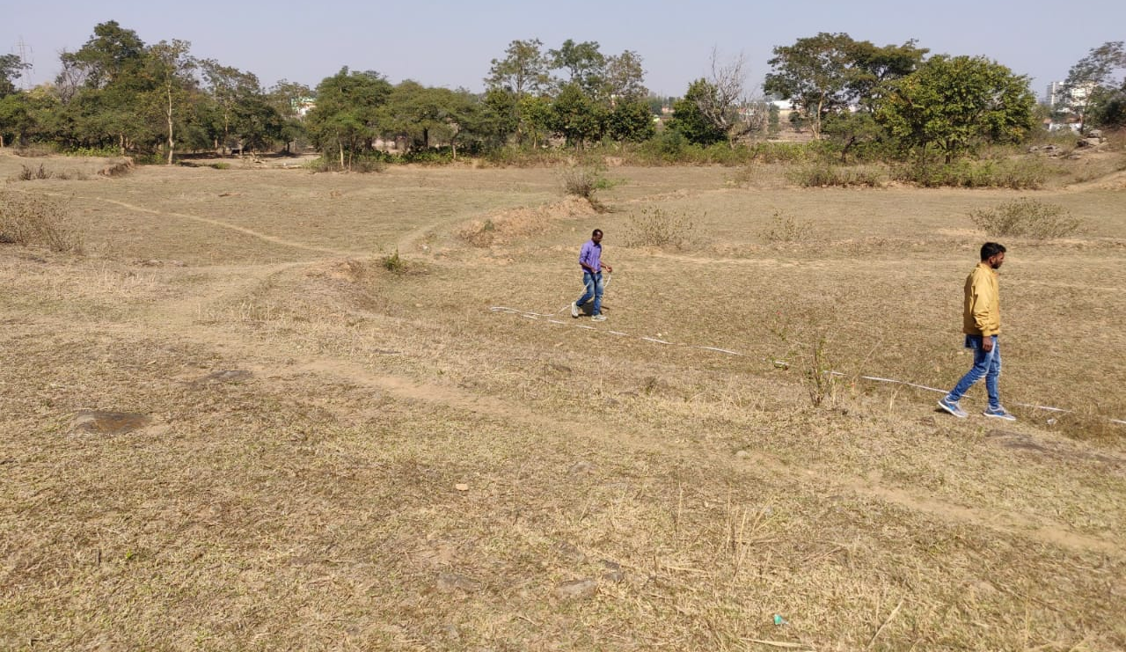
Housing Technology for Jharkhand
SITE FEATURES
Parameters | Particulars
Implementing Agency | SLNA
Ownership of Land | UD&HD, GoJ
Power distribution network | Available at 0.9 Km
Water supply | Available / To be extended up to plot
Public Transport Facilities | Available within 1 km
Facilitation for Factory Settings | State shall facilitate
Urban Development & Housing Department, Government of Jharkhand

Slide 7
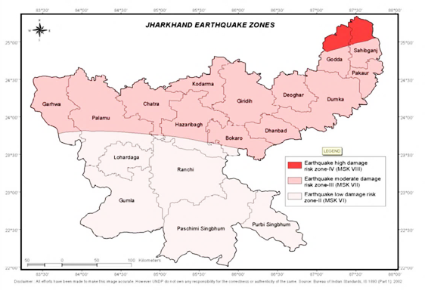
Housing Technology for Jharkhand
SITE FEATURES
Parameters | Particulars
Seismic zone | Earthquake low damage risk zone- II (MSK VI)
Geo-Climatic Zone | Humid sub-tropical climate
Type of soil | Clayey Silt Soil
General topography | Plain Vacant Land
Urban Development & Housing Department, Government of Jharkhand

Slide 8
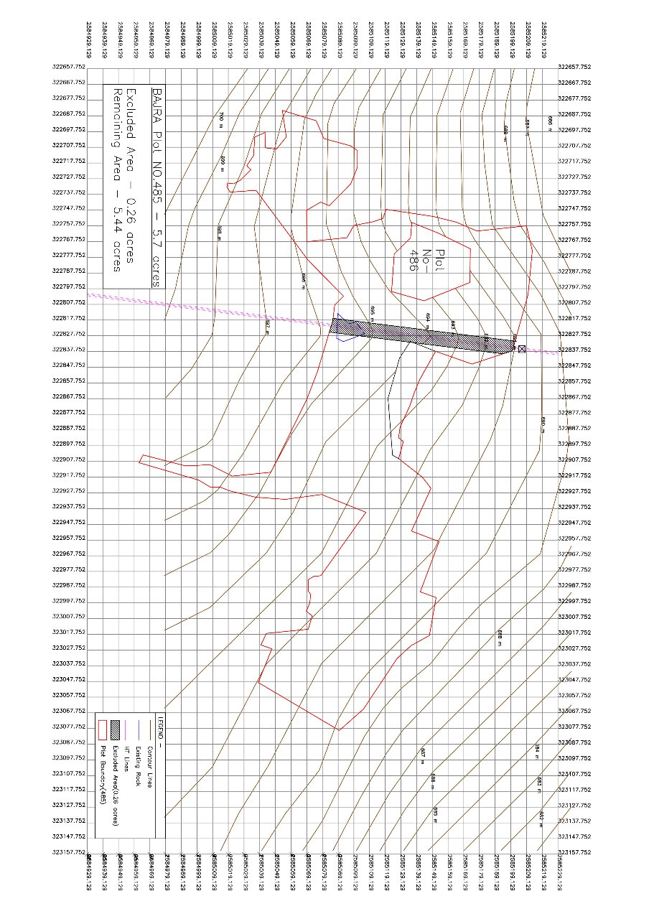
Housing Technology for Jharkhand
TOPOGRAPHY
Urban Development & Housing Department, Government of Jharkhand

Slide 9
THANK YOU.!

