Slide 1
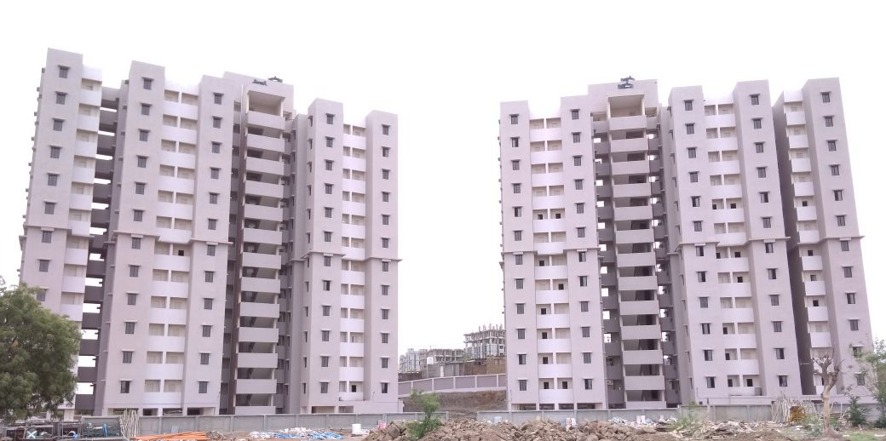
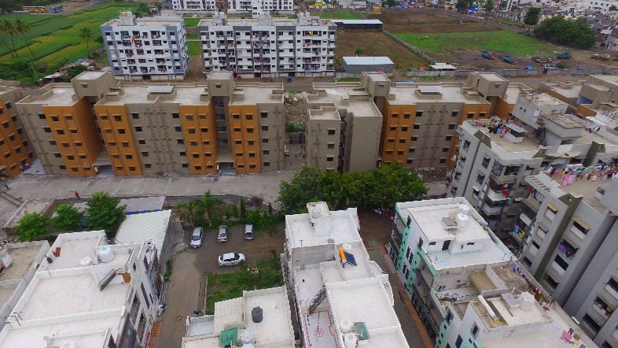
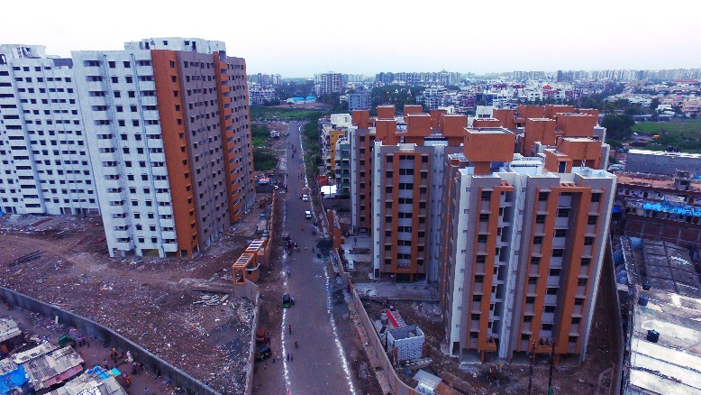
PROPOSAL FOR LIGHT HOUSE PROJECT OF GUJARAT
Gujarat
Affordable Housing Mission
Urban Development & Urban Housing Department
Government of Gujarat

Slide 2
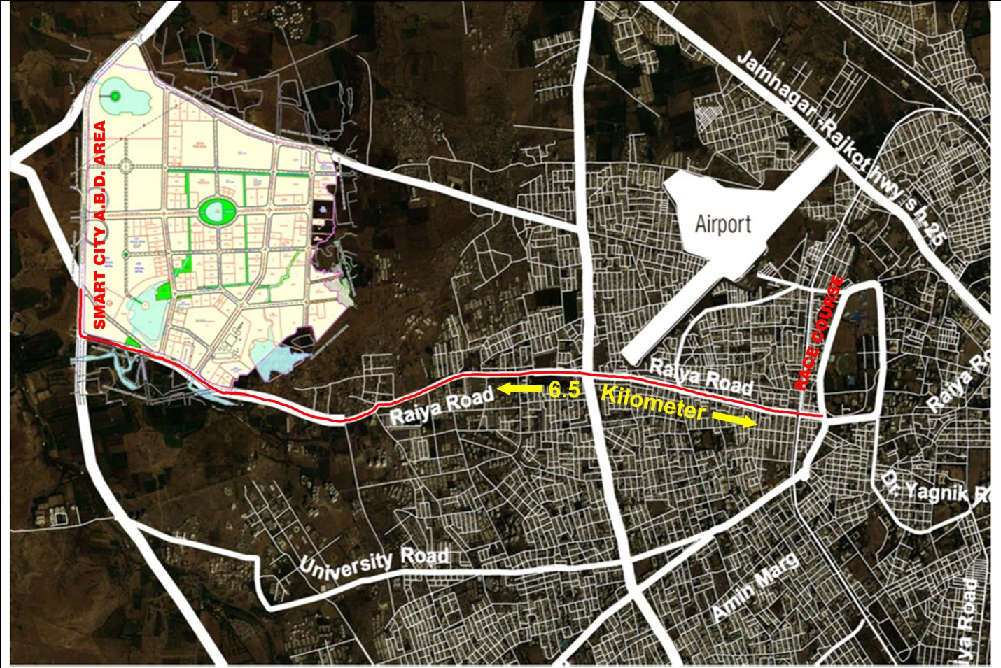
Gujarat
LOCATION MAP
Rajkot City proposed site for Light House Project under GHTC

Slide 3
Gujarat
SALIENT DETAILS
Rajkot City proposed site for Light House Project under GHTC
No | TP | Remarks
1 | Implementing Agency | Rajkot Municipal Corporation
2 | Ownership of the land | Rajkot Municipal Corporation
3 | Size of Proposed land | 2.43 hectors
4 | Buildable Dwelling Units | Approx. 1488 houses of 40 sq.m. carpet area
5 | Availability of basic amenities | Yes, available Power Distribution Network, Municipal Water Supply Network, Municipal Sewerage System, Public Transport Facilities etc.,
6 | Distance from the city centre | 6.5 km
7 | Site Development Status of the project | Green field land available with all amenities in the city area for execution of the project
8 | Availability of facilities for factory setup | 1.25 hector of land made available in the vicinity
9 | Details of transport linkage of the project | Yes, available

Slide 4
Gujarat
PROJECT SITE LOCATION
Rajkot City proposed site for Light House Project under GHTC

Slide 5
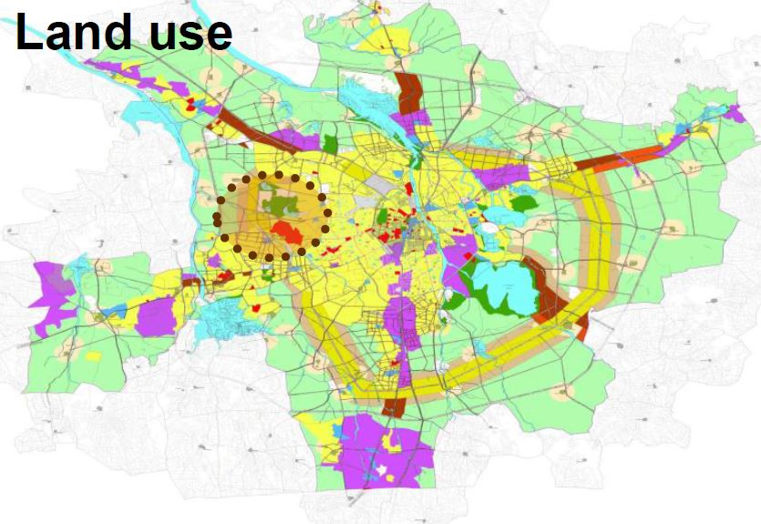
Gujarat
LAND USE FOR LHP
Rajkot City proposed site for Light House Project under GHTC

Slide 6
Gujarat
SITE DETAILS
Rajkot City proposed site for Light House Project under GHTC
No | TP | FP | FP area Sq.m. | Remarks
1 | 32 | 4/C | 24333.95 | Site for Execution of the light house project
2 | 32 | 63/5/B | 12583.00 | Site for component factory for Machinery and equipment
3 | 32 | 17/A | 10398.05 | Alternate site for execution of the project
4 | 32 | 4/A | 10759.00
5 | 32 | 4/B | 7580.50
6 | 32 | 4/D | 21267.65
Total |  |  | 86922.15
Project proposal has already been
submitted to MoHUA, New Delhi
vide letter no. AHM/PMAY (U)/
GHTC/2796 dated 12th Feb 2019
along with approval of State
vide circular note No. AHM/Projects/PMAY/SLSMC/2790 dated 11th Feb. 2019.32

Slide 7
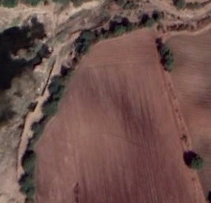
Gujarat
SITE PHOTOGRAPHS
Rajkot City proposed site for Light House Project under GHTC

Slide 8
Gujarat
OTHER INFORMATION
Rajkot City proposed site for Light House Project under GHTC
Site is located within the city area of Rajkot city and around 6.5 KM from the city centre
Available Infrastructure facilities on the proposed site :
RCC Roads
Municipal Water Supply Network
Power distribution network
Municipal Sewerage System
Transport Facilities
Provision of other land also made available in the vicinity for component factory set-up as required

Slide 9
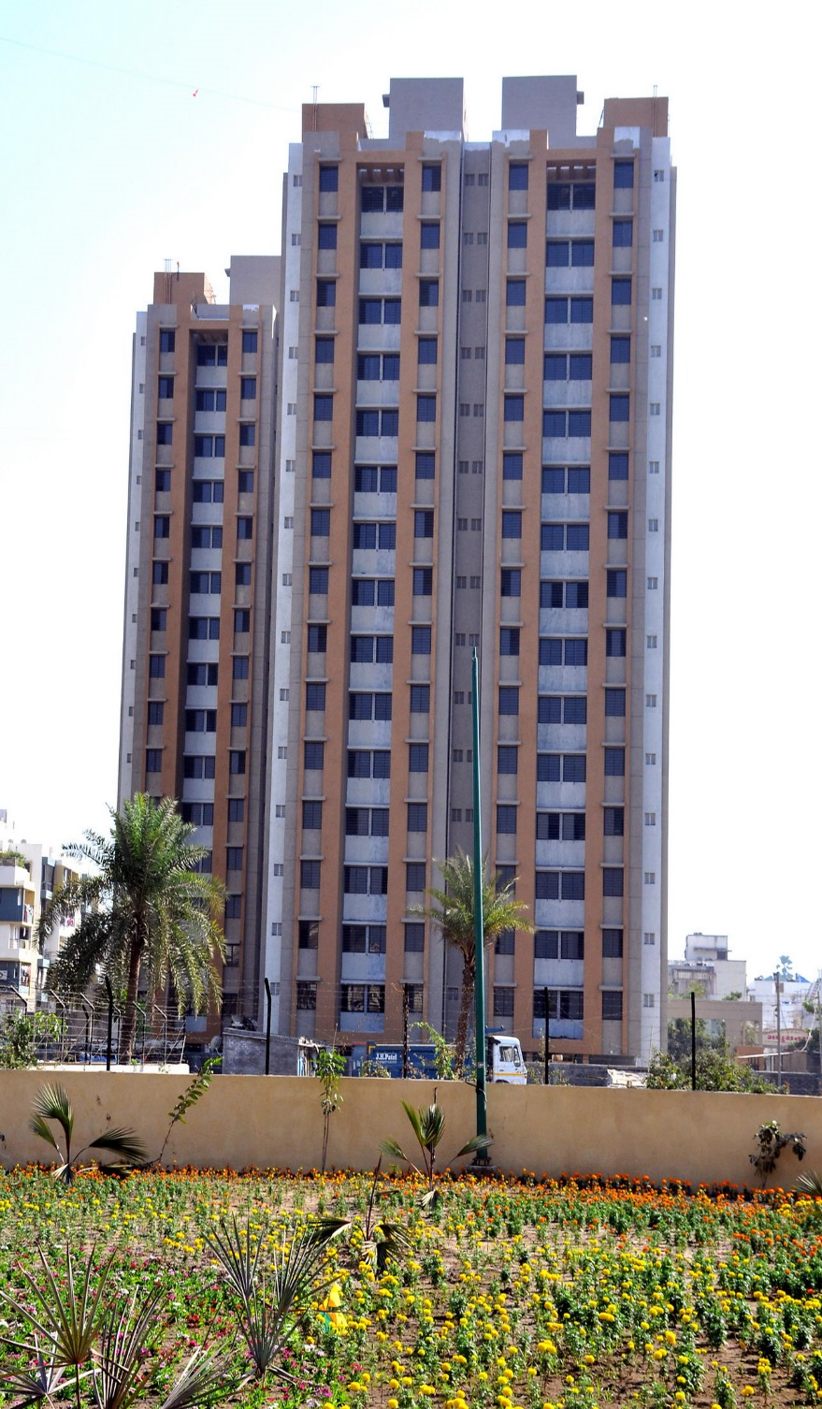
Gujarat
THANK YOU

