Slide 1
Ensuring Livability and Desirability of Affordable Housing
Global Housing Technology Challenge. India 02.03.2019
Jakob Brandtberg Knudsen
Head of School of Architecture
The Royal Danish Academy of Fine Arts
Schools of Architecture, Design and Conservation

Slide 2
Think circular economy from the start
Waste
Energy

Slide 3
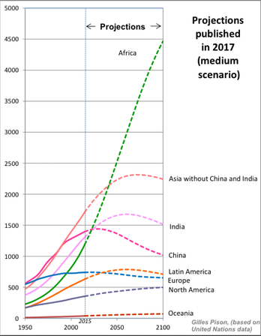
Population growth

Slide 4
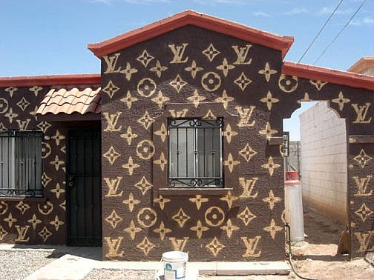
Desirability. A home is so not just a container
Social status
Investment
Hope
Pride
(A touch of class..)
A home is more than a house

Slide 5
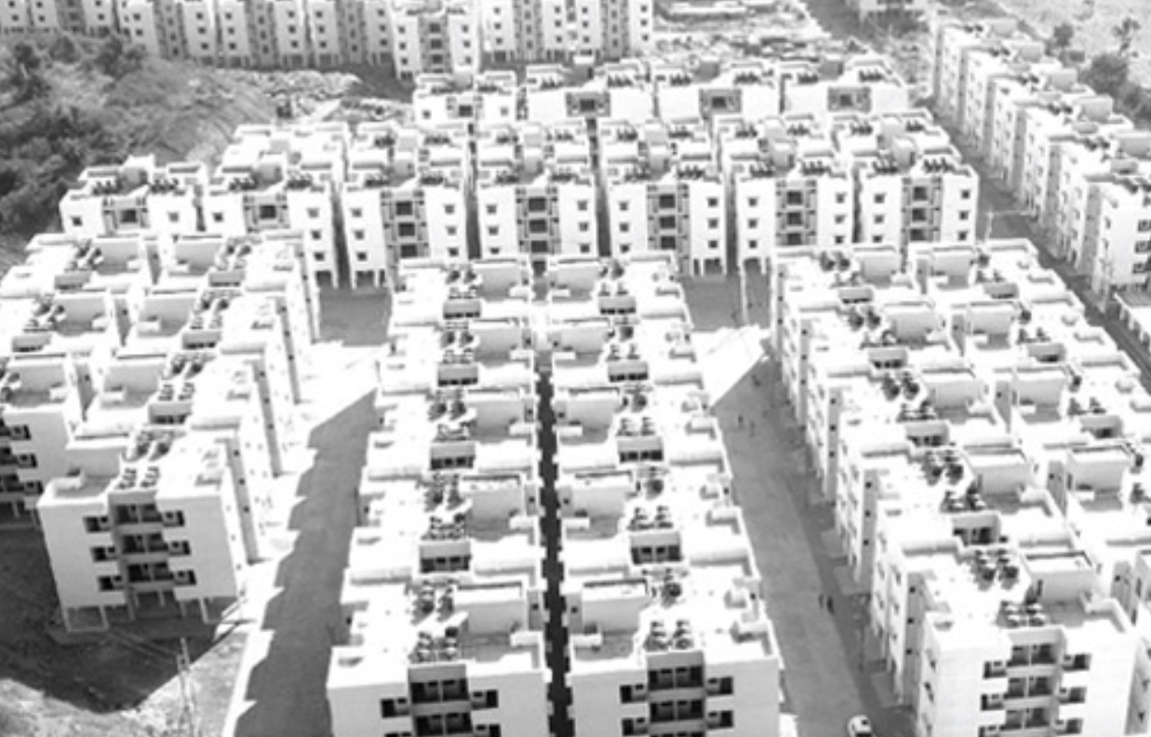
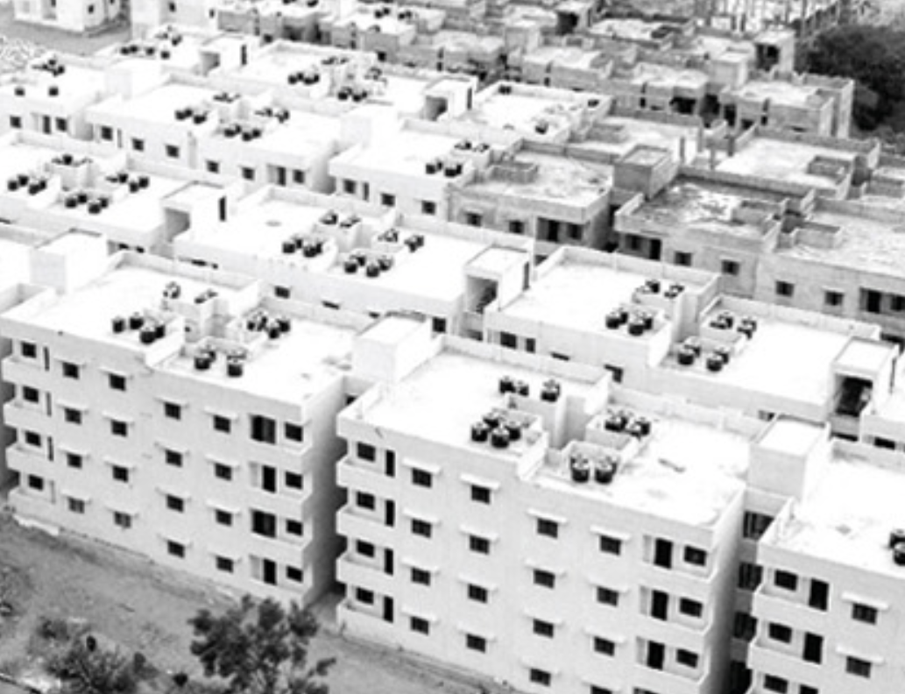
Livability
One size doesn’t fit all

Slide 6
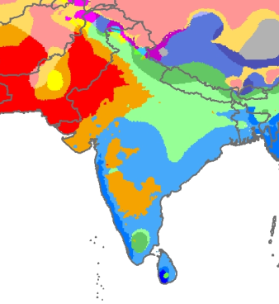
Climate
Hot-dry Tropics
High thermal mass
Thick walls
Heavy roofs
Hot-humid Tropics
Low thermal mass
Light walls.
Light roofs
Climate Zones. Koeppen climate classification

Slide 7
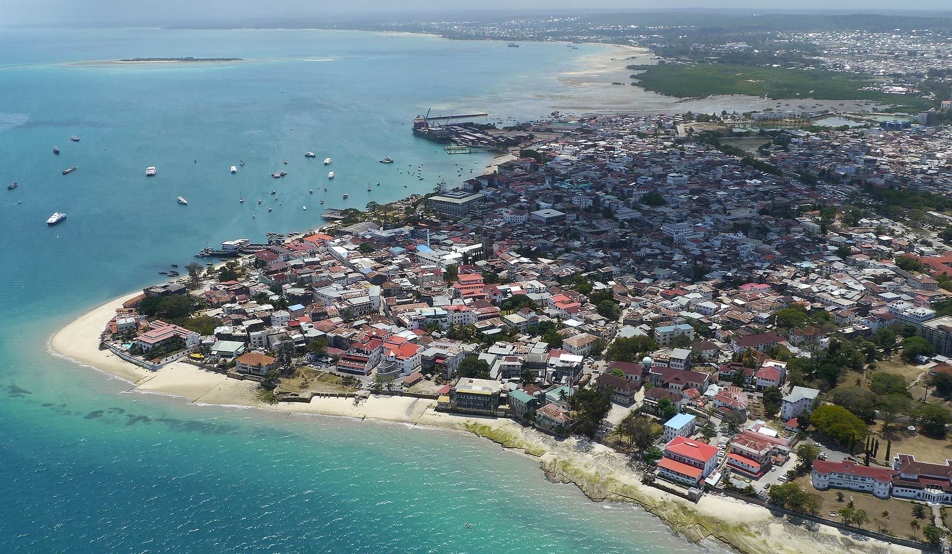
Zanzibar. Stone Town

Slide 8
Health. Top 10 Causes of Death
Cardiovascular Diseases
Diarrheal Diseases
Neonatal Disorders
Non-communicable Diseases
Chronic Respiratory
Diabetes
Mental Disorders
Unintentional Injuries
Neoplasms
Nutritional Deficiencies
Source: World Bank India
Source: Population Reference Bureau (2017) India

Slide 9
CINARK
Research in ecological building practice & construction in industrialized architecture

Slide 10
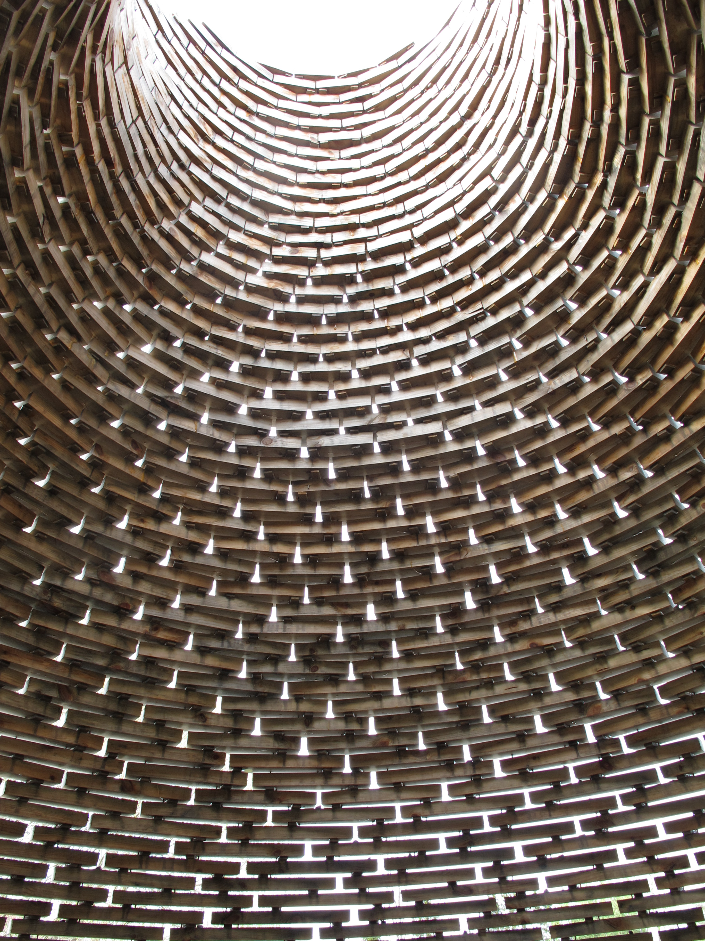
WHAT ? Construction in
Architecture
Development of constructions in architecture through non-toxic, low carbon materials, advanced industrial fabrication and tectonic design strategies
The changing role of the architect in new building processes, business organisations and collaboration
The architectural potentials in environmentally controlled and optimised industrial production, circular supply chains and solutions for upscaling

Slide 11
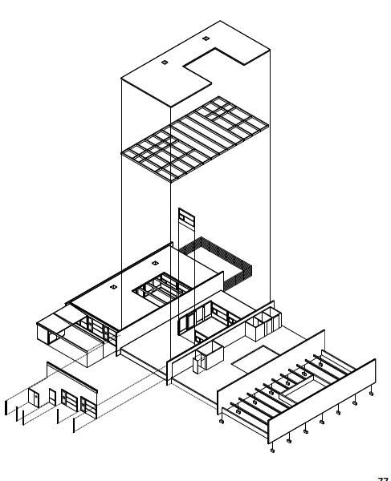
HOW ?
The task
…to develop, accumulate and co-ordinate research and education activities that focus on industrialized construction and architectural building practice from an ecologial perspective
…to outline and revise specific concepts, characteristics, methodologies, processes and products that define the ecology of tectonics in ‘Industrial Architecture’
…to clarify embedded and present problems and potentials in the building industry and architectural practice
…to collaborate with the building industry and related businesses

Slide 12
Forms of research …
Strategic research / Theoretical / Fundamental
Industrial research / Applied / Innovative / Practice based
Experimental research / Materials / Constructions / Systems / Buildings

Slide 13
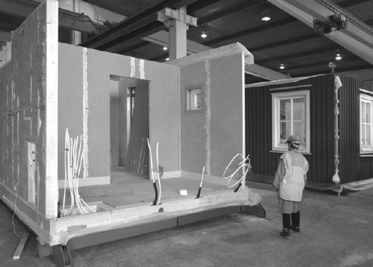
Strategic research
THEORETICAL STUDIES INTO IPD’S
Integrated Product Deliveries in Construction
Industrialization < > Sustainable Architecture?

Slide 14
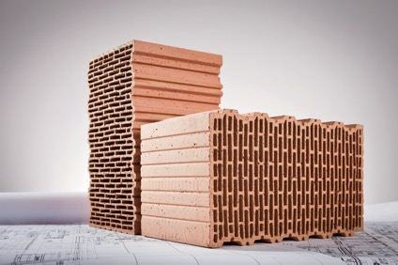
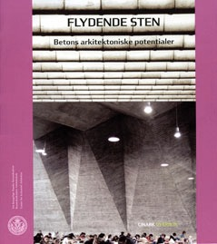
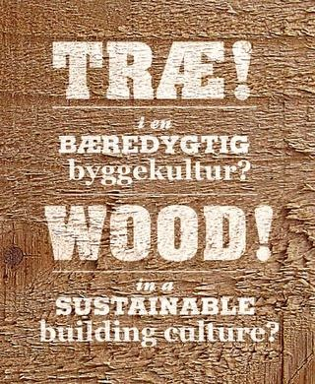

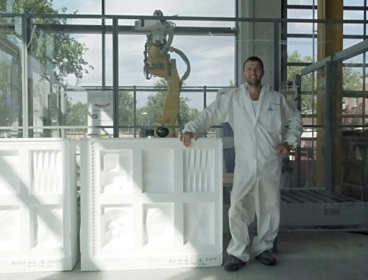
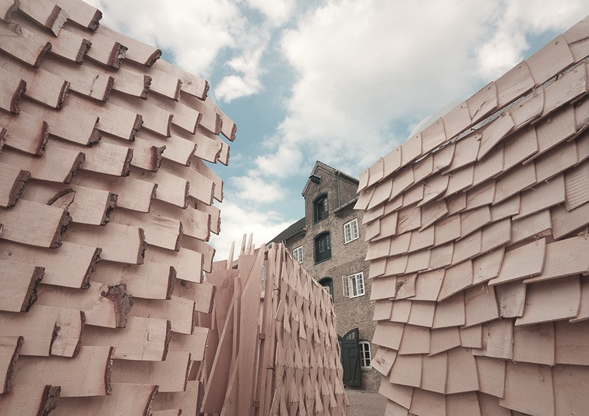
Industrial research
Investigations into materials, construction and builldings
Bricks & Masonry
Conrete & Formwork
Wood & Tectonics

Slide 15
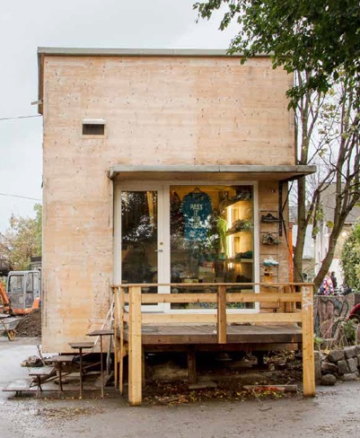
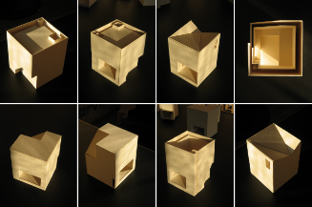
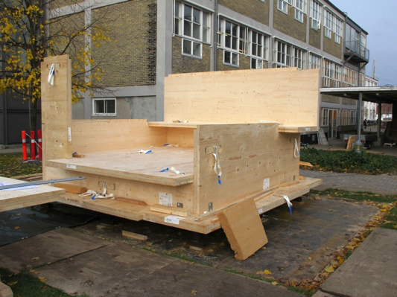
Experimental research
AUTARKI, demonstration project / CLT prototype, CINARK Researchers, KL

Slide 16
Experimental research
Circular tectonics / 3 wall prototypes, CINARK Researchers, 2017-2018

Slide 17

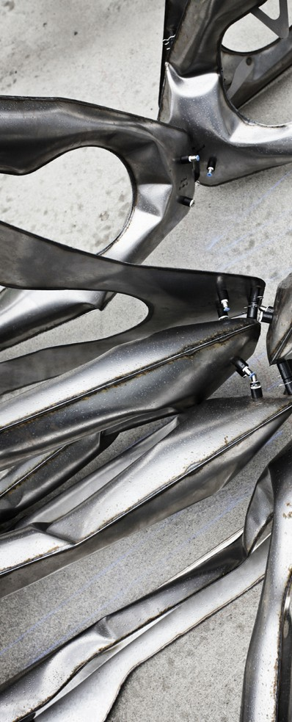
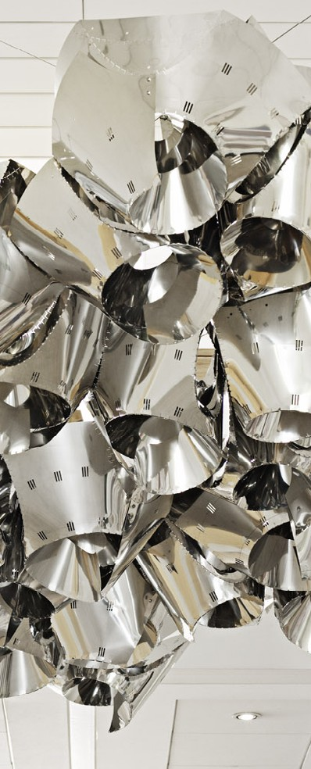
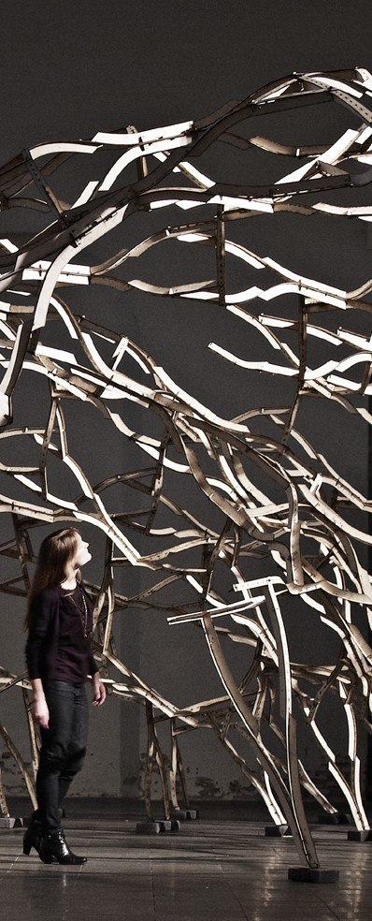
CITA COMPUTATION IN ARCHTIECTURE
DESIGNING WITH MATERIAL BEHAVIOUR

Slide 18
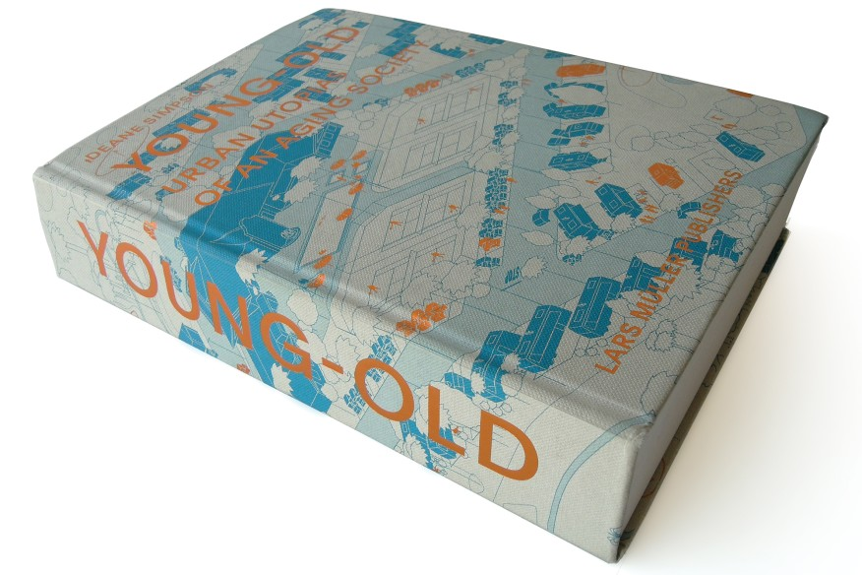
Urbanism and Societal Change

Slide 19
Where
to find us…
https://kadk.dk/en/cinark-center-industrialised-architecture
https://issuu.com/kadk/docs/cinark_10

