Slide 1
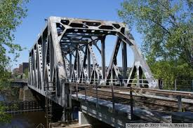
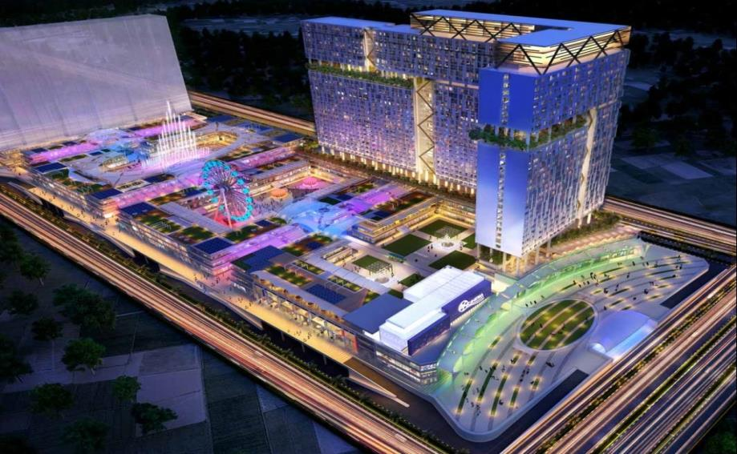
JINDAL STEEL & POWER LTD.
STEEL SOLUTIONS FOR CONSTRUCTION
Ashwani Kumar
Vice President

Slide 2
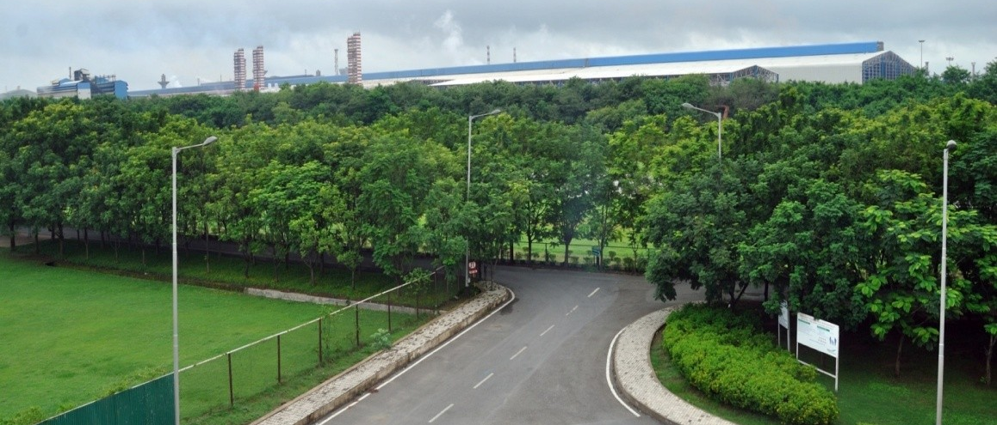
OWNERSHIP STRUCTURE – O P JINDAL GROUP
O P Jindal Group
(20 Billion US $ Group)
Jindal Saw
Shri. P.R. Jindal
JSL Limited
Shri. Ratan Jindal
JSW Steel/JSW Energy
Shri. Sajjan Jindal
Jindal Steel & Power Ltd (JSPL)
Shri. Naveen Jindal
Copyright @ 2015 Jindal Steel & Power Limited
2

Slide 3
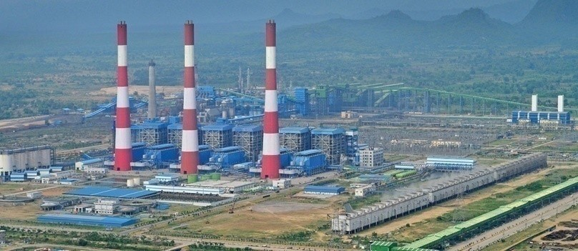
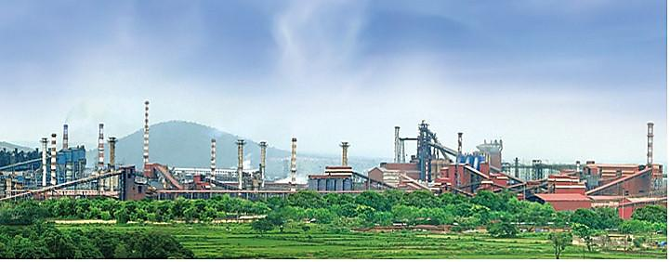
JSPL Plant Capacities
Angul
Raigarh
Patratu
Unit | Capacity
Steel Making Capacity | 5.0 MT
Plate Mill | 1.2 MT
Bar Mill | 1.4 MT
Unit | Capacity
Steel Making Capacity | 3.6 MT
Plate Mill | 1.0 MT
RUBM | 0.75 MT
MLSM | 0.6 MT
Unit | Capacity
Steel Making Capacity | -
Wire Rod Mill | 0.6 MT
Bar Mill | 1 MT
Sohar (Oman)
Unit | Capacity
Steel Making Capacity | 2.0 MT
Bar Mill | 1.4 MT

Slide 4
Jindal Steel Products
Product | Range
Beams Columns | 180mm-900mm depth for beams 152*152 to 356*406 in cross section for Columns
Angles Channels | 75mm-250mm 75mm-400mm
Rails | UIC 54, UIC60, IRS 52, CR 80, 100, 120
Plates | 6mm-150mm
TMT | 6mm-40mm, Fe 550 D, Fe 500 S, Fe 600
Wire Rods & Rounds | 5.5mm-25mm LC,HC,CHQ,Alloy,Electrode quality, tyre beads etc. 20mm-63mm

Slide 5
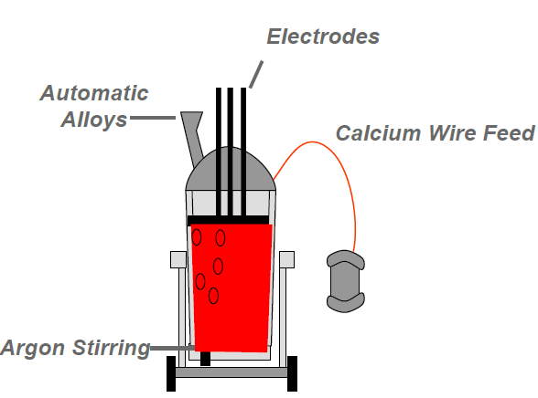
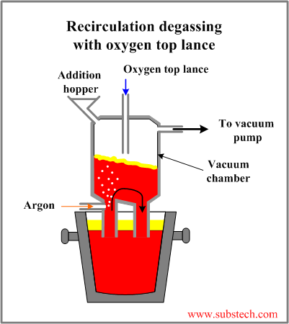
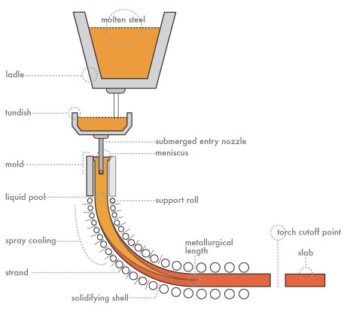
Clean & Lean Steel Making
Optimum alloy additions
Desulphurization for low levels of sulphur
Calcium treatment & inclusion shape controls
Temperature control
RH (Ruhrsthal Heraeus process) & VD
Degassing for low levels of gaseous contents
Argon stirring for homogeneity
Temperature control
Vertical mould caster for low entrapments
Automatic mould control, shrouding for good quality
Soft reduction for improved internal soundness

Slide 6
JSPL & Innovation
Contribution to building our nation

Slide 7
Building with FE 550D
Few practical advantages of using higher strength rebar
Fewer Bars Needed
Higher Spacing and Less Congestion
Lower Bar Diameter Needed
It help reduce the volume of steel used and reduce the column size.
Lesser Bars to Placed and Tied, therefore less labour time needed

Slide 8
Comparison of the models with different grades of TMT steel bars
 | Fe415 | Fe500 | Fe550D | %Structural steel saving when moving from FE500 to FE550D | %Structural steel saving when moving from FE415 to FE550D
Weight of steel in column(kg) | 6140.616 | 4828.477 | 4596.760 | 4.76% | 25.14%
Weight of steel in beam (kg) | 9050.407 | 7690.374 | 7133.515 | 7.24% | 21.18%
Area in sq. ft. | 8301.34 | 8301.34 | 8301.34 | - | -
Steel contribution in column per sq. ft. | 0.740 | 0.582 | 0.554
Steel contribution in beam per sq. ft. | 1.090 | 0.926 | 0.859

Slide 9
Comparison of the models with different grades of TMT steel bars
The total steel consumed in building designed with Fe500D =33.08 ton
The total steel consumed in building designed with Fe550D =30.38 ton
The total steel saving when moving from 500D to 550D in building designed
33.08-30.38=2.7 t
2.7/33.08*100=8.16%

Slide 10
SAVING IN STEEL ON INCREASING STRENGTH
Fe 415
Fe 500
Increase in strength by 20%
Saving in steel by 10%
Fe 600
Increase in strength by 44%
Saving in steel by 20-25%
Fe 550
Increase in strength by 32%
Saving in steel by 15-17%

Slide 11
JSPL Association with PMAY
JSPL got associated with PMAY for Lucknow Project under Lucknow Development Authority
Lucknow Development Authority is planning to build 12,000 G+3 houses under PMAY. The total area for one G+3 building is 18937 sqft. Each floor having 12 units.
The building was designed with Fe415 steel grade by the LDA, JSPL suggested to use Fe550D
A design comparison was done between Fe415 and Fe550D by the structural designer. JSPL collaborated with Optimum Design Pvt Ltd. for the same activity
There was almost 10 %Structural steel saving when moving from FE 415 to FE 550D which was further vetted and approved by IIT roorkee

Slide 12
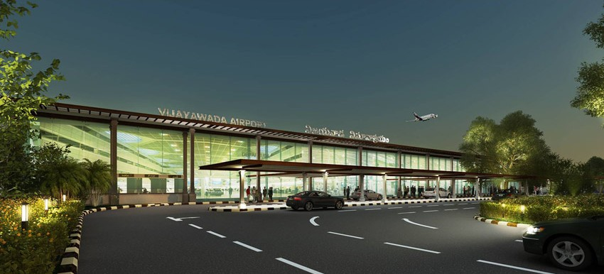
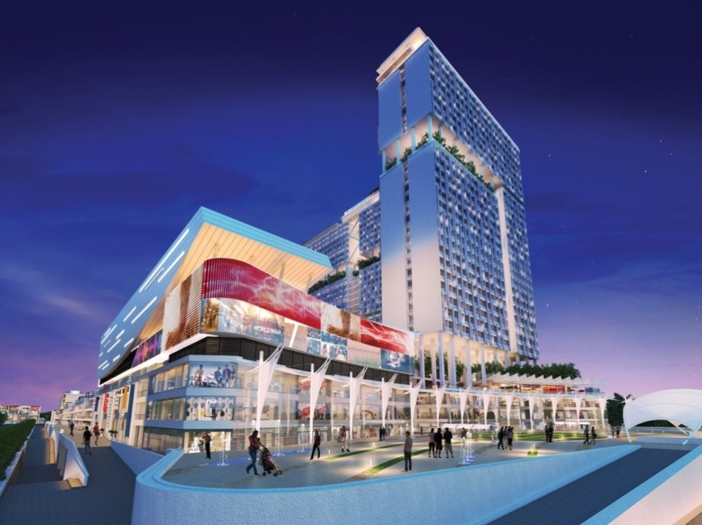
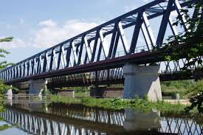
CONSTRUCTION
SOLUTIONS
BUSINESS

Slide 13
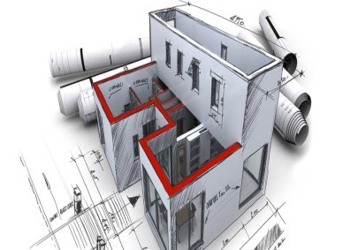
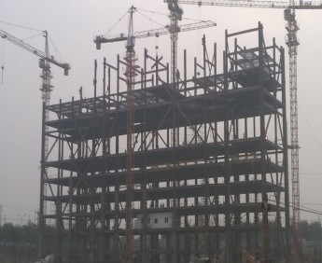
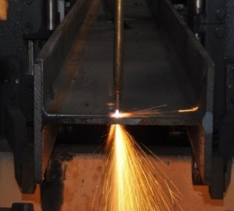
CAPABILITIES:
Detailed Modeling & Fabrication Drawing
In-house Design & Engineering
Architectural Modeling
Site Supervision & Erection Guidance
JUST IN TIME
DELIVERY
Fabrication in State-of-the-art manufacturing facility
Contract Management
Project Management & Project Scheduling

Slide 14
JSPL
Speed Floor

Slide 16
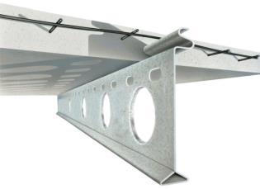
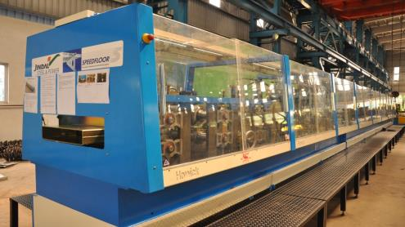
About – Speed floor System
Speed floor is a suspended concrete flooring system.
It uses a roll-formed steel joist with concrete topping for permanent structural support.
It is time and cost effective concrete flooring.
The joist is manufactured in a single integrated operation, it is roll-formed, punched, pressed, pre-cambered and cut to length at a fast production rate.
Machine Capacity = 8000MT/Year (approx 85 Lakhs Sqft / Year)
Speed floor joist
Joist Roll Forming Line

Slide 17
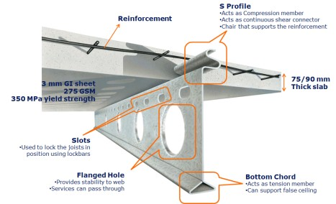
Specification of Speed floor Joist
Steel joist: f’y = 350 Mpa
Steel thickness: 3 mm
Concrete strength: 25 MPa (30 Mpa for Carparks)
Joist spacing: 1230mm, 930mm and 6 630mm.
All joists are pre-cambered of 1-1.25mm/m
200mm series joist has no service holes,
250 - 350mm series joists holes are 130mm diameter, 400mm series joist holes are 250mm diameter.
.

Slide 18
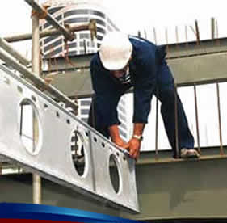
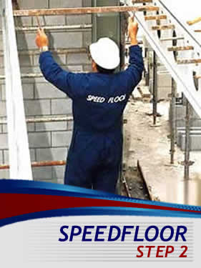
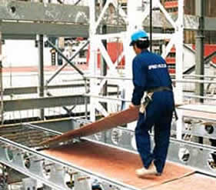
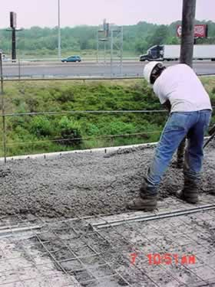
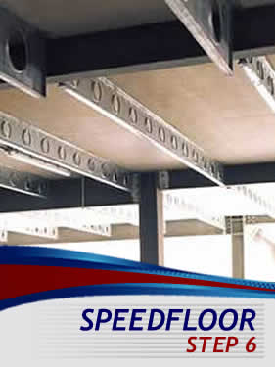
INSTALLATION
1. Speedfloor joists placed on beams
2. Lockbars placed into prepunched slots
3. Plywood placed from top
4. Mesh laid and Concrete Poured
5. Remove lockbars and plywood from bottom

Slide 19
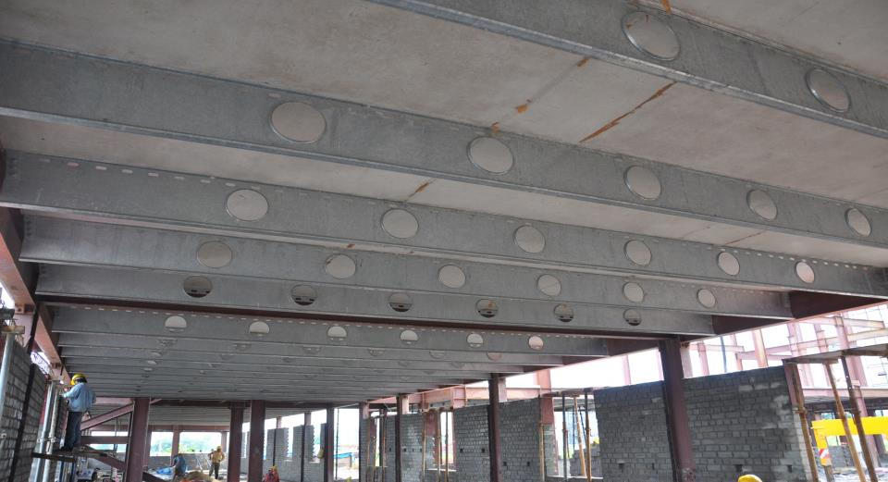
The Result
3 days after the concrete is poured the shutter system is removed.
Services can pass through the pre-punched holes.
False ceiling if needed may also be fixed to the bottom of the joist

Slide 20
Advantages of Speed floor system
No Propping
Less Erection time
Weight saving throughout structural components
Requiring less cranage than other systems
Easily accomodates services
Meets fire rating requirements
Reduce foundation size
Can work paralleley in more than one floor at a time

Slide 21
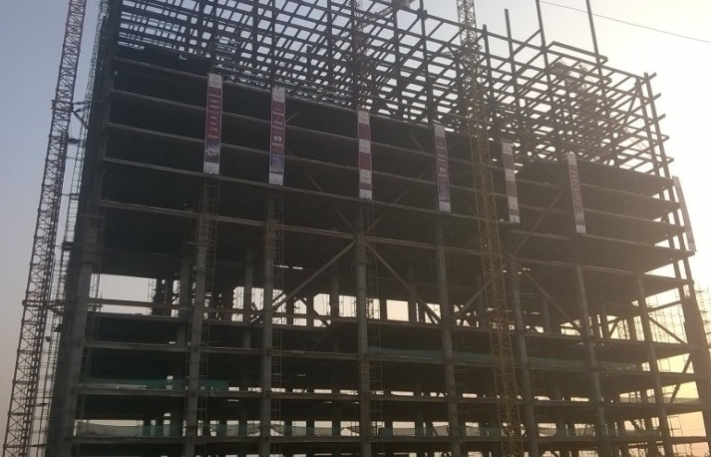
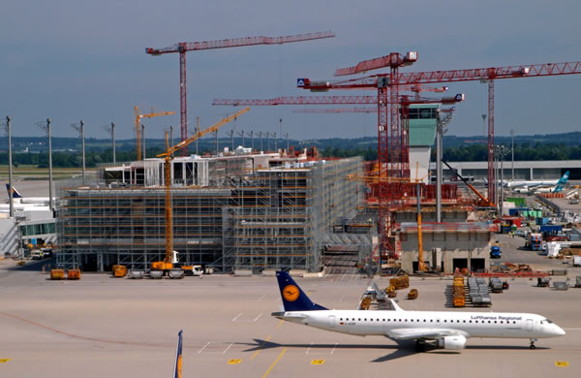
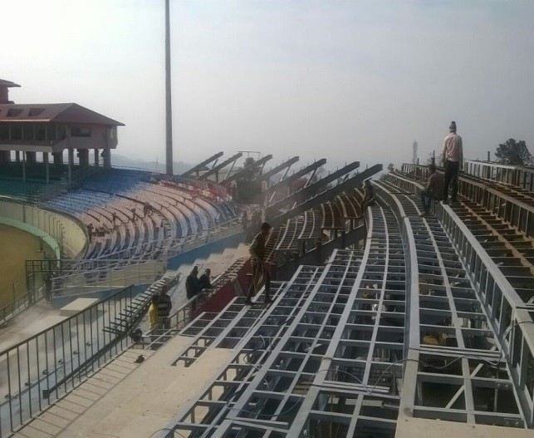
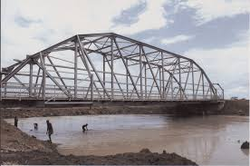
FABRICATED STRUCTURAL STEEL
Buildings
Heavy & complex structures – columns, beams, bracings
Use of E 550 Grade Plates and E 550 Universal Rolled Sections
Reduction in quantity of steel due to usage of higher grade
Offsite Fabrication – only bolted connections, no welding at site
Airport
Stadium
Bridges

Slide 22
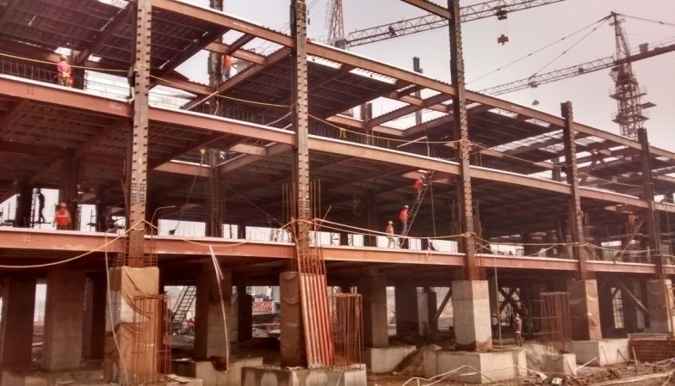
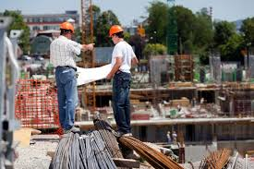
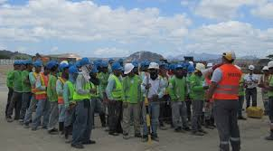
CONSTRUCTION MANAGEMENT SERVICE:
Supervision and Guidance on Erection of Structural Steel
Training contractors on Erection of Speed Floor System
Project Management and Project Scheduling for Just In Time (JIT) delivery
Ensuring proper Safety Norms are followed
ERECTION TO BE DONE BY NOMINATED ERECTION CONTRACTOR

Slide 23
JSPL COMPOSITE COLUMNS

Slide 24
COMPOSITE COLUMNS
Concrete encased steel I sections
It is a high grade steel I section embedded in concrete.
The steel, ties and reinforcement bars are placed and then concreting is carried out.

Slide 25
Why STEEL/COMPOSITE Buildings ?
Description | RCC Structure | Steel/ Composite Building
Completion Time | Years of time spent on construction | Within a few months
Earth Quake Resistant | Difficult to design | Suitable and easy to design
Flexibility and Accuracy | Difficult to get large span and complex structures | Easy to design, fabricate and erect
Floor Carpet Area | Wastage due to huge columns | Savings due to slender columns
Dead Weight | Huge weight coming on to the foundations | Reduced weight, savings in foundations
Aggregate Consumption | More resulting in huge storage space, untidy premises, huge water consumption in curing | Less resulting in easy to work atmosphere – Green buildings (Less Energy consumption, less noise)
Labour | Huge labour required – Providing labour huts and other facilities is a cumbersome activity | Few skilful labour only required
Revenues | Delayed sales/ operations | Early Revenues through operations or early sales, reduced interest on cost of capital

Slide 26
JSPL Some Key Projects

Slide 27
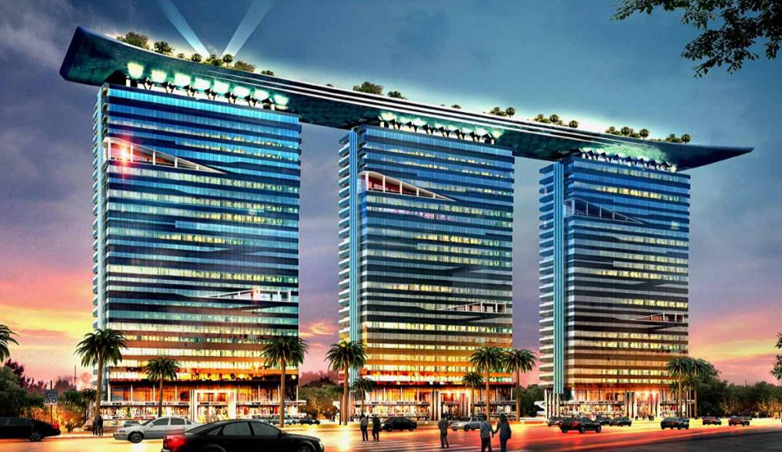
G+29 Alphathum Tower (5 Towers ), Noida
BUA – 22 lac Sft
13000 MT Structural Steel
Speed floor Slab System
Status: Under Progress

Slide 28
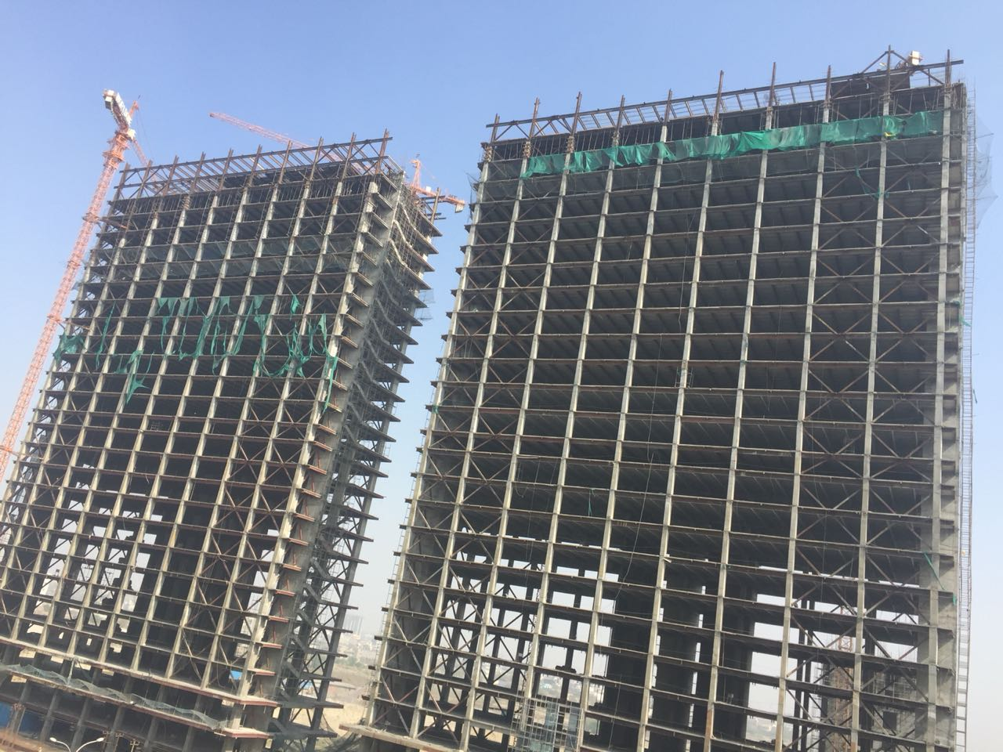
G+29 Alphathum Tower , Noida

Slide 29
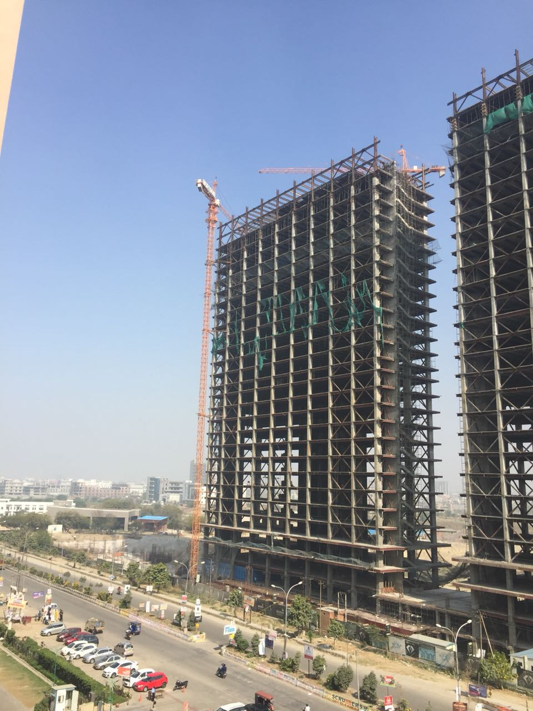
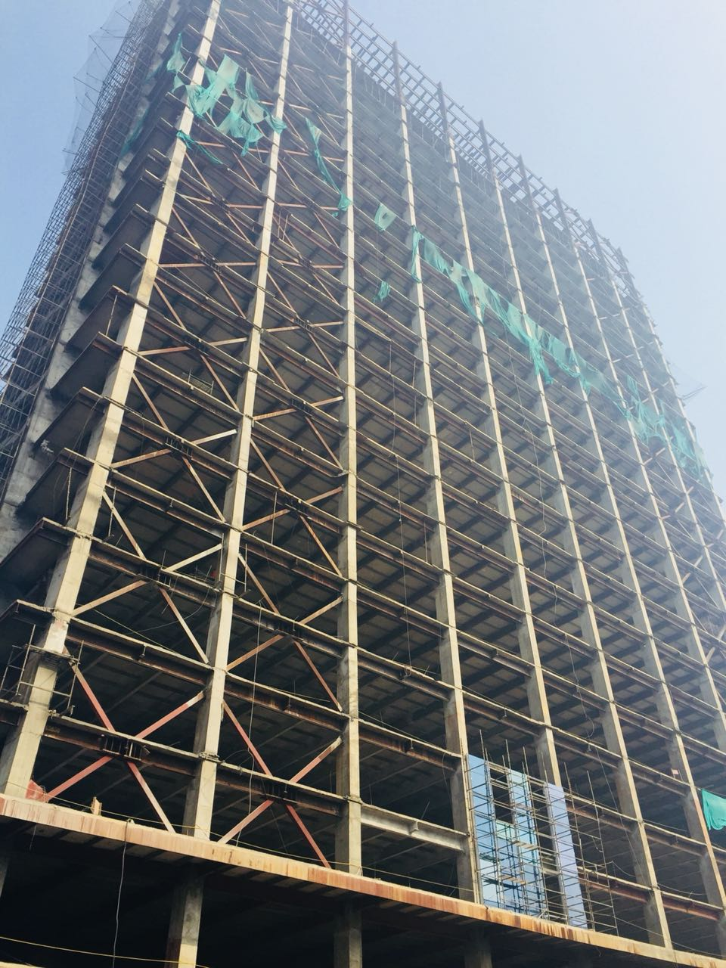
G+29 Alphathum Tower , Noida

Slide 30
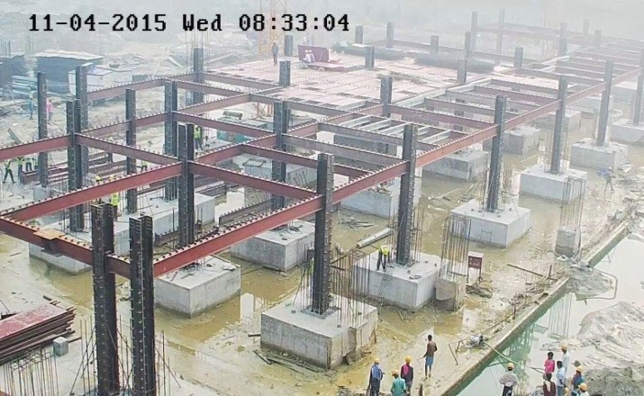
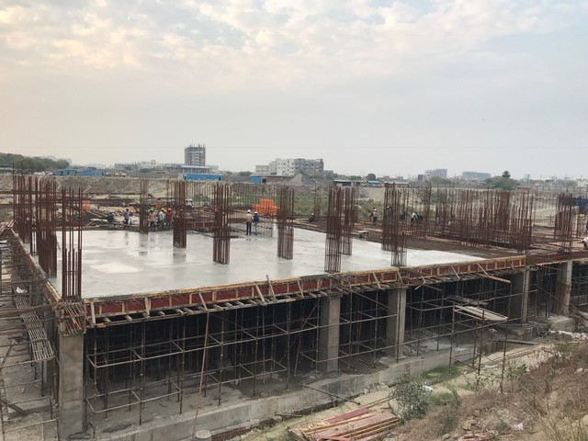
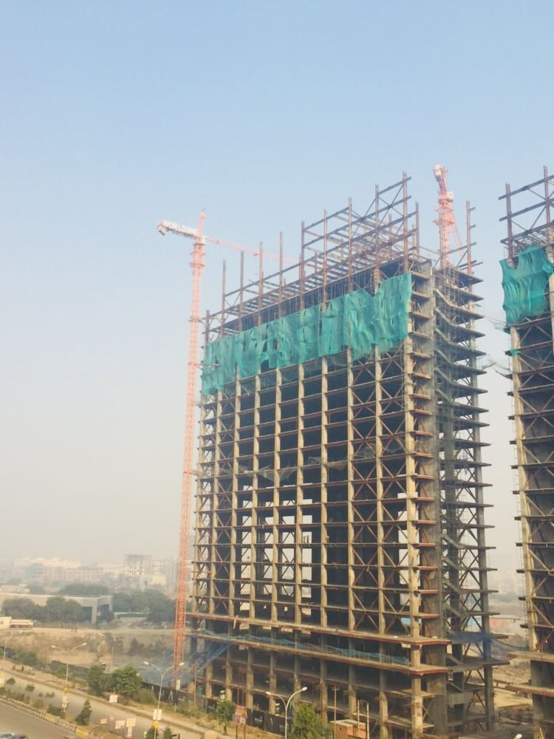
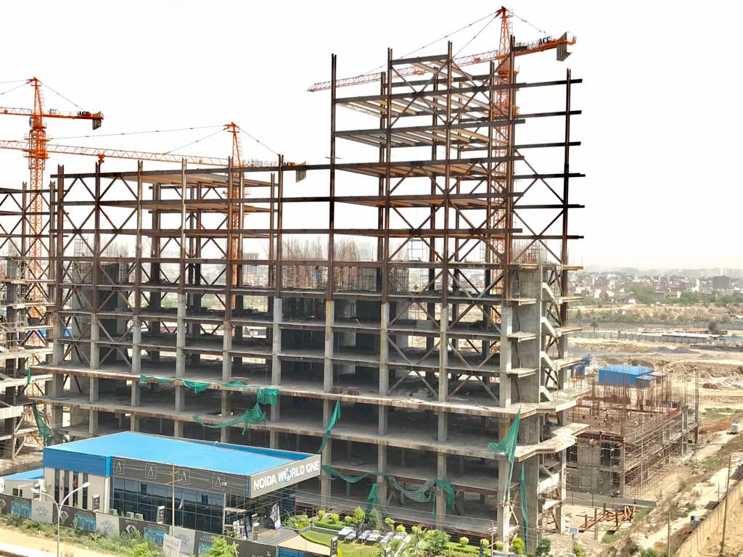
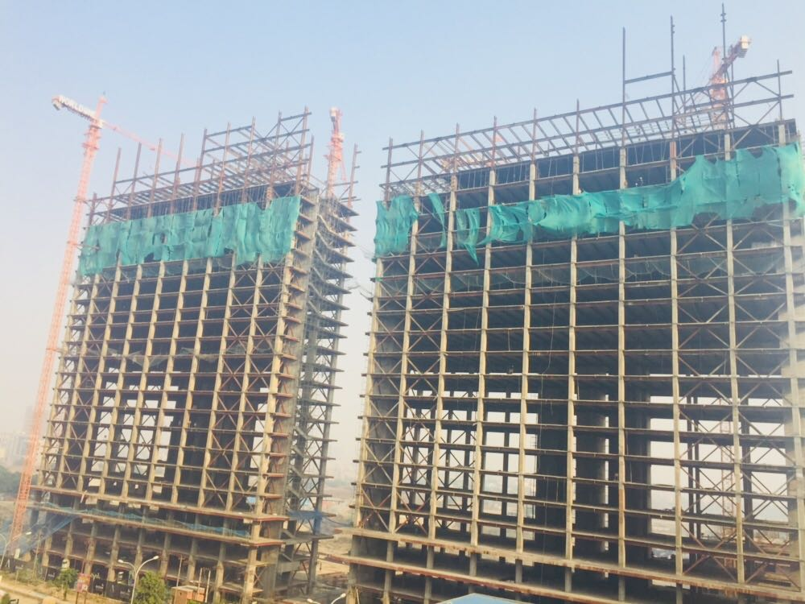
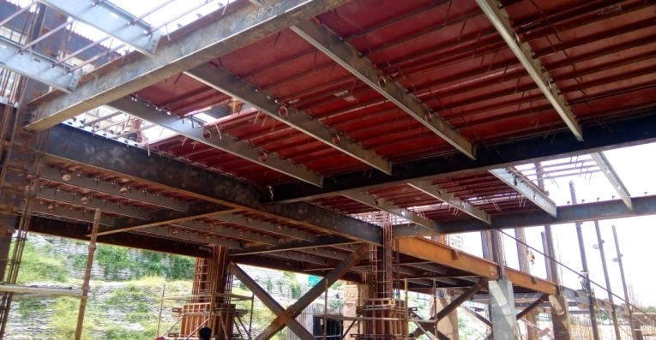
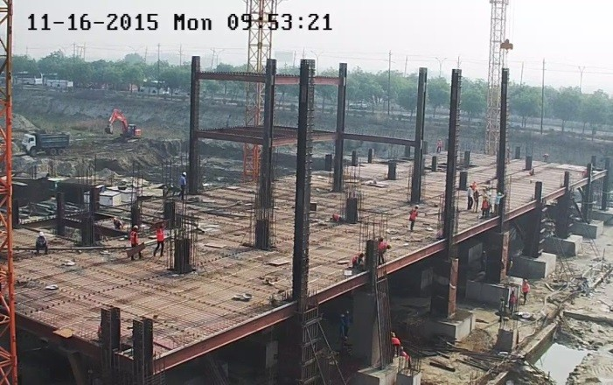
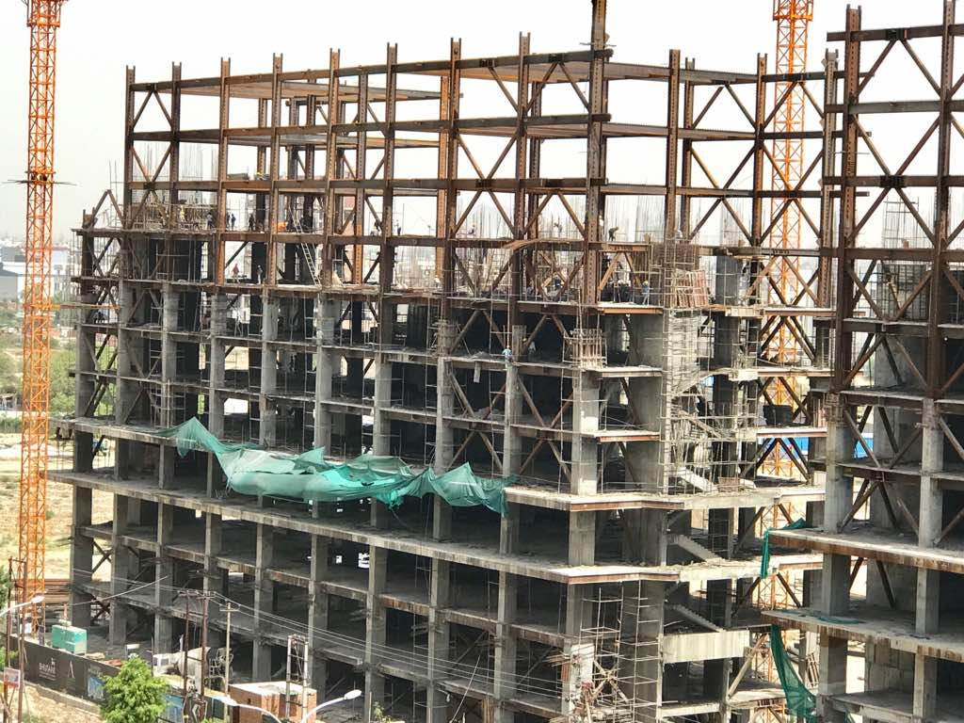
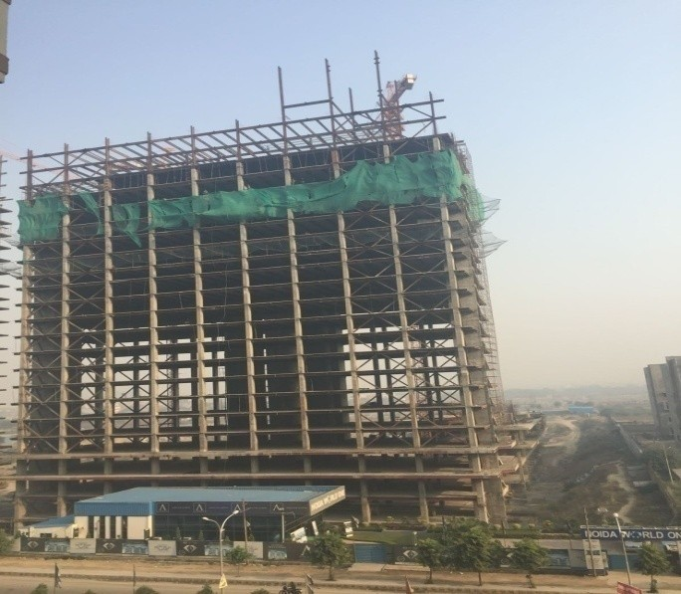
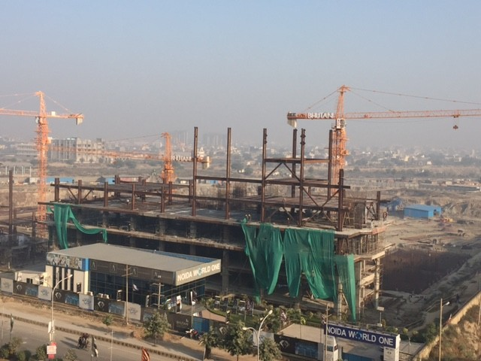
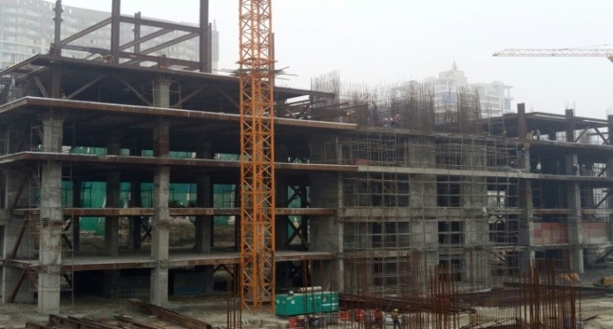
G+29 Alphathum Tower , Noida
Speedfloor Joists
Tower c
Speedfloor Joists
Tower B

Slide 31
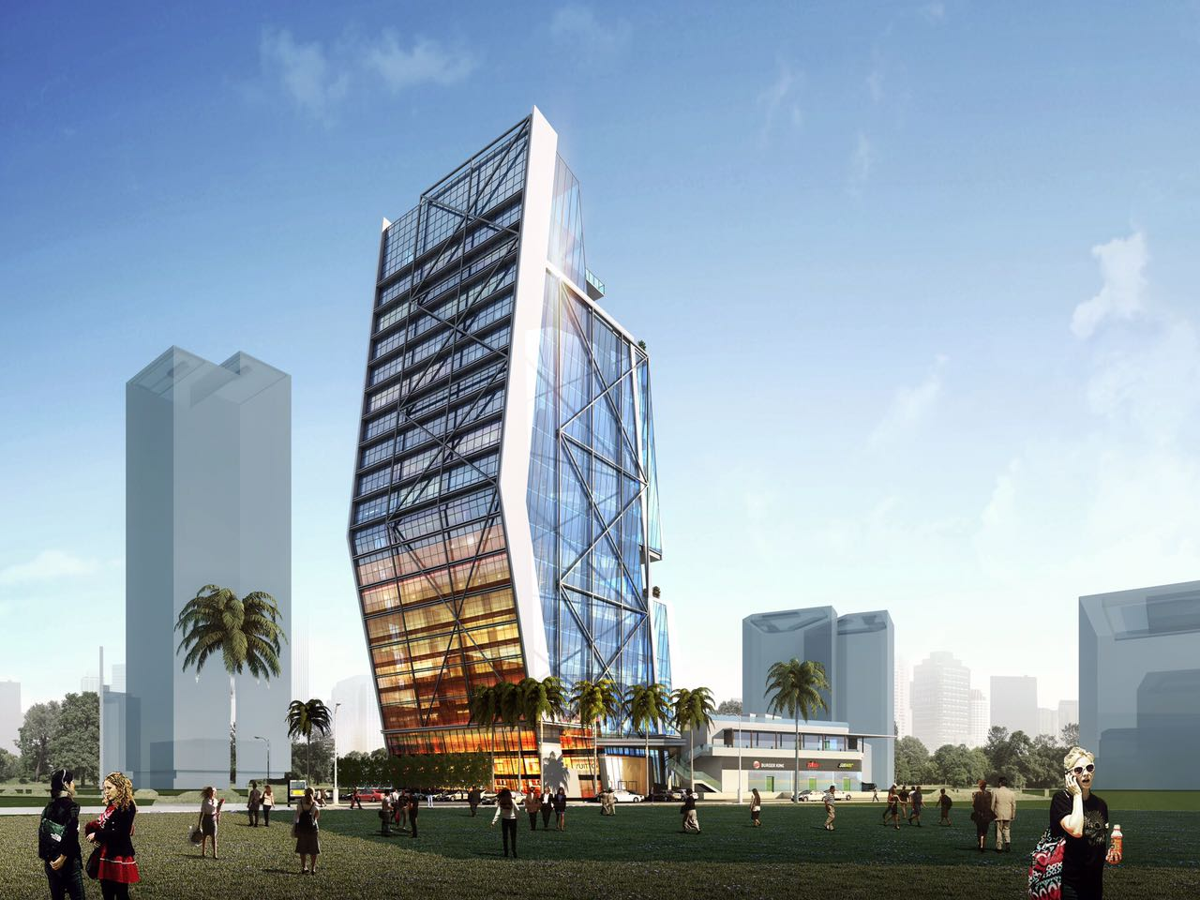
A
Windsor IT Building(G+14) , Filmcity Noida
Ajay Agarwal

Slide 32
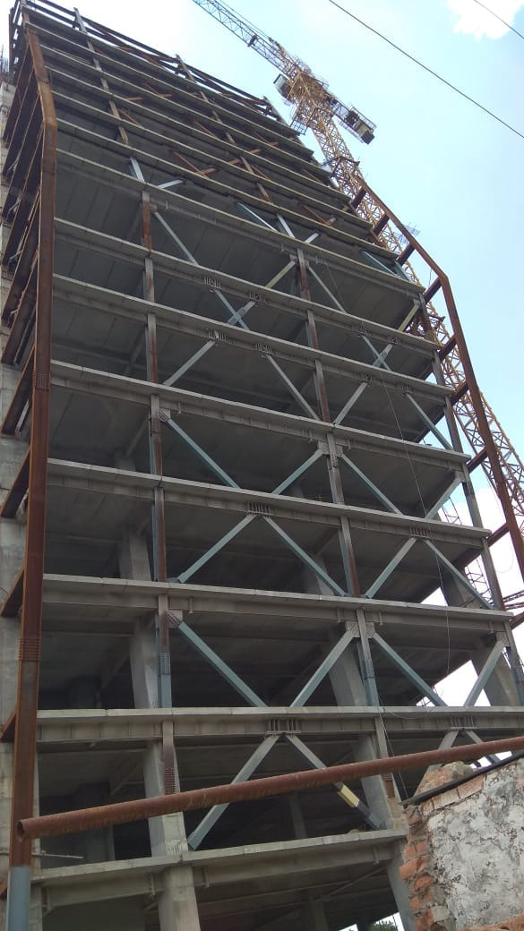
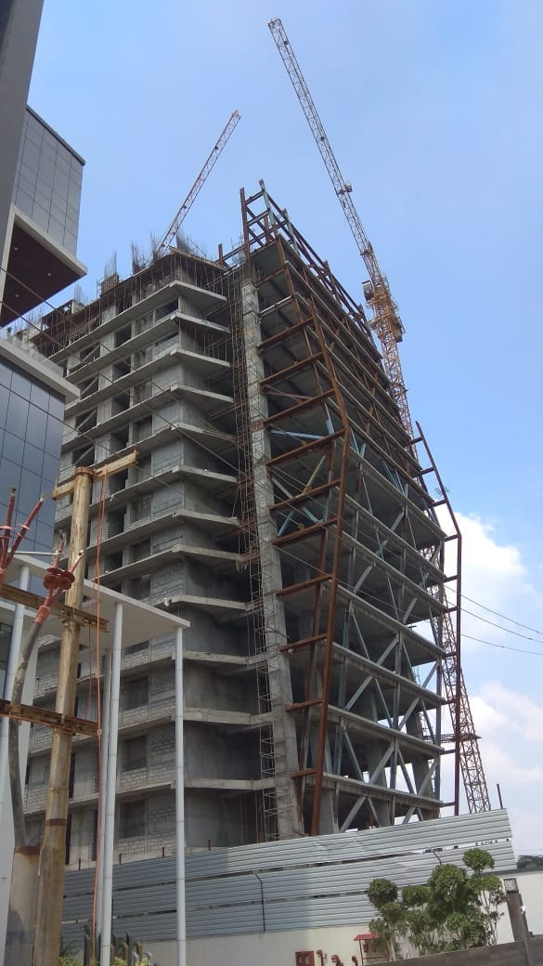
Windsor IT Building(G+14) , Filmcity Noida

Slide 33
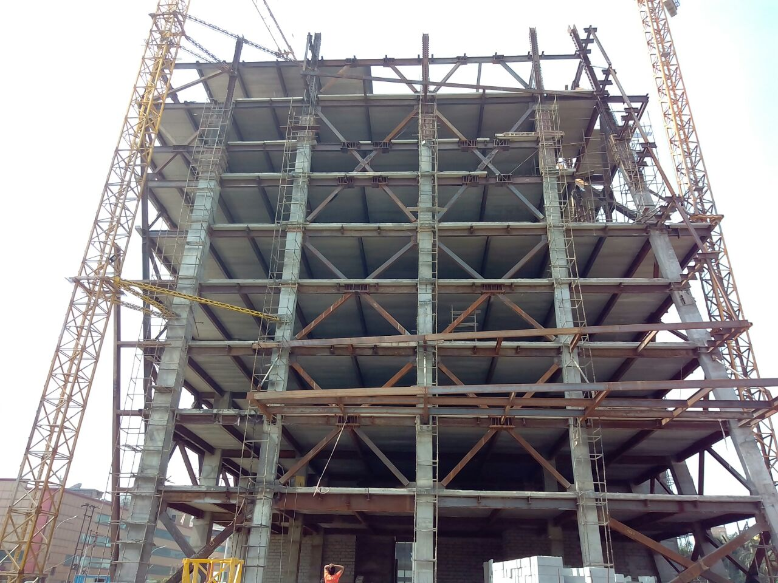
Windsor IT Building(G+14) , Filmcity Noida

Slide 34
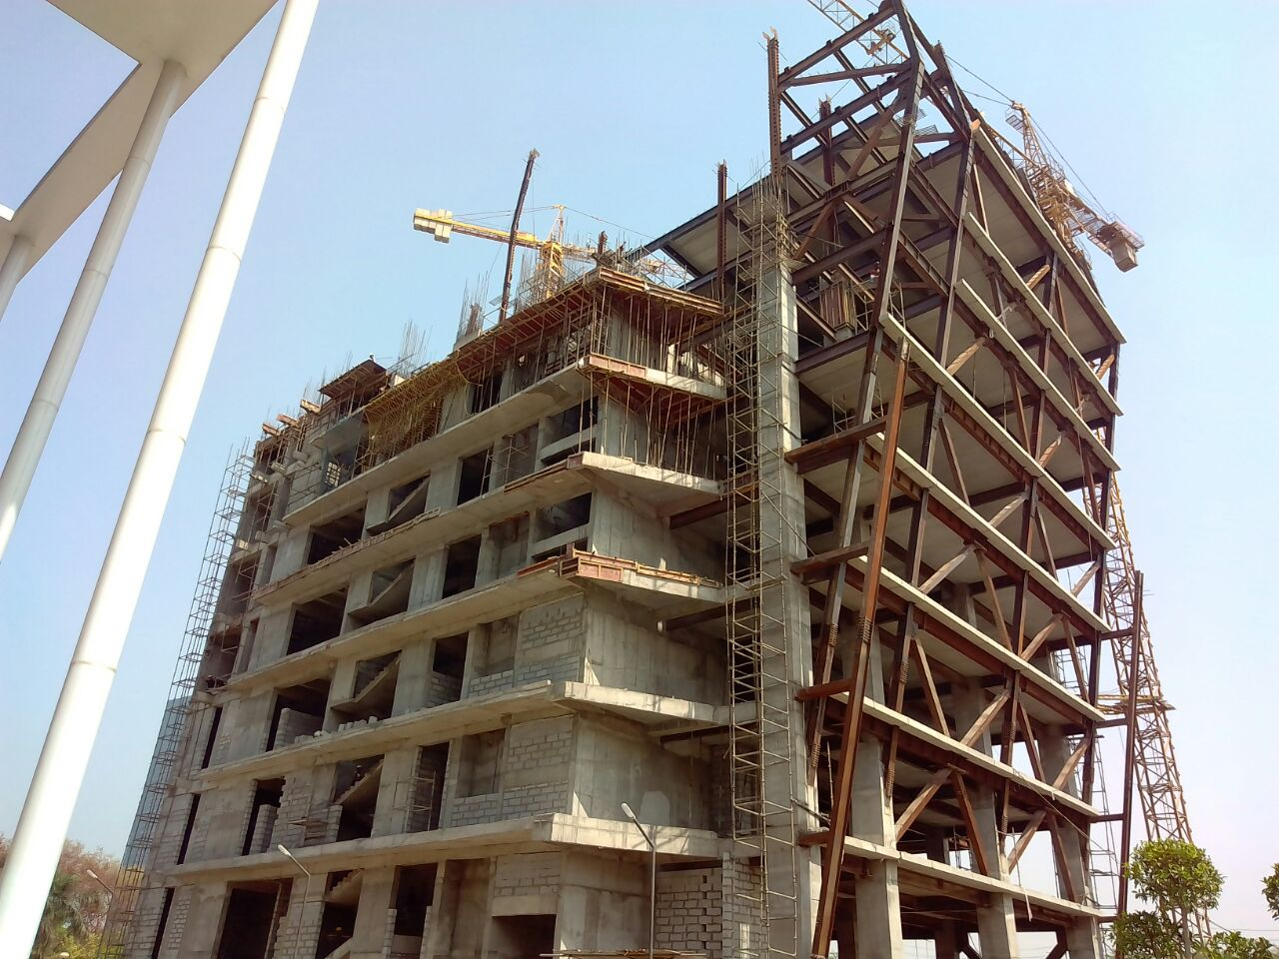
Windsor IT Building(G+14) , Filmcity Noida

Slide 35
Windsor IT Building(G+14) , Filmcity Noida

Slide 36
Windsor IT Building(G+14) , Filmcity Noida

Slide 37
Windsor IT Building(G+14) , Filmcity Noida

Slide 38
Construction of G+33 Mist Tower 1 at Festival City, Noida
Type : Commercial Building 3B+G+33, Noida
Structural Steel Quantity : 5200 MT
Built up Area : 8.0 Lakh Sft
Structural System : Composite structure.
Client : Bhasin Group
Columns: Built up Structural Steel encased in RCC. Steel Column Profile 500mmx500mm (E550)
RCC and Steel profile in columns act as monolithic structure to transfer the load as shear connectors designed for full load. This enables fast erection with fire rating requirements.
Beams: Built up/Rolled Structural Steel. 500mmx180mm (E550)
Diaphragm action of the slab along with monolithic behaviour of beams enable to transfer the lateral loads due to seismic and wind load. Brace and Framing action add stability against lateral forces
Slab: Speed flooring System 300mm depth (E350)
Unique Suspended cast in situ concrete flooring system which does not require prop. Light joist enable to cast the floor very fast.
Geometrical Details
Stair- 4Nos
Lift - 6Nos
Span 10.5m

Slide 39
Mist Tower, Festival city, Noida
BUA – 8 lac Sft
5300 MT Structural Steel
Speed floor Slab System
Status: Under Progress
May’2017

Slide 40
Mist Tower, Festival city, Noida
20th Oct 2015
2nd Nov 2015
10th Nov 2015
17th Nov 2015
30th Nov 2015
7th Dec 2015
15th Dec 2015
25th Dec 2015
15th Jan 2016
20th Feb’16

Slide 41
Multi level Car Parking (G+10) at Sir Gangaram hospital-New Delhi
1176 MT Structural Steel E-450 grade
Deck Slab System
Status: Completed

Slide 42
Multi level Car Parking at Sir Gangaram hospital-New Delhi

Slide 43
Multi level Car Parking at Sir Gangaram hospital-New Delhi

Slide 44
Embassy Tech Village , Bangalore
BUA – 15 lac Sft
9500 MT Structural Steel
12 Buildings

Slide 45
Embassy Tech Village , Bangalore

Slide 46
Embassy Tech Village , Bangalore
CONNECTING STEEL BRIDGE B/W BUILDINGS

Slide 47
Embassy Tech Village , Bangalore
BLOCK - A
BLOCK - B
BLOCK - C
BLOCK – I&J
BLOCK - E
BLOCK - C
BLOCK - L
BLOCK - L
BLOCK - F

Slide 48
Vijaywada Airport –New Terminal
1000 MT Structural Steel E-350BR grade
Status: Completed

Slide 49
Vijaywada Airport –New Terminal

Slide 51
OPPO INDIA MANUFACTURING COMPLEX- GREATER NOIDA
4500 MT Structural Steel E-350BR grade
Status: Completed

Slide 52
DELHI PUBLIC SCHOOL-JHANSI
150 MT Structural Steel E-350BR grade
Status: Completed

Slide 53
H20 IT PARK- GREATER NOIDA
1000 MT Structural Steel E-450BR grade
Status: On-going

Slide 54
M3M-IFC (G+40) , GURUGRAM
4500 MT Structural Steel
Solid Slab System
Status: Under Progress

Slide 55
NBCC-NICL, KOLKATA
3600 MT Structural Steel
Deck sheet Slab System
Status: Under Progress

Slide 56
Rolled Sections especially developed by JSPL for High Rise Buildings
500X8X13X180X69.47
500x8x14x180x72.14
500x10x16x180x85
500x11x16x180x88.9

Slide 57
Way Forward
Exponential increase in the usage of steel for Infra/construction. A huge gap between global practices and India.
Raising the awareness of high strength steels to architects, consultants etc.
Industry Academia tie up for propagation of high strength steel usage.
Support from Government bodies for establishing codes, research support.

