Slide 1
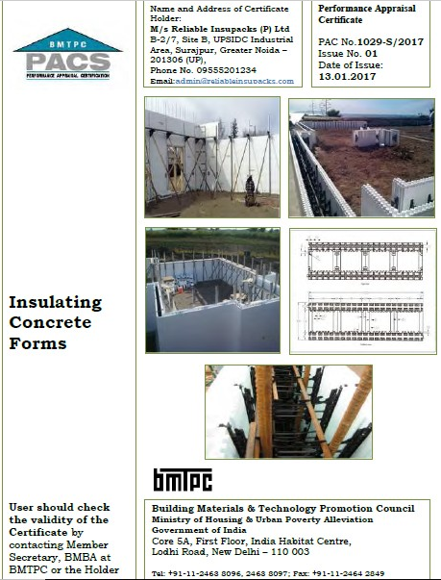
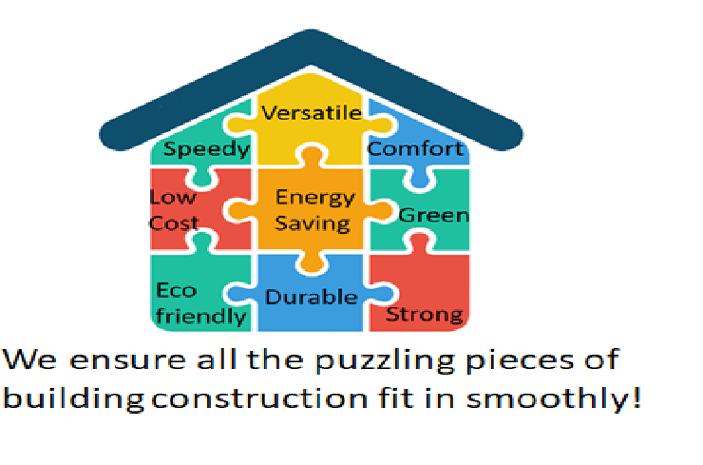
Mass Housing Construction with RELIABLE ICF
(Insulated Concrete Form work)
faster, stronger, greener, safer
MARCH, 2019

Slide 2
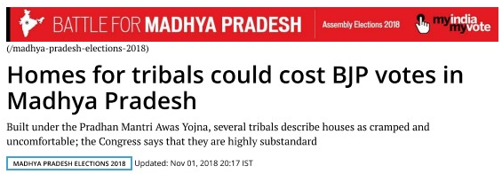

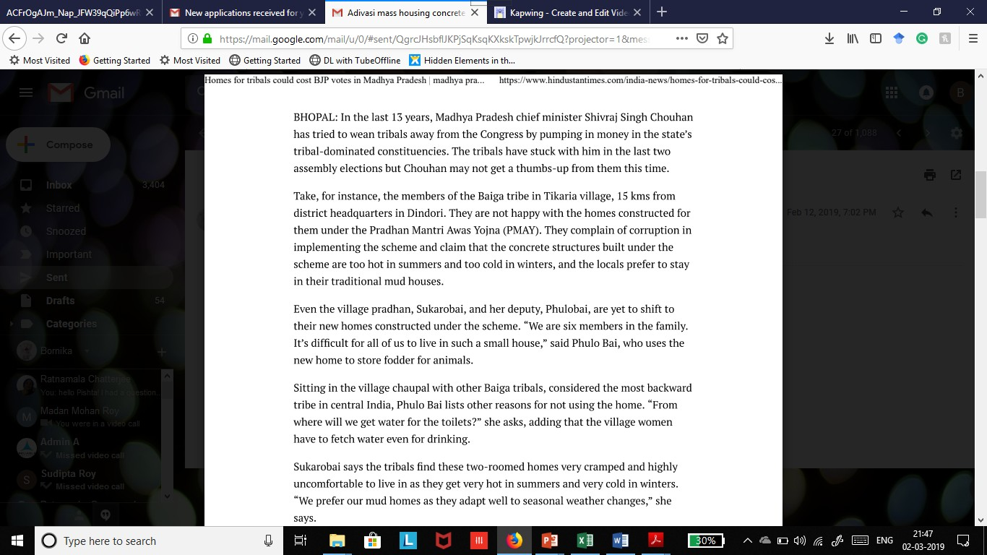
PMAY- An excellent scheme with problematic implementation?

Slide 3
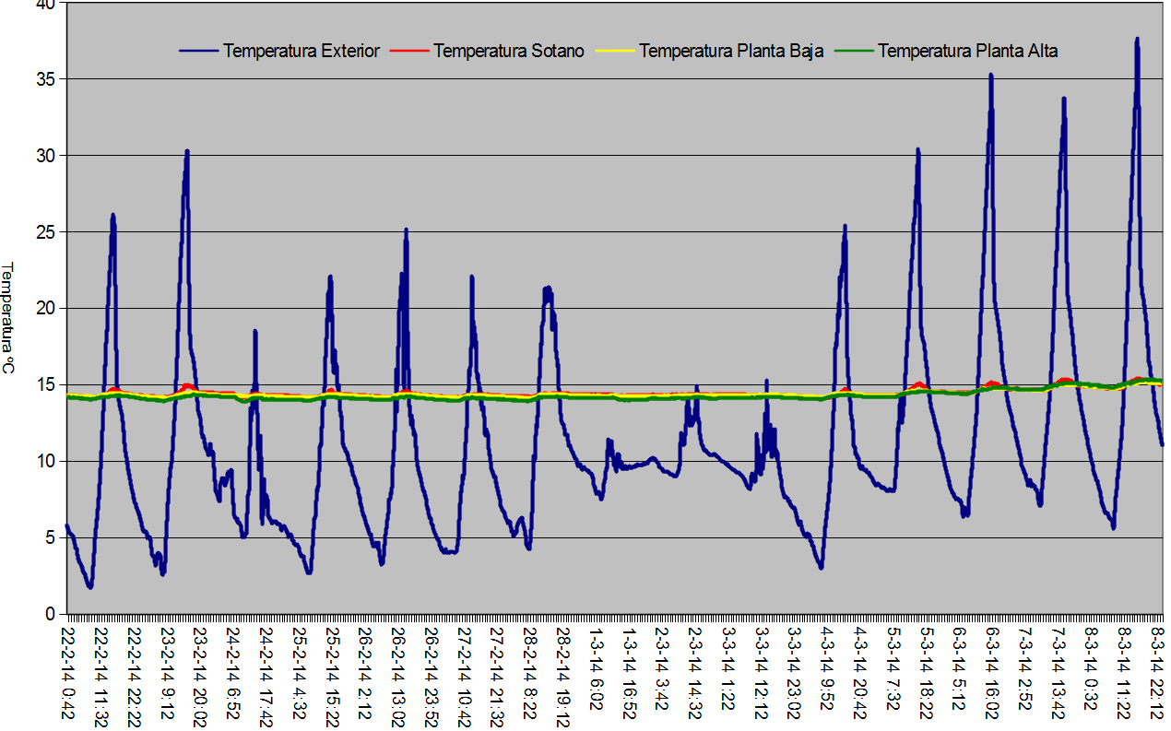
Comfortable ICF homes
Thermal insulation- R 19
Acoustic Insulation up to 60 Db dampened- impact + airborne

Slide 4
Why are ICF homes perfect for mass housing?
( a basic schema of our presentation today)
The concept of ICF – components, steps of construction
Comfort factor
Disaster resistance
Durability factor
Ultra-fast construction
A made-for-India, made-in-India product
Green factor
Affordability
Other concerns
Limitations

Slide 5
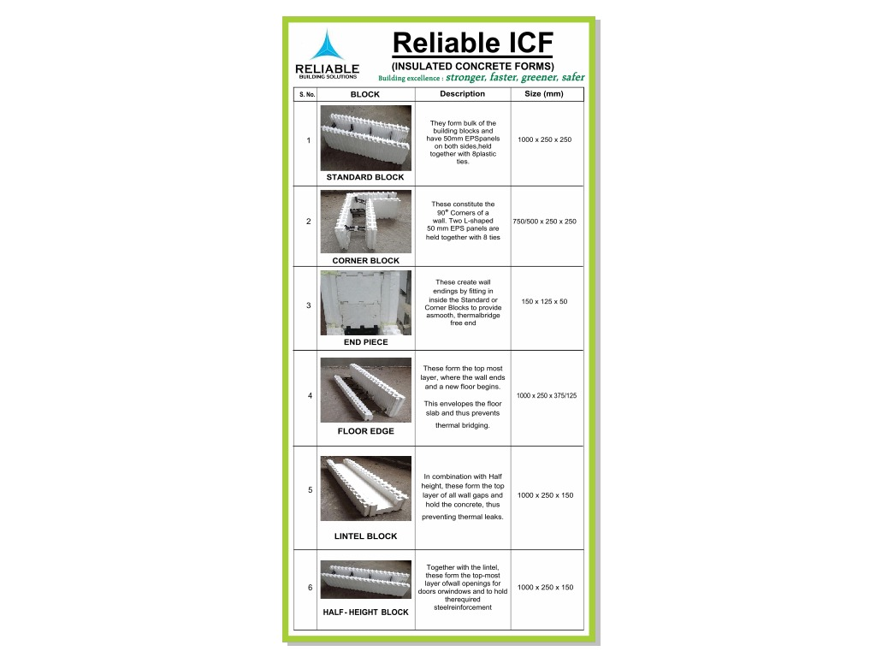

Slide 6
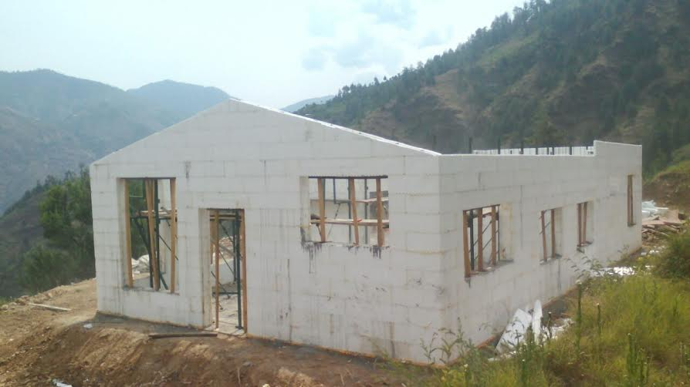
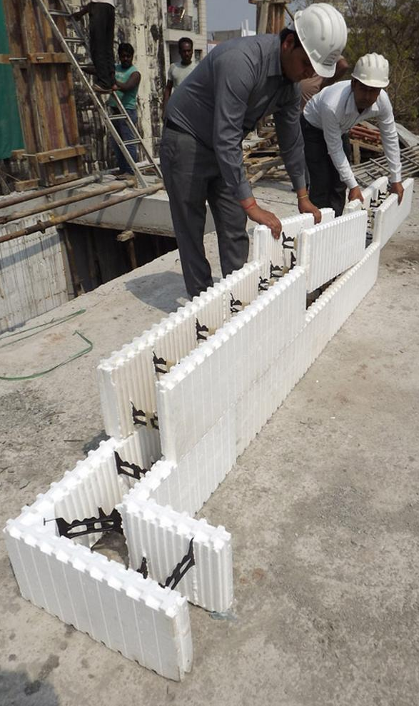
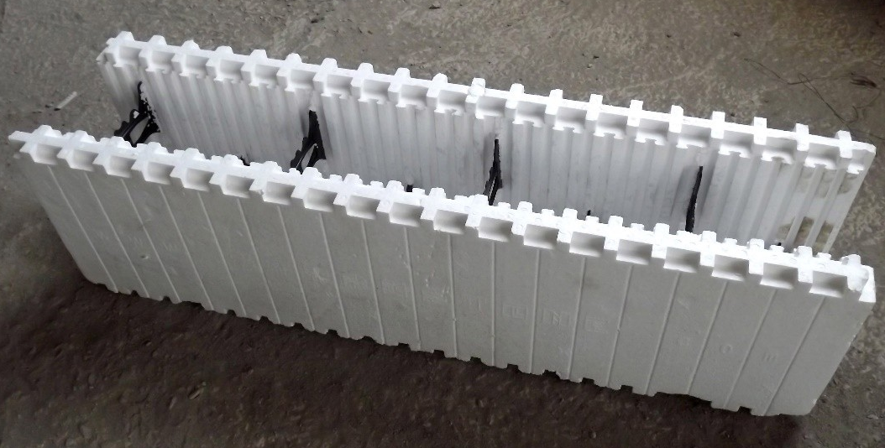
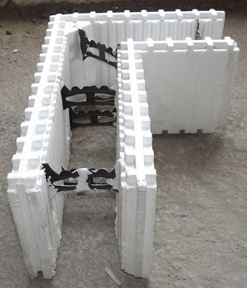
SHUTTERING/ FORMWORK
(interlocking, hollow molded EPS panels, held together by hard plastic ties)
Standard Block
Corner Block
Notes:
EPS stands for Expanded Polystyrene foam. High density, self-extinguishing grade EPS is used for ICF

Slide 7
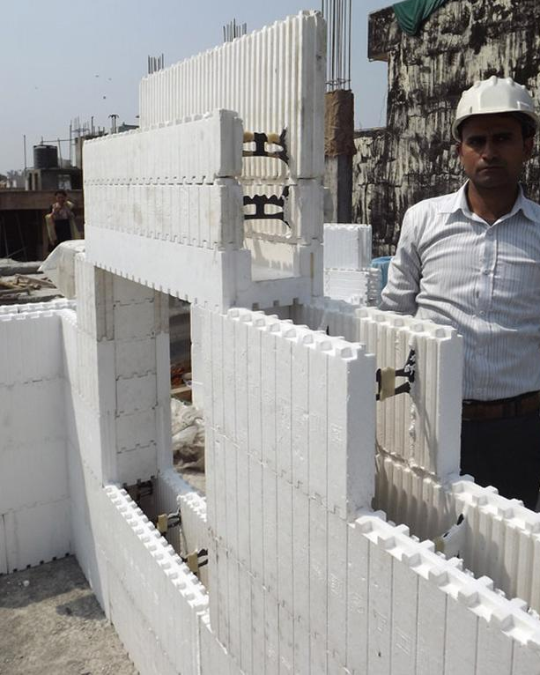
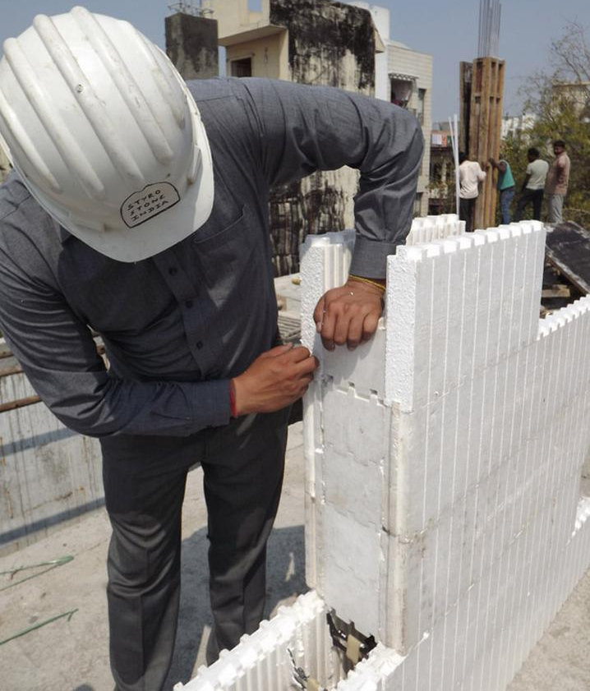
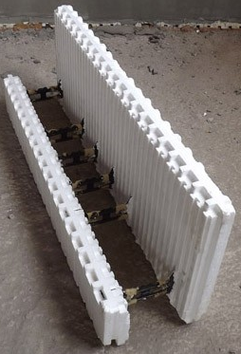
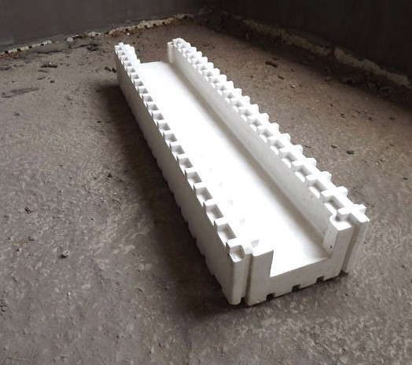

SHUTTERING/ FORMWORK
(interlocking, hollow molded EPS panels, held together by hard plastic ties
End pieces fit snugly to prevent thermal bridging
Floor Edge
Lintel
Half-height

Slide 8
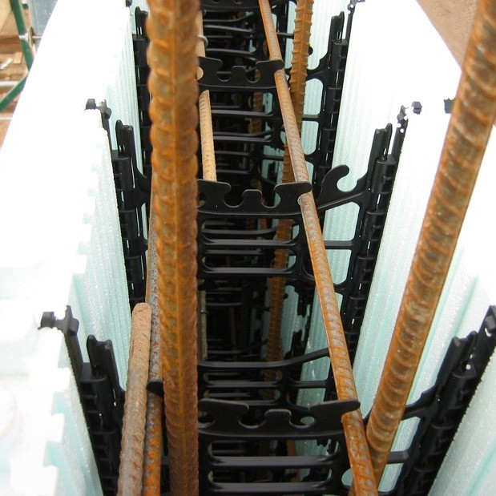
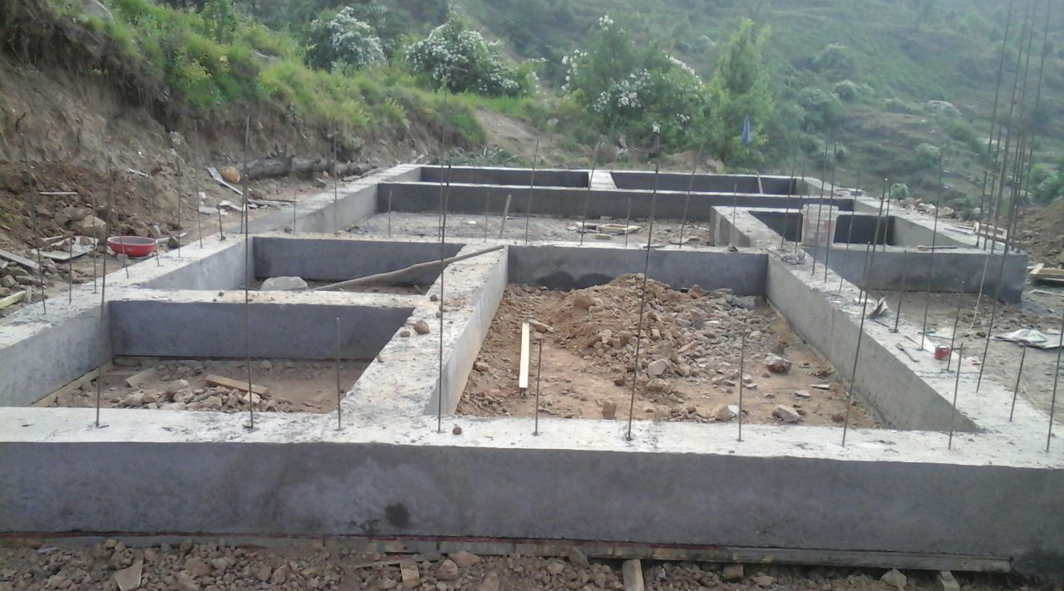
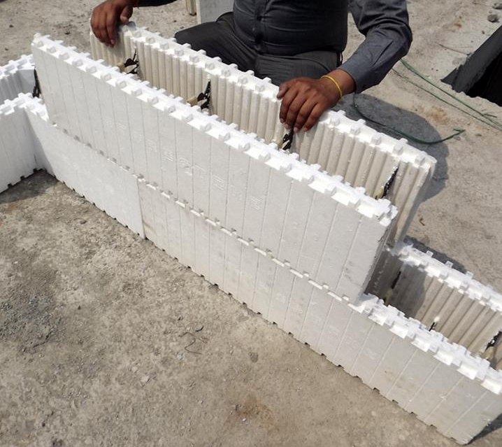
1. ICF walls can easily be built on conventional masonry footing or even step footings or shallow foundation systems including strip foundation
3. Fixing steel rebars (as per calculated requirements) to hard ties in the formwork reinforces the structure.
2. Ultra-fast shuttering/ formwork assembled by stacking interlocking hollow molded ICF blocks
Notes:
Horizontal rebars during assembly. Vertical before concrete.

Slide 9
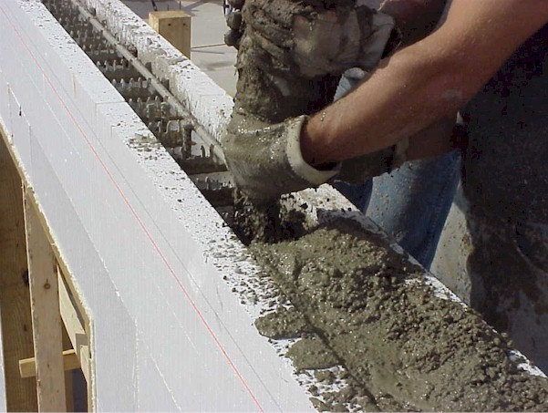
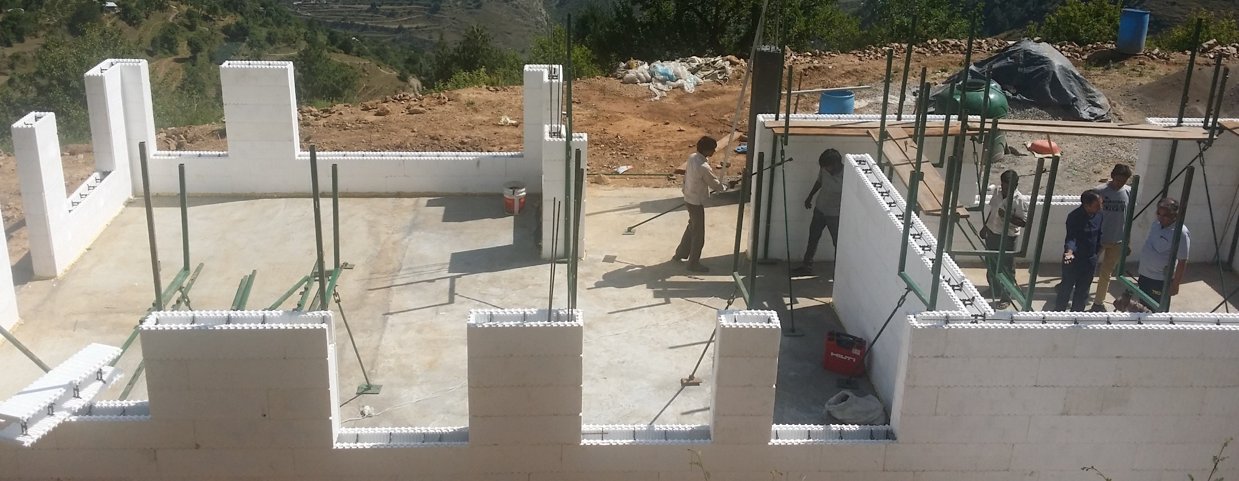
5. All necessary service conduits are marked and openings are cut with a drill/ hot knife
4. TRESTLES are erected for plumb straight walls & for support during concrete pour. SCAFFOLDING platforms on trestles allow easy access and assembly of higher walls
6. Concrete of a specified slump and strength (M-20/25 grade) is poured into the formwork to form a strong core.

Slide 10
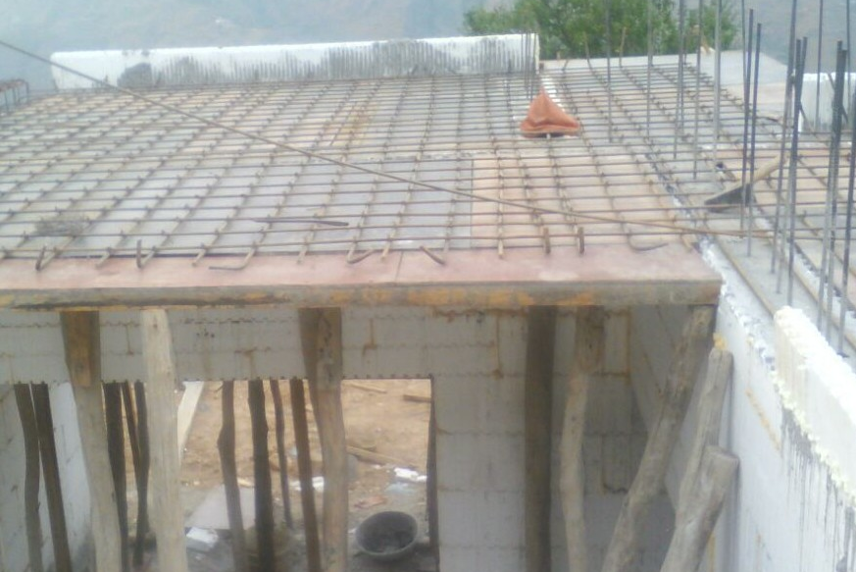
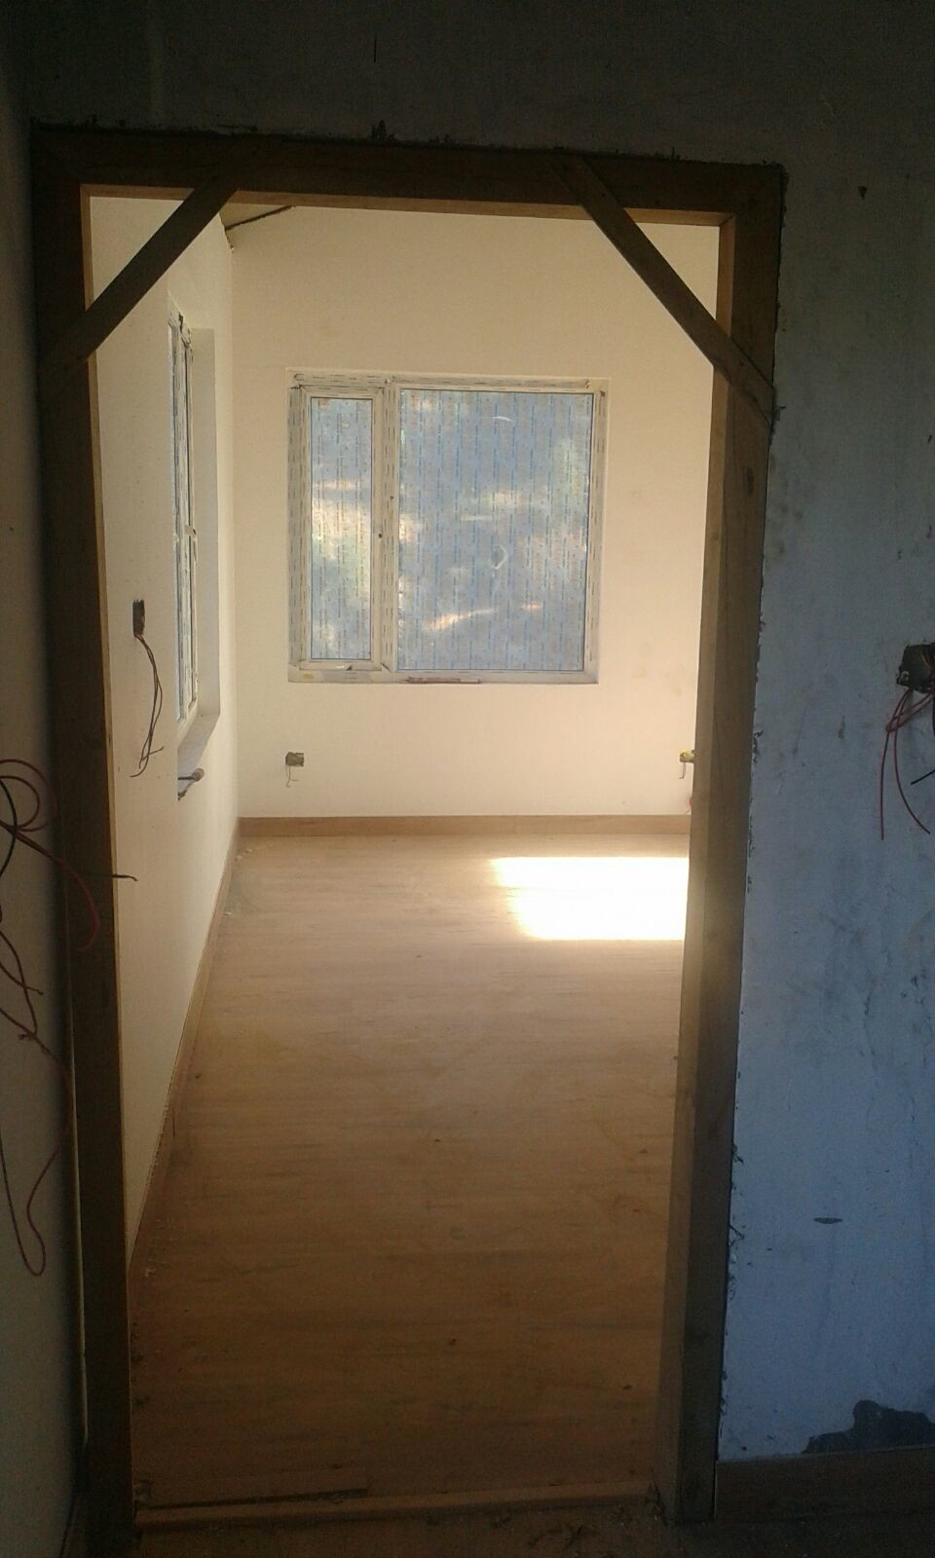
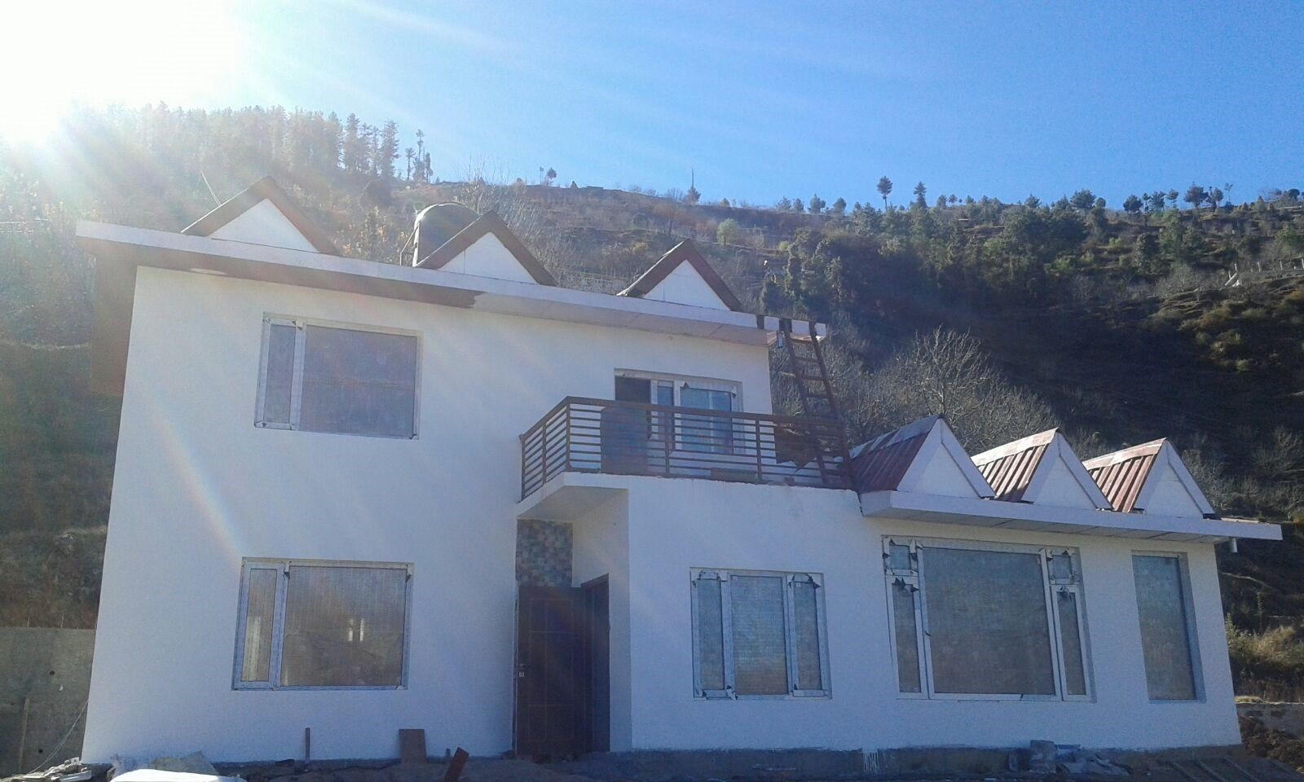
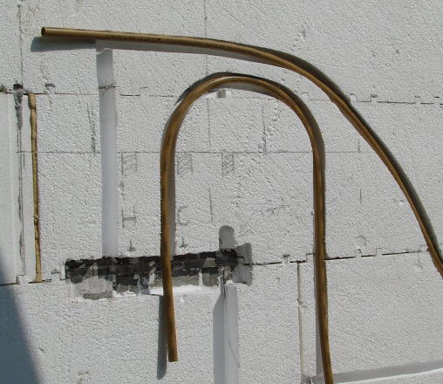
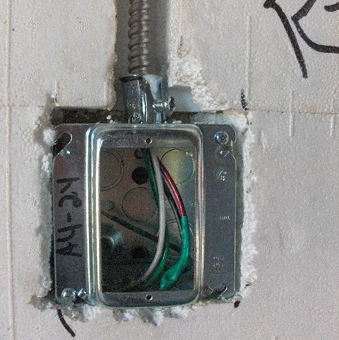
7. Shuttering for flooring and roofing follows.
8. Pipes for plumbing and cables/wiring are easily placed inside chased lines cut out on the insulation foam
10. The finished structure is ready after wall cladding or rendering.
9. Windows and doors are fixed after concrete is poured but before the finishing is done.

Slide 11
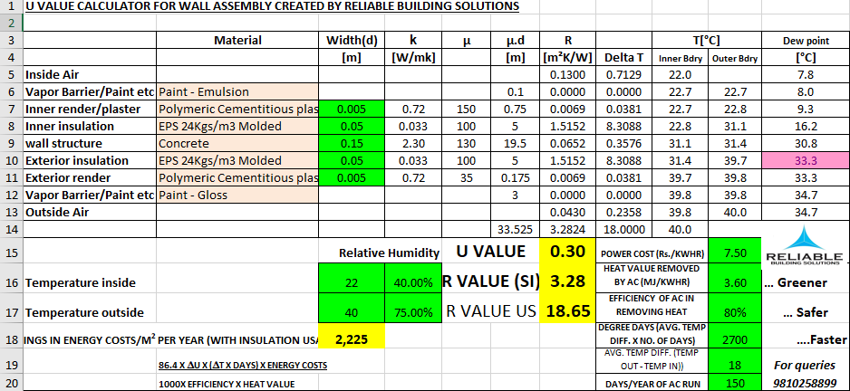
Comfort characteristics of ICF homes
Airtightness of 0.5 ACH/hour vs. 8 ACH/hour
Thermal Inertia of High mass concrete
U- value

Slide 12
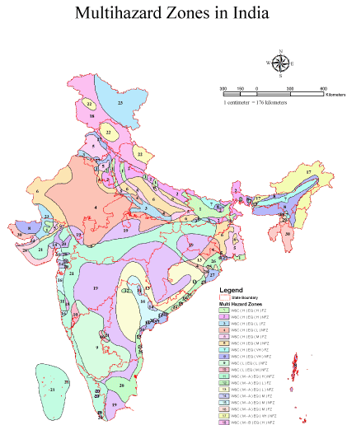
Disaster- resistant ICF homes
India is prone to:
Earthquakes
Landslides
Hurricanes
Cyclones
Floods
(sometimes a region is susceptible to multiple calamities)

Slide 13
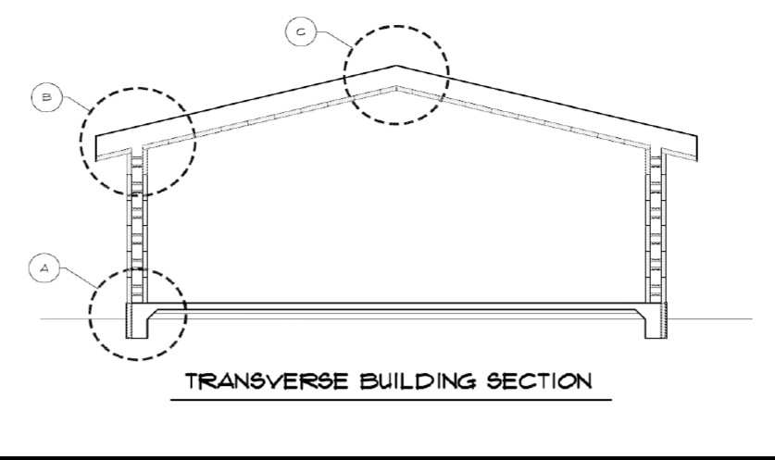
Disaster- resistant ICF homes
Seismic suitability: ride seismic waves
  Monolithic concrete
  Box- like structure; walls joint with roof & foundation
Hurricanes/ Cyclones: All walls act as shear walls in combination with the roof & floor
Fire:
  Self-extinguishing EPS. Flame extinguishes as soon as fire source is withdrawn.
  150 mm concrete has >2 hours of fire rating.
  Fire barriers integrated at each floor slab.
Flood: EPS shell absorbs only 0.3% of water by volume after 48 h of immersion.
CROSS-SECTION DETAILS OF DISASTER-RESISTANT ICF SHELL

Slide 14
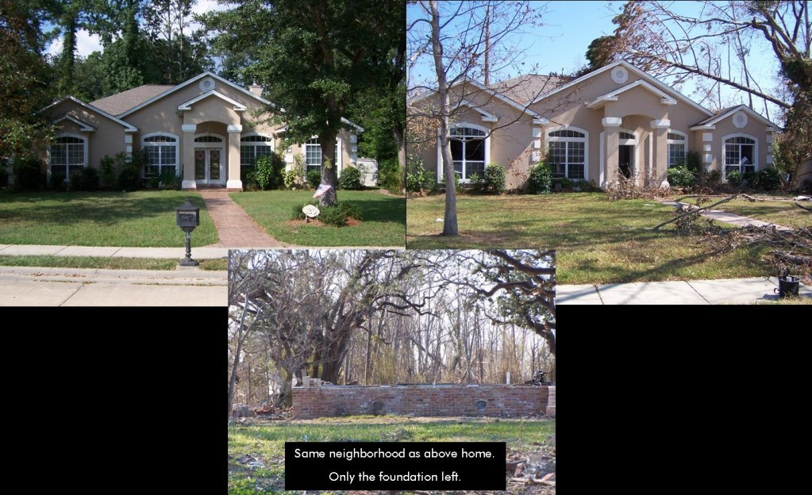
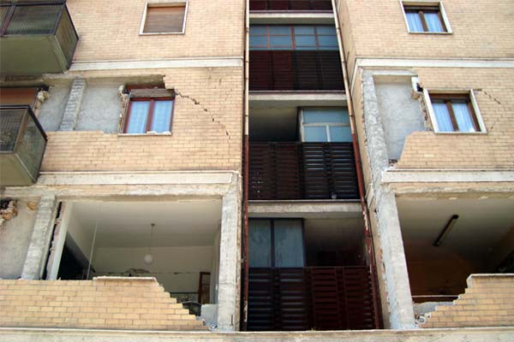
STRENGTH of ICF homes
An ICF home and neighbourhood : Before & After Hurricane Katrina
Stronger & Durable-
Fixed to the ground like a bunker
Cracks from mild tremors due to
Weak joints in conventional buildings

Slide 15
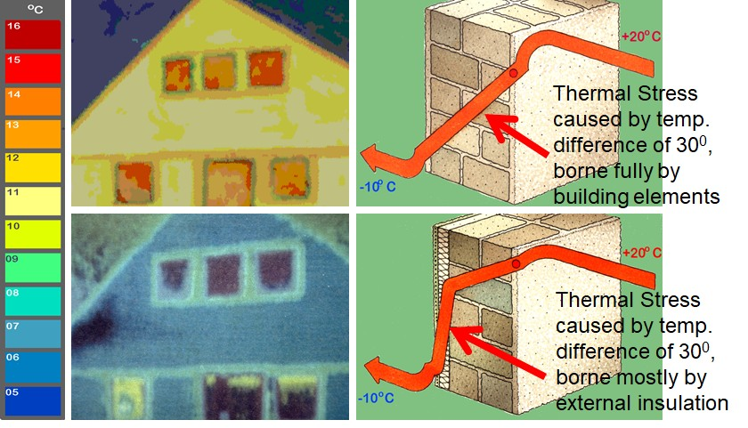
Thermal strength of ICF homes

Slide 16
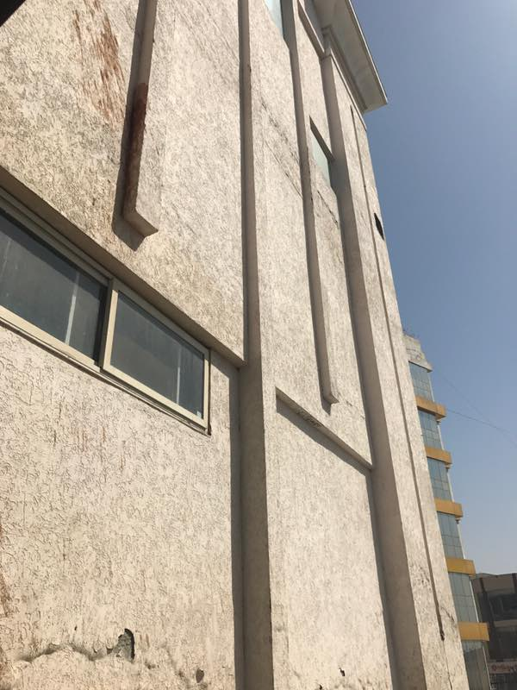
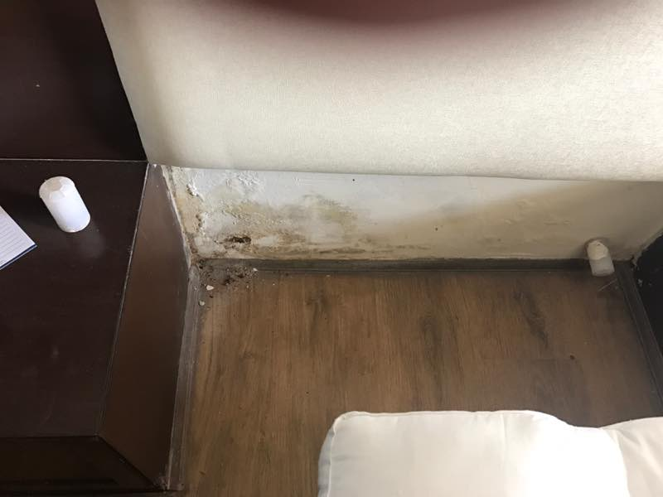
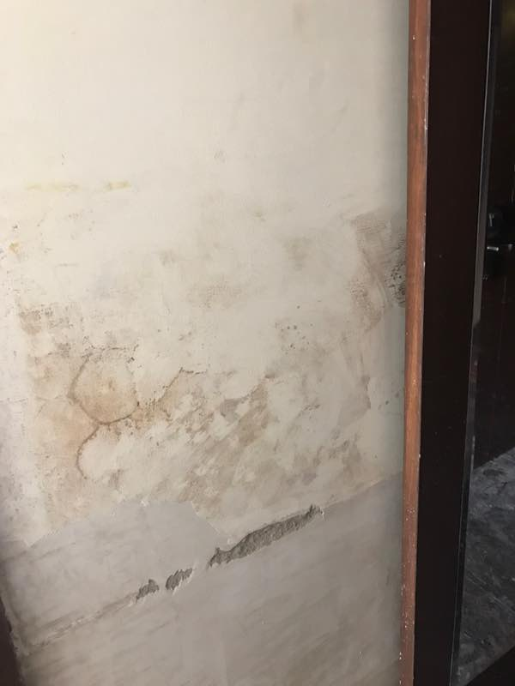
Moisture- proof ICF homes
Moisture ingress and dew point condensation causes cracks, plaster shedding off from ceiling and walls.

Slide 17
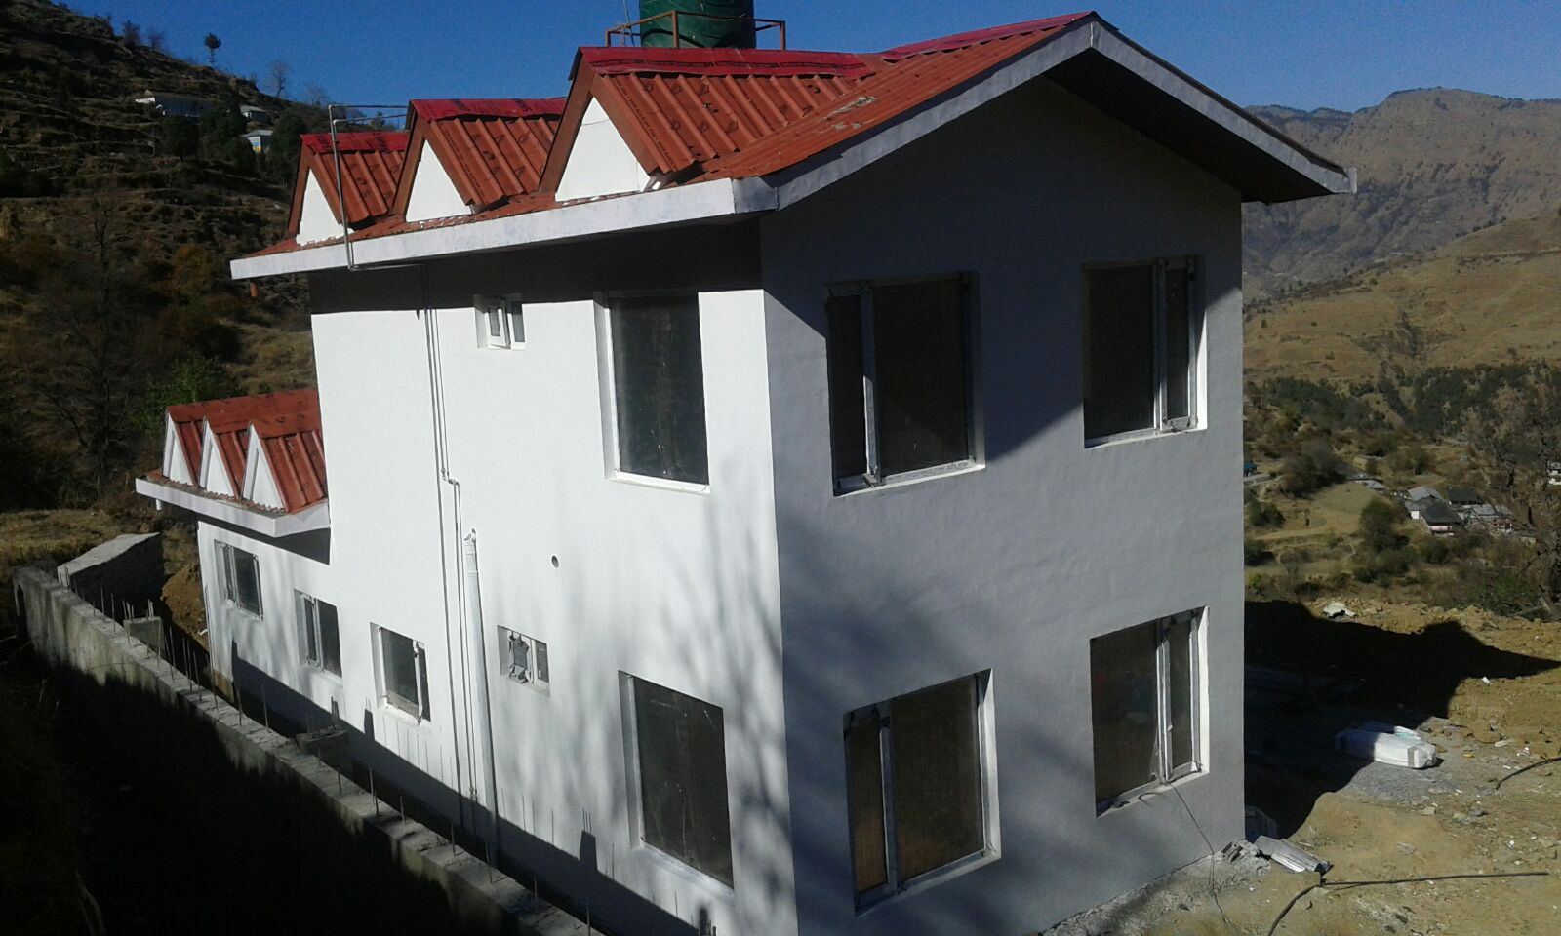
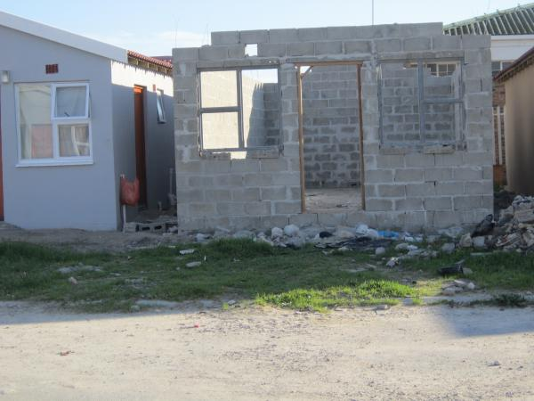
Speed of construction for ICF homes
ICF progress after 6 weeks Conventional

Slide 18
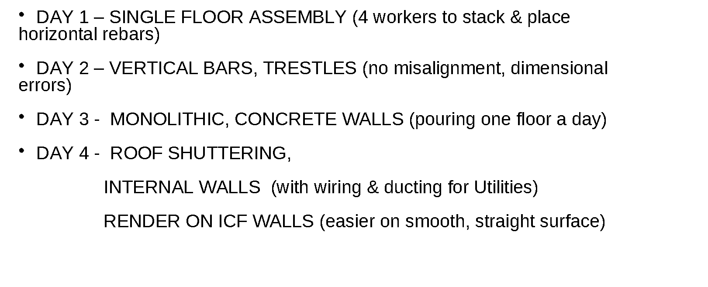
Ultra-fast ICF homes
(for a single family home of ~ 2000 sq. ft.)

Slide 19
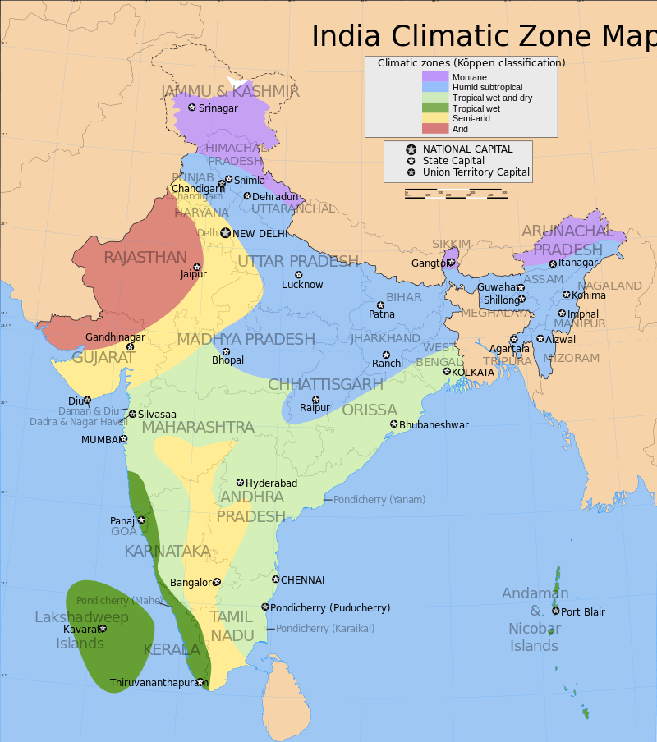
Geoclimatic suitability of ICF homes
Hot & Dry- Yellow & Red
Warm & Humid- Green
Composite- Blue
Cold/ Temperate- Purple
Energy efficiency & comfort in both extremes- heat & cold
No thermal leaks, airtight insulation.
Lightweight for remote areas, difficult terrain. Reinforced concrete for seismic safety.
Fast construction.
No thermal leaks, airtight insulation
No moisture ingress. No seepage, no damp. Cyclone & Hurricane resistant

Slide 20
Green factor of ICF homes
 | Sustainable Criteria | ICF walls
1 | Life | > 50 year & no significant repairs
2 | Reduced Resources | Zero on-site water Less concrete & steel required
3 | Reuse Resources | Green concrete Recycled Plastic for EPS & ties (Green form)
4 | Toxicity | No VOCs, no harmful chemicals

Slide 21
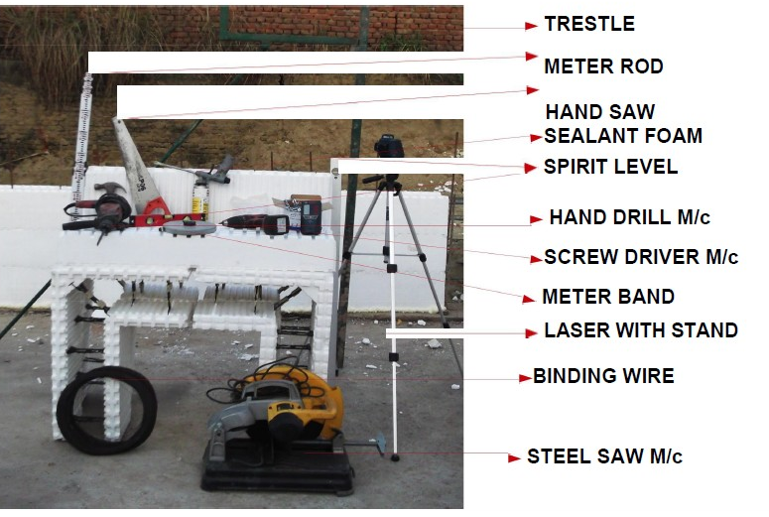
ICF homes require less skilled labour
Simple tools & Faster construction
=
Less skilled labour

Slide 22
Affordable ICF homes
Although the direct material cost of ICF homes may seem to be on the higher side because of their superior quality, due to savings in the following,
Labour costs
Steel & Concrete cost
Time
Water
the overall cost can be lower in mass housing due to economies of scale

Slide 23
Other concerns regarding use of ICF homes in mass housing
Likely timeline of 1000 houses (assuming 300 sq. ft.) = 11 months
Scalability : EPS Factories every 200 Kms. Set of moulds ~ Rs. 20 Lacs
Economics of scale: Green Concrete, Reduction in costs of steel etc.
Number of Floors- 7 (in earthquake zones)

Slide 24
Limitations of ICF technology
Limited by Indian Building Codes (USA/Europe vs. India)
  Non-contact lap joints
  Minimum steel requirement to prevent concrete cracking under thermal stress
  Minimum concrete thickness (6 inch vs. 4 inch monolithic)
Cannot be modified once built- walls are structural members
Availability & client permission for green concrete

Slide 25
Projects using ICF technology
S.No. | Location | Nature | Storeys | Area (Sqft) | Year | Construction time frame
1 | Manesar (Vill. Pachgaon) | Farmhouse | 1 | 2500 | 2015 | 3 months
2 | Surajpur, Greater Noida | Guardroom | 1 | 700 | 2015 | 15 days
3 | Indore | Car Showroom | 4 | 10000 | 2016 | 1 month
4 | Delhi, Mansarovar Garden | Residential | 5 | 10000 | 2016 | 6 months
5 | Theog, Himanchal Pradesh | Hill top farmhouse | 2 | 3000 | 2016 | 3 months
6 | Surajpur, Greater Noida | Office+Godown | 2 | 18000 | 2016 | 5 months
7 | Surajpur, Greater Noida | Basement+workshop | 2 | 6000 | 2016 | 3 months
8 | Near Hyderabad | Residential | 2 | 2500 | 2017 | 1 month
9 | CBRI Roorkee | Residential | 2 | 1250 | Pipeline | Pipeline
10 | Chanakyapuri, New Delhi | Heritage Building | 3 | 18000 | Pipeline | Pipeline
Total projects in India: 52,700 sq. ft.
>20,00,000 sq.ft worldwide as per list submitted

