Slide 1

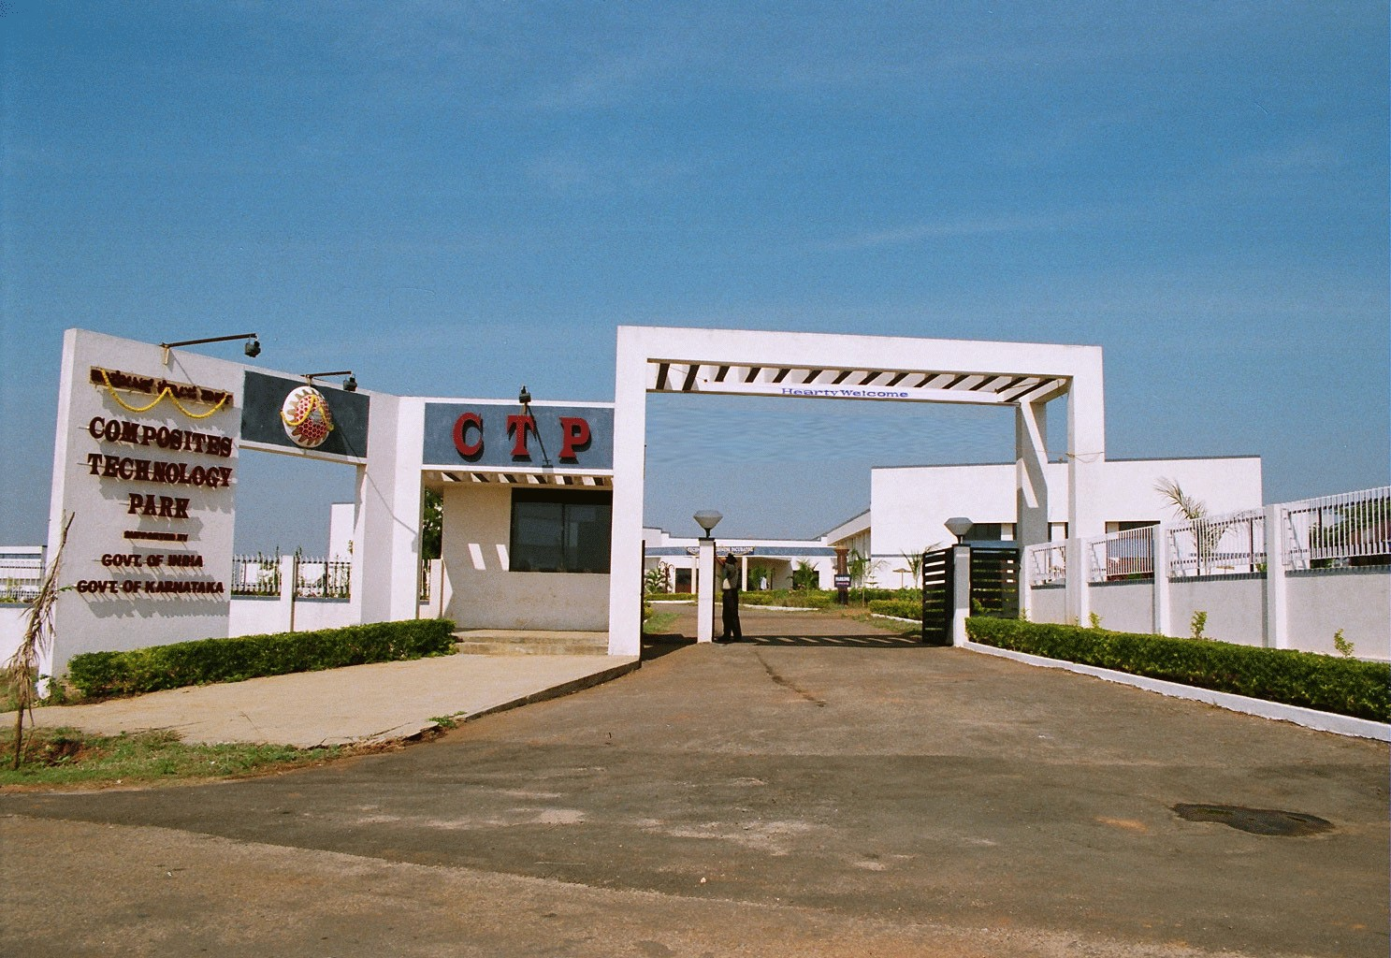


SOCIETY FOR DEVELOPMENT OF COMPOSITES
Composites Technology Park
(An R&D Centre established with the Support of Dept. of S&T, BMTPC and Coir Board of Govt. of India and Dept. of C&I, KHB and RGRHCL of Govt. of Karnataka)
Light Gauge Steel Framed Structure with Infill Concrete Panel (LGSFS – ICP) Technology
Proven and Demonstrable Technology
Pioneering Innovations in
Eco-friendly Materials and Products
Dr. R. Gopalan
Director & CEO
KVQA ISO 9001 Certified
Member, Green Building Council

Slide 2
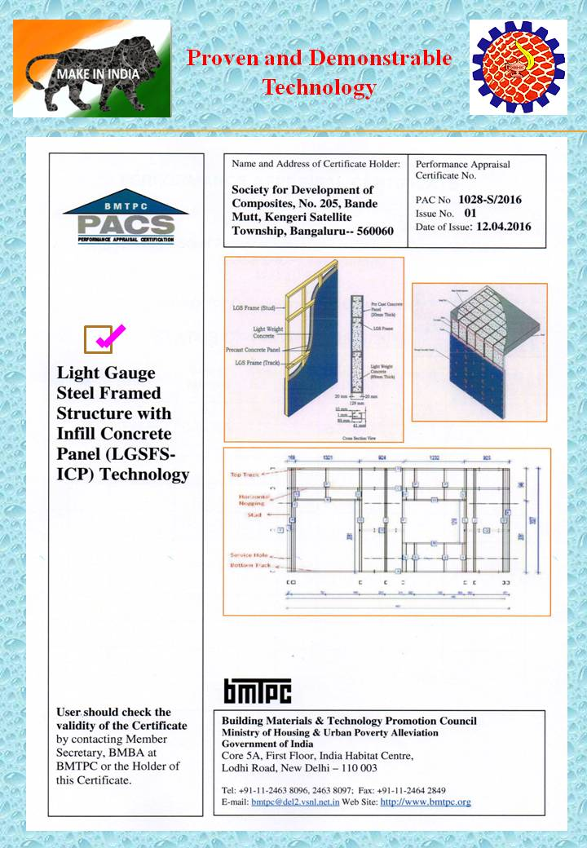

Slide 3
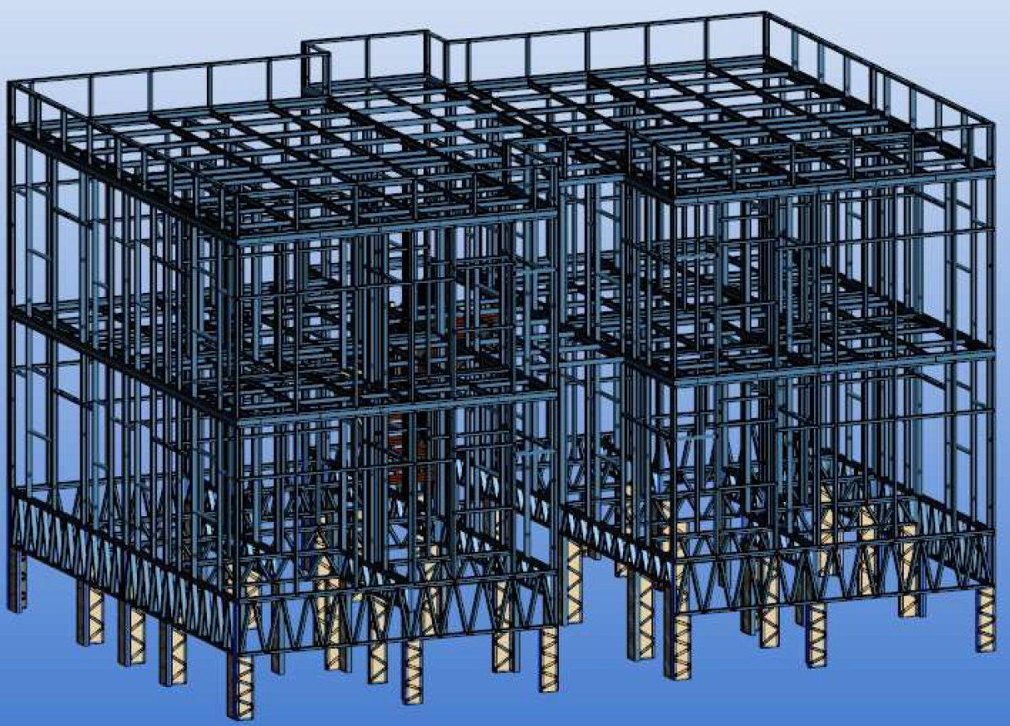
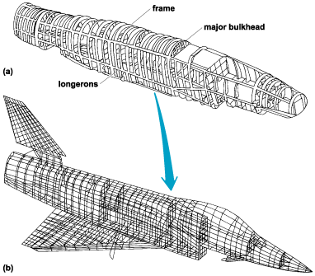
LGSFS Infill Panel Building Construction Technology is Analogous to Aircraft Technology
Air Frame Metal Structure of a Fighter Aircraft
Light Gauge Steel Frame Structure (LGSFS) for Foundation, Wall and Roof Slab of a G +1 Affordable House

Slide 4
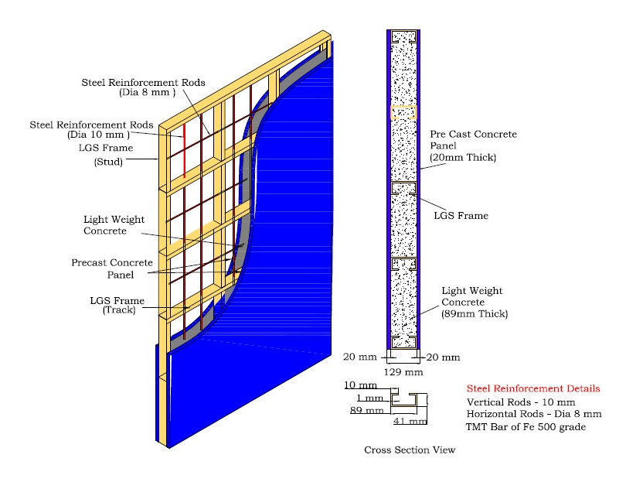
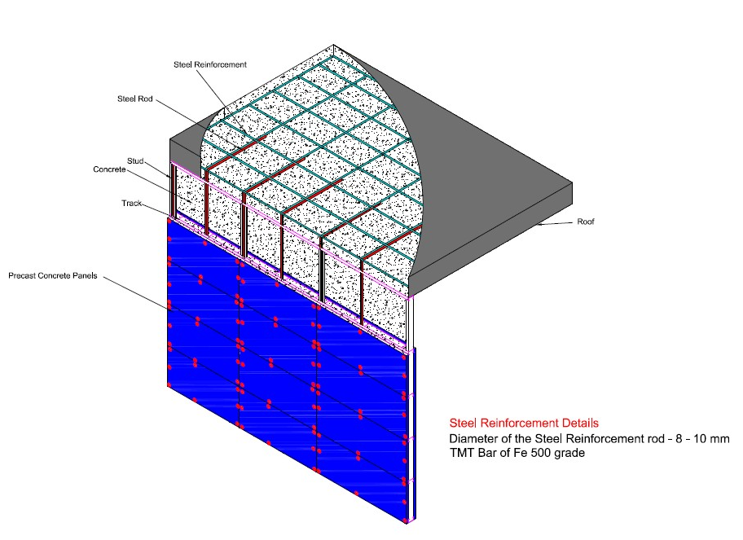
Schematic Diagram Showing LGSFS – Infill Concrete Technology

Slide 5
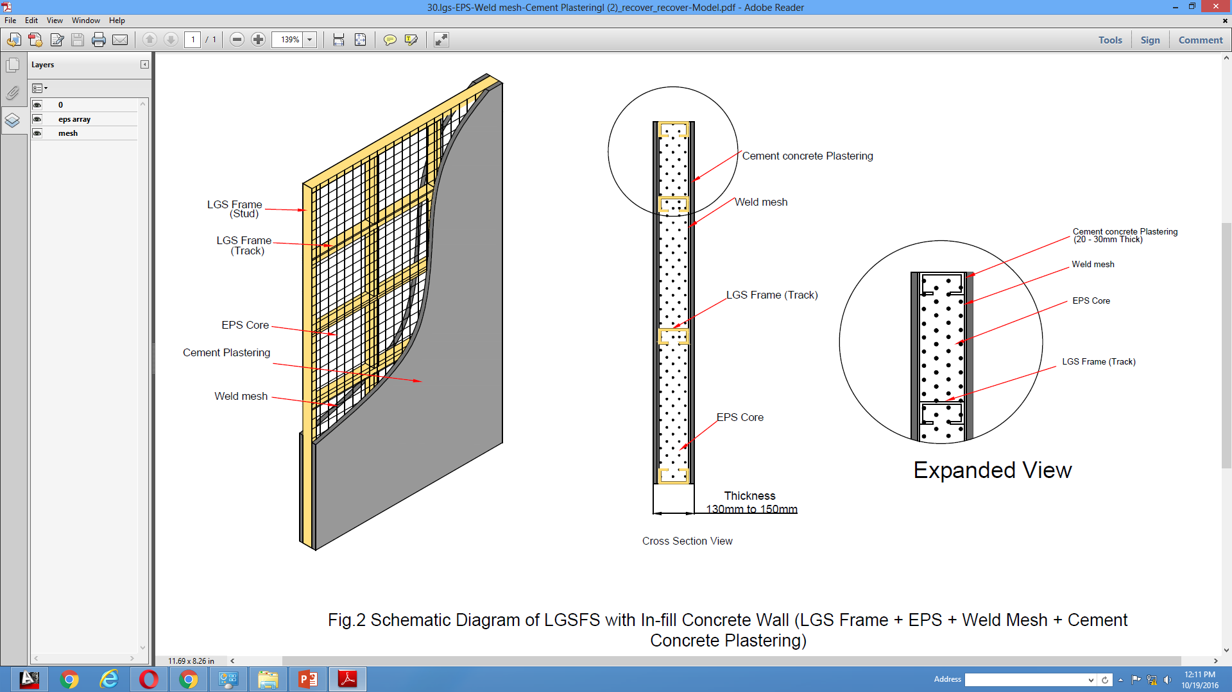
Schematic Diagram Showing LGSFS – EPS Infill Ferro Concrete Technology

Slide 6
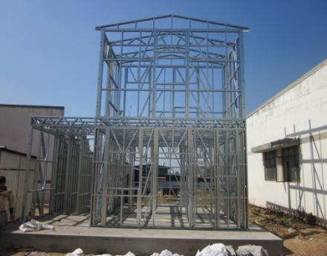
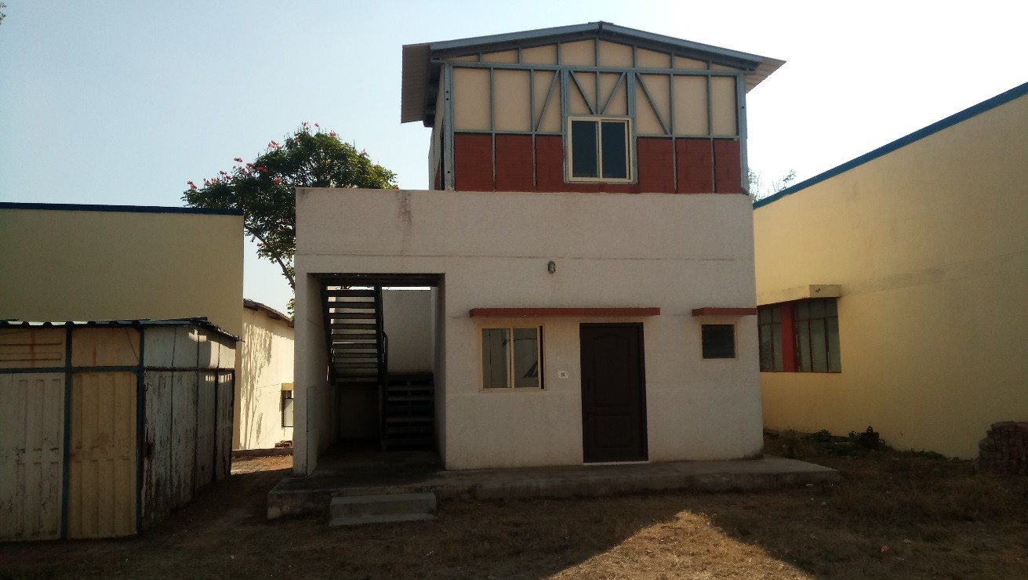
LGSFS Infill Concrete Panel Demo Building at CTP for Full Scale Testing

Slide 7

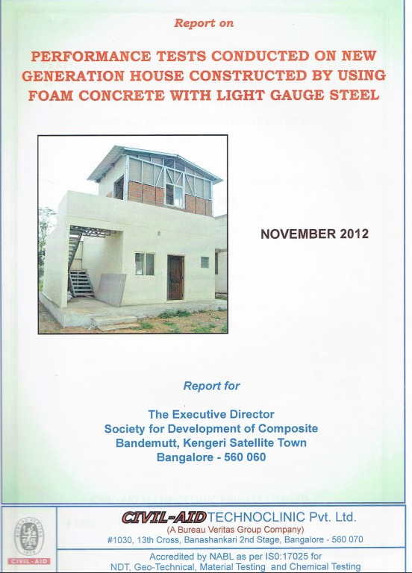

Various performance oriented tests on Foam Concrete with Light Gauge steel building constructed by Society for Development of Composites, Bangalore were carried out. They are:
Observation of housing unit.
Core Test.
Load test on roof slab.
Rain simulation test on wall surface.
Nailing test.
Ponding test on roof slab.
Door tests.
Acoustic comfort test.
Thermal comfort test.
Fire resistance test.
The results of various performance oriented tests revealed that the tested housing unit performed satisfactorily and meets the requirements of common people.

Slide 8
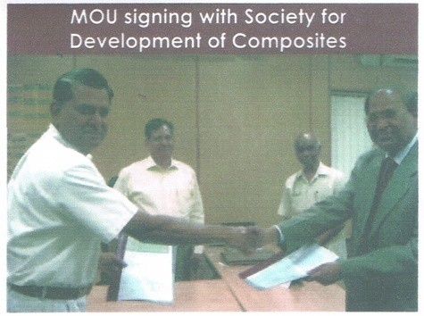
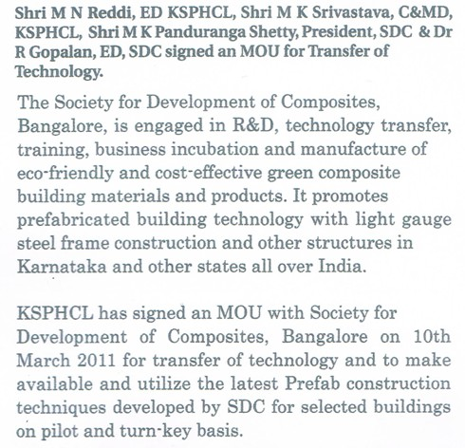
Demonstration of LGSFS – Infill Concrete Technology
MOU Signed between KSPHCL and SDC

Slide 9
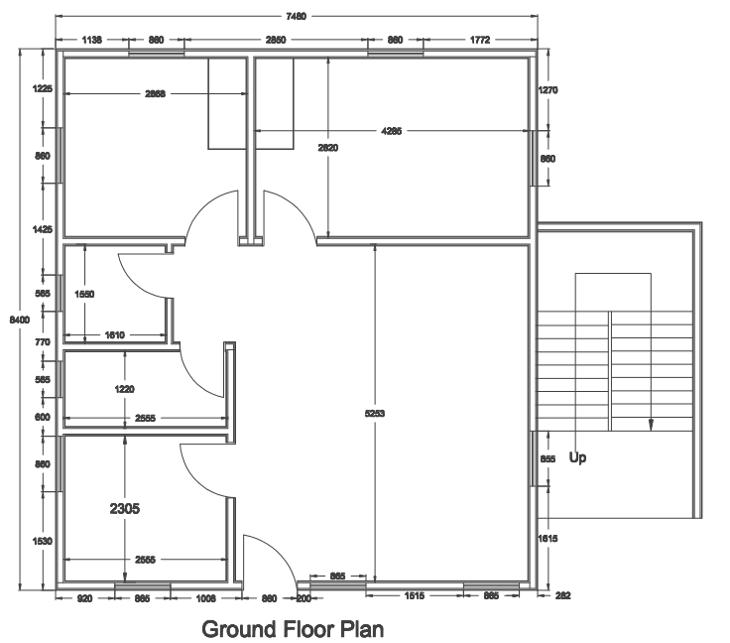
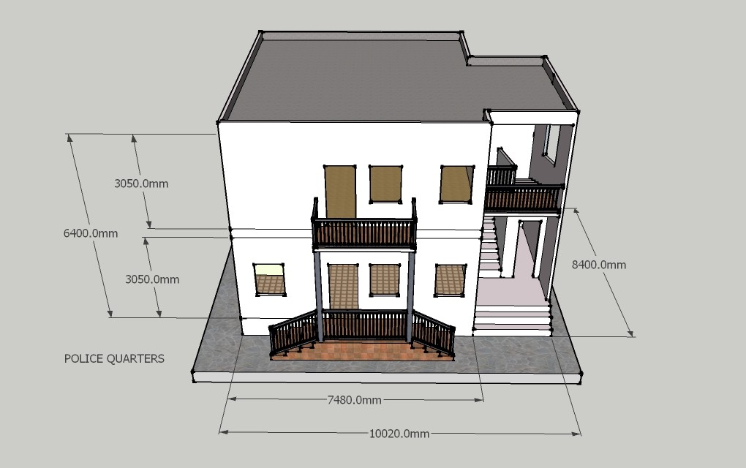
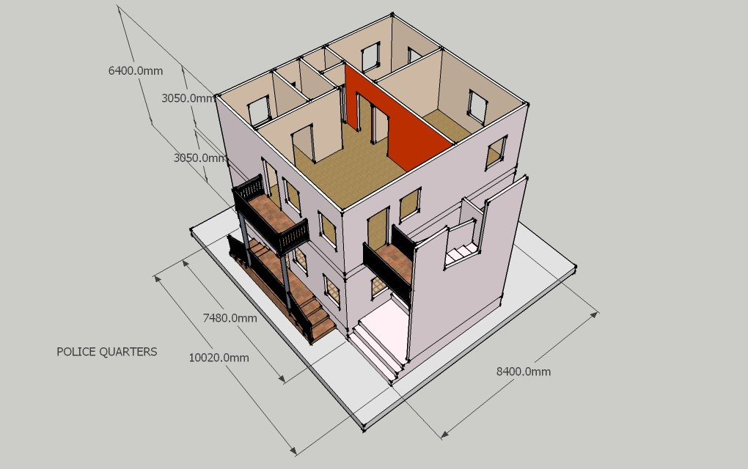
CAD Floor Plan and Elevation Drawing of G+1 PC Quarters for KSPHCL

Slide 10
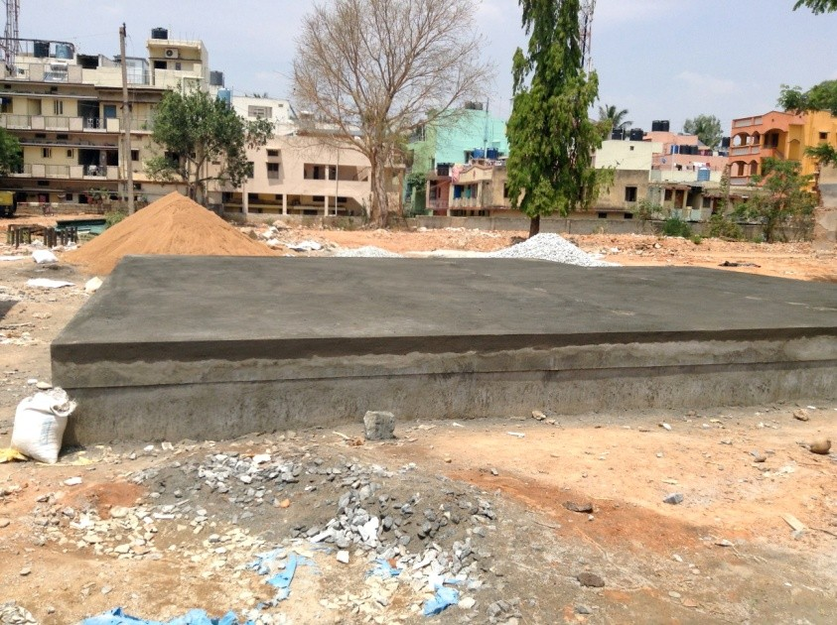
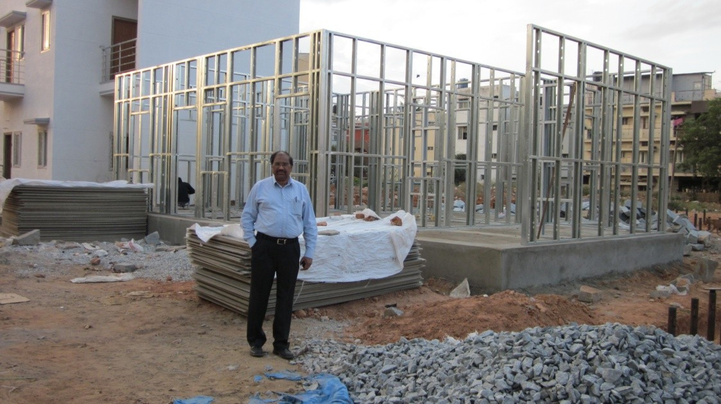
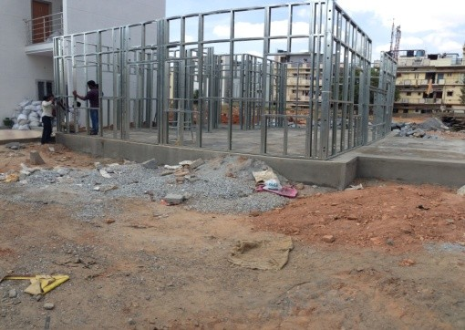
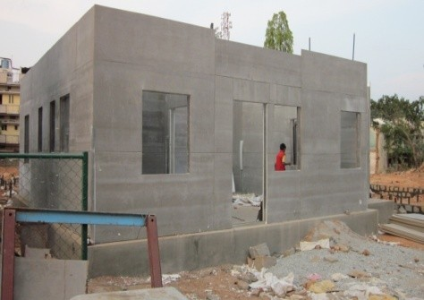
Step by Step Construction Process
Foundation and Floor
Erection of LGS Wall on RCC Floor
Erection of LGS Wall on RCC Floor
Fixing of Sacrificing Shutters

Slide 11
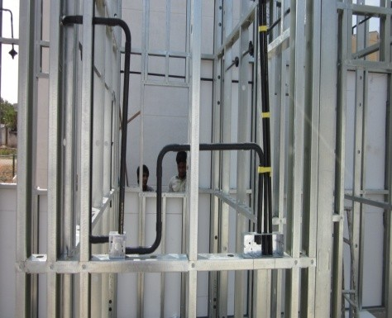
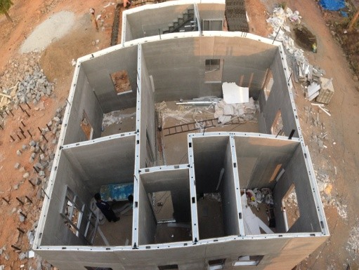
Step by Step Construction Process
Fixing of electrical & plumbing pipes
G.F.Wall structure ready for Foam concreting top view.

Slide 12
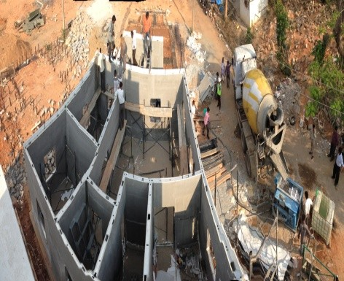
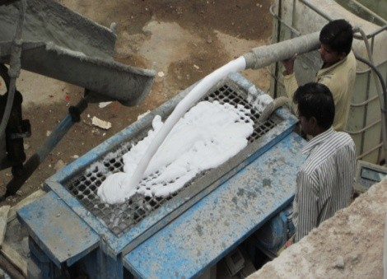
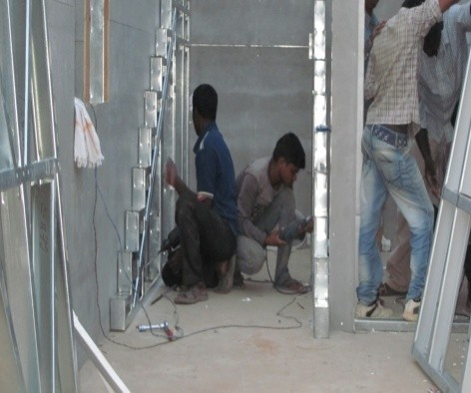
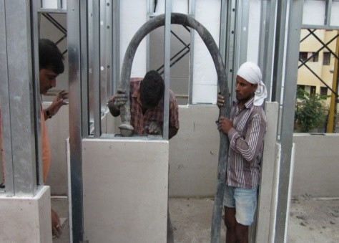
Foam concreting in progress.
Foam concreting closer view.
Fixing of LGS staircase.
Foam Concreting closer view.

Slide 13
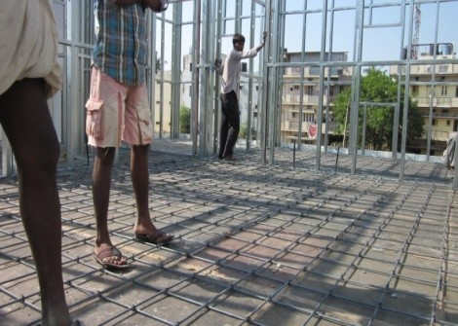
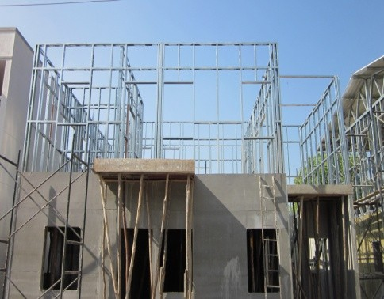
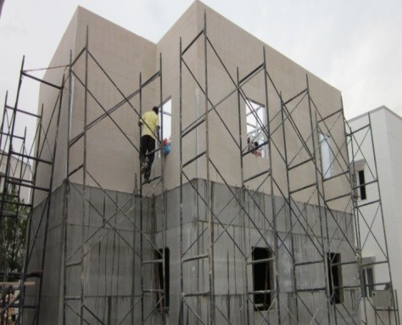
Steel reinforcement for G.F.roof slab.
Erection of LGS wall structure for first floor.
Cement fiber board fixing for F.F

Slide 14
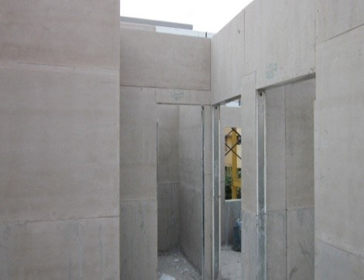
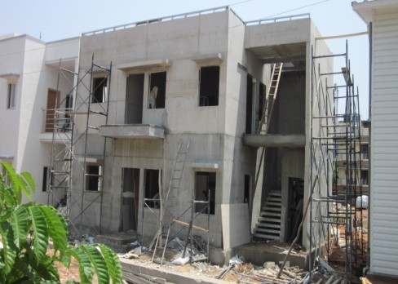
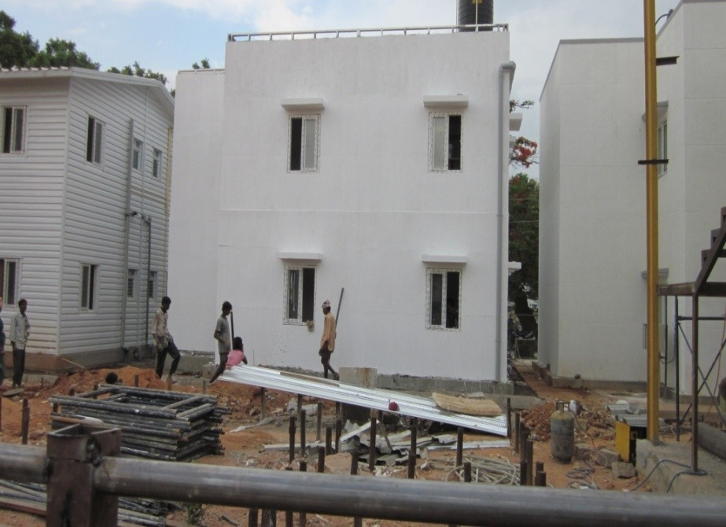
Inside view of cement fiber board fixing on 1st floor
Completed Ground and First Floor structure, ready for painting (front).
Completed building, after Painting (rear view)

Slide 15
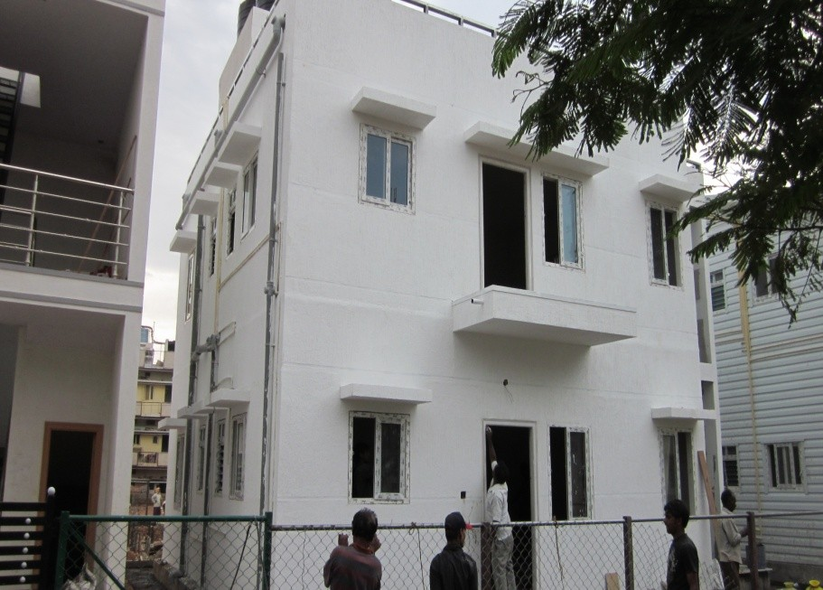
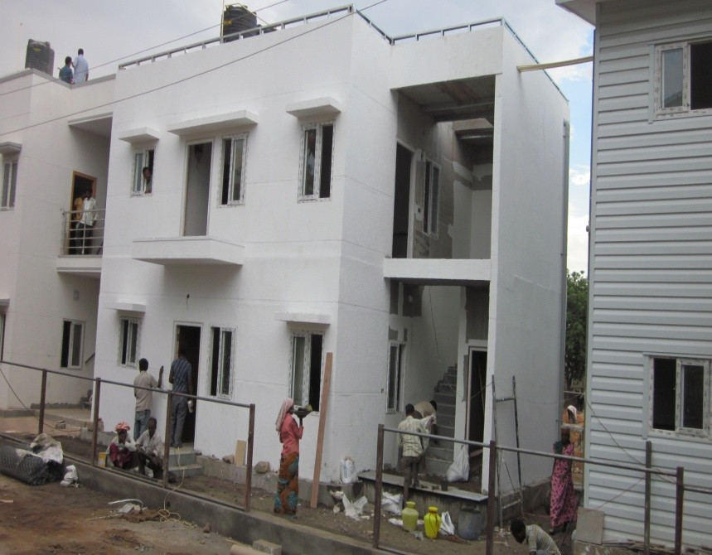

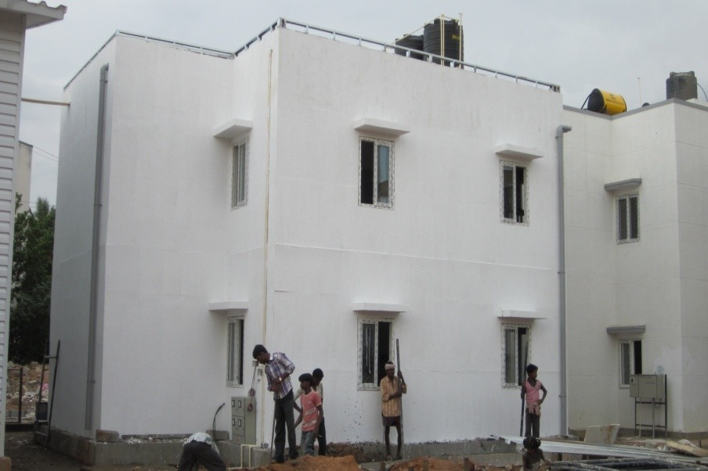
Completed building, after Painting

Slide 16
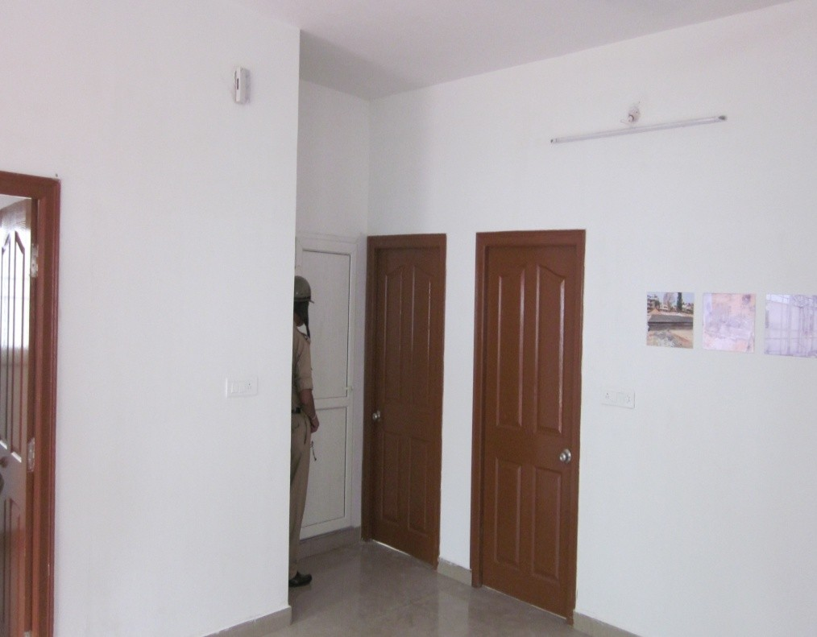
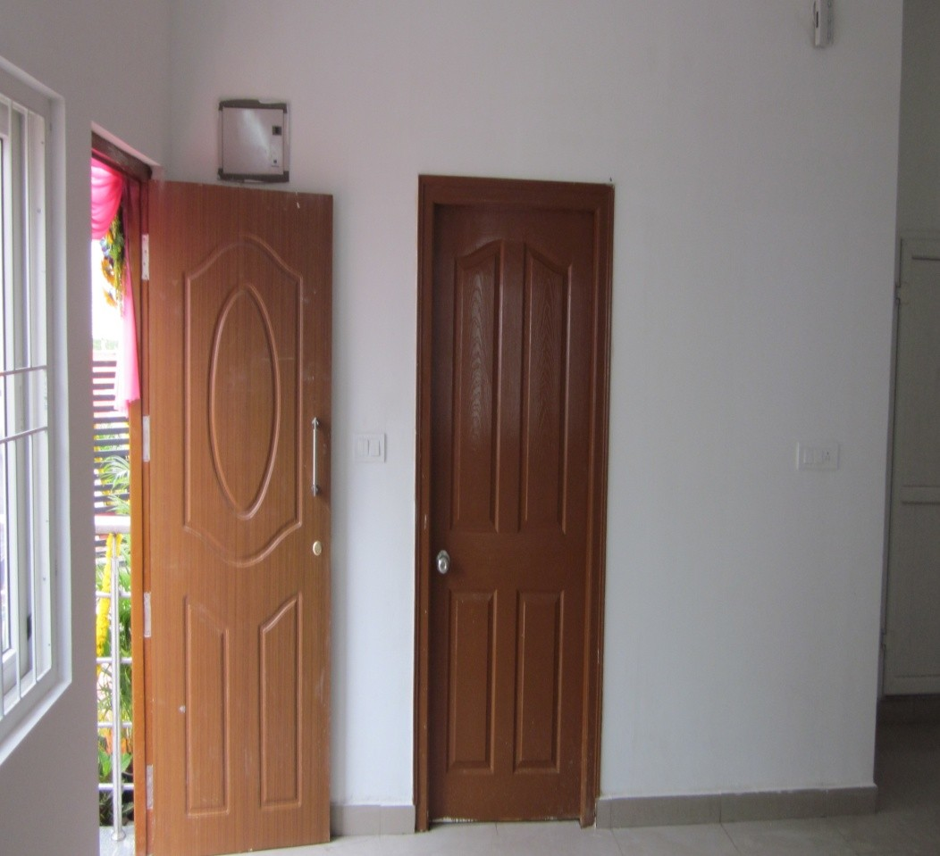
Interior View of Completed building

Slide 17
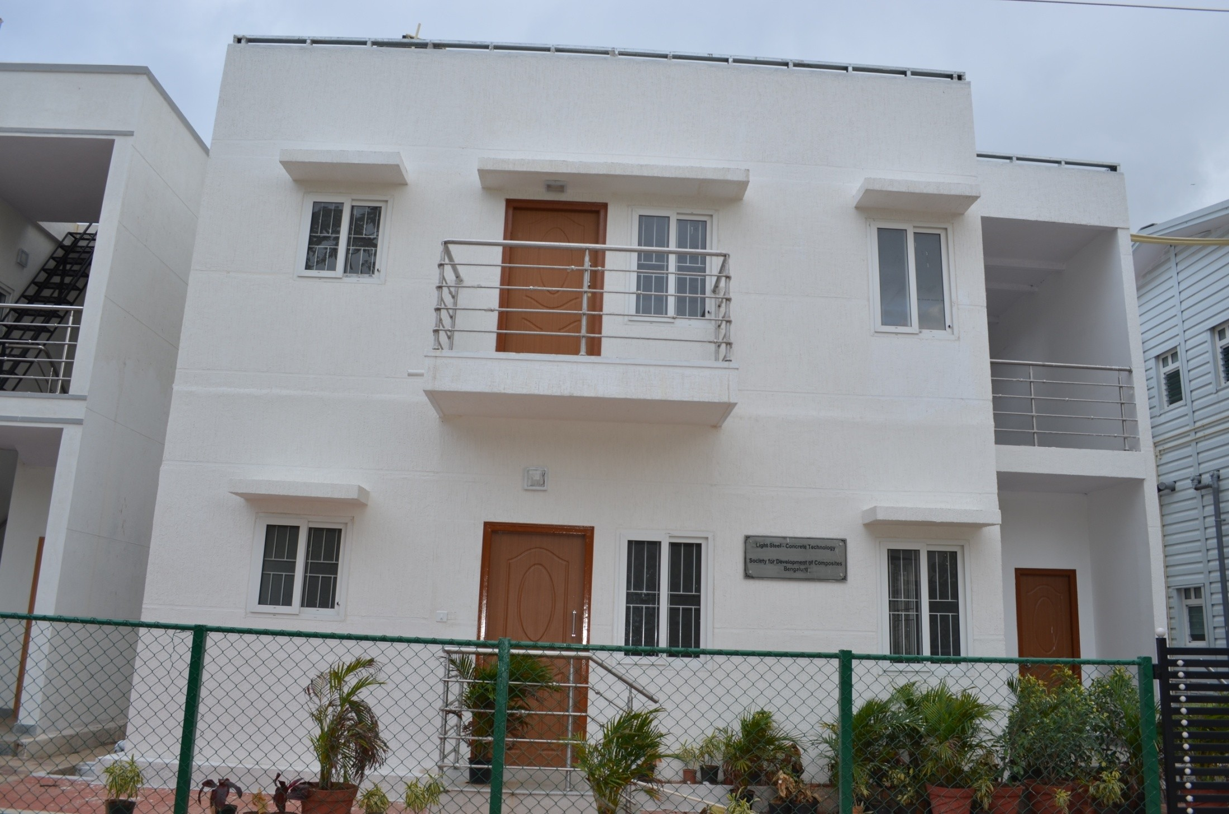
Completed building Ready for Inauguration

Slide 18
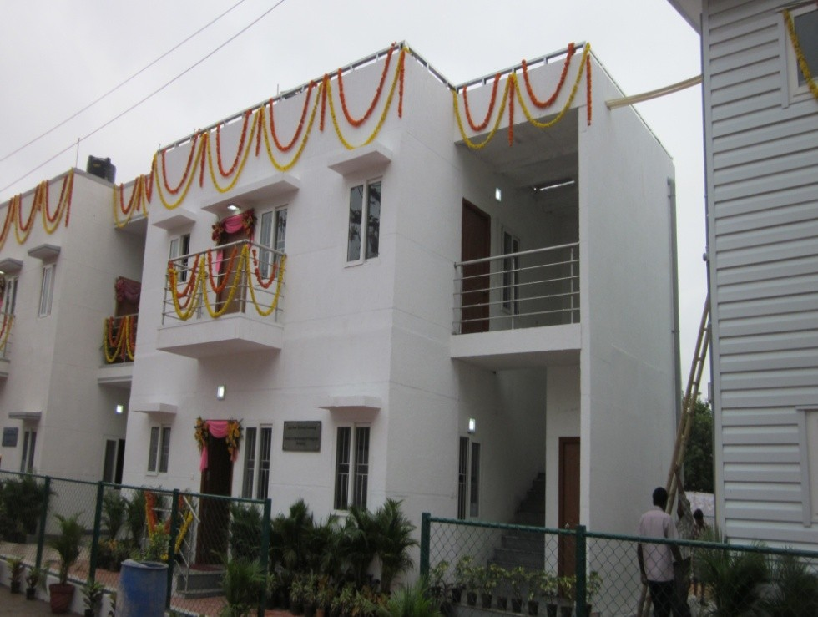
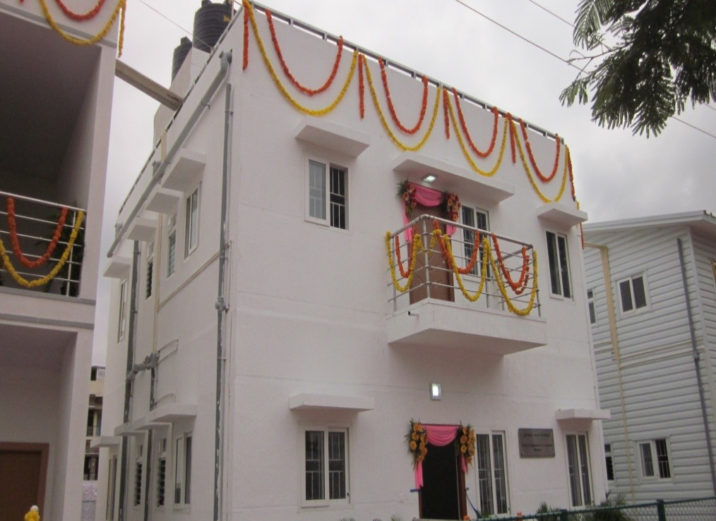
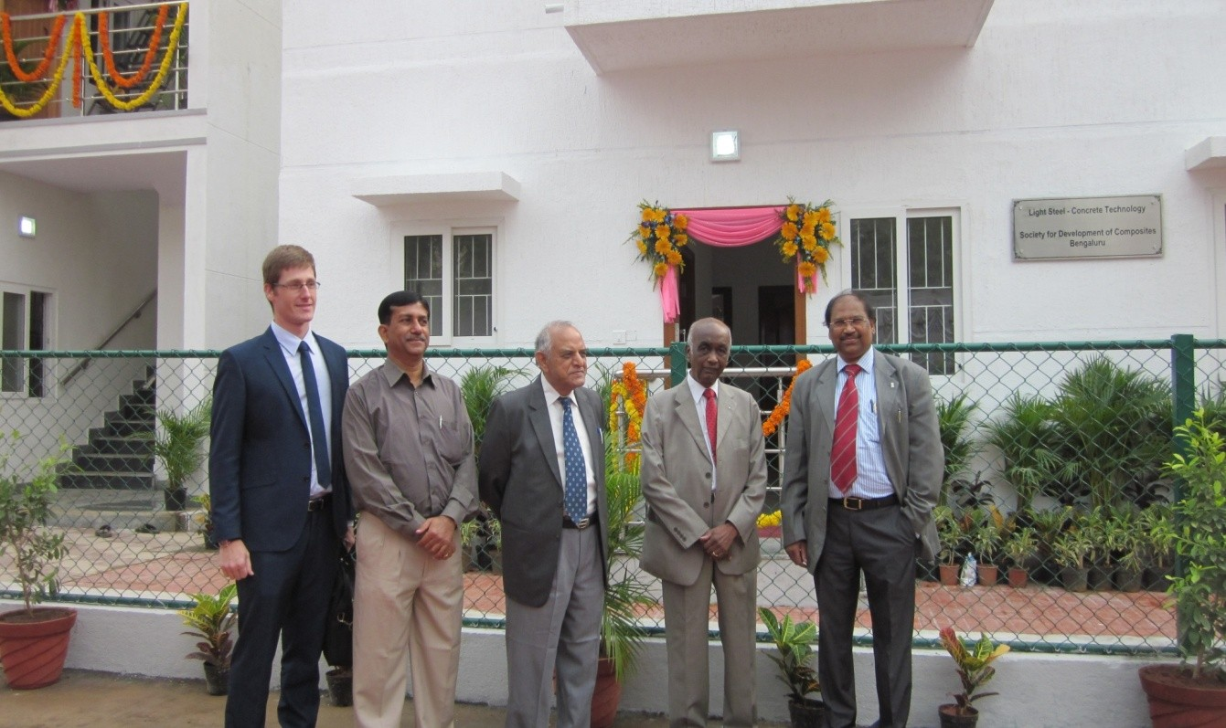
Completed building ready for inauguration at Adugodi Police Quarters, Bangalore

Slide 19
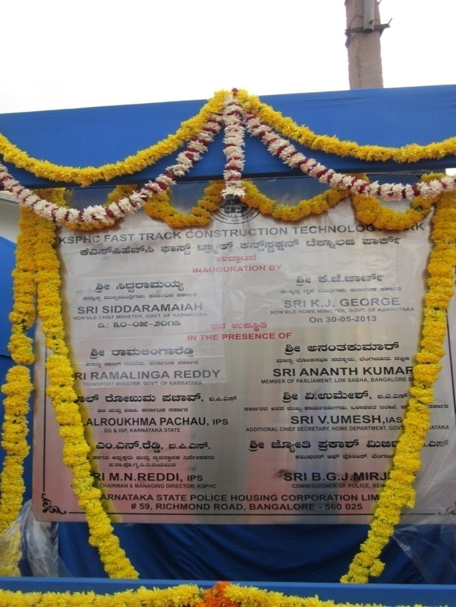
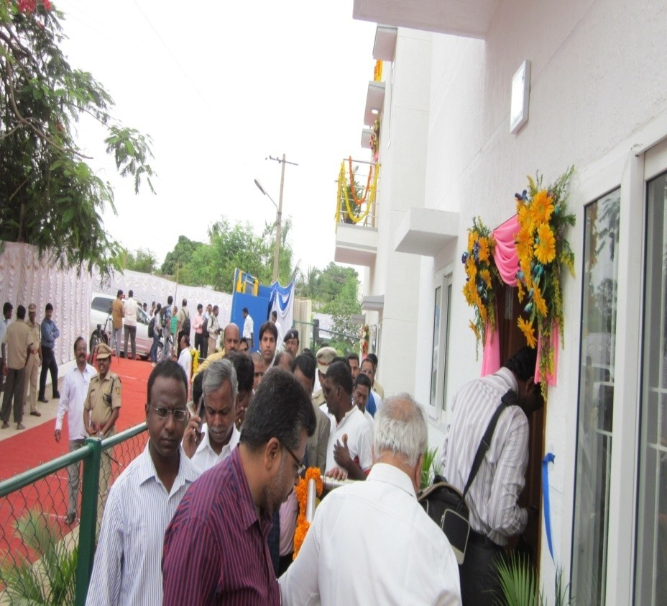

Slide 20
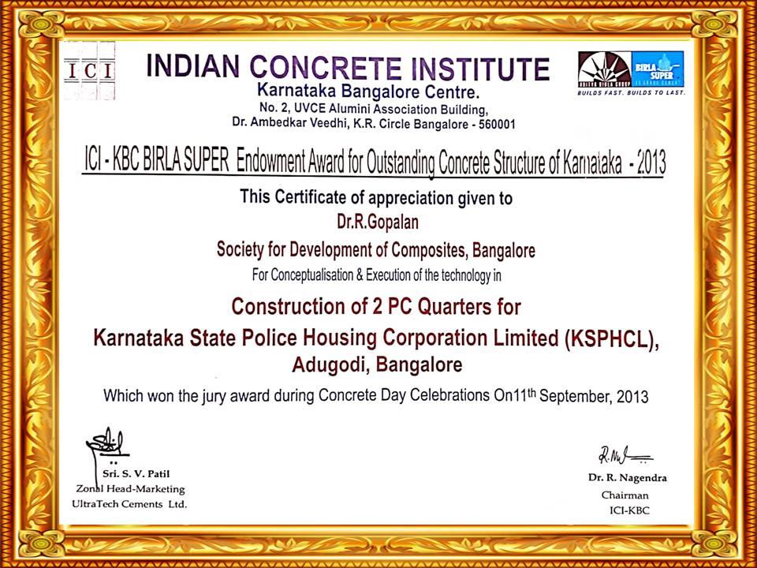

Slide 21
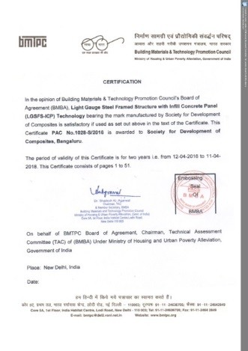

Slide 22
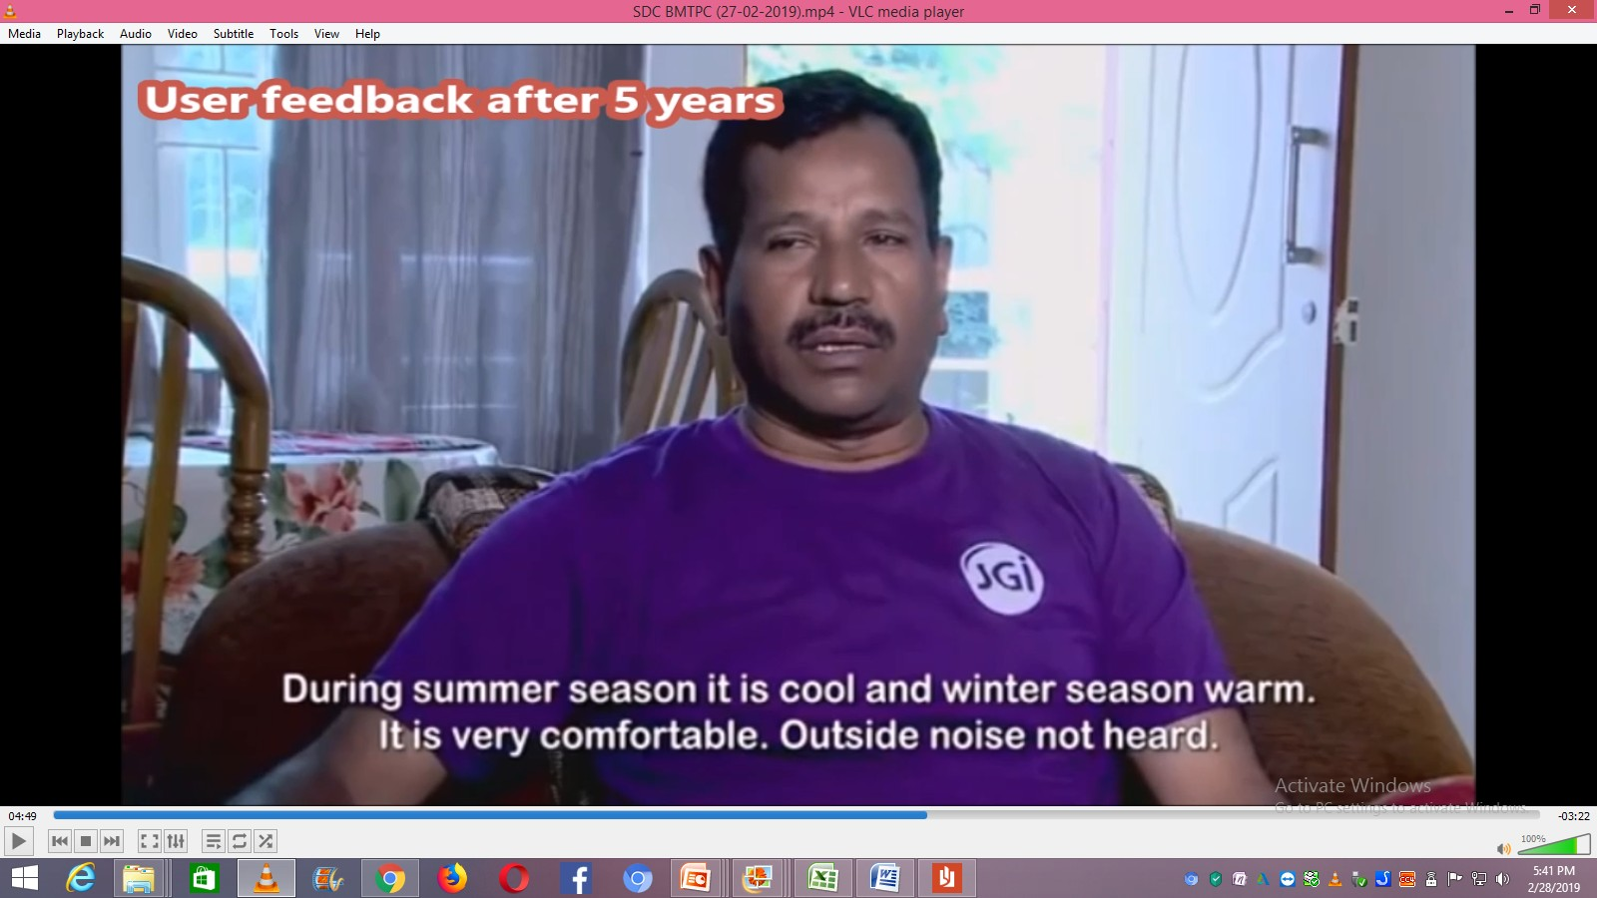
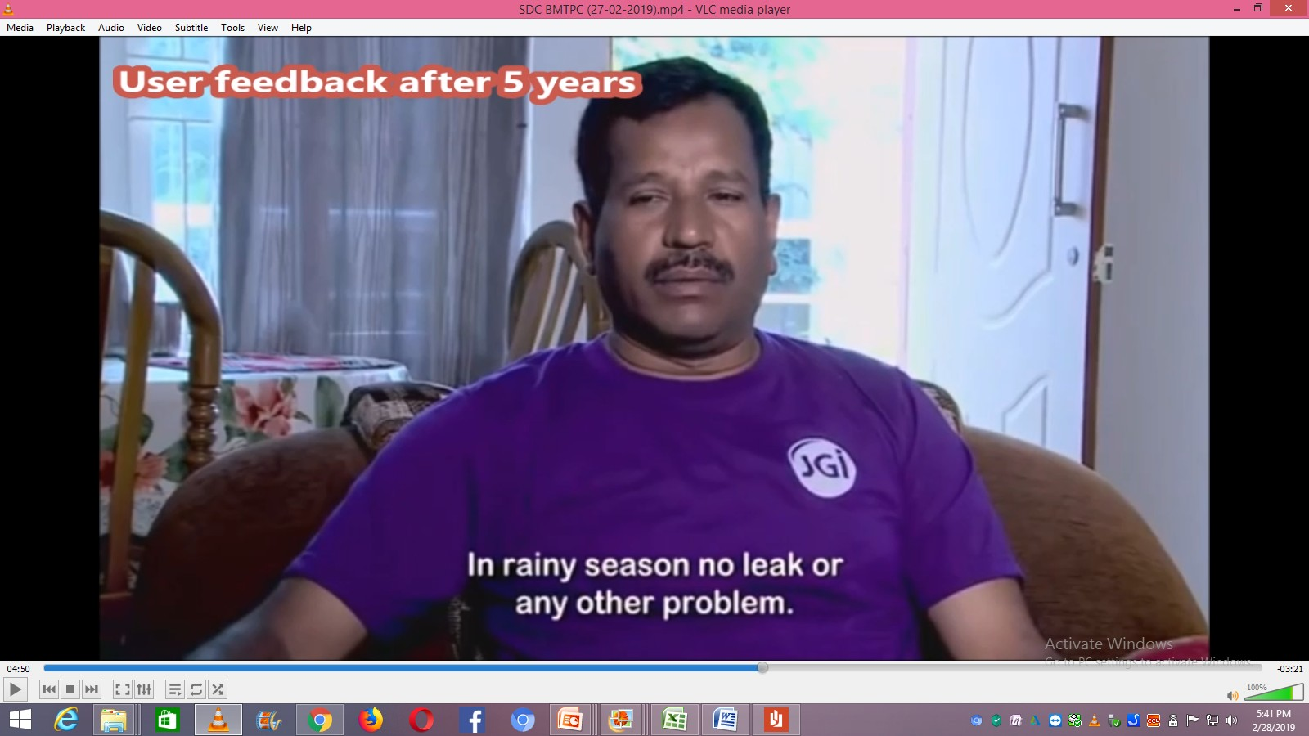
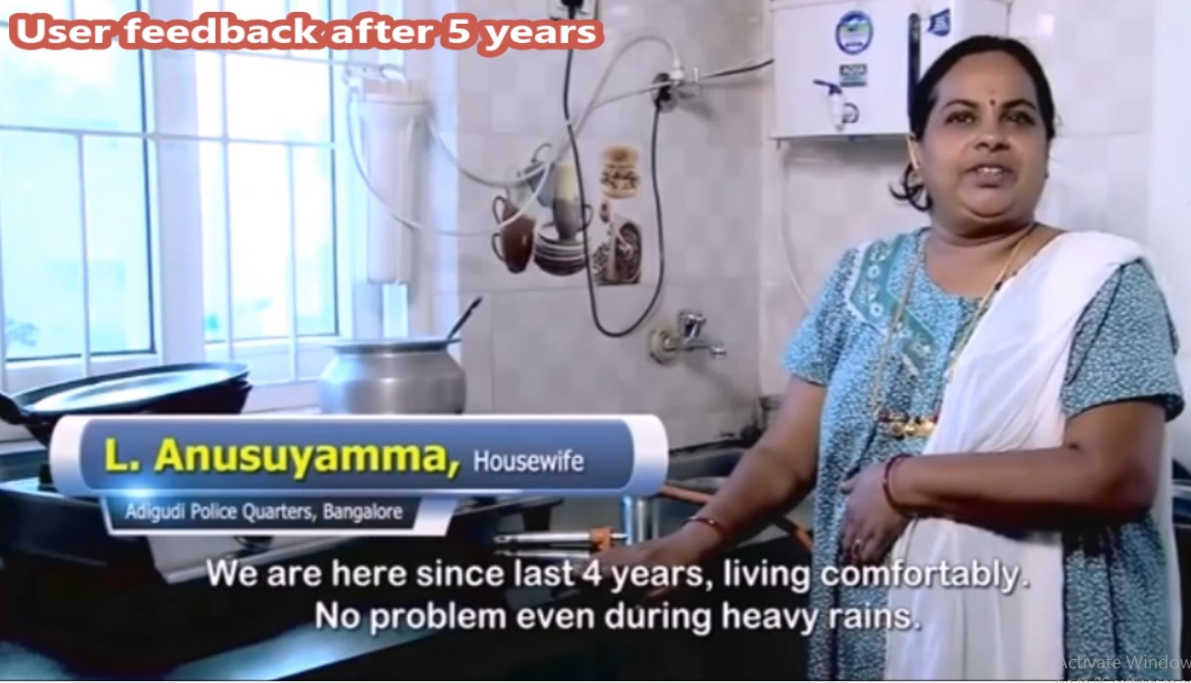
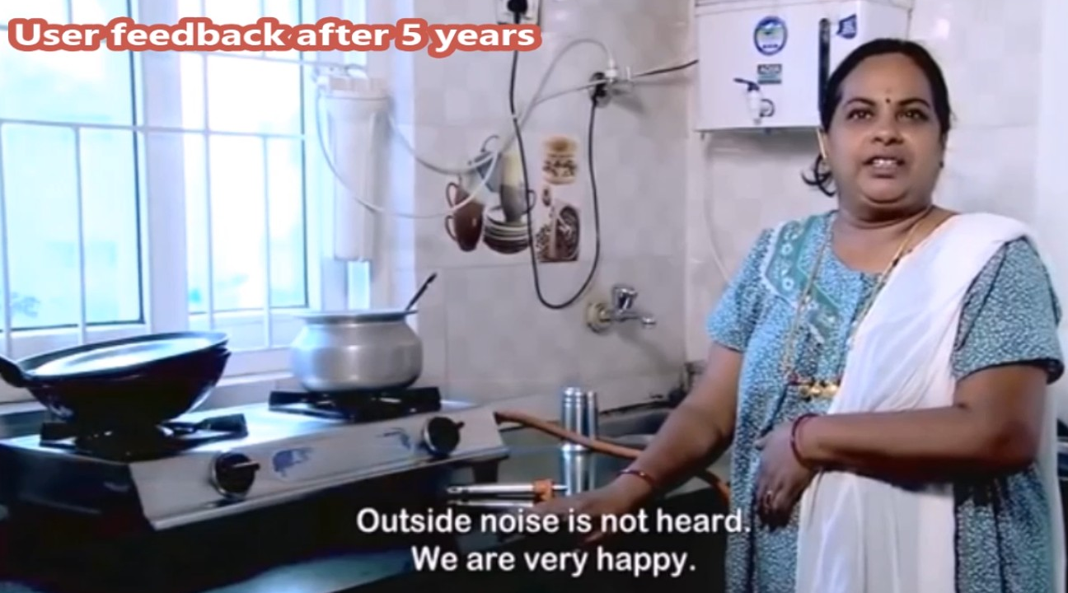

Slide 23
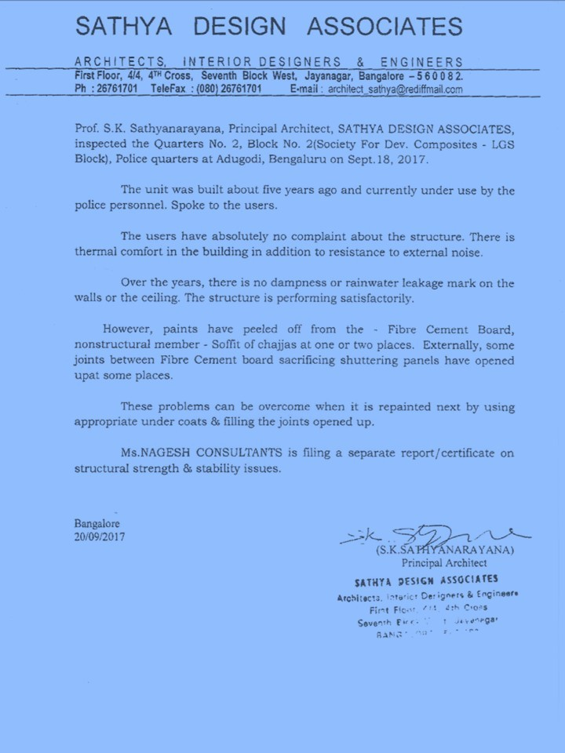
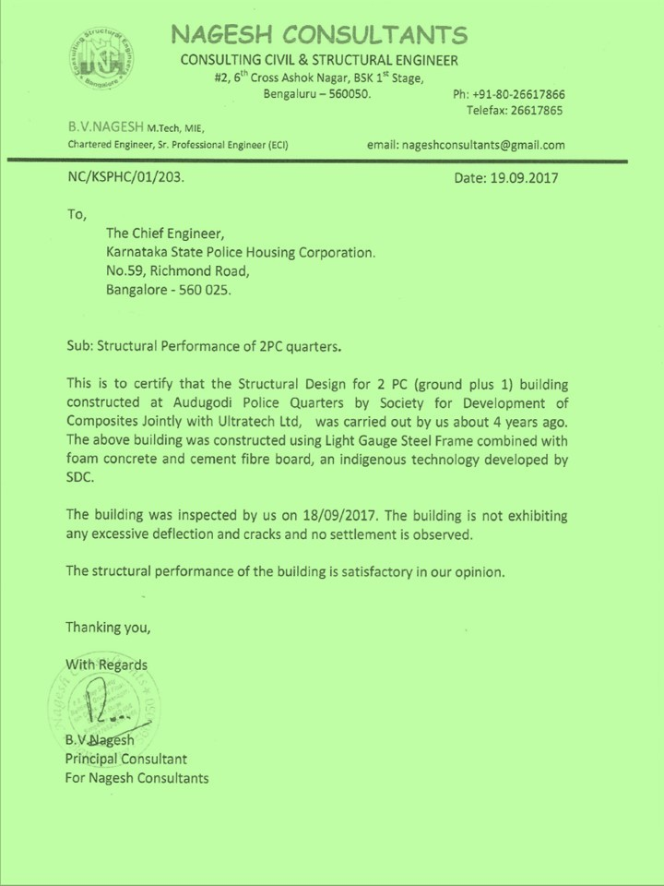

Slide 24



Approval of LGSFS – Infill Concrete Panel Technology by Task force, GOK

Slide 25



Slide 26




Completed Buildings using LGSFS Technology

Slide 27




Completed Buildings using LGSFS Technology

Slide 28





Inauguration of Flood Rehabilitation Building at Kodagu, Inaugurated by Hon’ble CM of Karnataka
Completed Buildings using LGSFS Technology

Slide 29

LGSFS-ICP Technology Approved by GOK
70 Multi Utility Hospital Buildings in Entire North Karnataka

Slide 30

Finished Photos of Multi Utility Hospital Buildings

Slide 31

Finished Photos of Multi Utility Hospital Buildings

Slide 32

Finished Photos of Multi Utility Hospital Buildings

Slide 33

Inauguration of TLH Multi Utility Hospital Building at Hangal

Slide 34




Inauguration of Multi Utility Hospital Building at Haveri

Slide 35




Inauguration of TLH Multi Utility Hospital Building at Afzalpur

Slide 36

Inauguration of TLH Multi Utility Hospital Building at Koppel

Slide 37

Inauguration of TLH Multi Utility Hospital Building at Gangavati

Slide 38




Finished Photos of Multi Utility Hospital Buildings

Slide 39


Slide 40







Proven and Demonstrable Technology
Over 250 Projects are Successfully Completed
Over 3 Lakh Sft Buildings are Constructed all over India and Received User Acceptance

Slide 41

Demonstration of G+3 LGSFS Building

Slide 42


CAD Floor Plan Drawing of the Proposed G+3 Building (KSDB)

Slide 43

CAD LGS Frame Structure Drawing of G+3 Building

Slide 44

CAD Elevation Drawing of the Proposed G+3 (KSDB)Building

Slide 45
Advantages of LGSFS – ICP Technology
Faster : 60% higher speed of construction.
Economical : 10% cheaper, about 50% lighter, ease of transportation & construction and less labour.
Better : Excellent thermal & acoustic insulation, maintenance free and long durability.
Safer : Flood, fire, earth quake cyclone resistant, corrosion resistant, anti-fungus, termite free.
Sustainable : Environment friendly, no need for metal moulds, less pollution (heavy trucks & cranes not required.)
Inclusive Development : Local materials and employment generation.

Slide 46
THANK YOU
For further details, please contact:
Dr.R.Gopalan, Executive Director
COMPOSITES TECHNOLOGY PARK
#205, Bande Mutt, Kengeri Satellite Township
Bangalore-560 060
Ph: 080 – 6599 7605, 6558 1005, 2848 2771,
Mob:93799 49152
Email: drgopalan2003@yahoo.com
Please visit our website:
www.compositestechnologypark.com
http://www.indiamart.com/sdc-bengaluru

